Slide 1
Echo360 is recording

Slide 2
Preparation for your Senior Year (and Beyond) in BME
Profs. Jeannine M. Coburn
Solomon Mensah
Notes:
Rising Seniors ☺

Slide 3
BME Connect Mentorship and Slack
Mentorship program
Why?
Make new friends
Learn new skills
Help your fellow students navigate the department and WPI
Not a huge commitment
Check in a few times per term
Meet in person once a term and get free food
Work in pairs with small groups of mentees
Perks: Resume Builder, Training, Shirt, Free Food, Preference for PLA Jobs
We now have a Slack!
Build community
Use your fellow classmates as resources
Not faculty moderated- safe space

Slide 4
Topics
The Academic Advisor
Degree Audit
Finding an MQP
REU, Summer Internships, Co-op
BME Careers (Graduate School, Industry)
BME Combined BS/MS Degree

Slide 5
The Academic Advisor
Role changes as you progress…!
Provide advice on major, courses, projects and required university policies (degree requirements)
Academic mentoring and career counseling
A contact person who can direct you to services on and off campus
Write letters of recommendations
An advocate to help you succeed!
The ultimate responsibility for making informed decisions about educational plans rests with you!

Slide 6
Preparing for you Academic Advising Meeting?
Review the BME sections in the Undergraduate Catalog
Updates to the BME requirements can be found on the BME Advising Canvas site
These requirements are more flexible than the previous requirements, you can follow either and graduate!

Slide 7
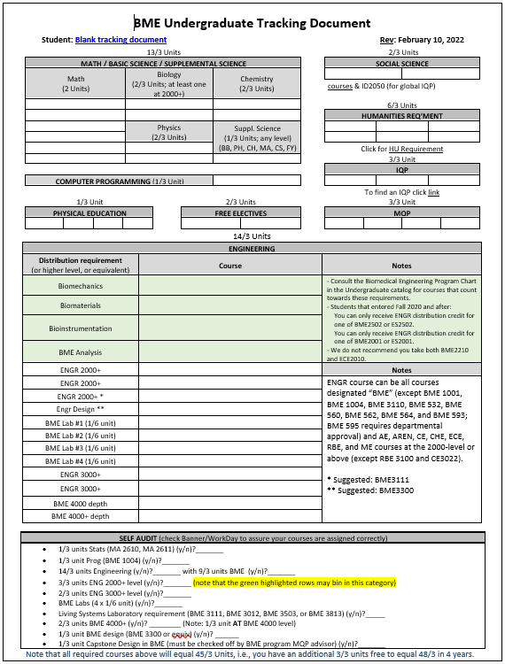
What to do before meeting with my academic advisor to get the most out of your meeting?
Update your tracking document (samples on Canvas)
To figure out what you need to graduate!
∗ All students need to complete 135 credits (15 units) of course work for a bachelor’s degree and 8 units of WPI coursework
∗ Unfortunately, it is not possible to appeal and change these requirements!

Slide 8
What to do before meeting with my academic advisor to get the most out of our meeting?
Review your Academic Progress Report in Workday
The Registrar conducts Senior audits in December
You will be notified if you are not tracking to graduation…!
You are receiving this email because you have filed for the May 20XX graduation. Below are your preliminary degree audit results for completion of your bachelor’s degree from WPI:
The following information is based on a review of the University requirements and your Major requirements, as of December XX 20XX. If you make any changes to your schedule, your degree audit will need to be reviewed again. Before you make any changes to your schedule, please consult your Academic Advisor.
Assuming successful completion of the coursework for which you are now registered in B, C and D terms, the following degree requirements in the box below will still need to be satisfied in order to fulfill your graduation requirements:

Slide 9
You may need a form for that
Important Notes:
Minor Completion Form - can be found in the department of your minor
If you and your Program Review Chair determine that a course substitution can be made, please complete the Course Substitution Form and submit it to the Registrar’s Office
If you need to change the Catalog Year your degree requirements follow, please complete the Catalog Year Change Request Form and submit it to the Registrar’s Office
You can change your catalog year; you cannot mix and match requirements

Slide 10
Important Degree Requirements
Course Counting: Courses may double-count for double-majors, minors, or graduate school, but no course can be triple-counted to fulfill degree requirements.
Math: Required to take 6 math classes (MA 1021, 1022, 1023, 1024), differential equations (MA 2051) and applied statistics (MA 2610 or MA 2611).
MA 2621 (Probability for Applications), MA 2631 (Probability), or MA 2071 (Matrices and Linear Algebra I) do not fulfill the BME requirement.
Biology: Required to take 2/3 units. At least 1/3 unit must be a 2000+ level. AP credit can count for a 1000-level biology course.
GPS (FY 1100 &1101): This is GPS course specific. GPS courses that include 1/3 unit of BB, PH or CH coursework may count this credit towards 1/3 unit of supplemental science. Students are advised to consult with GPS course instructors to find out what courses the GPS credits can be used for.
CS: Required to take one CS class in basic computer programming. Courses that fit this requirement are BME 1004, CS 1004 (Introduction to Programing for Non-Majors) or CS 1101 (Introduction to Program Design).
ID2050: this 1/3-unit course can be used as a Social Science requirement
Notes:
Don’t talk to long – rising seniors should know this

Slide 11
Important Degree Requirements
BME 1001 and 1004: Do not count for 14/3 unit ENG or BME courses; Can only be used as a free elective.
ISU: ISUs are custom designed course equivalents arranged between a student and a faculty advisor/instructor
Commonly counted as either 3000 or 4000-level BME courses (at the discretion of the advisor/instructor)
ISUs can only constitute up to 1/3 units of BME or ENG credit toward the student’s degree requirement (NOTE: a syllabus and final report are REQUIRED).
ENGR course requirements: ENGR course can be all courses designated “BME” (except BME 1001, BME 1004, BME 3110, BME 532, BME 560, BME 562, BME 564, and BME 593; BME 595 requires departmental approval) and AE, AREN, CE, CHE, ECE, RBE, and ME courses at the 2000-level or above (except RBE 3100 and CE3022).
Notes:
Don’t talk to long – rising seniors should know this

Slide 12
Important Degree Requirements
BME Engineering with Living Systems Laboratory: BME 3111, BME 3012, BME 3503, or BME 3813.
BME 4000-level courses: Select courses in your chosen specialization track.
Specializations: Help to bring focus to course and project planning; Students are STRONGLY encouraged to focus on one track in BME (Biomechanics, Bioinstrumentation/Biosignals/Imaging or Biomaterials/Tissue Engineering).
MQP: Must meet capstone design requirements*
Extra MQP credits: ENGR or BME courses cannot be replaced with extra MQP credits.
*If double major, MQP may have additional requirements
Notes:
Don’t talk to long – rising seniors should know this

Slide 13
Can I take grad courses as an undergrad?
Yes! BUT…
B.S. degree requirements must be met
Some graduate courses DO NOT COUNT toward B.S. degree (e.g., BME 560, BME 562, BME564)
Best to take graduate courses senior year
Talk to your Academic Advisor!
Is it appropriate for me to take graduate courses?
How will it affect my schedule / time to graduation?

Slide 14
BME Labs
Junior-level lab courses to provide skills 1/6 unit each
We recommend the following labs for students in each of the Specializations (number of terms offered per year in parentheses):
Biomaterials/TE* | Biomechanics/ Biotransport* | Biosintrumentation/sensors*
BME 3811 | BME 3503 | BME 3012
BME 3505 | BME 3505 | BME 3013
BME 3605 | BME 3014 | BME 3014
BME 3012 or 3813 | BME 3506 or 3012 | BME 3811, 3505, or 3605
*Alternatively, students can enroll in up to 1/3-unit ISU (ask a BME faculty with a research lab).
BME3111 – Physiology for Engineers
BME3300 – Biomedical Engineering Design
Other ENGR courses

Slide 15
How do I find an awesome MQP?
AY 2023/24 projects will be posted on Canvas
Propose your own idea (preferably as a team)
Must include a Capstone Design Experience!
Think of background courses and experiences that you’ll need for your MQP
Analysis/design skills
FEM/CAD, circuits, communication, materials
Lab skills - wet lab, cell culture, testing, instrumentation

Slide 16
Off Campus MQPs
You may find your own project sponsor:
Continue a summer internship or co-op
Continue a project you worked on in a research lab
UMass Medical School, Tufts Veterinary School, company, etc.
To qualify:
MUST be approved by your sponsor
MUST be approved by the BME Department
Must have a BME advisor (BME faculty – primary or collaborative)
MUST be a BME/Engineering project (not basic research)
MUST fulfill the Capstone Design requirements
Important notes:
WPI policy forbids students from receiving payment for working on MQPs for credit
MQP Registration form can be found on Registrar’s website

Slide 17
Graduate School Applications
Begin in the Fall of your Senior Year
GREs*, GPAs are VERY important for highly competitive programs!
Personal Statements/Recommendation Letters
See: http://www.wpi.edu/Academics/FS/letters.html
For letters, ask faculty that know you, served as project or research advisors, and/or you did well in their classes
*Due to COVID and equity concerns, many programs have made GREs optional. This increases the importance of your grades and letters of recommendation.

Slide 18
What can I do with a BS, MS, and PhD in BME?
Undergraduate (BS) Degree
Device/Implant Design and Development Team
Biomaterials Selection/Feasibility Assessment
Clinical, User Interface
QA/QC/Regulatory/Sales
Laboratory work
Master (MS/ME) Degree
Team Leader/Program Manager
Research and Development
Doctoral (PhD) Degree
Director of Research and Development
Academic Research

Slide 19
What is the difference between a M.S. and M.E. degrees?
The following information pertains only to the WPI BME Graduate Program!
Graduate programs at other institutions may have different application and admissions criteria!
MS requires a thesis or project
Generally considered more scholarly and hands-on than the ME degree.
The MEng does not require a thesis, but requires additional coursework
Generally viewed as a good technical degree
Additional information about BS/MS
https://wp.wpi.edu/bme/grad/
Notes:
Time allowing, cover this slide

Slide 20
BME Graduate Degree Programs
Master of Science (MS) – Thesis OR Project!
30 credits total
~ 1-2+ years beyond BS degree
Master of Engineering (ME)
33 credits total
Usually, 1 year beyond BS degree
Ph.D.
90 credits, 5+ years beyond BS degree
Uncommon to admit WPI students, but we do sometimes
Student / advisor agreement AND student meets admission criteria

Slide 21
What to do before meeting with my academic advisor to get the most out of your meeting?
Remember to sign-up in advance to meet with your academic advisor
Prepare questions you have about summer jobs, internships, career planning, etc.
Prepare questions you have about the BME distribution requirements
Your academic advisor should NOT choose your courses or tracks, but to review your choices how you plan to meet the BME degree requirements!
All BME students are STRONGLY encouraged to focus on one specialization area in BME; Students should select courses in their chosen track!

Slide 22
How can I improve my job prospects and marketability?
Do professional/community service
Get a career-oriented job (internship or co-op)
Use WPI HandShake to find job opportunities
Work in a lab on campus, at UMMS, or at another university
NSF REU opportunities
Get skills (CAD, MATLAB, SimuLink, Labview, etc.)
Notes:
CW

Slide 23
How do I find a job or research internship over the summer?
REU and summer internships are great, but very competitive!
http://www.nsf.gov/crssprgm/reu/reu_search.cfm
Career Development Center (CDC) Information Sessions
Summer Internships and Cooperative Education
Virtual Career Fairs
Additional resources
When:
REUs (NOW!!!!! Many are already closed!!!)
Internships/Co-ops (early D-terms)
Asking faculty for recommendation letters:
Ask faculty that know you well and/or you did well in their classes!

Slide 24
How do I find a job or research internship over the summer?
Jobs: Begin searching all year long
CDC is an excellent resource – seek their help! Resume/CV writing, internship/co-op and job search strategies, interviewing skills/mock interviews, career advising, job offer evaluation and negotiation skills
Search the web:
Handshake
JobFinder
Indeed
ZipRecruiter
Monster
Information about Massachusetts companies:
Social Media - LinkedIn / Twitter / Facebook
massmedic.com
massbio.org
massbiomed.org
masslifesciences.com
Visit individual company websites – search job openings

Slide 25
Why should I join the BMES chapter? Should I join BMES national?
Yes, and GET INVOLVED! It’s there for you!
Info on website under “Student Resources”
Techsync site (members only)
National BMES is a resource for you – access to the profession (~$30/year)
Skills builder, Resume builder
Notes:
JMC

Slide 26
Questions ?

