Slide 1
WELCOME
2020 STEM Week
Career Panel Series
IT/Computer Science

Slide 2
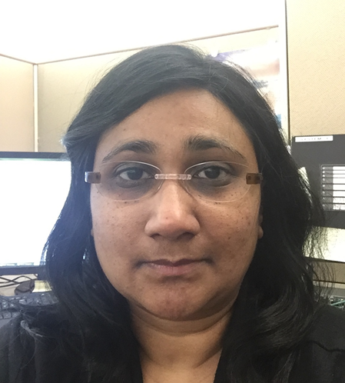
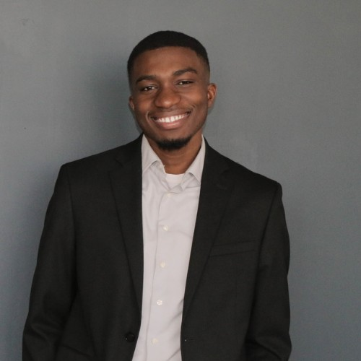
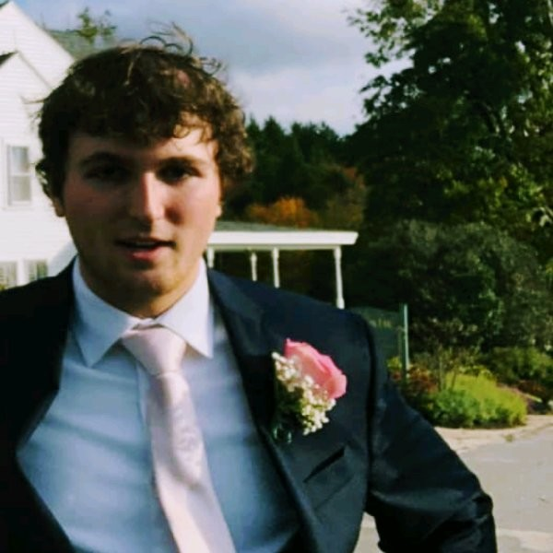
Meet your Information Technology career panel guides
Preeti Kothari
Prince Donkor
Will Adams
Facilitators: Drew Weymouth Christine Lloyd Nicole Anterni
Moderator Presentation/Slide Deck Chat/Questions

Slide 3
What are your thoughts?
Rate what you think a career in Information Technology may look like below.
Independent Collaborative
0
1
2
3
4
5
6
7
Only High School Diploma Needed Many levels of Education Needed
0
1
2
3
4
5
6
7
Not Physically Active Very Physically Active
0
1
2
3
4
5
6
7

Slide 4
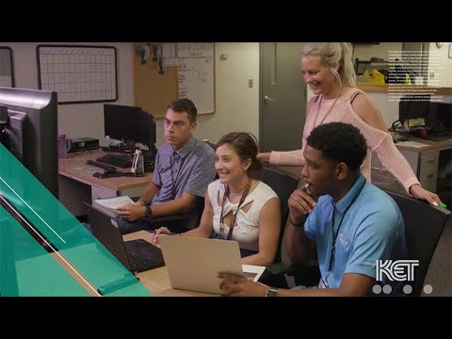
Information Technology
Notes:
3min

Slide 5
What did you see that would make you want to go to work every day?

Slide 6
Preeti Kothari
Software Engineer
Johnson Controls
MS in Computer Science, WPI
https://www.johnsoncontrols.com
and
https://simplex-fire.com/

Slide 7
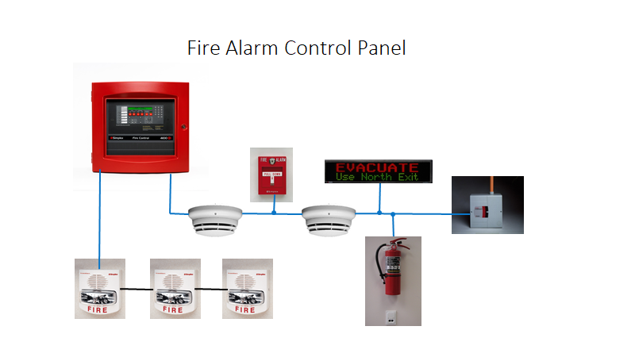

Slide 8
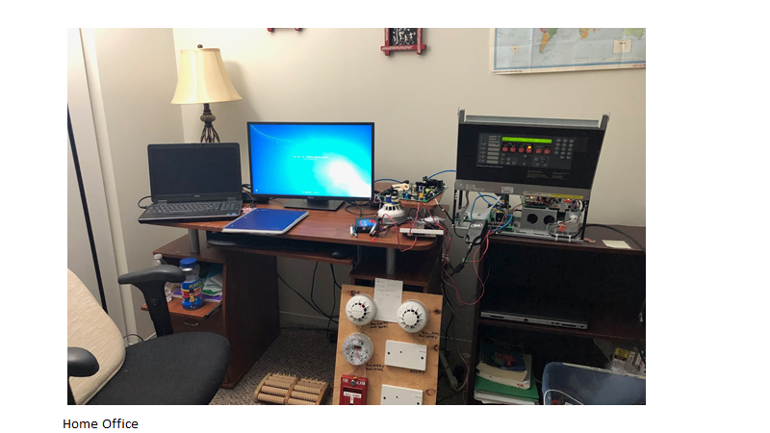

Slide 9
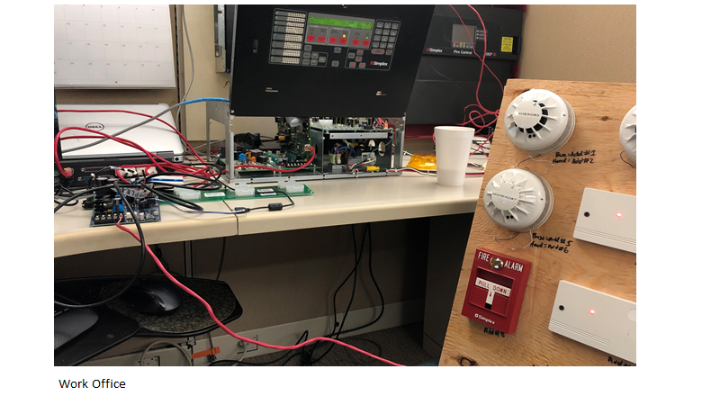

Slide 10
Resources
https://www.arduino.cc
https://www.codecademy.com/catalog
https://www.raspberrypi.org

Slide 11
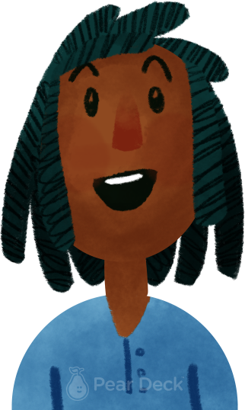
What questions do you have for panelist 1
OR
What will you remember next week about what the panelist said?

Slide 12
Prince Donkor
Software Developer at Cognizant

Slide 13
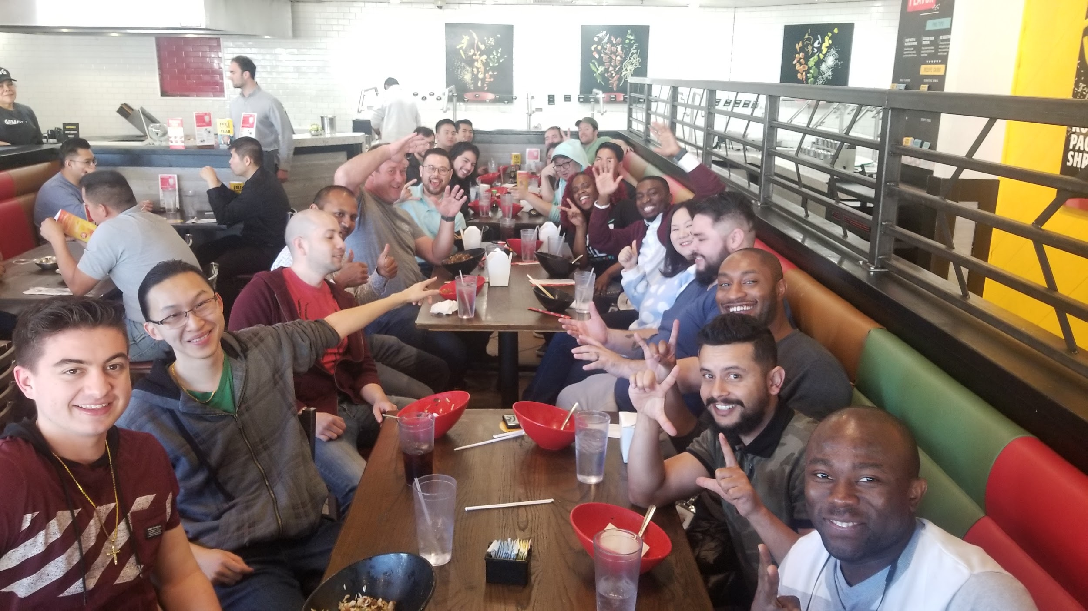
About Me
Highest Education: Coding Boot Camp, High School Diploma
Work Experience:
- 2015 - 2016 Network Admin/Tech Support - National Grid
- 2016 - 2018 Network Admin and Web Developer - Applied Communication Service, inc.
- 2018 - Present - Full Stack Software Engineer - Cognizant
Early interest - Coding : From Worcester Technical High School, - Real Estate : From my mother
Hobbies: Cooking, Buying Real Estate, Ping Pong
Education Path: Worcester Technical High School, A little bit of college, CODING BOOT CAMP, Self educating
Occupation: Full Stack Engineer. At Cognizant we are service company and we help clients envision, build and run more efficient businesses .

Slide 14
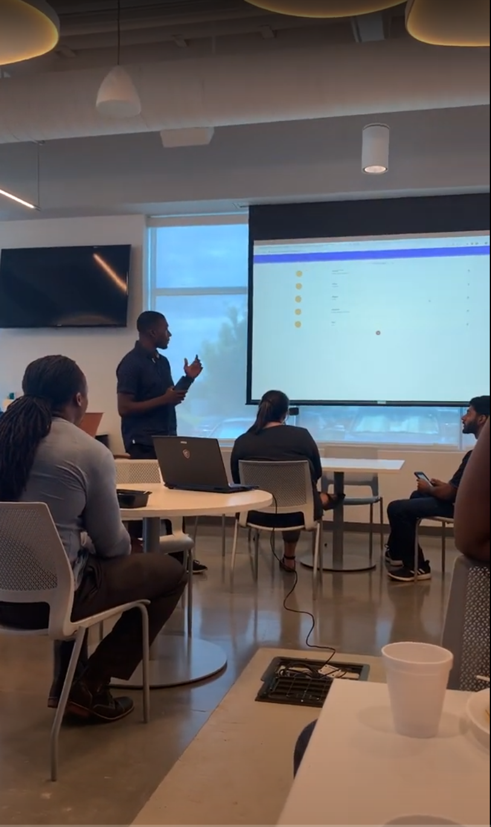
What my day looked like pre covid.
Would wake up at 6
Be at work by 8:00 am
Stand up at 8:30 with everyone in the company for any update
FREE BREAKFAST!!! - (I miss this)
Stand up with my team (AKA Pod), update my team on what I am working on today, what I worked on yesterday and if there are any blockers (Something preventing me from finishing my task).
Check all emails at 9:00 am
Start working on my stories around 9:30 am
From 9:30 - 12:00 is spend on working on a story with my partner (pair programming)
12:00 - 1:00 Lunch - On Wednesday there are what we call lunch and learn where lunch will be provided to everyone at the office and someone will present a new technology or new ways to build an app, basically anything code related.
1:00 - 5:00 - Back to coding with my partner to complete stories and task.

Slide 15
What questions do you have for panelist 2
OR
What did the panelist say that you identified with?

Slide 16
Will Adams
Information Security Specialist
Communications & Power Industries (CPI)
BS in Information Technology, UMass Lowell
Pic of panelist here
Show up on time, have an interest, and you can do it too!
Hiking, Kayaking, Camping, Biking, Home server lab, video games, personal finance.

Slide 17
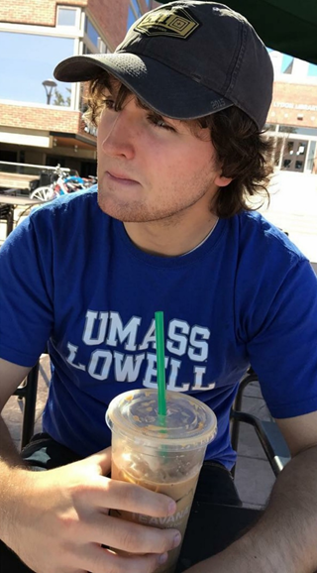
Occupation:
Intern - desktop support leading to systems and network admin work
Security - Audit and compliance leading to “Systems & Security”
Vulnerability Management across CPI Radant’s six divisions
Information Security Specialist - INFOSEC/Cyber team at Corporate
Day in the Life:
Read threat news
Respond to alerts
Involved in policy and procedure creation and revision
Vulnerability management, endpoint detection and response work, and seek out ways to close any identified gaps… maybe improving a process or seeking out better tools
Always busy

Slide 18
Resources
For students interested in getting started in IT:
Degree program, whether it be online or in-person
Certificates from CompTIA, (ISC)², plenty of others
Learn from Udemy.com as well if interested.
If anyone has direct questions, they can email me at William.Adams@cpii.com.

Slide 19
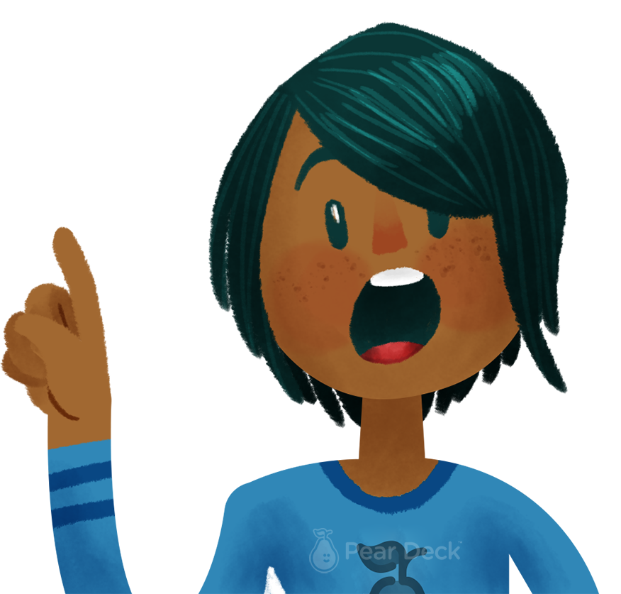
What questions do you have for panelist 3
OR
What did the panelist say that surprised you about the
IT career field?

Slide 20
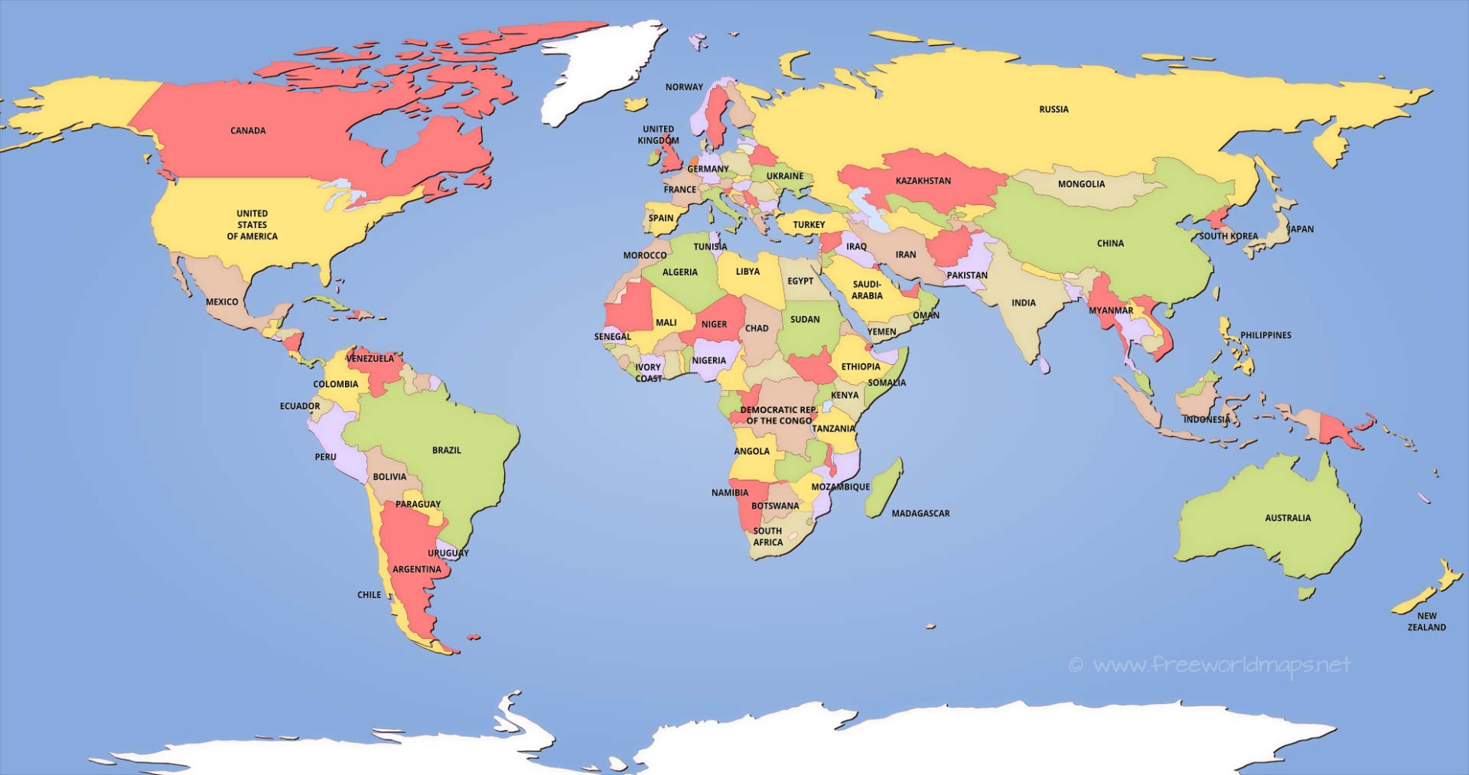
Where in the world do you want to work?

Slide 21
Pretend your friend was absent from class today… Write what you would say if you had to explain this career field to your friend.

Slide 22
I WONDER
What are other STEM Occupations?
Periodic table of STEM careers
Interact with the different STEM career fields and observe education requirements and pay/salary information
Watch videos explaining several different occupations.

Slide 23
I WONDER
What is college, what does it look like, what type of degrees can you get from college?
How Does College Work
What Is College?: Exploring What's Possible After High School

Slide 24
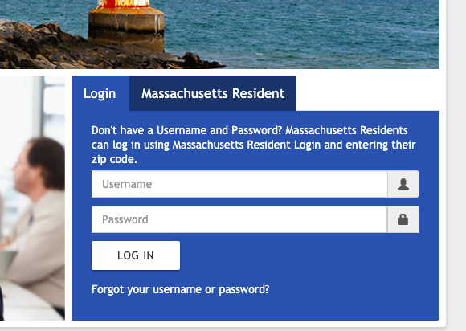
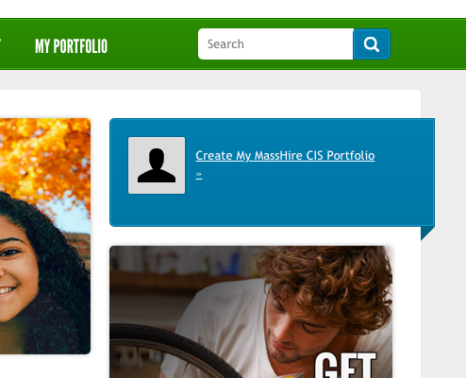
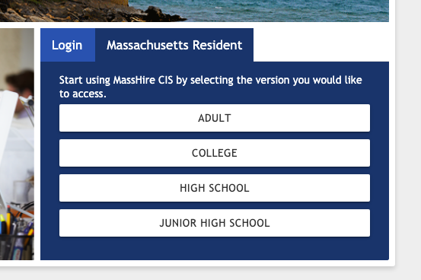
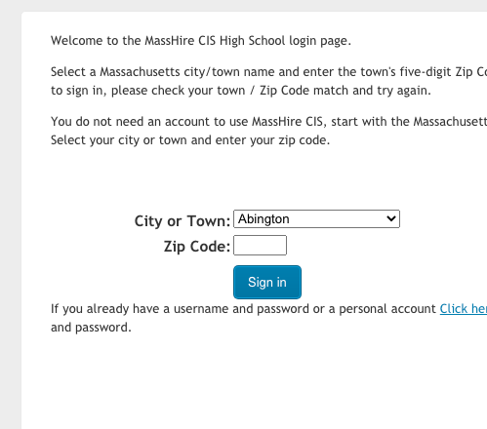
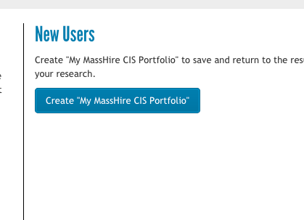
I WONDER
Massachusetts Career Information Systems
Portal Website
Site to help in career planning for MA residents
1
4
2
5
3

Slide 25
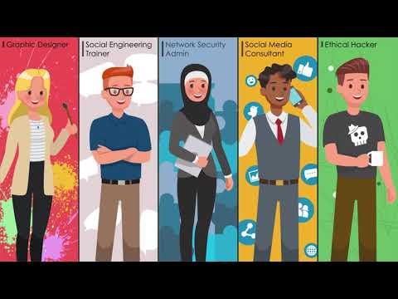
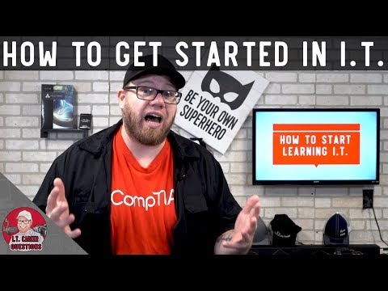
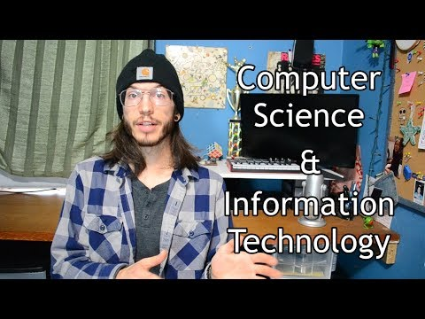
MORE VIDEOS…
Information Technology

Slide 26
Strongly Agree
Agree
Disagree
Strongly Disagree
STEM is relevant to my daily life ...
Notes:
Story Problem
Type in a story problem, and update the answer options to suit your story.
🍐 This is a Pear Deck Multiple Choice Slide. Your current options are: A: Option A, B: Option B, C: Option C, D: Option D, E: Option E,
🍐 To edit the type of question or choices, go back to the "Ask Students a Question" in the Pear Deck sidebar.

Slide 27
Strongly Agree
Agree
Disagree
Strongly Disagree
STEM could be a part of my future ...
Notes:
Story Problem
Type in a story problem, and update the answer options to suit your story.
🍐 This is a Pear Deck Multiple Choice Slide. Your current options are: A: Option A, B: Option B, C: Option C, D: Option D, E: Option E,
🍐 To edit the type of question or choices, go back to the "Ask Students a Question" in the Pear Deck sidebar.

Slide 28
I can help solve problems with STEM using my unique strengths ...
Strongly Agree
Agree
Disagree
Strongly Disagree
Notes:
Story Problem
Type in a story problem, and update the answer options to suit your story.
🍐 This is a Pear Deck Multiple Choice Slide. Your current options are: A: Option A, B: Option B, C: Option C, D: Option D, E: Option E,
🍐 To edit the type of question or choices, go back to the "Ask Students a Question" in the Pear Deck sidebar.

Slide 29
Strongly Agree
Agree
Disagree
Strongly Disagree
People like me do STEM ...
Notes:
Story Problem
Type in a story problem, and update the answer options to suit your story.
🍐 This is a Pear Deck Multiple Choice Slide. Your current options are: A: Option A, B: Option B, C: Option C, D: Option D, E: Option E,
🍐 To edit the type of question or choices, go back to the "Ask Students a Question" in the Pear Deck sidebar.

Slide 30
I learned something new about STEM at this event ...
Strongly Agree
Agree
Disagree
Strongly Disagree
Notes:
Story Problem
Type in a story problem, and update the answer options to suit your story.
🍐 This is a Pear Deck Multiple Choice Slide. Your current options are: A: Option A, B: Option B, C: Option C, D: Option D, E: Option E,
🍐 To edit the type of question or choices, go back to the "Ask Students a Question" in the Pear Deck sidebar.

