Slide 1
Project Team Dynamics: Looking in the Mirror
Charles Morse, MA, LMHC
Associate Dean for Student Development
Director of Counseling
Worcester Polytechnic Institute
cmorse@wpi.edu
WPI SUMMER INSTITUTE FOR
PROJECT BASED LEARNING
JUNE 20 - 23, 2018

Slide 2
Overview
A few exercises which will help you reflect on your team dynamics
Highlight the theme of differences as a source of tension within groups, but also a group’s greatest asset
Avoidance of tension/conflict is the most common factor in breakdown of group functioning

Slide 3
Stages of Group Development
Forming
Storming
Norming
Performing
Adjourning
Synergy

Slide 4
MBTI Exercise I/E

Slide 5
MBTI I/E (cont.)

Slide 6
MBTI P/J

Slide 7
MBTI P/J (cont.)

Slide 8
Group Work
Talk about your I/E and P/J types and how they might be affecting team dynamics now or in the future?
If your group is over-represented in one aspect or the other, how might this affect team functioning? Potential blind spots?

Slide 9
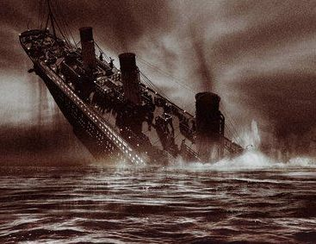
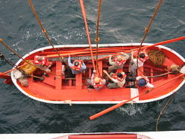
Tough Decisions

Slide 10
Conflict Resolution Styles

Slide 11
Differences and Diversity
Our minds tend to react to differences as “wrong” and/or “bad”
Our minds aren’t always our best asset
Diversity can be understood as how we relate to differences
Accept, Allow, Make room for…
vs.
Invite, Embrace, Curiosity

Slide 12
Summary
Truly embracing differences will be messy, uncomfortable
Differences also provide the fuel which drives Synergy
Synergy requires psychological safety
The ability to read and react to other people in the group (social sensitivity)
Equal opportunity to participate in the group

Slide 13
Consultation
Sign up for a consultation slot for Friday between 2:15 – 4:00pm
Catch me at a coffee break, lunchtime, etc.
Email me to arrange a time…
Charlie Morse
cmorse@wpi.edu

