Slide 1
The effect of video game violence on children and young adults
Issy Rhodes

Slide 2
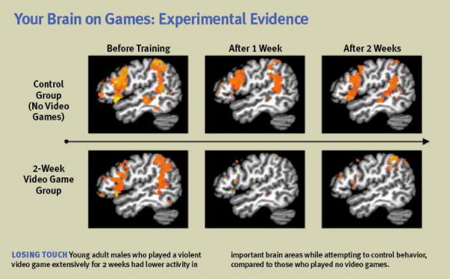

Slide 3
Analysis of the brain scans
The brains of video game players show a significant decrease in brain activity in the frontal, parietal, and temporal lobes as compared to the control group.

Slide 4
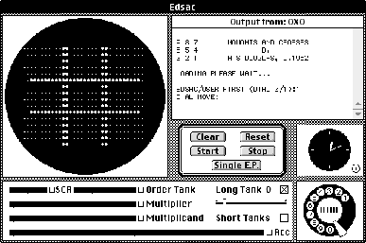
Evolution of game design
The first video games were OXO and Tennis for Two (possibly the inspiration behind Pong). They were created in the 1950’s and the graphics were very simple based on modern standards but were groundbreaking for the time.
https://youtu.be/s2E9iSQfGdg?t=10
OXO

Slide 5
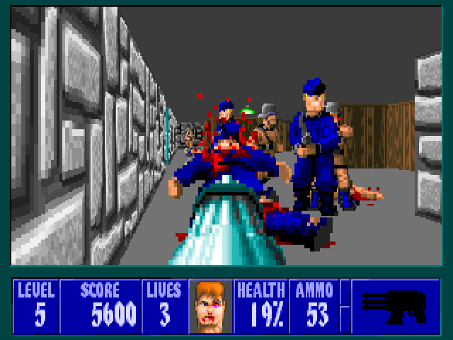
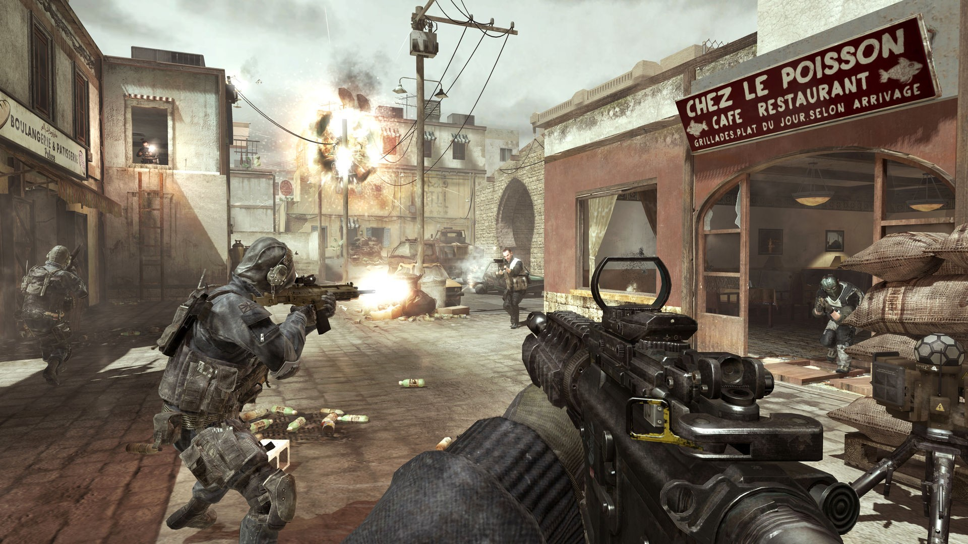
Wolfenstein 3D vs Call of Duty: Modern Warfare 3

Slide 6
The evolution of graphics
As seen in the last slide, the graphics of video games have greatly improved over the past 20-30 years. Wolfenstein 3D, the game seen on the left, came out in 1992; while COD Modern Warfare 3 was released in 2011.
The image to the right shows the resolution of different types of displays, such as 4K, which is a common display for modern video games and can be up to 2160 by 4096 pixels. This provides a striking contrast to video games from a few decades which only had a few hundred by a few hundred pixels.

Slide 7
Experts’ opinions on this issue
Experts from the American Psychological Association have proposed a resolution to: “support funding of basic and intervention research by the federal government and philanthropic organizations to address the following gaps in knowledge about the effects of violent video game use, endorse the development and implementation of rigorously tested interventions that educate children, youth and families about the effects of violent video game use; and strongly encourage the Entertainment Software Rating Board to refine the ESRB rating system specifically to reflect the levels and characteristics of violence in games in addition to the current global ratings.”

Slide 8
The popularity of games over time
The “golden age of video games” was from 1978-1984, when video games experienced a boom in popularity, games had great technical and artistic creativity, and the number of arcades in Europe, North America, and Asia more than doubled.
Popular games from this time period include Space Invaders, Pac-Man, Phoenix, Donkey Kong, Galaga, Ms. Pac-Man, and Mario Bros.
In contrast, the most popular video games of the 21st century include several FPS’s such as BioShock, Halo, Fallout, and Call of Duty.

Slide 9
Sources
https://sites.psu.edu/siowfa15/2015/12/03/are-video-games-as-addictive-as-drugs/
https://www.humanbrainfacts.org/basic-structure-and-function-of-human-brain.php
https://en.wikipedia.org/wiki/OXO
https://www.dosgamesarchive.com/download/wolfenstein-3d/
https://www.pcmag.com/article2/0,2817,2396833,00.asp
https://commons.wikimedia.org/wiki/File:8K,_4K,_2K,_UHD,_HD,_SD.png
https://www.apa.org/about/policy/violent-video-games.aspx

