Slide 1
‘Build Your own Digital Railway’ Programme
Elizabeth Fitch
Joshua Friscia
Jordan Kovar
Sean McCarthy
Stephanie Rivard
April 29, 2015

Slide 2
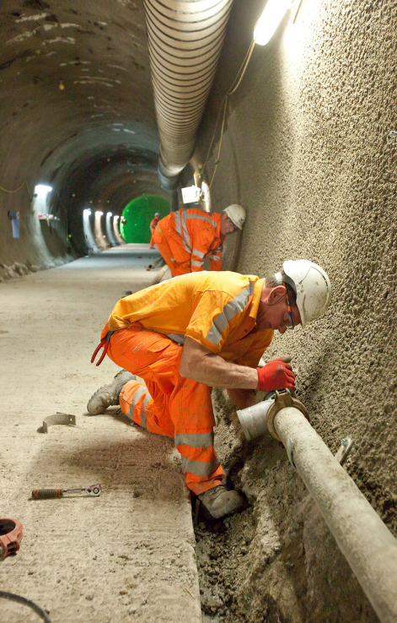
Presentation Overview
Questions
STEM Education in the UK
Young Crossrail
Project Goals
Observations
Stakeholder Interviews
Ambassador Interviews
‘Build Your Own Digital Railway’
Learning Outcomes and Qualifications
Initial Program Criteria
Final Criteria and Program Overview
Supporting Documents

Slide 3
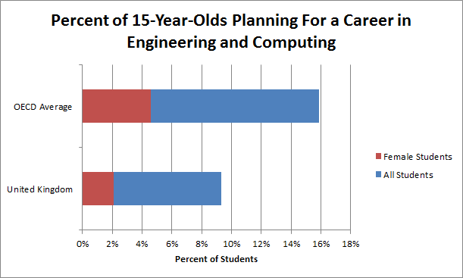
Stem Education in the UK
Deficit of over 10,000 workers a year in SET professions
20 year decline in number of students taking A-Level physics
42% of employers in the UK claim there is a shortage of STEM proficient employees
STEM Outreach Programs:
STEMNet
STEMWorks
Young Crossrail

Slide 4
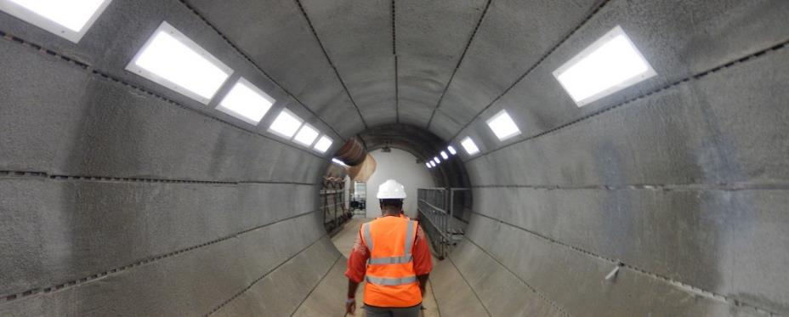
Overall Project Goal
Develop an educational program for Key Stage 4 and Key Stage 5 students, which focuses on exploring different engineering subjects related to the engineering and technology utilized in the Crossrail project

Slide 5
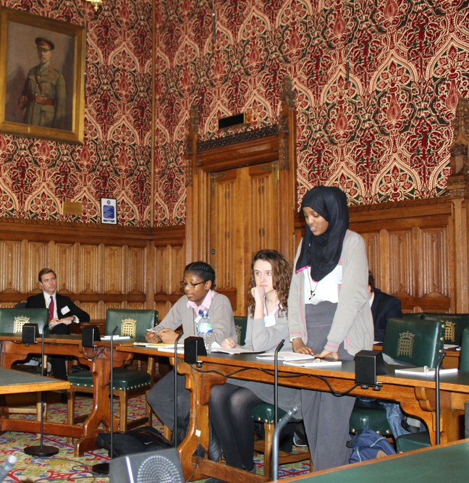
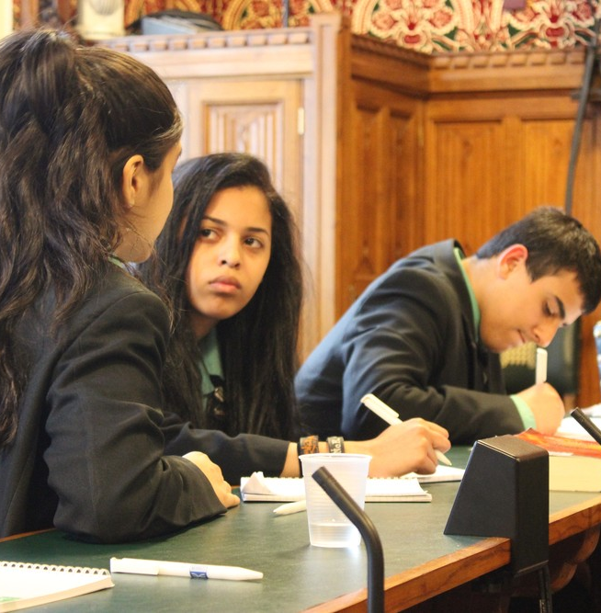
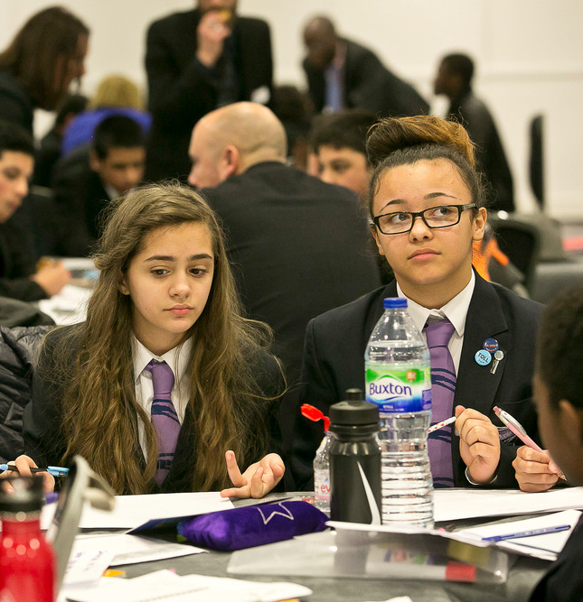
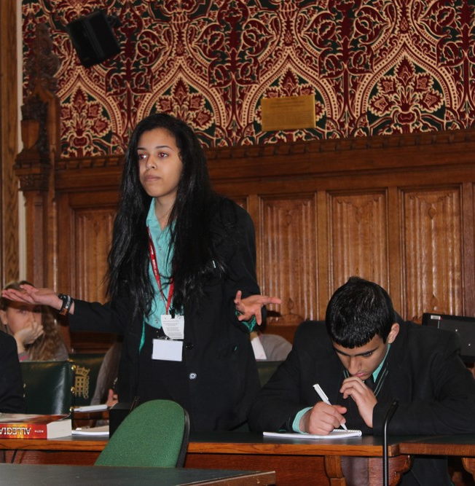
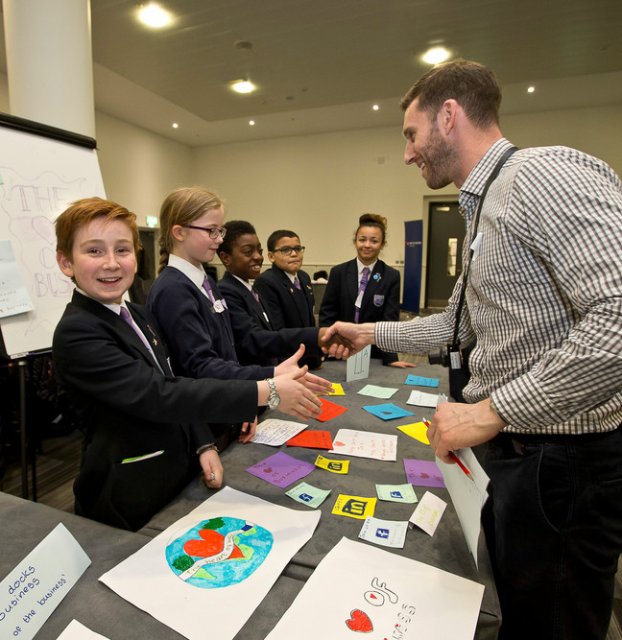
Observations
Young Crossrail TUCA Visit
Young Crossrail House of Parliament Debate
London City Airport Industry Day
Maria Fidelis Year 8 Theme Day
Maria Fidelis School Visit

Slide 6
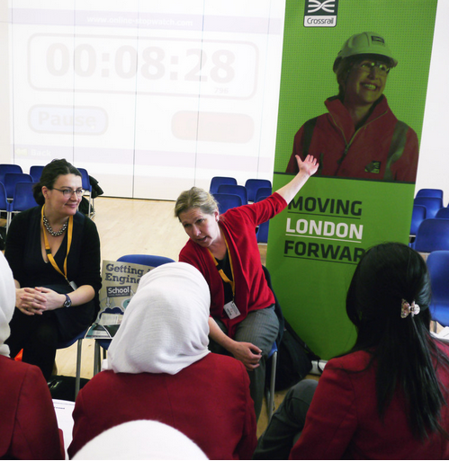
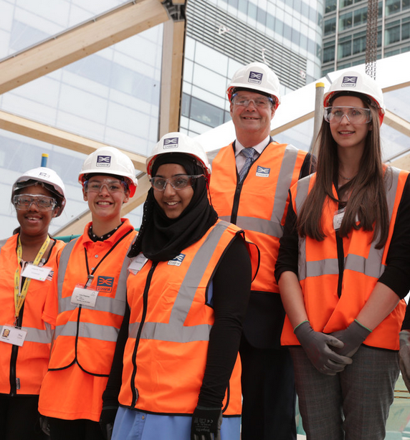
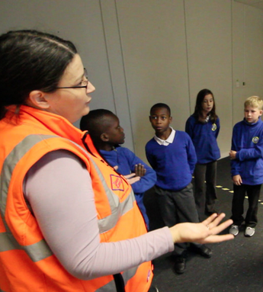
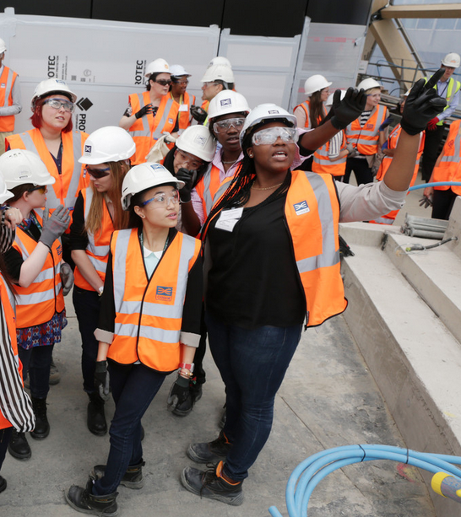
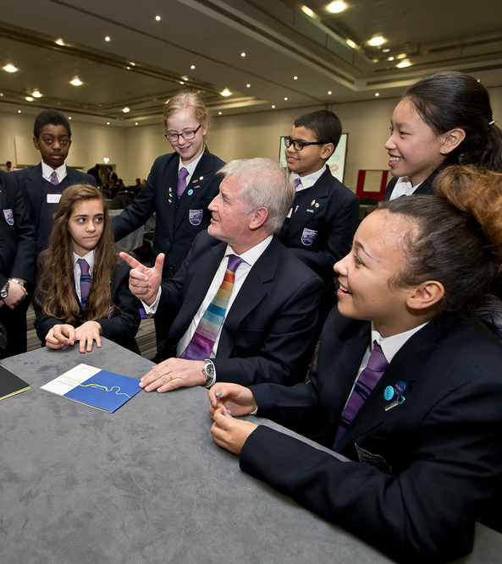
Ambassador Interviews
Engage girls who might shy away from more technical topics
Keeping the presentations short
Remember to cover the “so-what” factor
Be mindful of ambassadors time/schedules

Slide 7
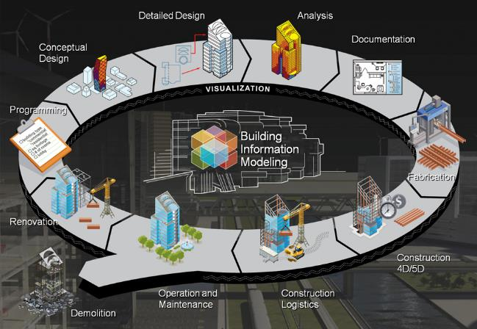
Stakeholder Interviews
Gained insights on BIM and how to introduce this to students
Create the next generation of BIM workers
Emphasize collaboration side of BIM

Slide 8
Initial Program Criteria
Maps to one or more vocational qualifications
10-12 week program
Adaptable to different schools
Open-ended design focus
Representative of STEM-related careers
Flexible time commitments for ambassadors

Slide 9
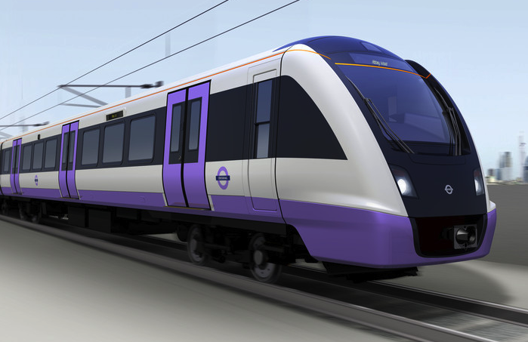
‘Build Your Own Digital Railway’
Explores 5 Phases of BIM
Students design their own ‘Digital Railway’ which will encompass the entire railway experience from stations to the trains
Brief kept open ended
Students provided with Crossrail information for inspiration

Slide 10
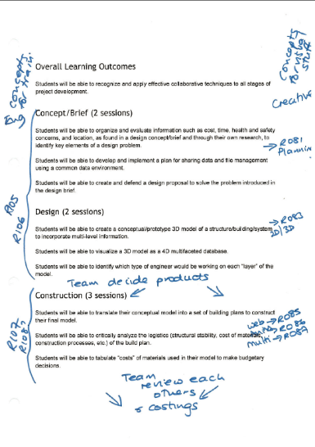
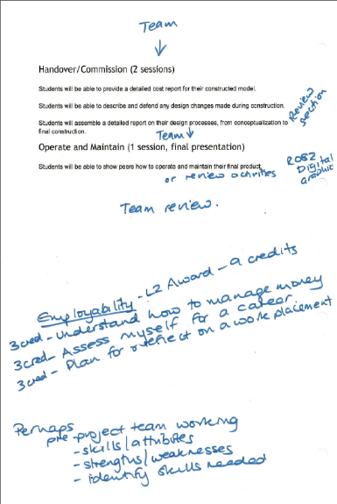
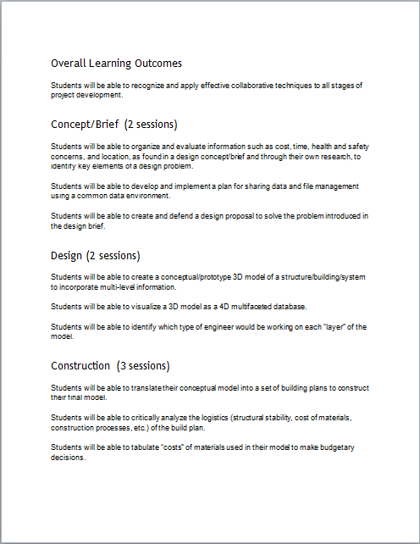
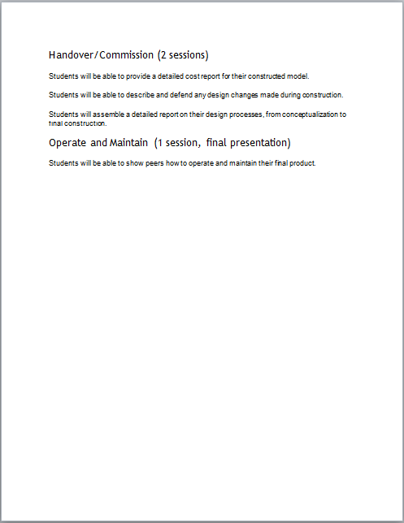
Learning Outcomes and Qualifications

Slide 11
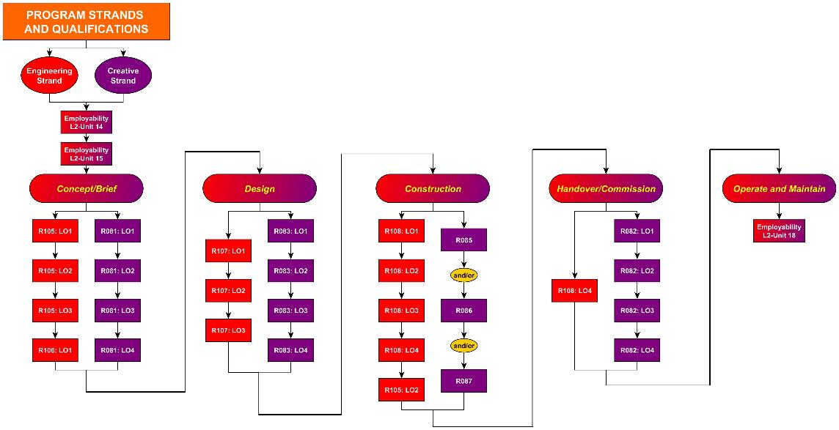

Slide 12
Final Criteria and Program Overview
10- 12 week program
Maps to three qualifications
Incorporates Crossrail concepts and corporate values
Open-ended problem that engages and encourages student creativity and collaboration
Encourages students (especially girls) to pursue engineering careers
Adaptable to different schools’ curriculum
Teachers serve as main program facilitator
Ambassadors serve as mentors

Slide 13
Supporting Documents
Teacher Delivery Handbook
Mentor Handbook
Student Resource Handbook
Construction Handbook
Guide for the delivery of the five modules, each mapped to our learning outcomes and five BIM phases
Provides ambassadors with information on their roles and responsibilities in the program and how to be an effective mentor
Provides teachers with recommendations on what different modes of construction the students can use to build their models
Resource for students to utilize throughout their project, including a list of video resources, case studies related to Crossrail and other rail projects, and STEM and transit websites

Slide 14
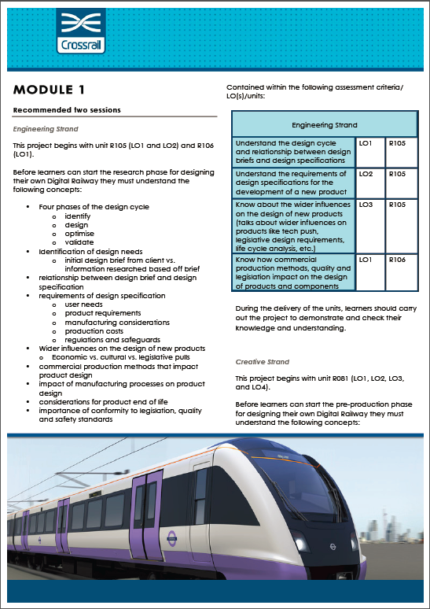
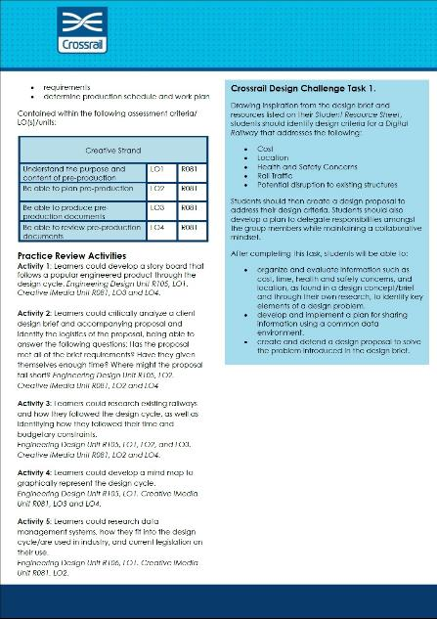
Teacher Delivery Handbook
Section for each strand
Summary of key concepts
List of learning outcomes
Suggested activities for each module
Crossrail Design Challenge Task

Slide 15
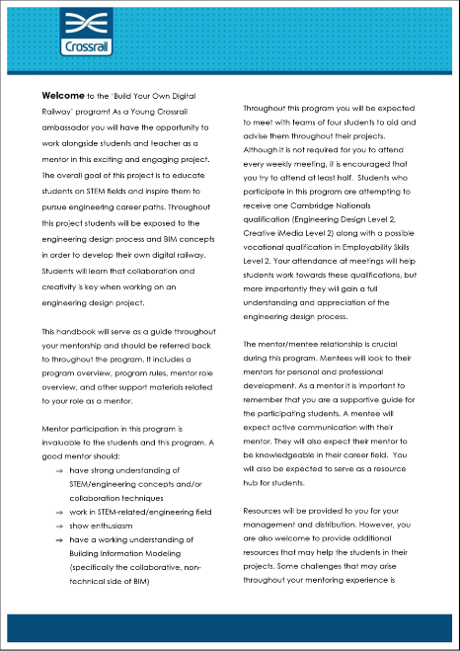
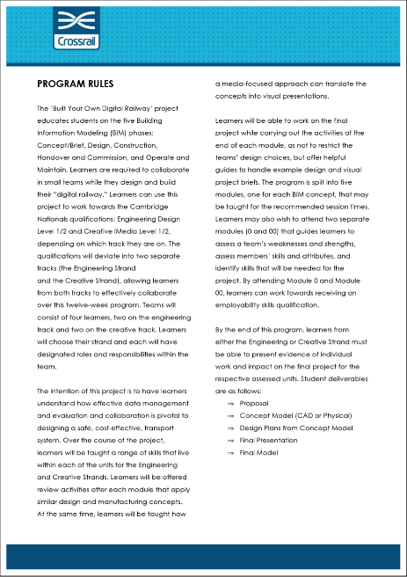
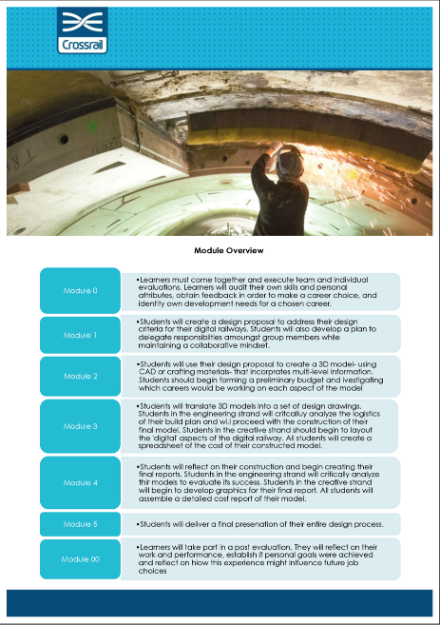
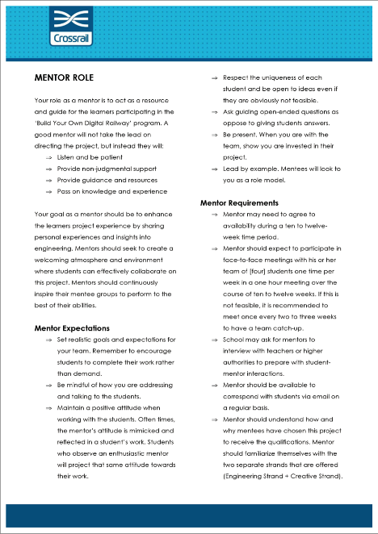
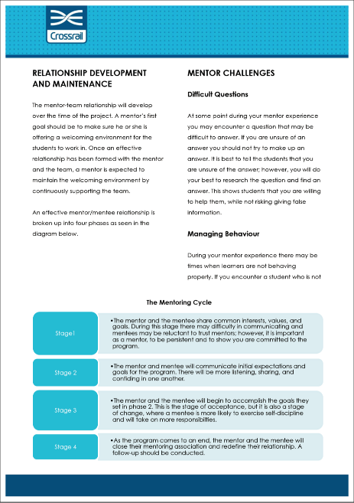
Mentor Handbook
Program Welcome
Program Rules
Module Overview
Mentor Role/ Expectations/ Requirements
Relationship Development and Maintenance
Mentoring Challenges

Slide 16
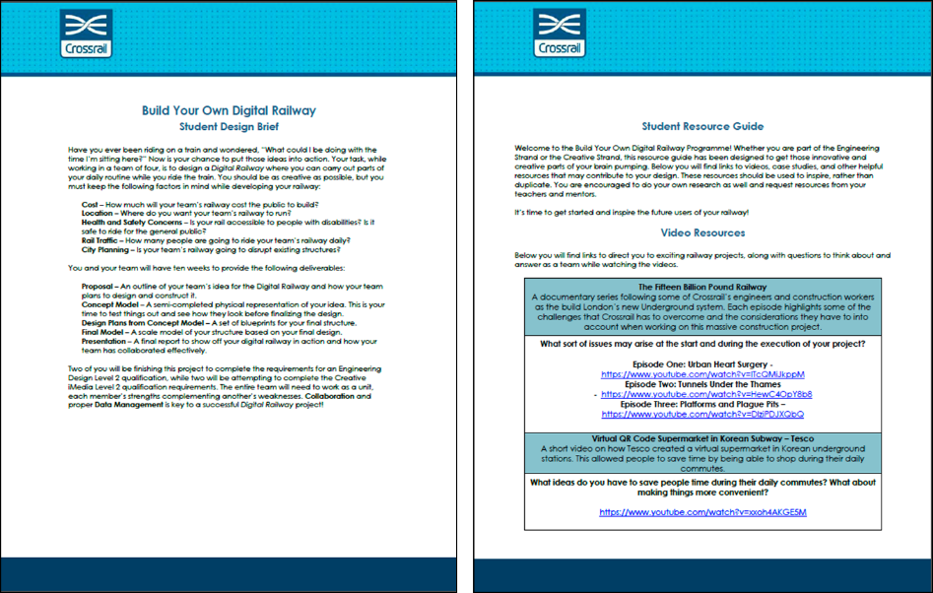
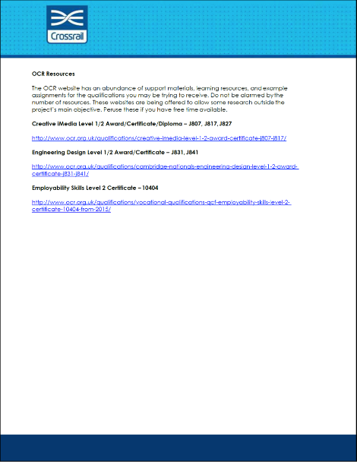
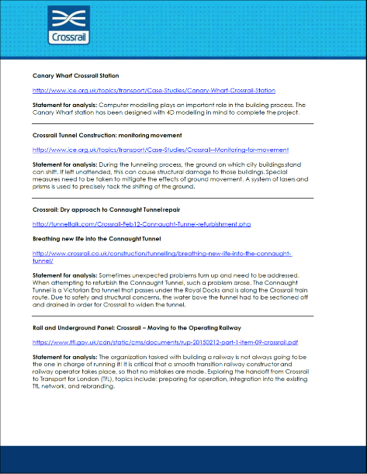
Student Resource Guide
Student Design Brief
Video Resources
Case studies
OCR resources

Slide 17
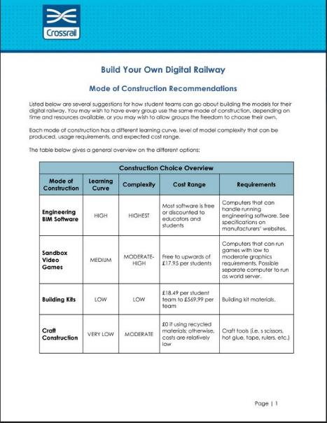
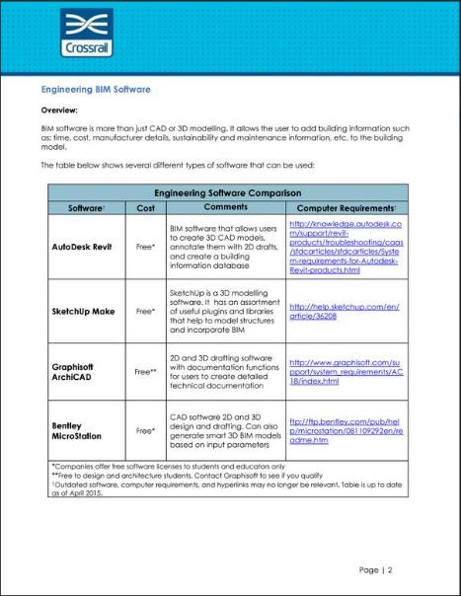
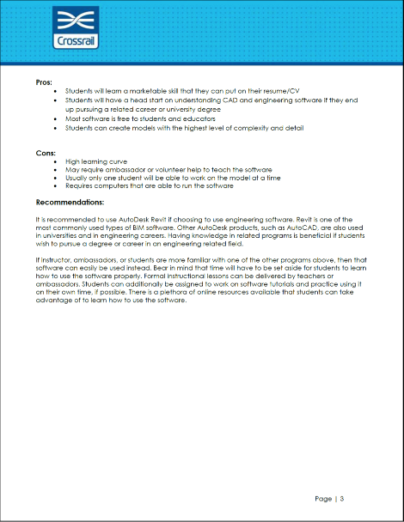
Construction Guide
Construction choice overview
Section for each method of construction
Method overview
Method pros and cons
Method recommendation

Slide 18
Recommendations
Pilot program with schools
Information hub that serves as common database for all students
Project hand-off program
Project showcase events
Teacher briefing and orientation sessions
Ambassador team mentors
Project Updating Guide/Checklist

Slide 19
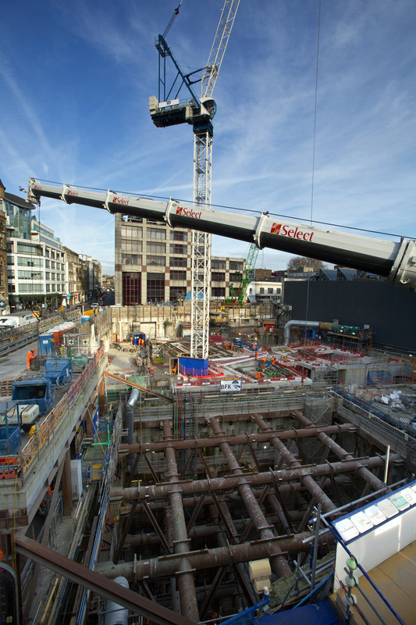
Acknowledgements
Sally Speed - Crossrail
Lauren Hillier – Crossrail
Dominic Golding – Worcester Polytechnic Institute
Patricia Stapleton – Worcester Polytechnic Institute
Alison Pearce – OCR
Sonia Zahiroddiny – HS2
Kevin McGeever – National Rail
Tahir Ahmad – Crossrail
Rebecca Roberts – Swanlea School
Anita Money – Maria Fidelis School
Young Crossrail Ambassadors

Slide 20
Questions
Notes:
http://eandt.theiet.org/news/2013/feb/images/640_crossrail-construction.jpg
http://www.theconstructionindex.co.uk/assets/news_articles/2013/03/1362119645_cross12.jpg
http://blogs.ft.com/photo-diary/files/2013/11/Crossrail.jpg
http://cdni.wired.co.uk/1920x1280/a_c/crossrail.jpg
http://cdn.spectator.co.uk/wp-content/uploads/2013/06/Martin-Crossrail_167750270.jpg
http://futurecity.co.uk/wp-content/uploads/2010/04/17461_crossrail_tunnel_boring_machine_fully_assembled_12_dec_2012.jpg
http://i.telegraph.co.uk/multimedia/archive/02495/66287_Crossrail_s-_2495552k.jpg
http://d.ibtimes.co.uk/en/full/1358191/crossrail-whitechapel.jpg
http://now-here-this.timeout.com/wp-content/uploads/2013/05/crossrail.jpg
http://www.crossrail.co.uk/benefits/supporting-local-communities/
http://www.crossrail.co.uk/careers/young-crossrail/find-out-more-about-our-partner-schools
http://www.crossrail.co.uk/careers/young-crossrail/latest-news
http://www.utahcte.org/blog/wp-content/uploads/2011/12/DSCN0037.jpg
http://glneurotech.com/images/bioradio/hs-students-with-bioradio_1200x800.jpg
https://asunews.asu.edu/files/cad_image_2.jpg

