Slide 1
Corporate Waste Recycling Improvement in the Croydon Council
Alex Bell, Julia MacLeod, Dan Murray, Nick Papa
Notes:
J

Slide 2
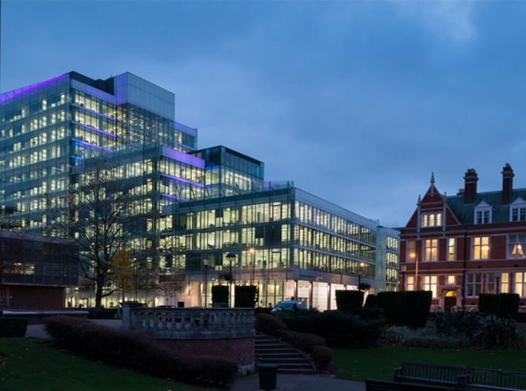
Croydon Council
“Responsible for the collection…of waste from all homes in the borough…”
Notes:
D
Change title

Slide 3
Croydon Council
“…it is clearly very important that Croydon Council itself achieves high levels of recycling with its own operation”
- Bob Fiddik, Sustainable Development and Energy Team Leader at the Croydon Council

Slide 4
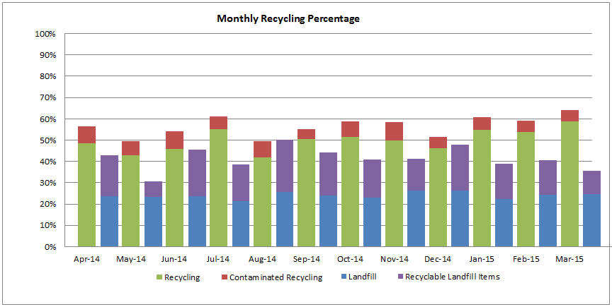
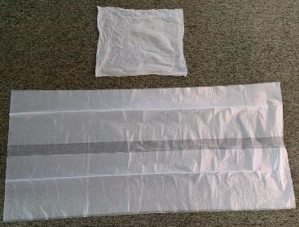
Current Data
Notes:
J

Slide 5
Overview
Project Goal & Objectives
Interviews & Site Visits
Town Hall & Clock Tower
Survey Data & Analysis
Conclusions & Recommendations
Notes:
J

Slide 6
Project Goal & Objectives
Evaluate Croydon Council’s current recycling practices and provide recommendations for improved strategies
Objective 1: Identify best practices for recycling
Objective 2: Clarify current in-house plans, policies, and guidelines
Objective 3: Conduct baseline assessment of in-house recycling
Objective 4: Evaluate employee opinions on current policies
Objective 5: Develop a set of recommendations
Notes:
N
More explanation as to why project is happening
Introduce as to why each section was done

Slide 7
Overview
Project Goal & Objectives
Interviews & Site Visits
Town Hall & Clock Tower
Survey Data & Analysis
Conclusions & Recommendations
Notes:
N

Slide 8
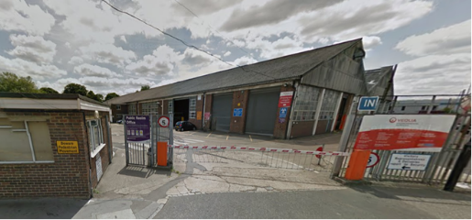
Interviews
Head of Facilities Management – Mark Norrell
Corporate recycling in West Sussex
Direction for the Council’s improvement
Recycling Champions
Volunteers
Encouraged others to recycle
Why recycling champions became dormant
Stubbs Mead
Contract details
Joel Benham
Health and Safety
Notes:
D

Slide 9
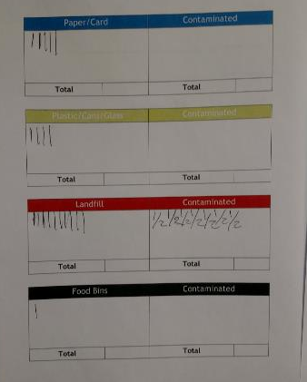
Interserve Shadow
Obtain further understanding of waste collection
Compare methods of various operatives
Contamination data collection
Notes:
A

Slide 10
Interserve Shadow
Operative 1
Floor walker
Separated most of the visible contamination
Very knowledgeable about recyclable materials

Slide 11
Interserve Shadow
Operative 2
Multi-service operative
Separated some of the visible contamination
Puts other jobs before waste collection

Slide 12
Interserve Shadow
Operative 3
Floor Walker
Separated minimal visible contamination
Improper understanding about recyclable materials

Slide 13
Interserve Shadow
Similarities
Walk around floor multiple times a day
Separate partial contamination
Empty bins as necessary
Bring full bins to “Goods-In” room
Tally contaminated bags on chart

Slide 14
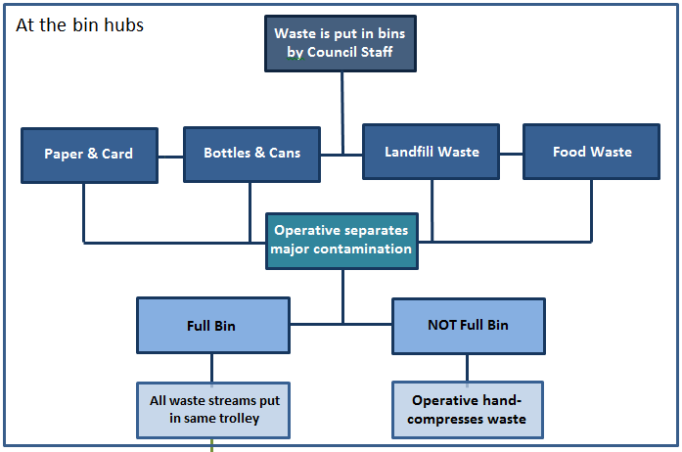
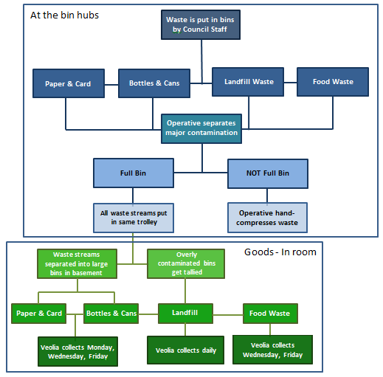
Interserve Shadow
Notes:
Edit colors/visual

Slide 15
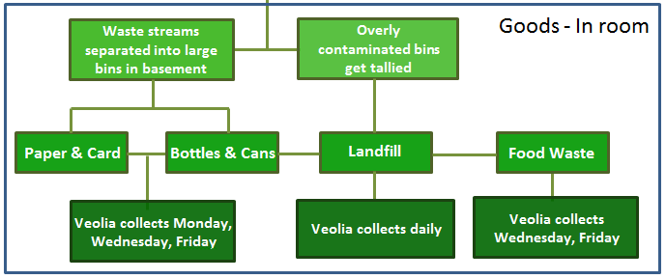
Interserve Shadow

Slide 16
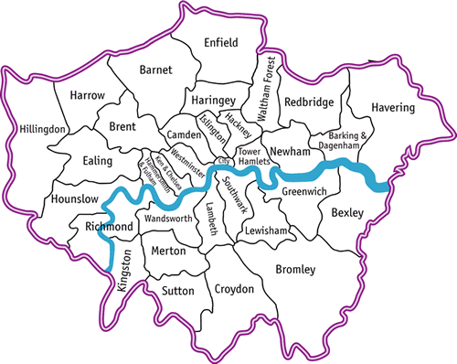
Outside Interviews
Contacted
All the boroughs
Alternative Contact
Sutton
Waltham Forest
Bromley
West Sussex
Site Visits
Kingston
London Fire Brigade
Bexley
Camden
Notes:
A
Link it back to Croydon → anything that is similar/significant

Slide 17
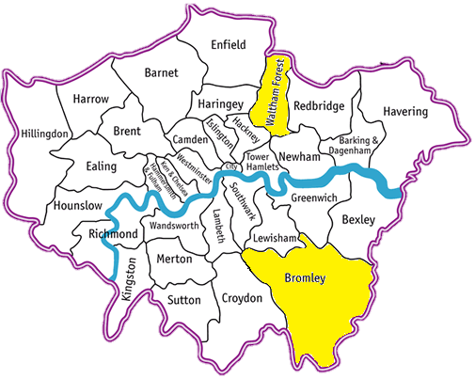
Outside Interviews
Waltham Forest
Poster Campaigns
Recycling Champions
Bromley
Info session
No under-desk bins
Consistency between Council and residents
Notes:
D,J

Slide 18
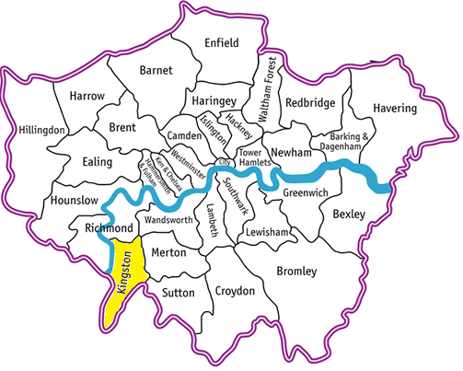
Outside Interviews
Kingston upon Thames
Effective campaigning
Green Champions
Volunteers
Encouraged colleagues
Notes:
A
Multi media campaigns

Slide 19
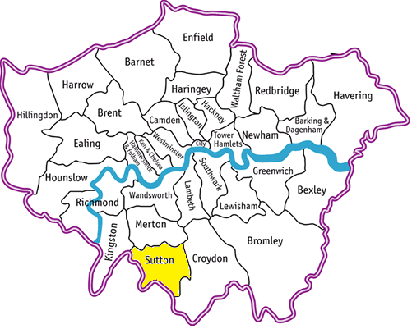
Outside Interviews
Sutton
Effective Labeling
Sustainability Team
Financial Evaluation
Recycling Champions
Notes:
N

Slide 20
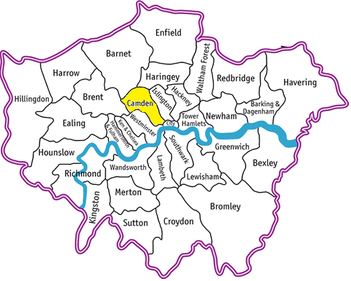
Outside Interviews
Camden
Education over enforcement
Reducing paper use
Communication
Color coded bags
Green Champions
Volunteers
Encourage others
Notes:
D

Slide 21
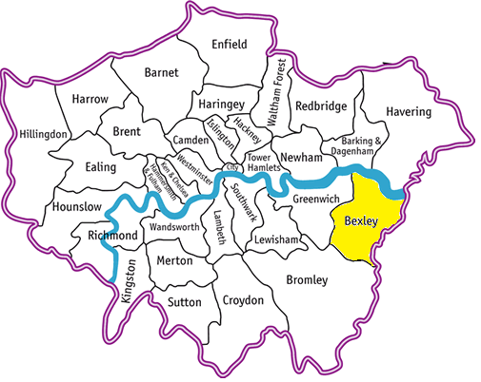
Outside Interviews
Bexley
Communication
Trash compactor
Visual Waste Audit
Notes:
N
More recyclables per bin
Provided results to employees

Slide 22
Outside Interviews
London Fire Brigade
98-99% Recycling rate
Contract changes
Green Champions
Emphasis on education
Strong Communication
Reuse
Notes:
J
Clarify about percentage → focus on what comes out of the door
Waste audit

Slide 23
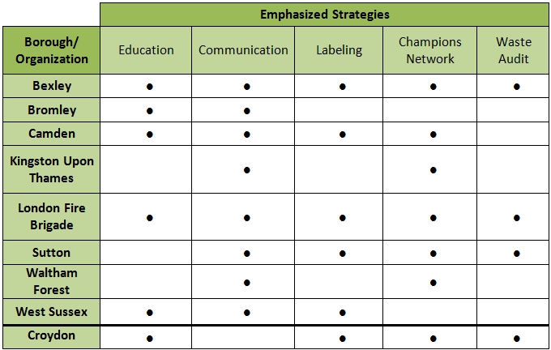
Findings
Notes:
Emphasis instead of Findings

Slide 24
Findings
Notes:
Emphasis instead of Findings

Slide 25
Overview
Project Goal & Objectives
Interviews & Site Visits
Town Hall & Clock Tower
Survey Data & Analysis
Conclusions & Recommendations
Notes:
J

Slide 26
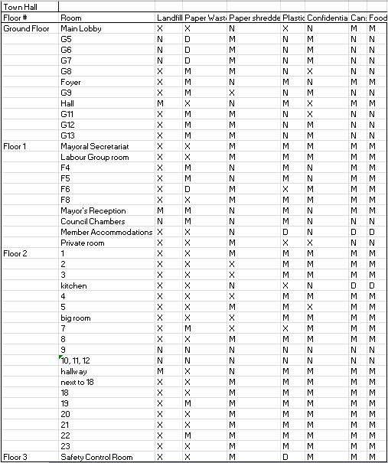
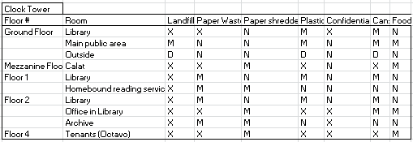
Town Hall Table

Slide 27
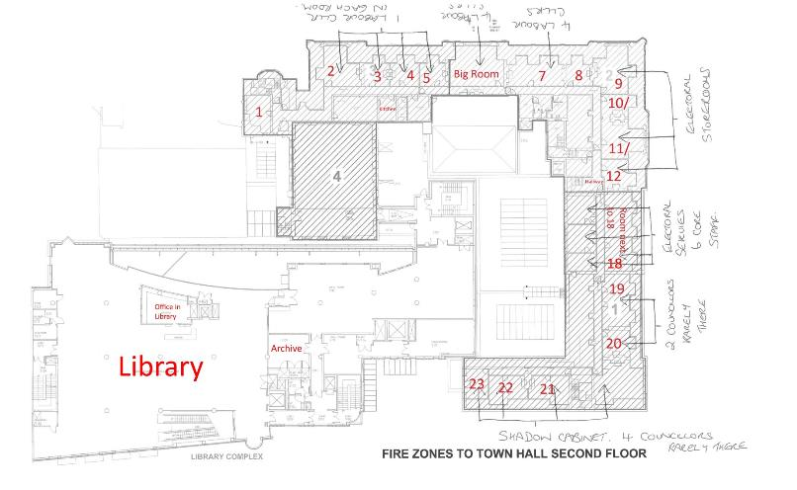
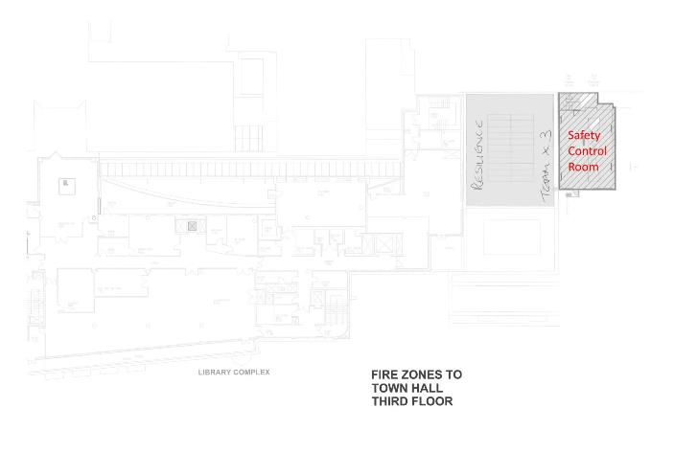
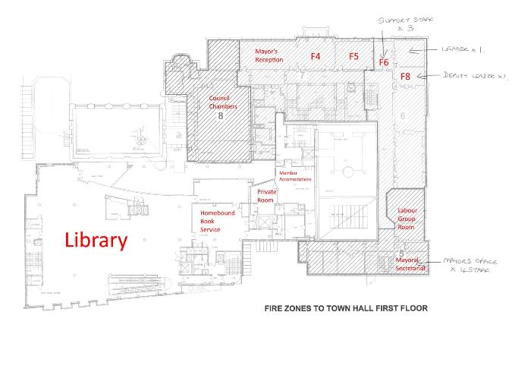
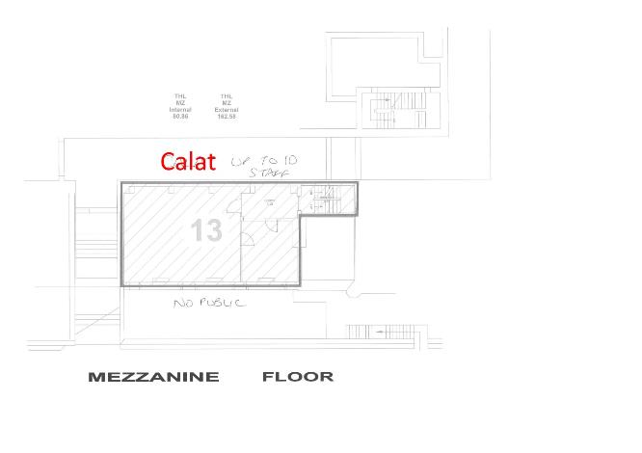
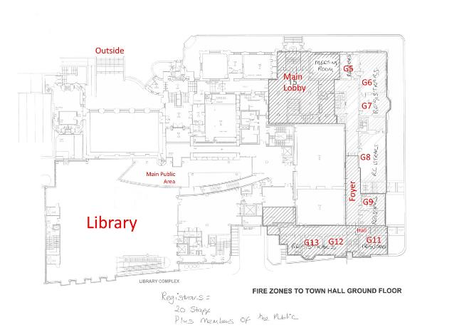
Town Hall Map
Notes:
D

Slide 28
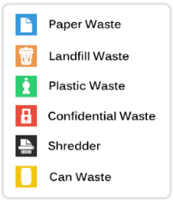
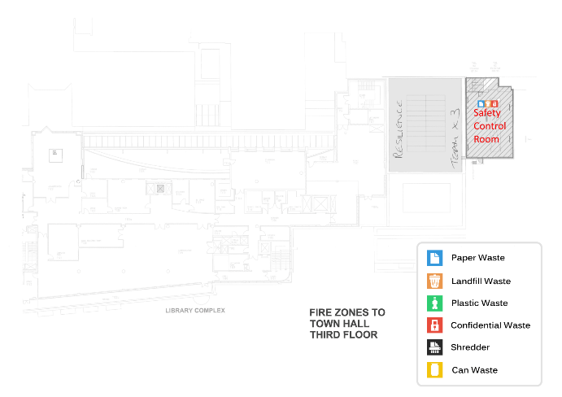
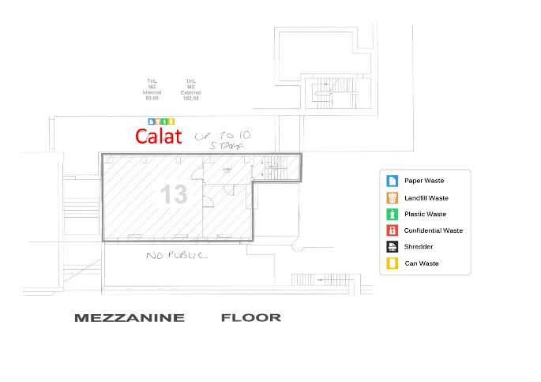
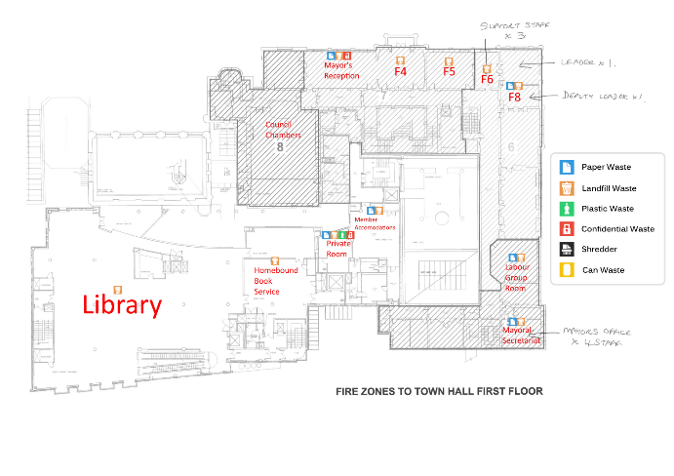
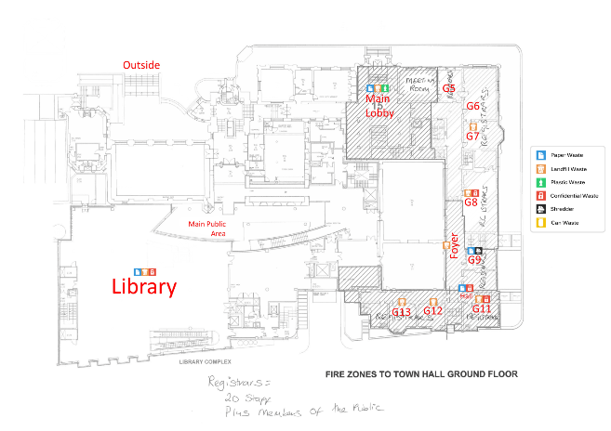
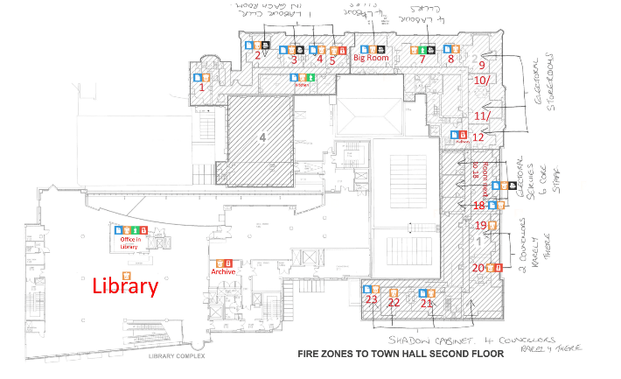
Waste Icon Map
Notes:
N

Slide 29
Overview
Project Goal & Objectives
Interviews & Site Visits
Town Hall & Clock Tower
Survey Data & Analysis
Conclusions & Recommendations
Notes:
D

Slide 30
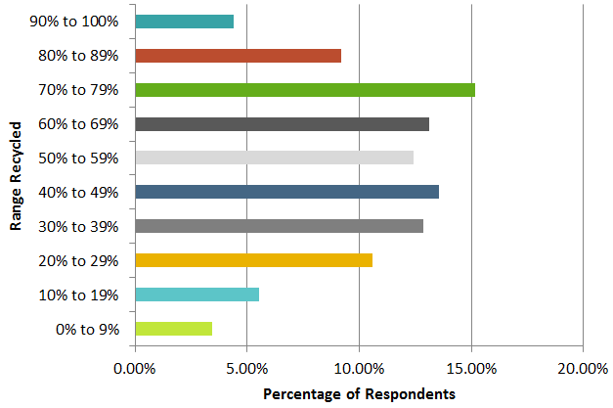
Survey Analysis
What percentage of office waste in your building do you think is currently being recycled? (n=438)
113 correct
Notes:
A

Slide 31
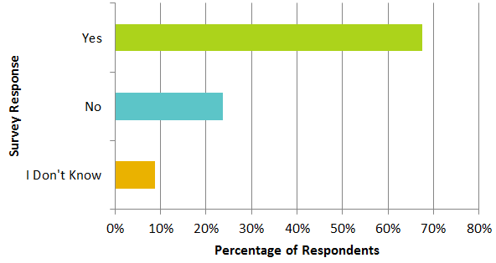
Survey Analysis
Do you think the Council should do more to educate staff on reasons to recycle? (n=438)
Notes:
A

Slide 32
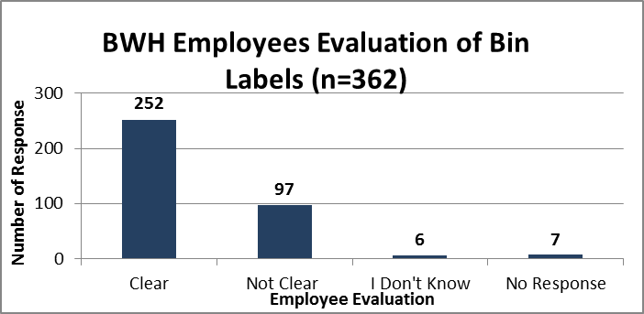
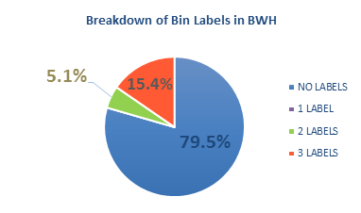
Survey Analysis
Approximately 70% of respondents believe the labeling is clear
However, there is a significant number of labels missing
Labeling is confusing and ultimately uninformative
Notes:
A
But there is a significant number of labels missing
Not necessarily unclear – they just fell off

Slide 33
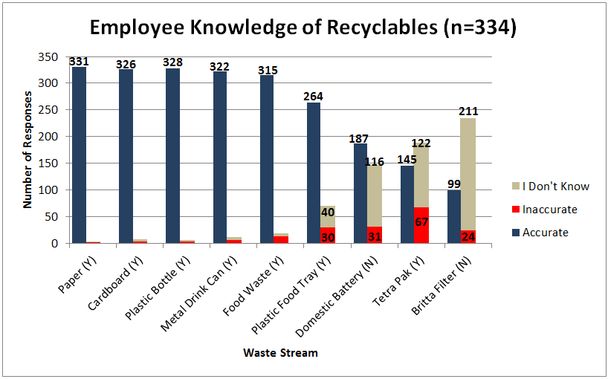
Survey Analysis
92% of BWH respondents said they know what materials go in what bin
Common recyclables are more well known
11% of BWH respondents were correct
Notes:
A

Slide 34
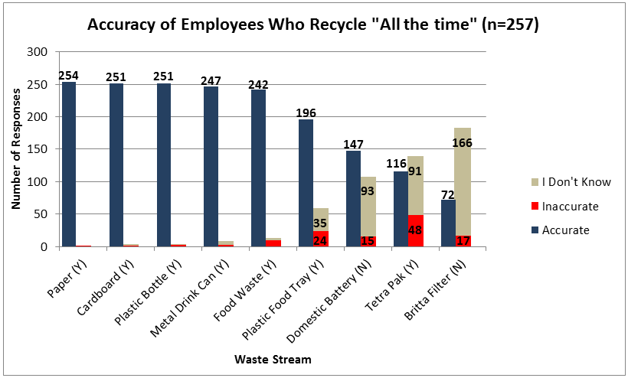
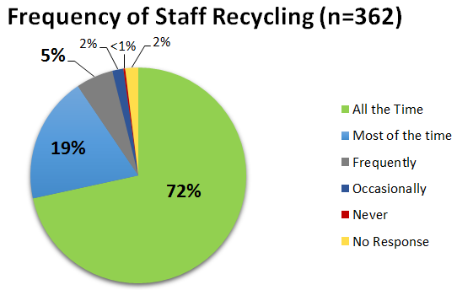
Survey Analysis Recycling Frequency & Knowledge
72% BWH respondents said they recycle all the time
Similar trend to overall respondents
Approximately 13% of BWH employees were correct
Notes:
A

Slide 35
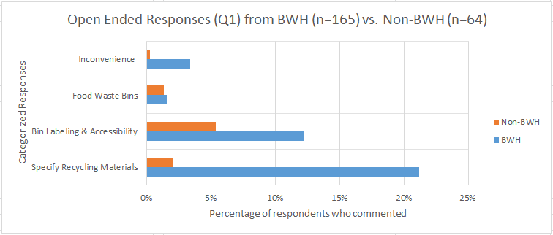
Survey Analysis
Please tell us if there is anything you think is not clear and how it can be improved
“An accurate list of what can and can’t be recycled. The signs are too generic”
“It would be better to put detailed pictures over each bin”
“There are no separate bins in the area I work in”
“There will always be room for improvement”
“The signs are clear. It is staff that require more education”
“There are the minority that choose to recycle in the incorrect boxes esp food bins”
Notes:
N

Slide 36
Comments
“There are no separate bins in the area I work in”
“Damp paper towels - do these count as general paper recycling waste or other?”
“An accurate list of what can and can’t be recycled. The signs are too generic”
“It would be better to put detailed pictures over each bin”
“Full list on each bins needed”
“There will always be room for improvement”
“Whether coffee cup tops, tetra packs, straws, and other items can be recycled. Include diagrams”
“The signs are clear. It is staff that require more education”
“We don’t have recycling bins in the office”
“There are the minority that choose to recycle in the incorrect boxes esp food bins”
“I am really fed up with colleagues who put waste in the wrong bin”
Notes:
N

Slide 37
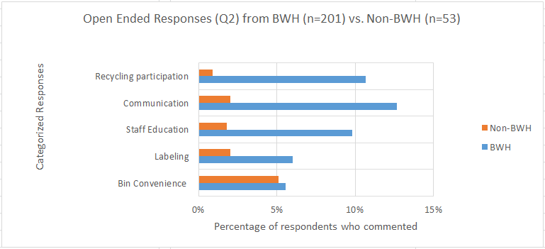
Survey Analysis
What could the Council do to encourage you to recycle more of your waste at work?

Slide 38
Comments
“…better information about the advantages and reasons for recycling”
“Better communication on the justification and benefits”
“…tell us how much we are recycling on a regular basis and keep encouraging us”
“Provide bins”
“…more encouragement – maybe educating”
Provide more ways to dispose of recyclable waste”
“It is pretty clear, people are lazy and don’t read the signs”
“Make as accessible and easy as possible”
“Have quarterly competitions on each floor and zone”
“Promote a campaign to raise awareness and get the message across”
“Competition between floors to produce the most recycling and least general waste”

Slide 39
Overview
Project Goal & Objectives
Interviews & Site Visits
Town Hall & Clock Tower
Survey Data & Analysis
Conclusions & Recommendations
Notes:
N

Slide 40
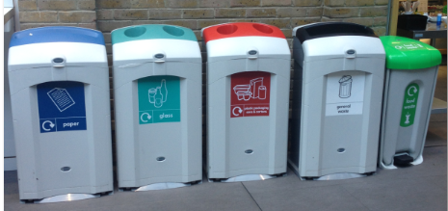
Major conclusions
Accessibility
Need bins to be able to increase recycling rates
Important to identify necessary waste bins
Clear and Effective Labeling
All staff must be made aware of what materials go where
Pictorial labeling helps solve confusion
Communication through entire process
Procurement → Labeling → Employees → Collection team
Provide updates on recycling rates and figures
Notes:
J

Slide 41
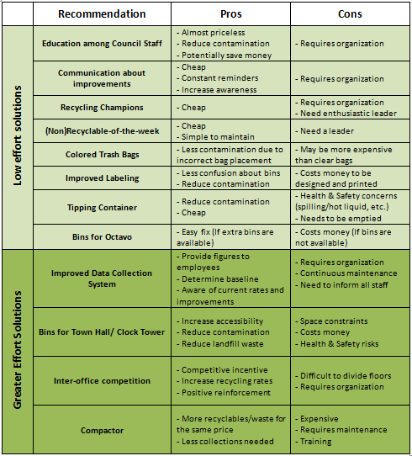
Recommendations
Notes:
Potentially add parts about participation
Talk about contract changes

Slide 42
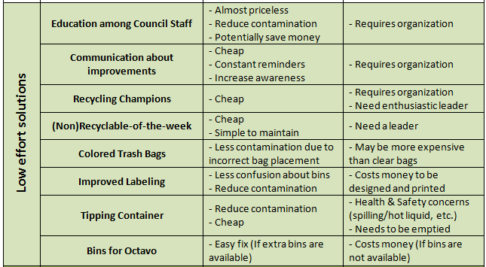
Recommendations
Notes:
Potentially add parts about participation
Talk about contract changes

Slide 43
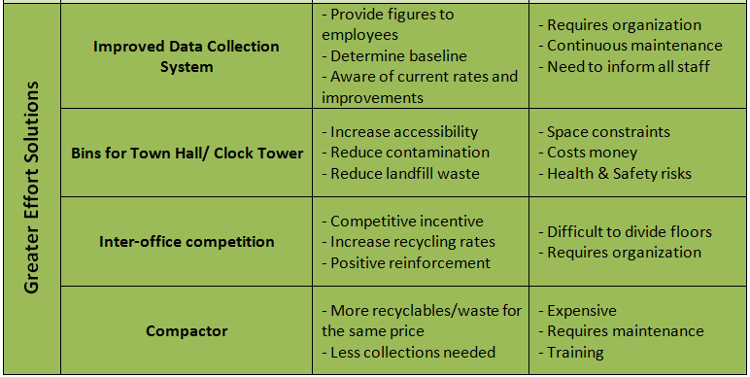
Recommendations
Notes:
Potentially add parts about participation
Talk about contract changes

Slide 44
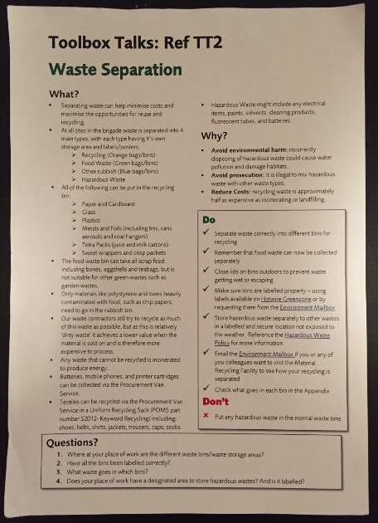
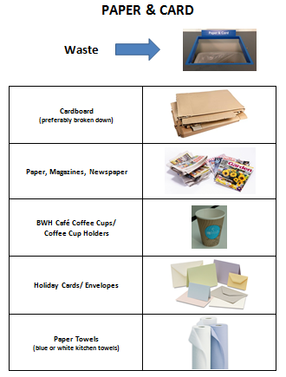
Recommendations Education
Notes:
A

Slide 45
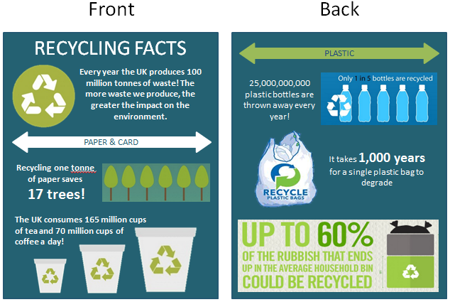
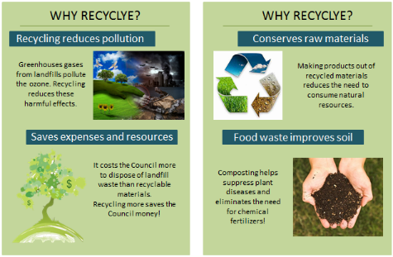
Recommendations Communication
Notes:
A/J
UK specific stats

Slide 46
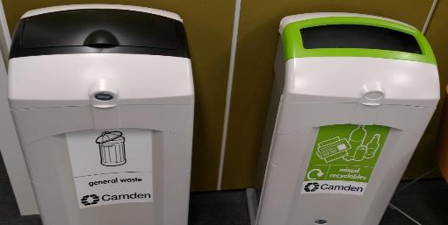
Recommendations Labeling
Notes:
D

Slide 47
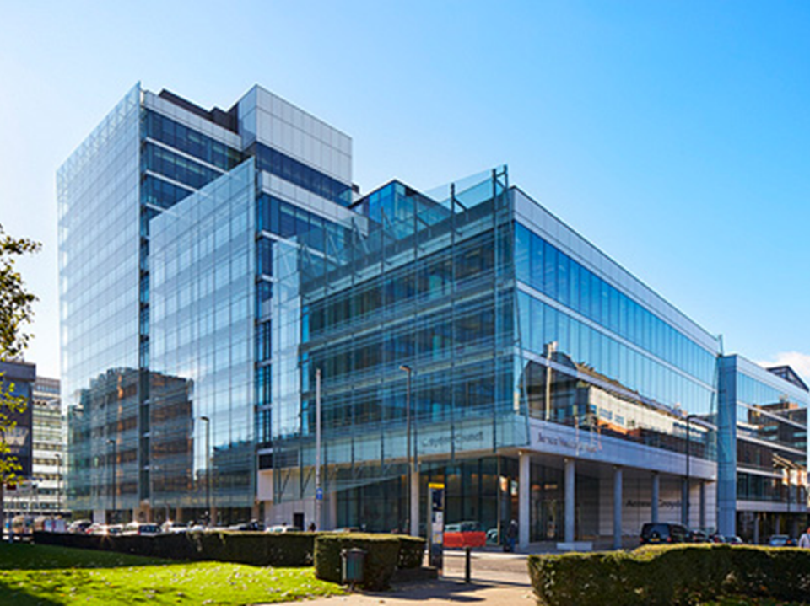
Questions?

