Slide 1
Evaluating Digital Learning Resources for International Students at the British Museum
28 April 2016
Emily Aldrich, Kyle Bessette, Preston Mueller, Meghana Prakash
Worcester Polytechnic Institute

Slide 2
Outline
Nature of the problem
Tool prototype and target audience
Goal overview and logistics
Methods and results
Recommendations

Slide 3
Problem and Goal Overview

Slide 4
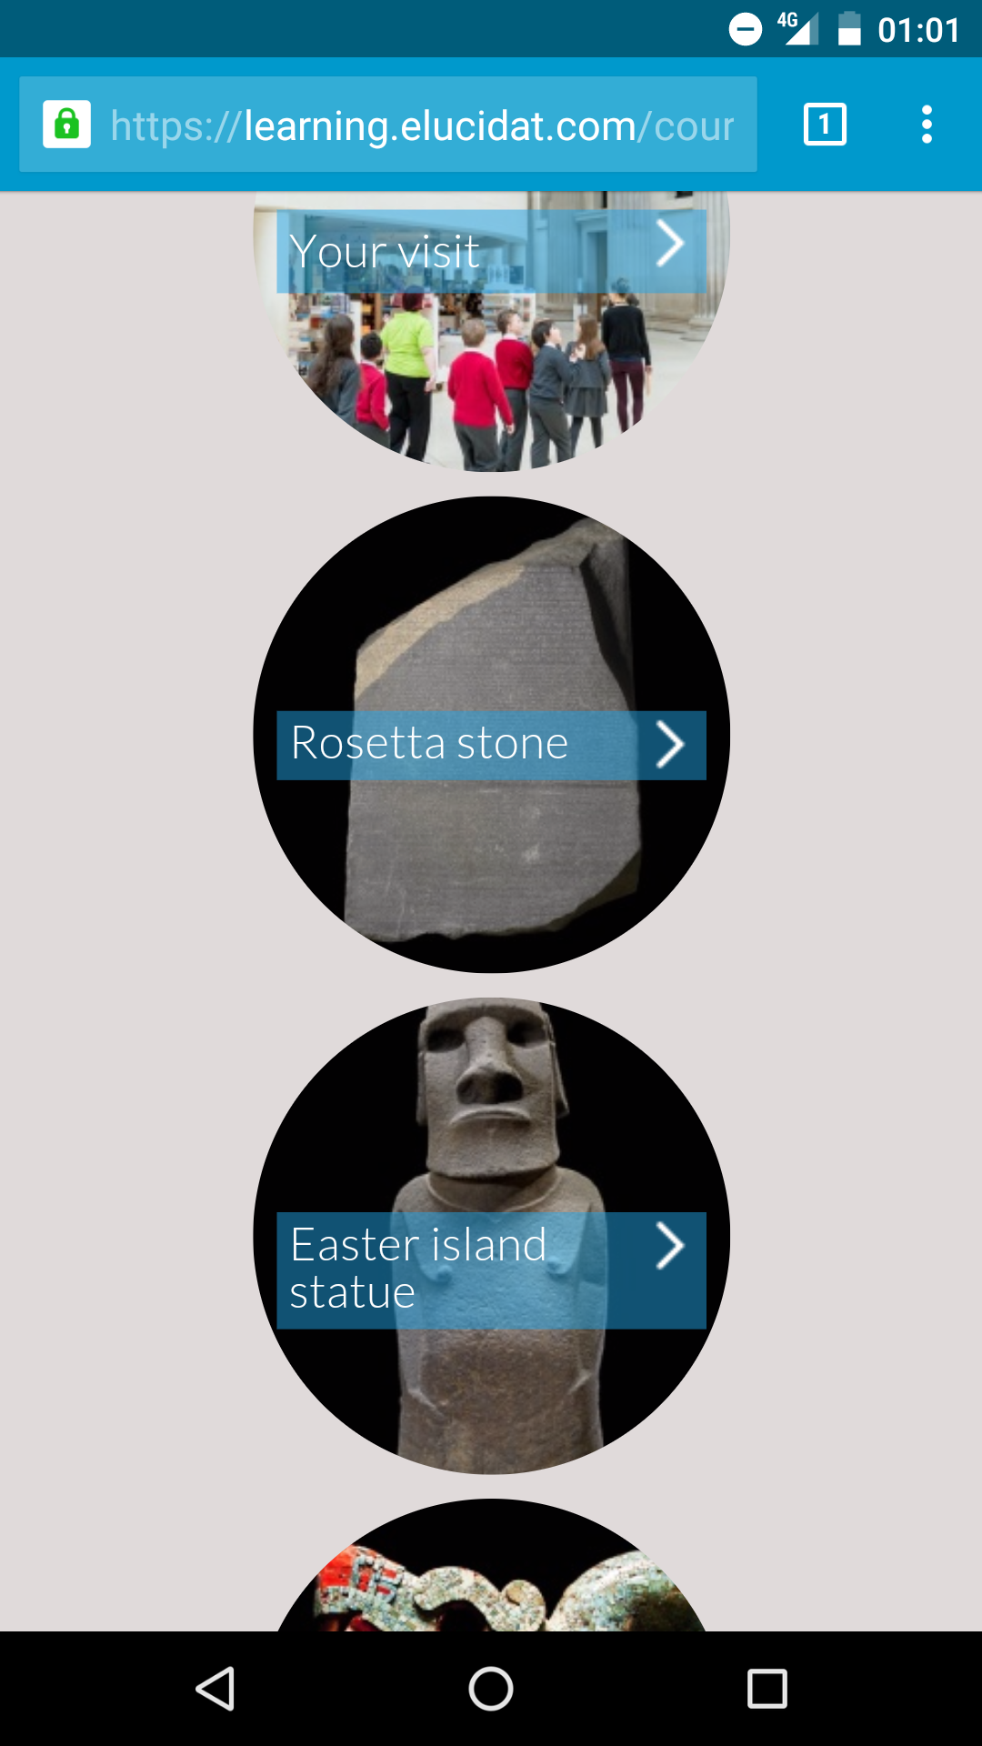
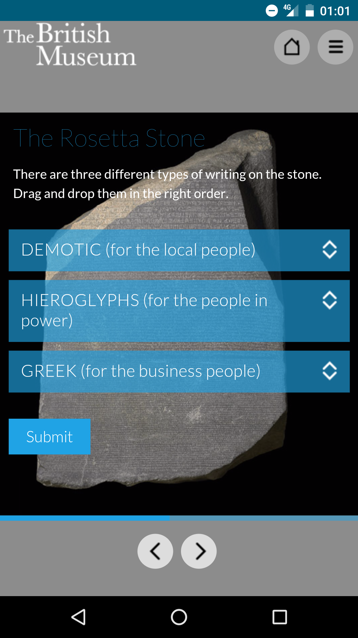
Tool Prototype

Slide 5
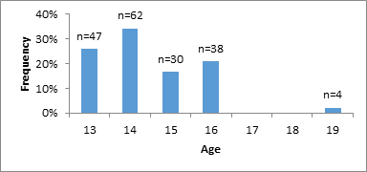
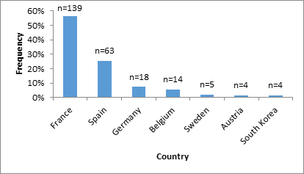
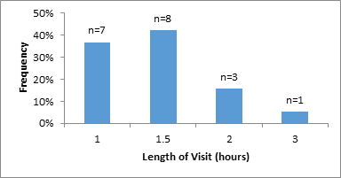
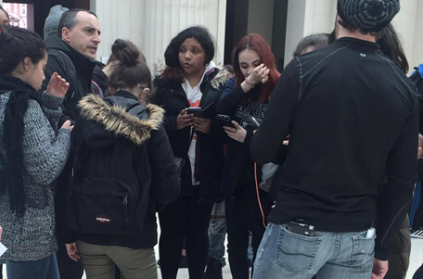
Target Audience

Slide 6
Goal
We evaluated the effectiveness of the British Museum's pilot digital learning tool designed to educate and engage international students of ages 13-18.

Slide 7
Methodology and Results

Slide 8
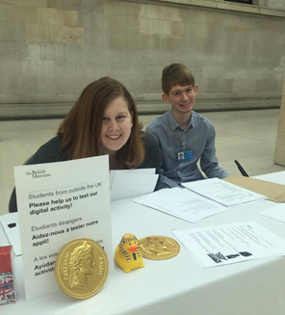
Logistics
Welcome station
Group types

Slide 9
Methods: Overview

Slide 10
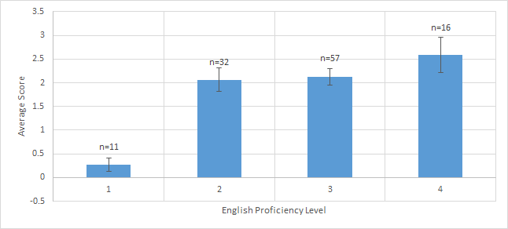
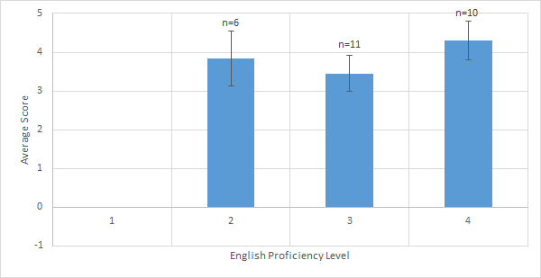
Objective 1: Determine the effect of English proficiency on pilot test subjects' information retention
Non-users
Pearson's correlation: 0.355
P-Value: 0.000092
Tool users
Pearson's correlation: 0.1447
P-Value: 0.4715

Slide 11
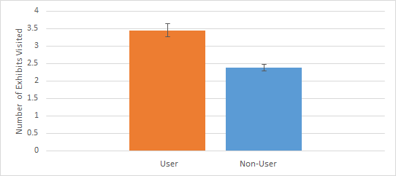
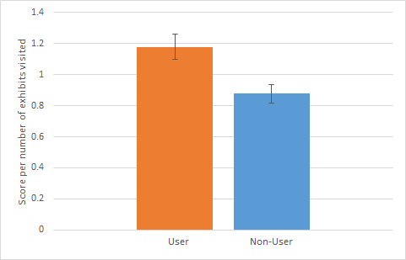
Objective 2: Determine the educational value of the digital learning tool
Survey score per exhibit
Users standard error=0.08
Non-users standard error=0.06
P-Value= 0.005106
Number of exhibits visited
Users standard error=0.19
Non-user standard error=0.09
P-Value=0.0000039

Slide 12
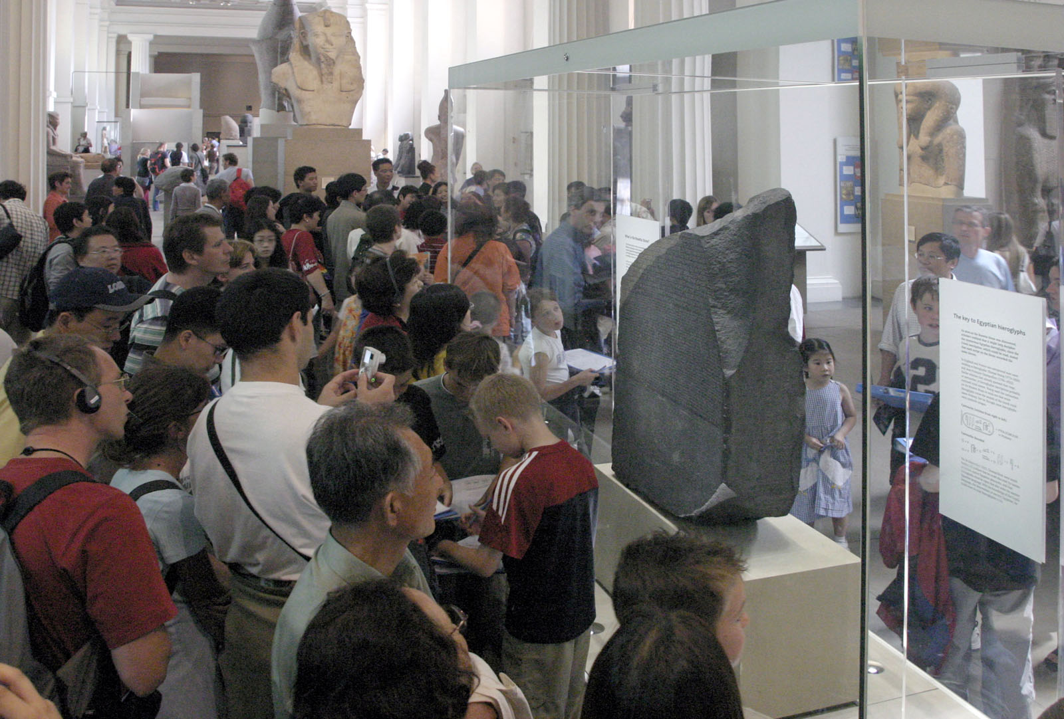
Objective 3: Assess the engagement and enjoyment of visitors using the digital learning tool
Survey data
Student interaction
British Museum Rosetta Stone [Online image]. (2013).Retrieved from rosettastone.co.uk/blog/wp-content/uploads/2013/07/rcrowd.jpg

Slide 13
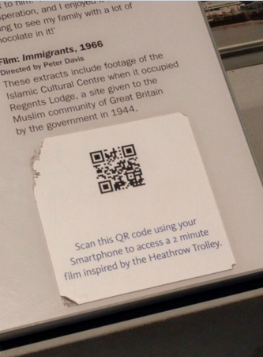
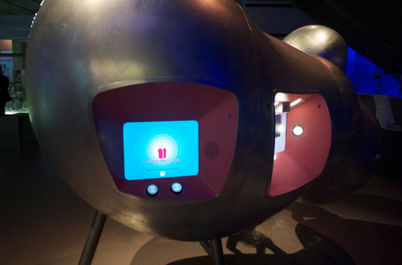
Objective 4: Evaluate the advantages and disadvantages of the use of similar resources in other museums
No handheld devices
Interactive fixed display screens
QR codes

Slide 14
Recommendations

Slide 15
Recommendations
Accessibility (Advertising, wireless internet)
Tool adjustments (More exhibits, tool restructuring, more questions per piece)
Additional foreign language assistance

Slide 16
Recommendations
Potential alternatives
Further research

Slide 17
Thank you!
This project was made possible thanks to the support of the following:
Professor Joel J. Brattin
Professor Lauren Mathews
Professor Sarah Crowne
Professor Dominic Golding
Jane Findlay
Emilia McKenzie
Adam Rozan
The British Museum

Slide 18
References
Aesch, A. (2012). Developing a new mobile workshop for the Samsung Digital Discovery Centre (Unpublished master's thesis). Universita della Svizzera Italiana. Retrieved from http://www.britishmuseum.org/pdf/developing-a-new-mobile-workshop-sddc_2012.pdf
Alexander, E. P., & Alexander, M. (2007). Museums in motion: An introduction to the history and functions of museums. Rowman Altamira.
British Museum. (2012). Teachers’ notes and trail Self - led visit: EFL [Brochure]. Author.
British Museum. (2013). Towards 2020: The British Museum’s Strategy. Retrieved from https://www.britishmuseum.org/pdf/Towards_2020-The_British_Museum_Strategy.pdf
British Museum. (2014, May). Building Development Framework Towards the Future. Retrieved from https://www.britishmuseum.org/pdf/british-museum-building-development-framework-May-2014.pdf
British Museum. (2015, July 13). British Museum annual visitor report 2014/15. Retrieved from http://www.britishmuseum.org/PDF/BM-report-and-accounts-2014-2015.pdf
Cain, M., Lindblom, S., & Walden, J. (2013). Initiate, create, activate: Practical solutions for making culturally diverse music education a reality. Australian Journal of Music Education, (2), 79-97.
Caulton, Tim (1998). Hands-On Exhibitions: Managing Interactive Museums and Science
Centres. New York, NY: Routledge
Chen, Y., Lai, T., Yasuda, T., & Yokoi, S. (2011). Information design for visualizing history
museum artifacts., 809.
Churches, A. (2011). Digital Learning. FeatureArticle, 39(2), 34. Retrieved February 4, 2016,
from http://go.galegroup.com.ezproxy.wpi.edu/ps/i.doid=GALE%7CA276516900&v=2.1&u=mlin_c_worpoly&it=r&p=AONE&sw=w&asid=4bc0411913aa486e5c155934d3003e01
Doll, S. (2012). Digital Technologies and Visiting School Groups: A Case Study at the British Museum (Unpublished master's thesis). Universita della Svizzera Italiana. Retrieved from http://www.britishmuseum.org/pdf/Digital%20technologies%20and%20visitng%20school%20groups_SusannaDoll.pdf
Drago, A., Ryall, A., & Stearn, M. (2014). Challenging history in the museum. Farnham, GB: Ashgate.

Slide 19
Falk, J. H., & Dierking, L. D. (2000). Learning from Museums: Visitor Experiences and the
Making of Meaning. Walnut Creek, CA: AltaMira Press.
Hein, G. E. (1998). Learning in the Museum. London, GBR: Routledge.
Jeffery-Clay, K. R.. (1998). Constructivism in Museums: How Museums Create Meaningful
Learning Environments. The Journal of Museum Education, 23(1), 3–7.
Jovana, M., & Olivera, G. (2010). Intercultural dialogue in the museum context. US-China Education Review, 7(7), 30-42.
L, J., Becker, A., Estrada, V., & Freeman, A. (2015). The NMC Horizon Report: 2015 Museum
Edition. New Media Consortium. Retrieved February 15, 2016, from http://files.eric.ed.gov/fulltext/ED559371.pdf
Lopez, L., Daneau, D., Rosoff, S. M., & Congdon, K. G.. (2008). The Individual Video Experience(iVE): The iPod as an Educational Tool in the Museum. Art Education, 61(1), 13–18. http://doi.org/10.2307/27696258
Mastascusa, E. J., Snyder, W. J., & Hoyt, B. S. (2011). Effective Instruction for Stem Disciplines: From Learning Theory to College Teaching. Hoboken, NJ, USA: Jossey-Bass.
Mikalef, K., Giannakos, M., Corianopoulous, K., & Jaccheri, L. (2012). Do Not Touch the
Paintings!: The Benefits of Interactivity on Learning and Future Visits in a Museum.
Entertainment Computing - ICEC 2012: Lecture Notes in Computer Science, 7522, 553- 561.
Museum of London (2013) London's History (1.003) [Android] Received from
https://play.google.com/store/apps/details?id=com.anspear.language.historyiap
Nakamura, K., Erickson, V., & Ford, V. (2002). Creating cross-cultural exhibits in schools. New York, NY.
Pew Research Center. (2015). Chapter One: A Portrait of Smartphone Ownership. Retrieved February 04, 2016, from http://www.pewinternet.org/2015/04/01/chapter-one-a-portrait-of-smartphone-ownership/
Pew Research Center. (2015). 7% of Americans Rely Heavily on a Smartphone for Online Access. Retrieved February 04, 2016, from http://www.pewinternet.org/2015/04/01/u-s-smartphone-use-in-2015/pi_2015-04-01_smartphones_01/
Simon, N. (2010). The participatory museum. Santa Cruz, CA: Museum 2.0.
Vicente, E., Camarero, C., & Garrido, M. J. (2012). Insights into Innovation in European Museums: The impact of cultural policy and museum characteristics. Public Management Review, 14(5), 649-679.

