Slide 1
Regeneration of Beckenham Place Park
27 April 2016
Alexandra Czamara, Andrew Dunne, Carl Pierce, Alexis Sturgis

Slide 2
Social Value
Park budgets are frequently facing budgetary cuts in the United Kingdom
Poor quality
Minimal amenities
Investment in the park will add social value by:
Engaging community members in new amenities
Increasing volunteer efforts

Slide 3
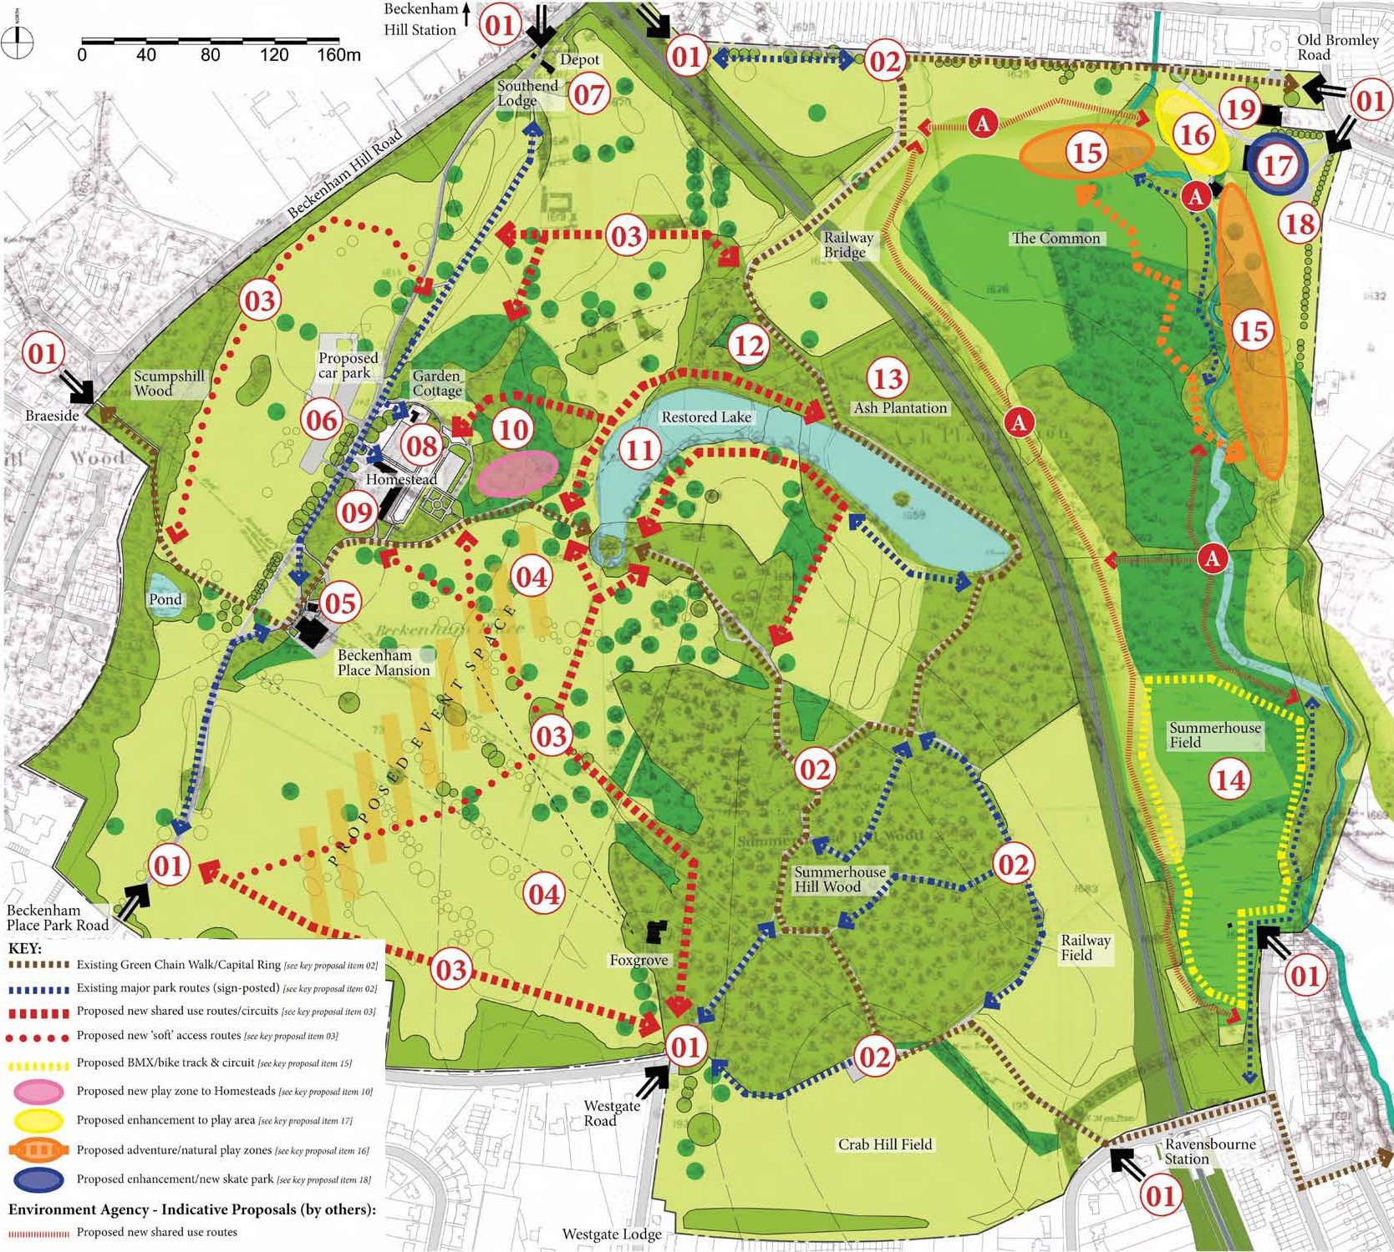
Beckenham Place Park

Slide 4
Project Goal
Our goal was to propose a strategy for the Lewisham Council to evaluate how the public values Beckenham Place Park, with particular consideration to the issues of social value and volunteerism.

Slide 5
Content
Background
Objectives
Methodology
Results
Recommendations

Slide 6
I. Background
We can measure social value quantitatively and qualitatively
Social audit and accounting
Social return on investment (SROI)
Harnessing volunteer efforts
Involvement with the community
Sense of ownership

Slide 7
II. Objectives
Established and implemented a method for assessing Beckenham Place Park’s evolving social value.
➔Surveys ➔Observational Study
Identified beneficial practices for harnessing volunteerism in parks.
➔ Interviews
Justified short-term and continual investment in the park by highlighting the park’s value for the community.
➔ Situational Analysis

Slide 8
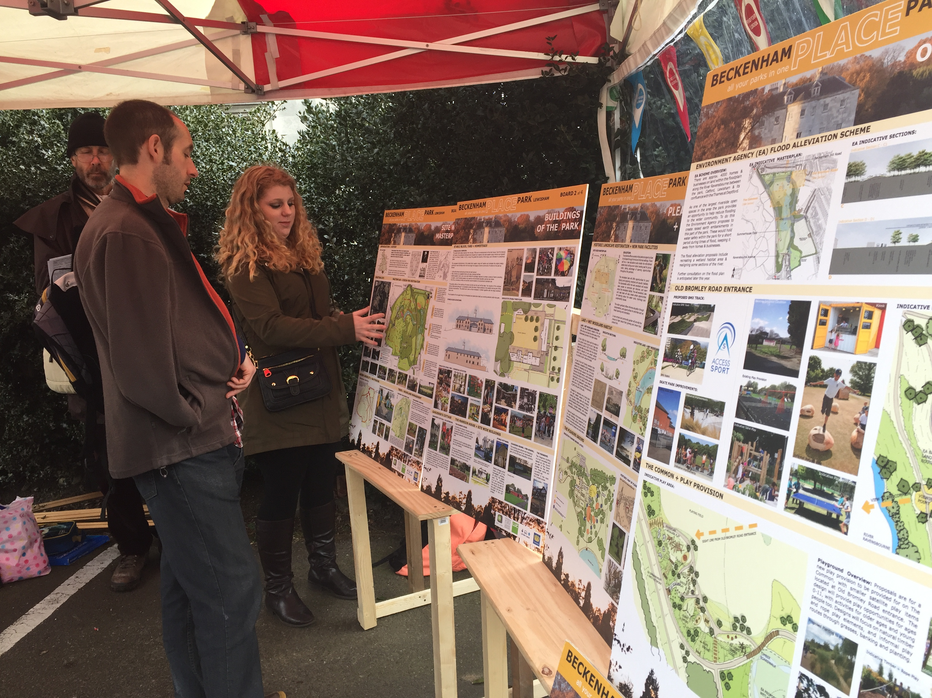
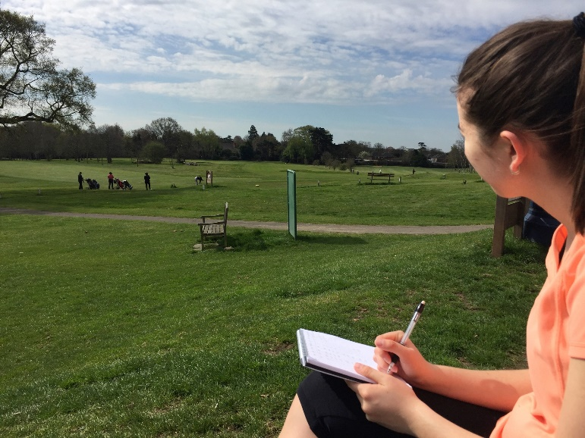
III. Methodology
Surveys
261 Survey responses
12 Consultation events
Observational study
Observe park activity
Record visitor demographics
Interviews
Management
Field volunteers
Situational Analysis
Analyse Strengths, Weaknesses, Opportunities, Threats
Relate Beckenham Place Park to similar park regenerations

Slide 9
IV. Condition of Beckenham Place Park
246 respondents

Slide 10
IV. Park Visitation of Beckenham Place Park
254 respondents

Slide 11
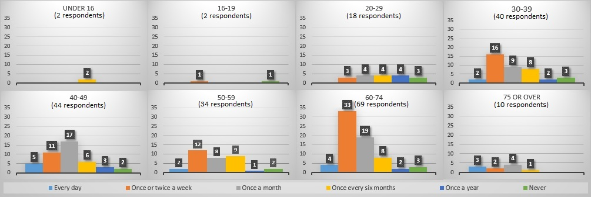
IV. Frequency of Visits to the Park
Based on Age of Visitor

Slide 12
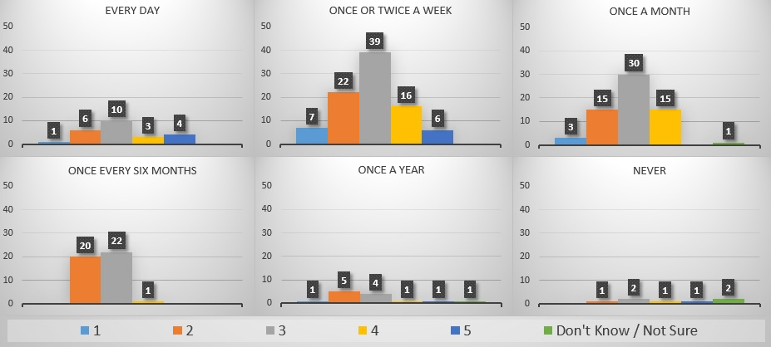
IV. Frequency of Visits to the Park
Based on the Perceived Quality of the Park

Slide 14
IV. Interest in the park post-regeneration
243 respondents

Slide 16
IV. Observation Results

Slide 17
IV. Observation Results
507 observed visitors on the weekend
320 observed visitors during the week

Slide 18
IV. Observation Results

Slide 19
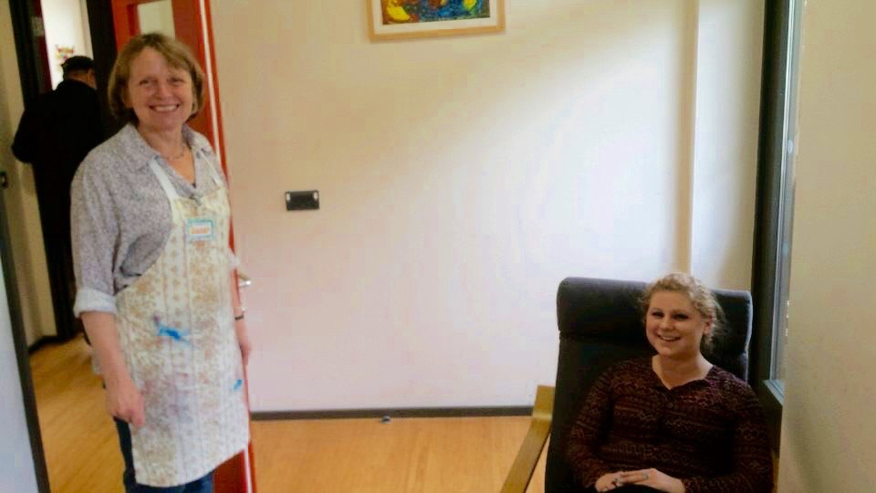
IV. Harnessing Volunteerism
Three keywords found in interviews with Sydenham Garden volunteers:
Management
Ownership
Organization

Slide 20
IV. Justifying Investment
 | POSITIVE | NEGATIVE
INTERNAL | Strengths Large amount of capital (~8.8 million pounds) Strategic relationships (Heritage Lottery Fund and stakeholders) Name recognition Historic aspects and heritage Large amount of green space (267 acres) Ancient woodland Abundant wildlife | Weaknesses Poor to average condition Golf course affiliation Limited resources (annual budget and management) Locals opposed to regeneration Muddy trails (limited during wet weather) Limited access Poor signage Railroad divide (one bridge)
EXTERNAL | Opportunities Grant funding More and improved amenities Community interest and involvement Regenerated wetlands Improved trails New café and toilets Improved skate park and play areas Increased volunteer efforts | Threats Loss of golfing community Rumors among the community (negative promotion) Potential loss of mansion bid Safety risks (lake and lack of lighting) Divide in community between boroughs

Slide 21
V. Recommendations
Enhancing design stage III
Highlight access and signage in the park
Recruit local organizations for small scale events
Allot an area for a driving range (Foxgrove)
Create play areas at both locations (Old Bromley Road and Homesteads)
Renovate paths to accommodate walkers and cyclers

Slide 22
V. Recommendations
Harnessing volunteer efforts
Hire a qualified coordinator to manage volunteer work.
Create a mission statement.
Determine a method to acknowledge volunteer work continuously.
Develop a schedule for available volunteer work

Slide 23
V. Recommendations
Justifying funding for the park
Advertise the improved park post-regeneration
Communicate with stakeholders the social and economic value of the regeneration.

Slide 24
Acknowledgements
We would like to thank:
Alison Taylor
Laura Harper
Professor Joel J. Brattin
Professor Lauren Mathews
Professor Dominic Golding
Professor Sarah Crowne
The Lewisham Council

Slide 26
Events in Beckenham Place Park

Slide 27
Play Provisions

Slide 28
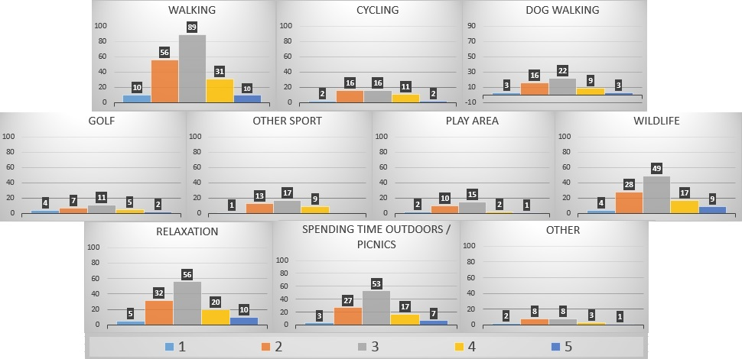
Reason for visitation based on perceived condition

Slide 31
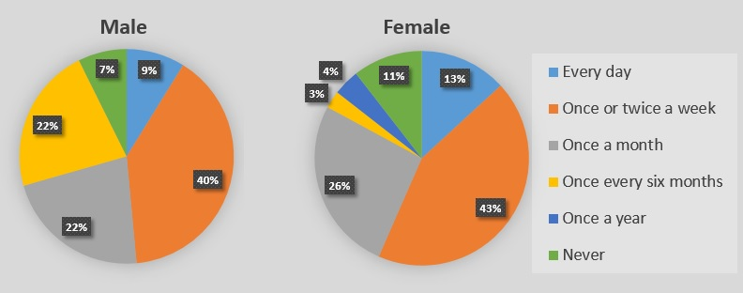
Park Visitation based on Gender

Slide 32
Desired Events based on Age

Slide 33
Observation of Park Demographics

Slide 34
Observation of Park Demographics

Slide 35
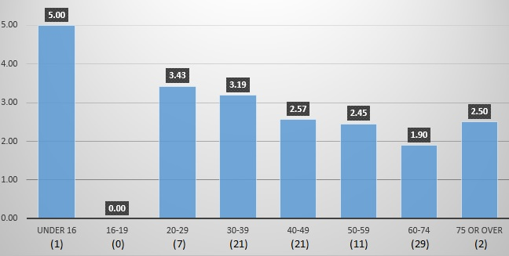
Likelihood to Volunteer Based on Age

Slide 36
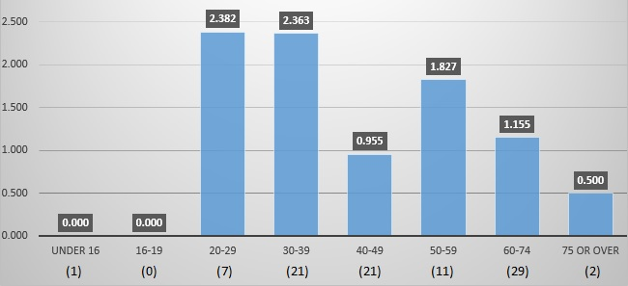
Standard Deviation of Volunteer Options based on Age

Slide 37
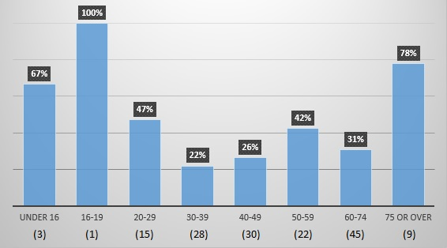
Not Interested in Volunteering based on Age

