Slide 1
Demonstrating the Value of Commonside’s Services
Maggie Goodwin, Humberto Leon, Noel Qiao, Emily Thayer
Notes:
Hello! Thank you so much for attending our final presentation.
We will be presenting recommendations for demonstrating the value for Commonside’s organization which will hopefully aid them in getting more funding.

Slide 2
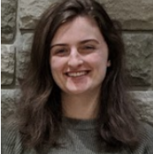
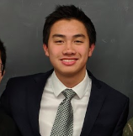
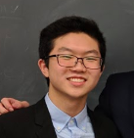
Our Team
Maggie Goodwin
Humberto Leon
Noel Qiao
Emily Thayer
Computer Science
Electrical and Computer Engineering
Electrical and Computer Engineering
Mathematical Sciences
Notes:
We’re a group of students from Worcester Polytechnic Institute in Massachusetts. Introductions.

Slide 3
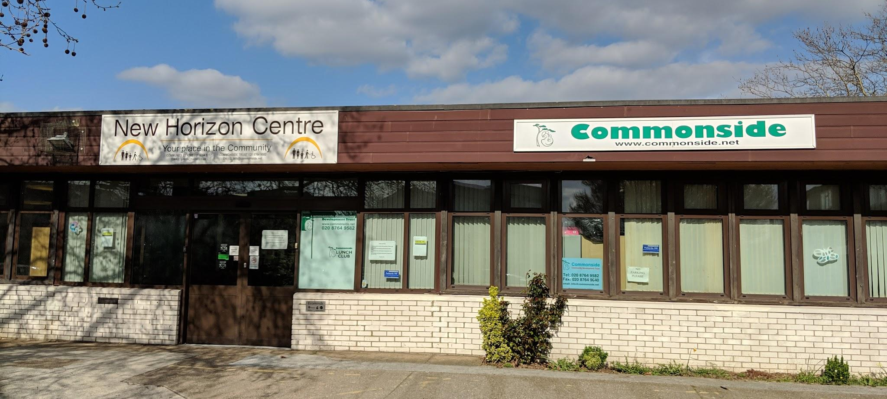
Notes:
As you know, this is Commonside at the New Horizon Community Centre, servicing the residents of Merton. Commonside provides events for the community, as well as services through the Step Forward and Lunch Club programs. Ultimately, our project goal was to provide recommendations that will lead Commonside towards more funding, whether that be with or without accreditation.

Slide 4
Commonside
Commonside
Accreditation
Funding
Funding
Notes:
Noel At the beginning of our project, our team believed that the relation between funding and accreditation was direct. However, we found that accreditation and funding have to be pursued separately. We will focus first on our findings regarding accreditation.

Slide 5
“I would definitely say that [Advice Quality Standard (AQS) accreditation] has increased our quality, the quality of our work... it’s improved our model...”
Lyla Adwan-Kamara,
CEO of Merton Centre for
Independent Living
Notes:
Maggie
So one of the first things we did to explore advice quality standard (gold standard accreditation for advice services!) was talk to Lyla, CEO of Merton CIL (advice services by and for deaf and disabled people)
We talked to Lyla about her experience with AQS and how the process was for a small organization like MCIL
Through this interview, we found that while AQS is an involved and challenging process and did not directly help them attain funding, it was ultimately a useful guide for developing a well-structured, safe and ethical advice service
To expand our knowledge about the advice quality standard, the gold standard in accreditation for advice services and gain some context for our project, We spoke to Lyla, CEO of Merton CIL an advice org by and for the deaf and disabled, about her experience with AQS, to gain insight into what the process is like for smaller organizations and what challenges come with it
Through talking with Lyla, we found that while AQS is an involved and challenging process and did not directly help them attain funding, it was ultimately a useful guide for developing a well-structured, safe and ethical advice service

Slide 6
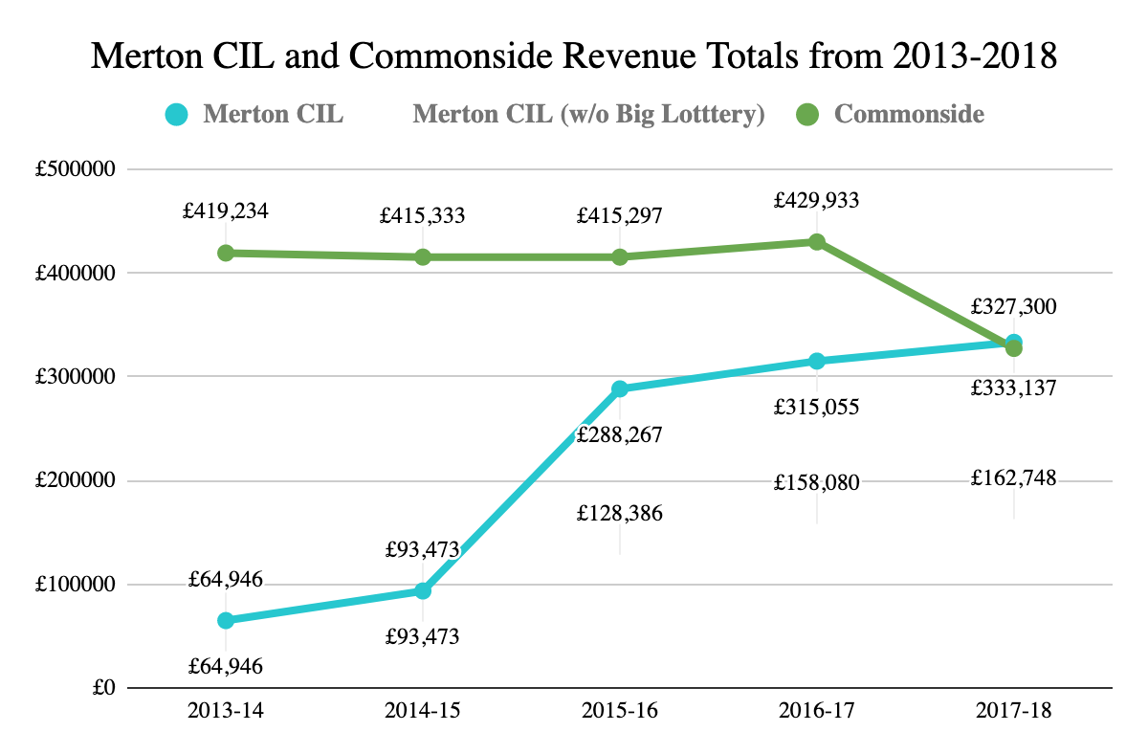
An accreditation is not directly linked to more funding
£159,881 difference
£34,362 difference
Notes:
Humberto
We also received their (Merton CIL)’s financial history before and after attaining AQS
Here, you can see a comparison of Commonside’s revenue in green and MertonCILs revenue in light blue. However
in 2015, Merton CIL began the application for accreditation
in Jan 2016, Merton CIL received the accreditation, 16/17 financial year is when we would have first seen a change in funding
HOWEVER, they also re-received funding from Big Lottery in 2015, causing the spike in donation amounts
not correlated
We can’t confidently say correlation between accreditation and funding
Because it funds all sorts of areas, they don’t have a strict accreditation requirement. It is not tied to any accreditation.
If you take big loterru away which is not tied to accreditation, you can see that the jump is not that big meaning that there is no correlation between accreditation and getting more money.

Slide 7
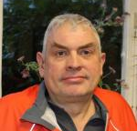
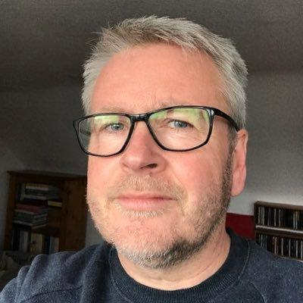
Does accreditation matter to funders?
Jason Charles
Ray
Hautot
John Dimmer
Community Development Officer for MOAT Homes
Social Prescribing Coordinator-Figges Marsh, Cricket Green, Tamworth House, Wideway Medical Practices
Head of Policy, Strategy and Partnerships at London Borough of Merton
Notes:
Humberto
From finding that accreditation is not directly linked to more funding we decided to interview funders and proxys.

Slide 8
What Do Funders Want to See?
Volunteer hours
Number of clients helped
Number of successful PIP appeals
Amount of PIP granted to clients
...Demonstrated Outcomes.
Notes:
Noel
findings regarding 94 points and our recommendations
Of course funders want safe work, but being able to prove impact through demonstrated outcomes might be equally important or more important than having an accreditation.

Slide 9
Commonside
Commonside
Accreditation
Accreditation
Funding
Notes:
Emily
If an organization can effectively demonstrate their outcomes, it will lead to more funding. This is the additional focus of our project.

Slide 10
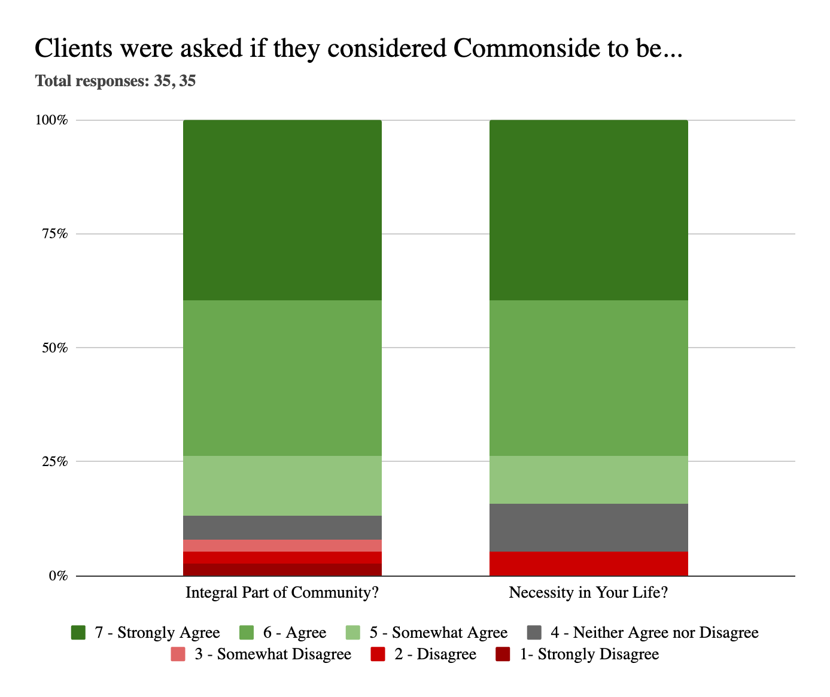
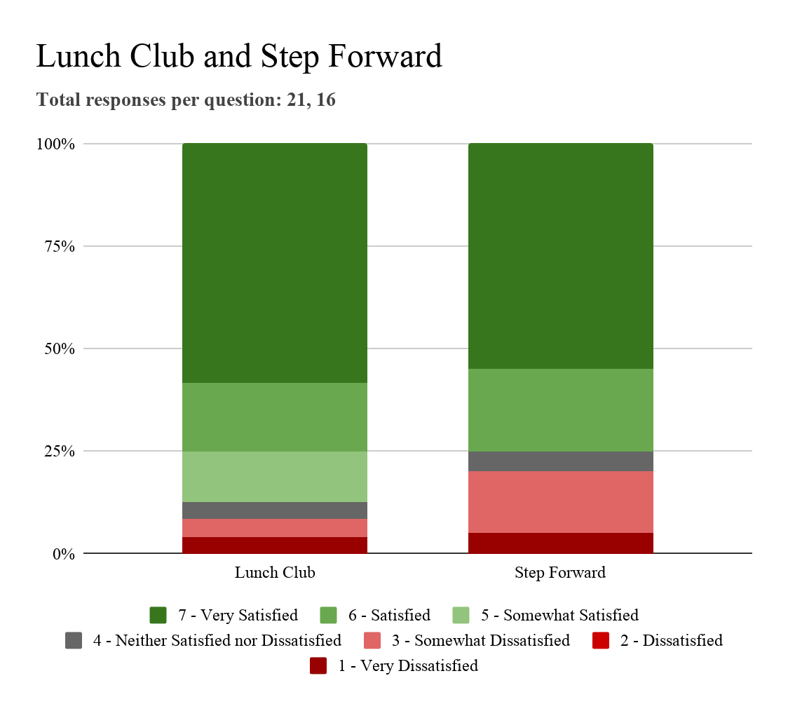
Commonside is an important part of the community
Notes:
Emily
Client feedback is a prominent aspect of the AQS requirements. Simultaneously, it is a quick and easy way for Commonside to evidence very basic outcomes of their events and services and present them to funders or the general community.
Survey is part AQS requirement to have feedback opportunities

Slide 11
Commonside has positively impacted people’s lives
YOSIEF
“ People of our age need to come out when you’ve been living alone to meet and share things with each other.”
PETER
“There’s nowhere else to go that matches the benefits of Commonside.”
BILL
“You won’t find better people than these.”
Notes:
Maggie
To supplement our surveys as well as bring in that “human” side of the organization, we interviewed 3 clients of commonside to find out how it had made a difference in their lives
We interviewed:
Yosief, a man who lost his memory in an accident who commonside helped to tell his story, and socialize with the community
Bill, a 95 year old man who stays sharp and social by attending lunch club almost every day
And peter, one of Commonside’s greatest success stories, who was able to receive PIP with step forward’s help and now gives back to the community by volunteering at Commonside whenever they need him
These case studies are included in one of our deliverables to commonside in a presentation to demonstrate outcomes to funders and can be built upon even further

Slide 12
Low-Hanging Fruit
VS
Bang for the Buck
Notes:
Maggie
Even tho AQS is not directly linked to funding, We still want to recommend AQS to commonside for its structural benefits, so we’ve divided them up into low hanging fruit and bang for the buck (low impact, easy to implement vs high impact, difficult to implement)

Slide 13
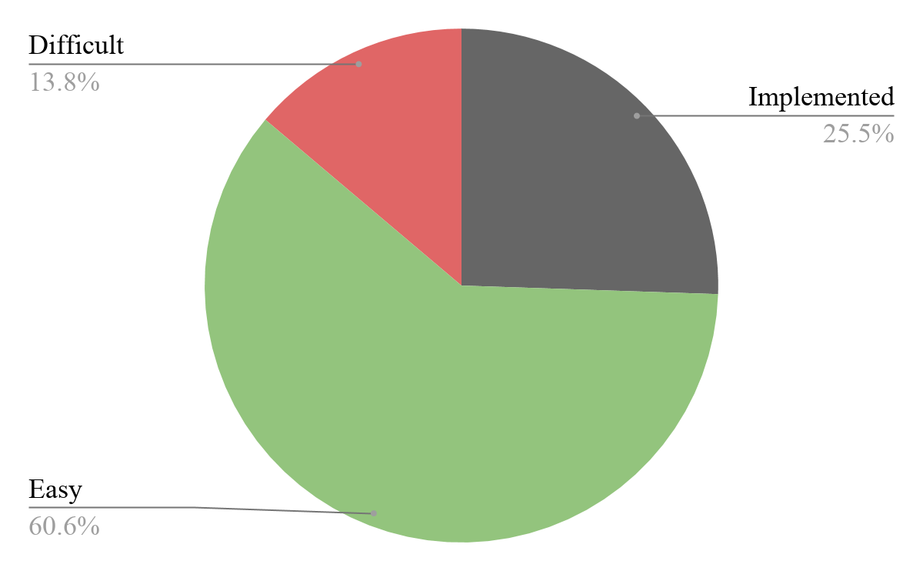
Commonside could easily meet 60% of AQS requirements
Notes:
Humberto
Quick explanation of AQS
requirements
within 3 months - 60%
As you can see about 60% of the requirements are easily implementable which we deemed as able to be done within three months each of the requirements independently, which matches one quarterly review.

Slide 14
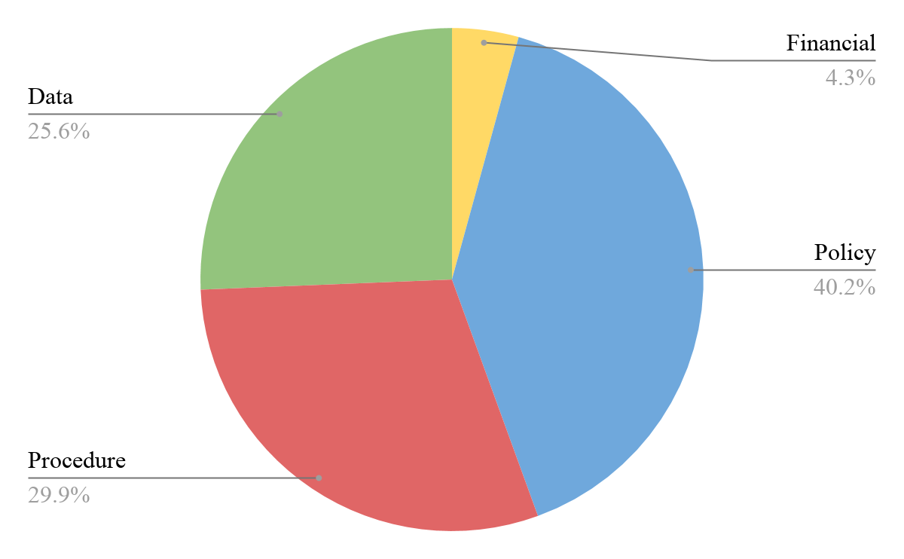
70% of AQS requirements are policies or procedures
Notes:
Humberto
Of the 94 requirements, 25% of them require some kind of data management system. Commonside currently does not have a good database and so that helped form our team’s recommendations for their future.
Most of them fall under policy and procedure and fall in the easy to implement within three months. However, a big part still falls under and is a big category of concern.

Slide 15
2. Addition of a Conflict of Interest policy.
3. Policy regarding the type of work they do for the public and funders.
1. Appoint individual to oversee the quality processes.
4. Written procedure matching employee skills to roles.
Notes:
Humberto
Here are some of the policies and procedures that we recommend commonside have if they want to put resources both into boths acquiring AQS and demonstrating outcomes to get more funding.
we linked current policies they have to AQS (low hanging fruit!) to give them head start on where they are in the process and will give that to them as one of our deliverables
examples of low hanging fruit we encountered shown on slide
simply someone qualified needs to be chosen to be responsible for this
since this may be common sense or less formal already, just need to formalize process on “paper”
same as above
Easier policies and proceduress that might be spoken already within the organization but might still need to be written down as they progress towards AQS.
again, many stuff is a verbal understanding/institutional knowledge, could be written down and solidified

Slide 16
25% of AQS requirements are data-related
Notes:
Humberto
Of the 94 requirements, 25% of them require some kind of data management system. Commonside currently does not have a good database and so that helped form our team’s recommendations for their future.
Most of them fall under policy and procedure and fall in the easy to implement within three months. However, a big part still falls under and is a big category of concern.

Slide 17
Accessible
DATABASE
Secure
Backed Up
Searchable
Exportable
Notes:
Noel
-Database is a versatile all encompassing recording keeping system
-Current system is a record keeping system
-Database is 2 for 1 in that it helps with AQS requirments and can help with demonstrated outcomes
Mention Image Integral!!!

Slide 18
Thank You!
Any questions or comments?
Notes:
Emily
We’ve had such a great time getting to know everyone here at Commonside. We hope we have presented some of the best possible recommendations and that we have contributed to the longevity of the organization. Thank you so much for coming, we’d like to open the floor for questions or comments.

Slide 19
Acknowledgements
Special thanks to the following who assisted with our project:
Naomi Martin, Director of Commonside Community Development Trust
Bill, Yosief, and Peter, who allowed us to interview them for our project
The rest of the Commonside staff, volunteers, and clients for welcoming us and helping us achieve our goal
Jason Charles, Ray Hautot, John Dimmer, and Lyla Adwan-Kamara for taking the time to talk with us
Notes:
Emily

