Slide 1
HYBRID TECHNOLOGY AND PROGRAMMING AT THE FREUD MUSEUM
Dhruv Patel, Tessa Phillips, Jack Pszeniczny, Istan Slamet
24 April 2024

Slide 2
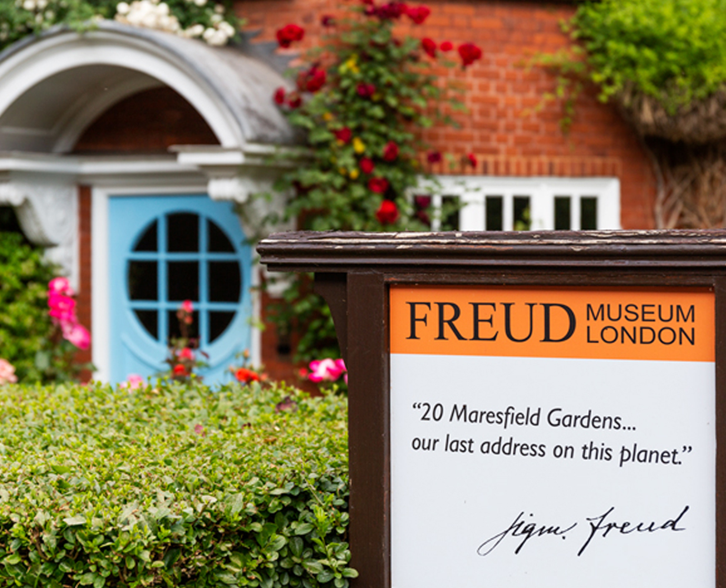
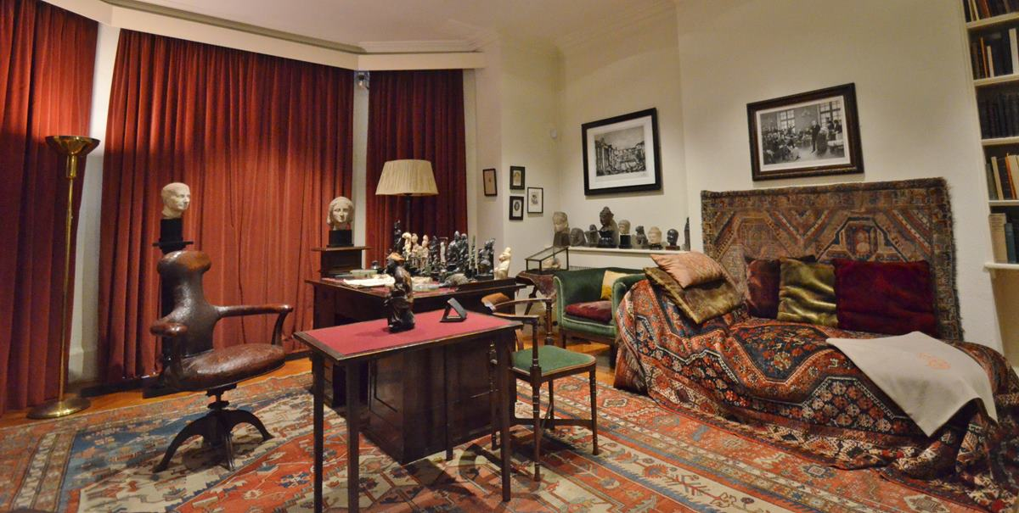
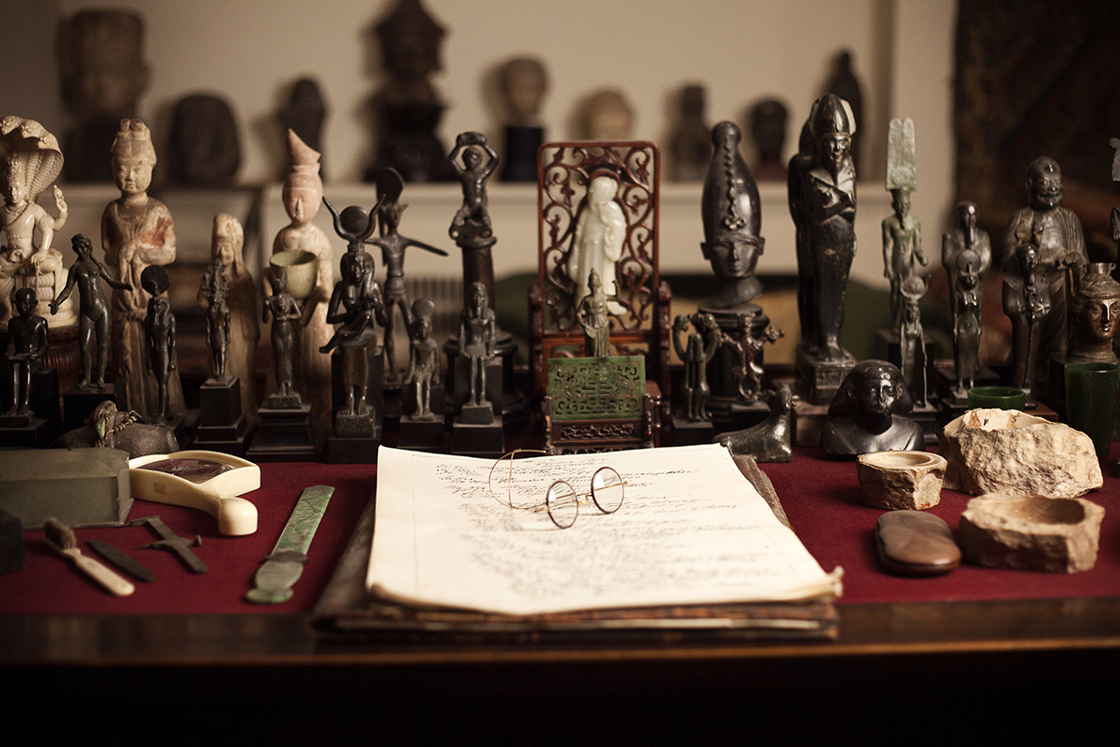
The Freud Museum London
2
Notes:
Istan
Heritage site museum that exists in Sigmund Freud’s final home in London. He lived
Preserves and promotes legacies of Sigmund and Anna Freud for the learning and enjoyment of all
Preserves house, artifacts
Also holds events, educational programs, lectures
Many of which are being held online or in hybrid settings
The museum is taking steps adapting to the effects of the pandemic
Beginning to take measures to catch up

Slide 3
Going Hybrid at the Freud Museum
Upcoming Summer Renovations
Programming in a Hybrid Model
Exploring
Hybrid Technologies
3
Notes:
Jack
The reason for the project: the Freud Museum has a planned technological renovation of the Video and Exhibition rooms.
The museum has budgeted about 30,000 pounds to complete the renovations
During our project term we investigated the types of programming that work best in a hybrid model (conferences, courses, events)
To assist the museum in reaching their goal of going into a hybrid model we explored potential technologies to install in the Video and Exhibition rooms
We also found a UK based supplier, installer, and maintenance service

Slide 4
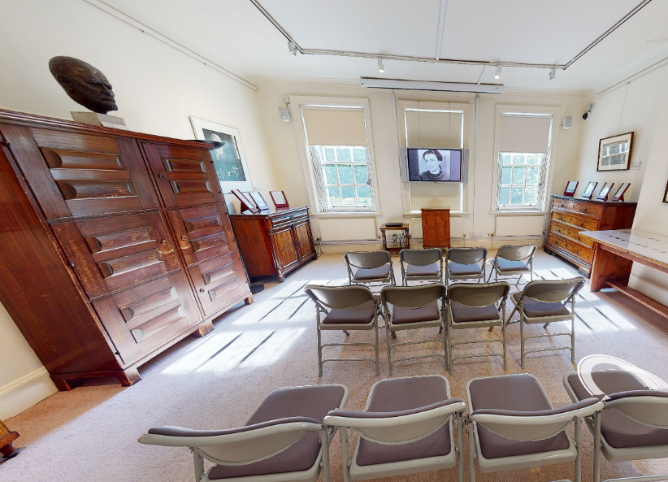
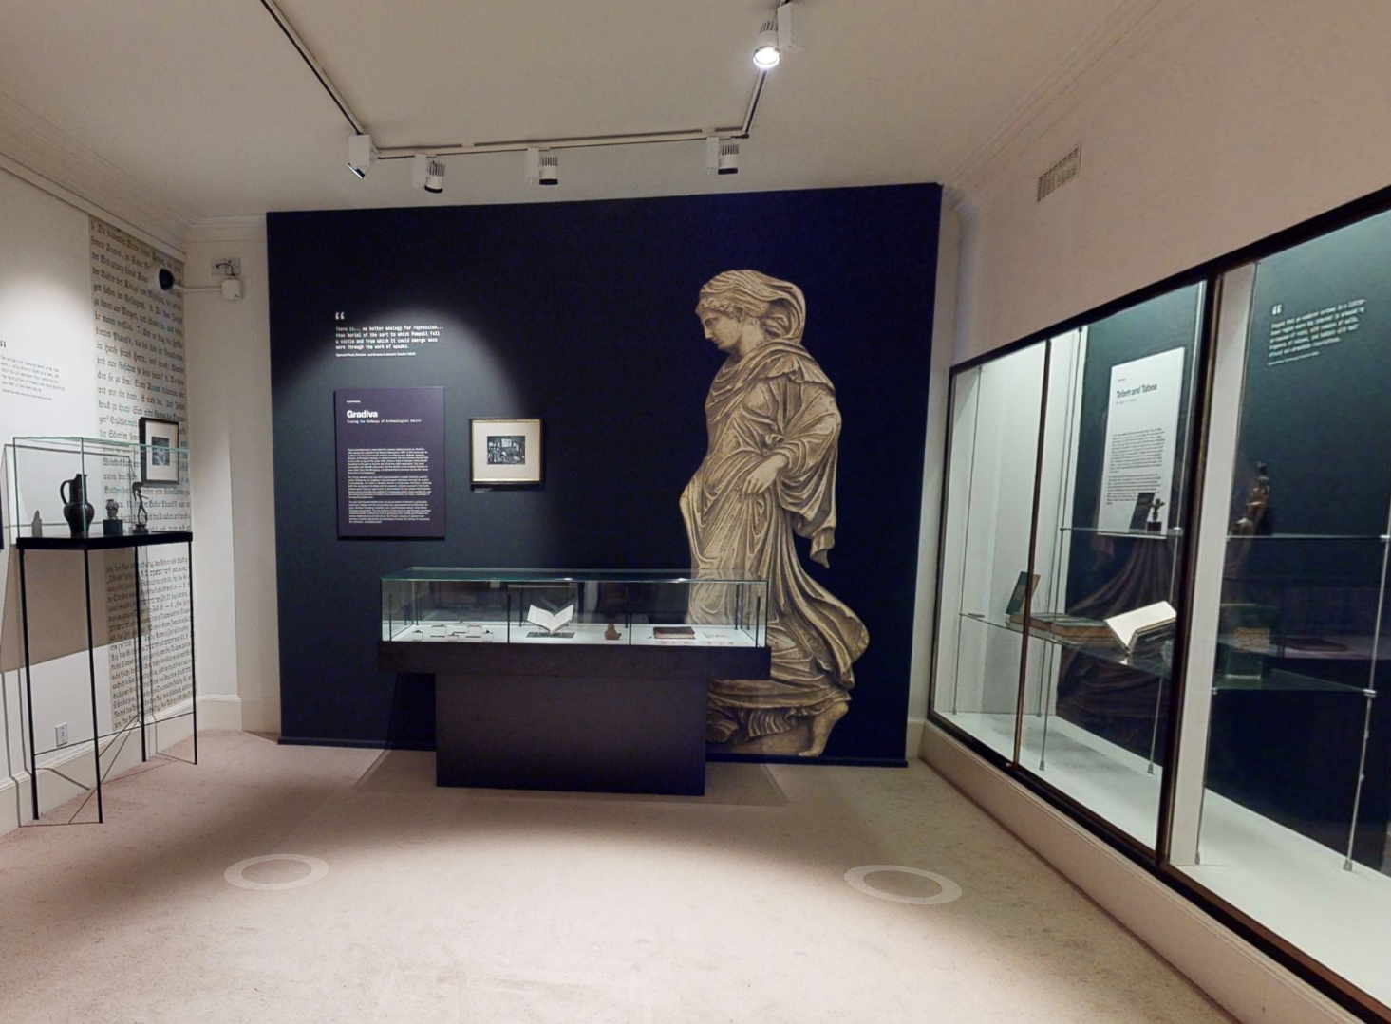
Video & Exhibition Rooms
4
Notes:
Istan

Slide 5
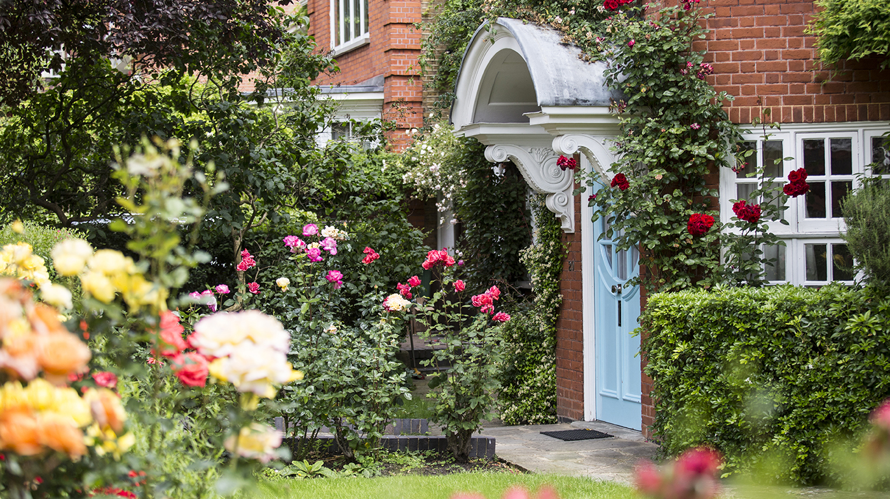
Project Goal
Help the Freud Museum London (FML) staff develop plans to improve existing museum space for hybrid (i.e., online and in-person) events, exhibitions and programming.
5
Notes:
Jack

Slide 6
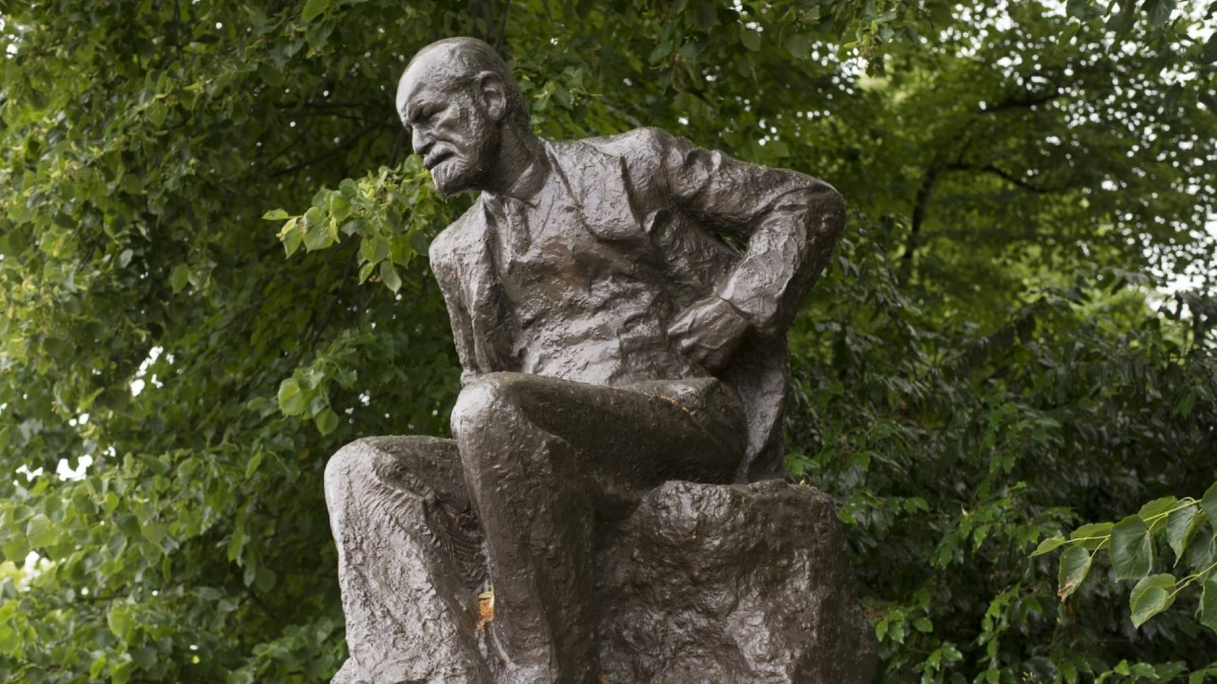
Methodology
Assess Current and Best Practices in London
Evaluate the Current Use, Needs, and Limitations of the FML Video & Exhibition Rooms
OBJECTIVE 1
OBJECTIVE 2
Evaluate Stakeholder Perspectives on In-House and Online Events
Recommend Appropriate Conferencing Equipment and Configurations
OBJECTIVE 3
OBJECTIVE 4
6
Notes:
Jack
Introduce each objective
Objective 1: interview staff of V&A and British Library
Objective 2: Interview staff of FML
Objective 3: Interview past speakers, survey members and past event attendees, hold focus group with select members
Objective 4: research

Slide 7
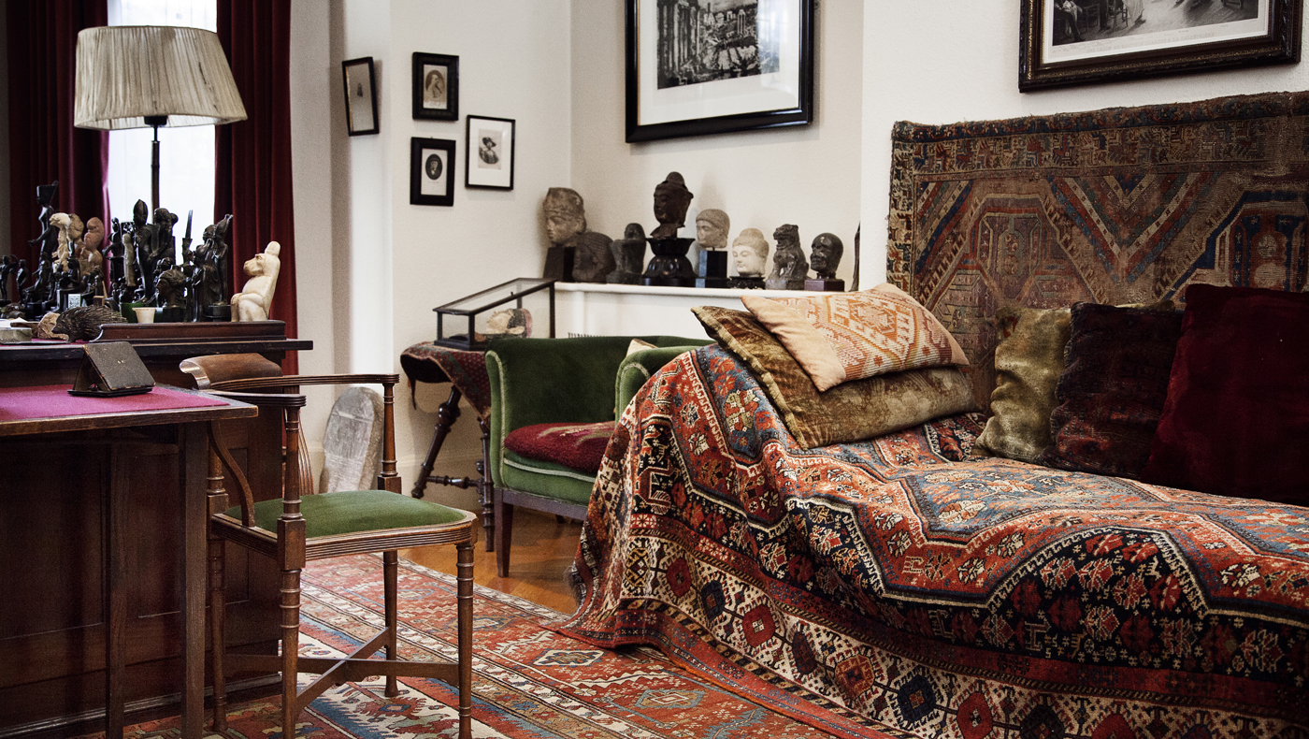
FML Staff Interview
Discussion Topics
Connecting to international audiences
Easy-to-use system
Video and audio quality
In-house attendance
Courses should not go hybrid
7
Notes:
Jack
When the museum went online during the pandemic, staff realized how big of an international following the museum had
They believe that using hybrid events will be a great way to keep this audience engaged in the future
Hybrid is alleviates some accessibility issues of local members
We learned that staff members place an importance on an easy-to-use system
It should be as glitch free as possible
Focus should be on the program not making the system work properly
Different speakers should be able to come in with their own powerpoints and slides and be able to connect easily
We found from staff that many members and attendees of events place a high value on the content of events
Thus importance on having high quality microphones for online audiences to hear
Important to plan out events and speakers early
Make sure cameras are well positioned to capture speakers
Emphasize in-person audience
Do not detract from the "allure" of attending events at the Freud museum
In a learning environment courses should stay in the current online only format

Slide 8
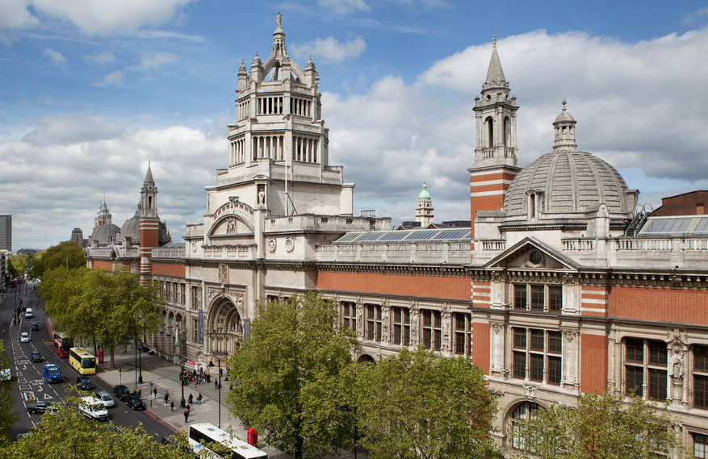
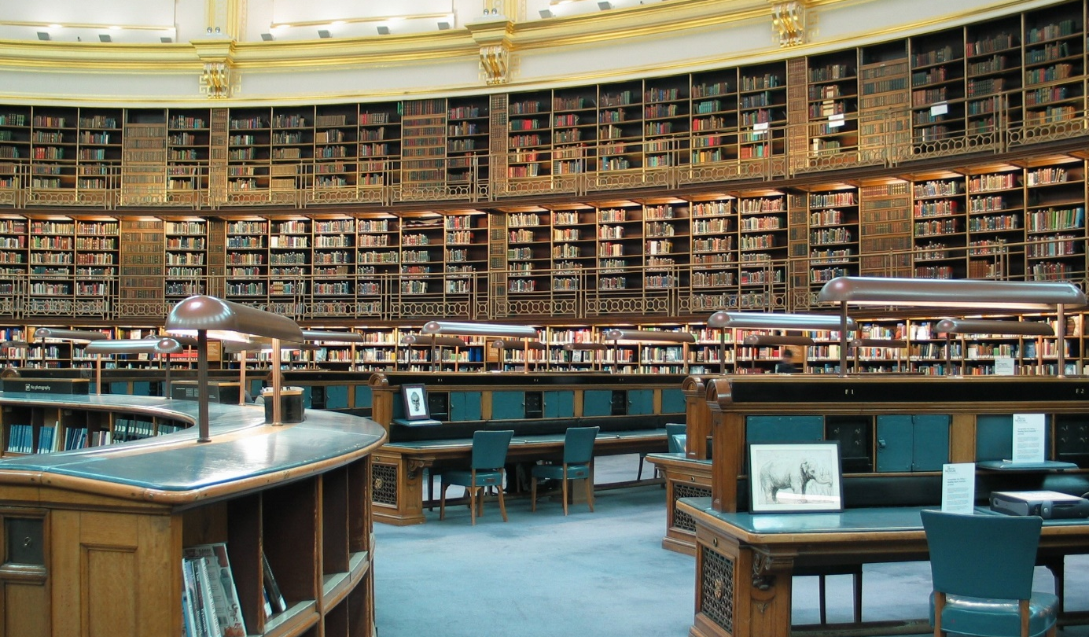
V&A Museum & British Library Interview
Discussion Topics
Microsoft Teams platforms
Training sessions
Production company
Event recordings
In-person attendance
8
Notes:
Dhruv
Both organizations use Microsoft teams and other Microsoft products

Slide 9
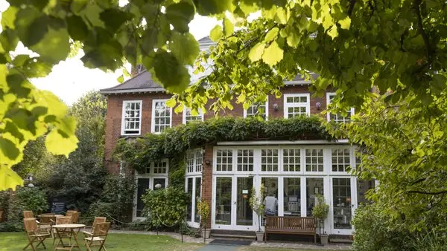
Speaker & Panelist Interview
Discussion Topics
Audience size
Engagement
Zoom etiquette
Webinars
Technology improvements
9
Notes:
Jack
Hybrid events are great because they allow for an audience size to be larger than what is able to fit in-house
Just need someone to manage audiences
In a teaching model it can be difficult to keep students engaged
Freud Museum should not come across this issue as members and attendees pay to attend events and have a vested interest into the content being discussed
FInd that it may be important to send out a document containing expectations when joining an event online
Muting
camera
FInd zoom meeting to be more engaging and rewarding for the online audience compared to zoom webinar
Technology will keep improving so it will be important to stay up to date

Slide 10
Program Evaluation Survey
65.5% 55 and older
54% live in London
59.7% Members/Patrons
37% not Members/Patrons, but attend FML programs
98.3% would consider attending an FML hybrid program
10
Notes:
Tessa

Slide 11
Program Evaluation Survey
Online Attendee Respondents (n=31)
11
Notes:
Tessa

Slide 12
Program Evaluation Survey
In-Person Attendee Respondents (n=8)
12
Notes:
Tessa

Slide 13
Program Evaluation Survey
In-Person & Online Attendee Respondents (n=16)
13
Notes:
Tessa

Slide 14
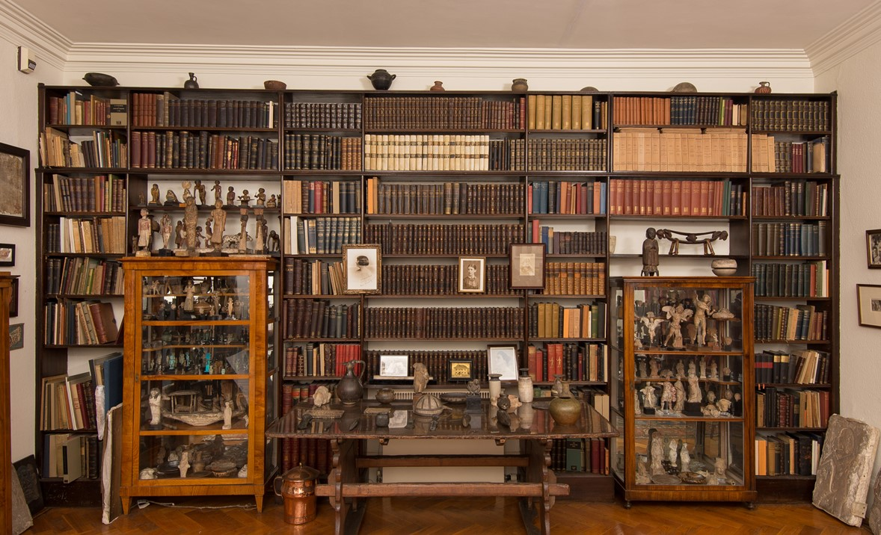
Focus Groups
Discussion Topics
Online & In-person
Online
Room size and comfort
Networking limitations
Being in the museum
Recordings
14
Notes:
Dhruv
4 people attended our focus group
2 online
2 both
ONLINE
They value being in the museum
People online found it more convininent and accessible
Valued recordings so that they could focus on the event rather than taking notes
BOTH
The members found the room size to be small at times and congested
The seats were uncomfortable after a long period of time
They mentioned that the network and video quality was subpar at times and made it hard to follow

Slide 15
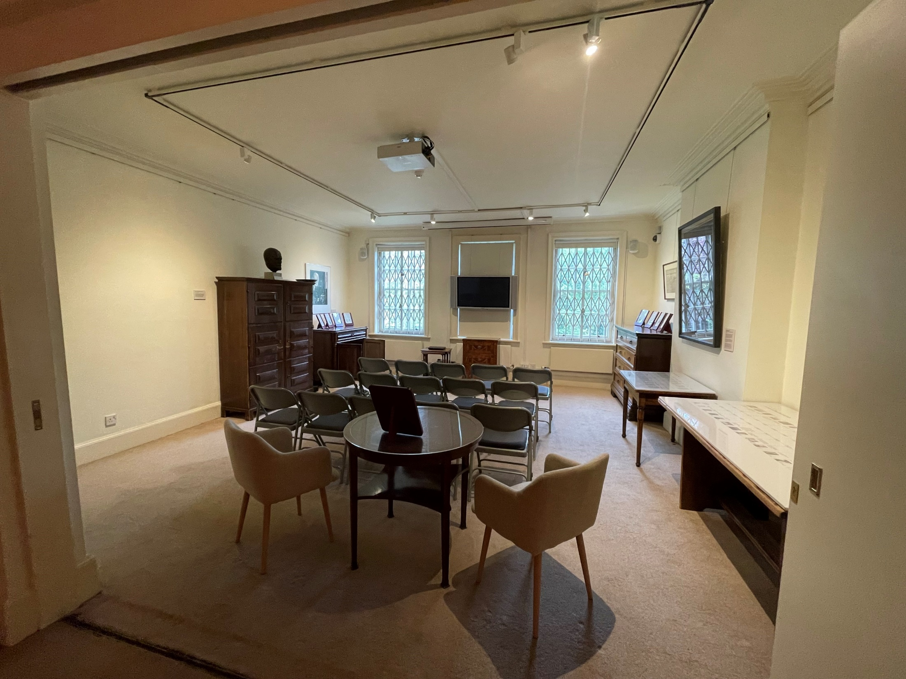
Video
Room
1
2
2
3
(1) Projector
(2) Two speakers
(3) 42-inch monitor
Four microphones
Projector screen
15
Notes:
We inventoried and analyzed the Video Room and Exhibition Room for our recommendations
Circled in red is equipment used for events

Slide 16
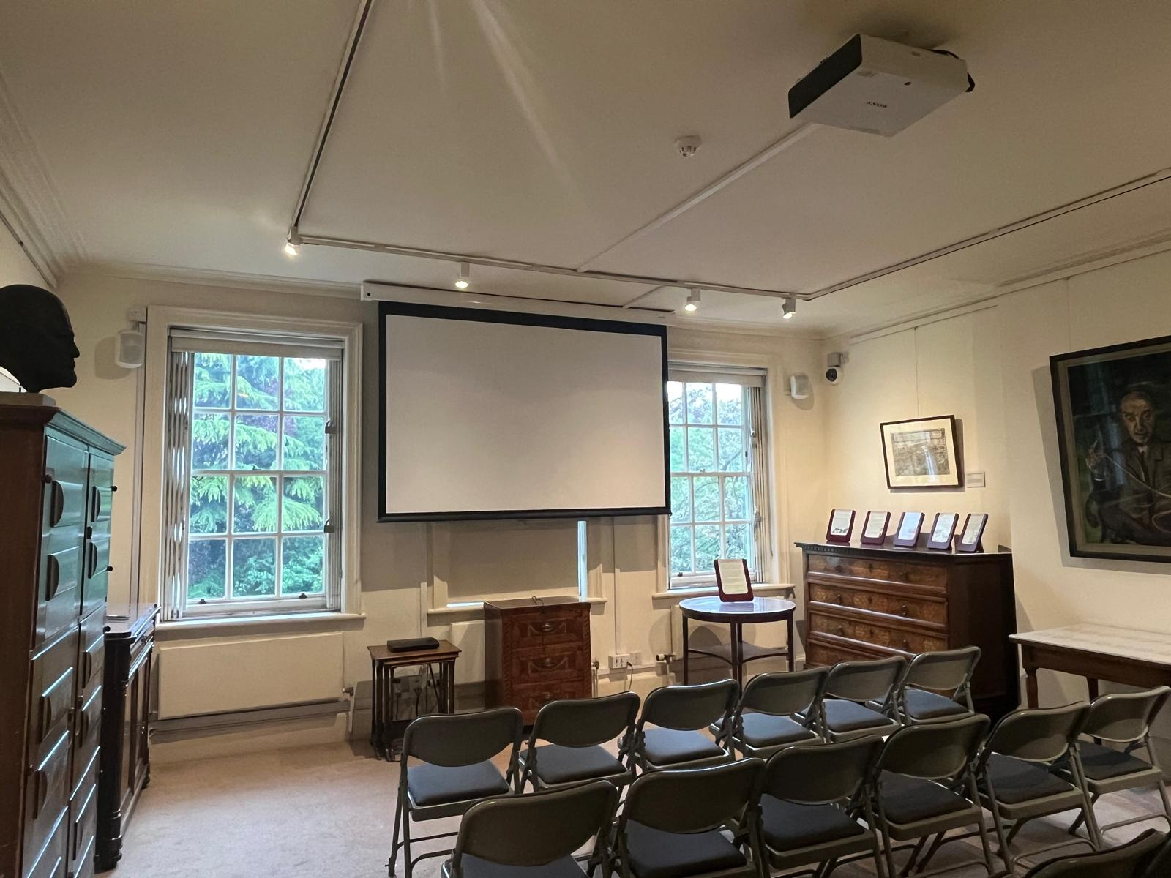
Video
Room
(1) Projector
(2) Two speakers
(3) 42-inch monitor
Four microphones
Projector screen
16
Notes:
The previous team at the FML found most people either skipped or never revisited the V & E rooms
Some of the least engagement in the museum
VIDEO ROOM
Most visitors stayed to watch the video but skipped the surrounding displays
Video is an intro video on Freud
EXHIBITION ROOM
The display in the center of the room received the most engagement and dwell time
Potential reasons for reduced engagement at the displays may be less amount of text to interact with
Nothing to do other than look at it
Other display is simply a collection of archives
Most skipped in the room

Slide 17
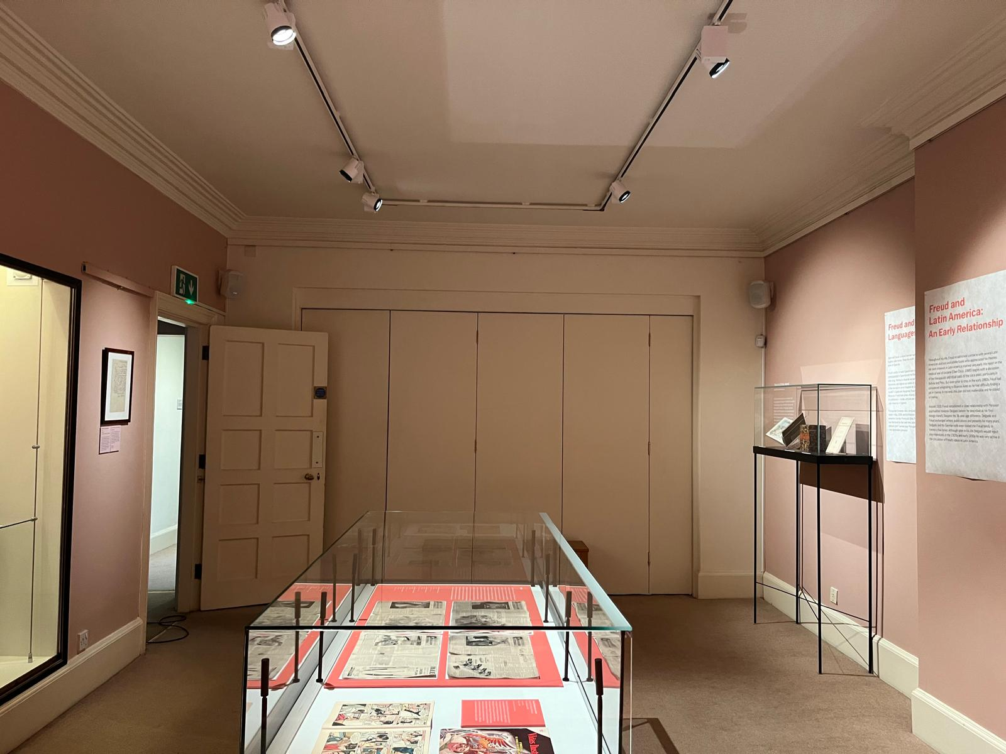
Exhibition
Room
Two speakers
Partition door
17
Notes:
This is the Exhibition Room
Circled are the two speakers
The partition door is in between them which connects the two rooms

Slide 18
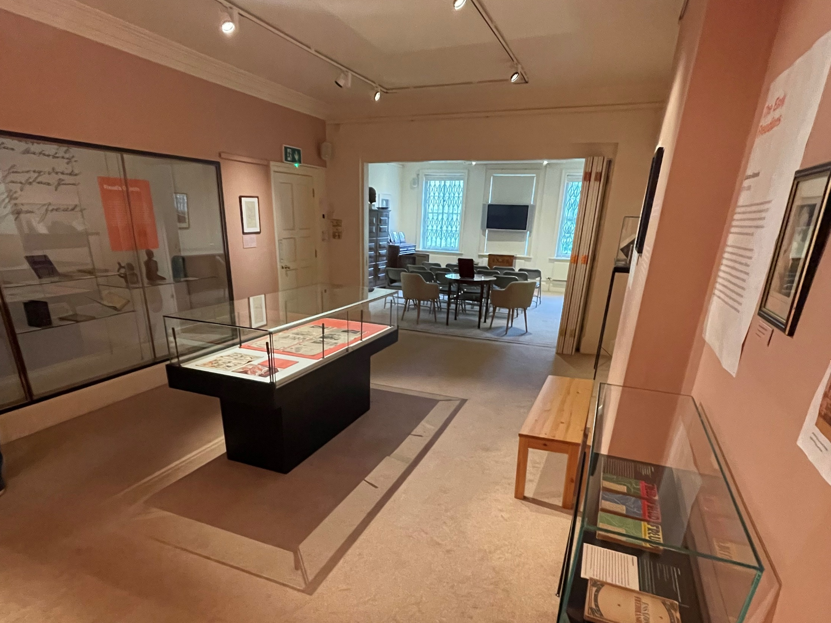
Exhibition
Room
Two speakers
Partition door
18
Notes:
The previous team at the FML found most people either skipped or never revisited the V & E rooms
Some of the least engagement in the museum
VIDEO ROOM
Most visitors stayed to watch the video but skipped the surrounding displays
Video is an intro video on Freud
EXHIBITION ROOM
The display in the center of the room received the most engagement and dwell time
Potential reasons for reduced engagement at the displays may be less amount of text to interact with
Nothing to do other than look at it
Other display is simply a collection of archives
Most skipped in the room

Slide 19
Recommendations
Programming
Software
Hardware
19
Notes:
Dhruv

Slide 20
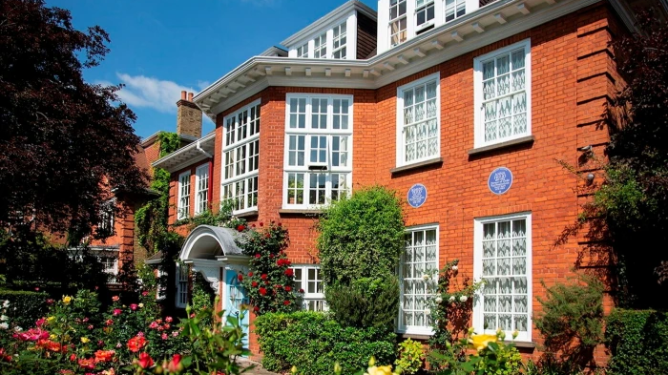
Programming in a Hybrid Model
Conferences
Events
Courses
20
Notes:
Jack
Due to audience sizes, content, and demand we find that conferences and Events are conducive to hybrid models
Often times speakers should be booked early to sell most tickets
Conferencing can be configured in a meeting style so in-person and online audiences can communicate back and forth
Learning can be hindered if two audiences join in separate ways, it will be best if they stay online so the lecturer can focus on one audience and one set of questioning

Slide 21
Software Recommendations
21
Notes:
Dhruv

Slide 22
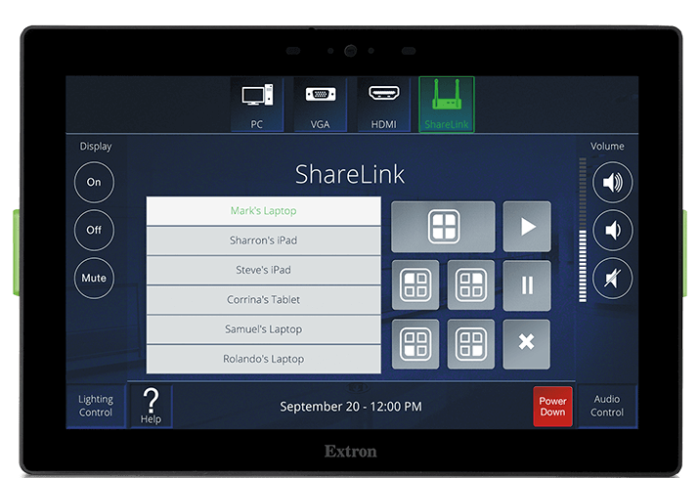
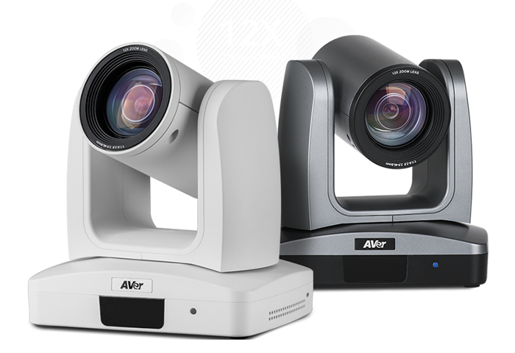
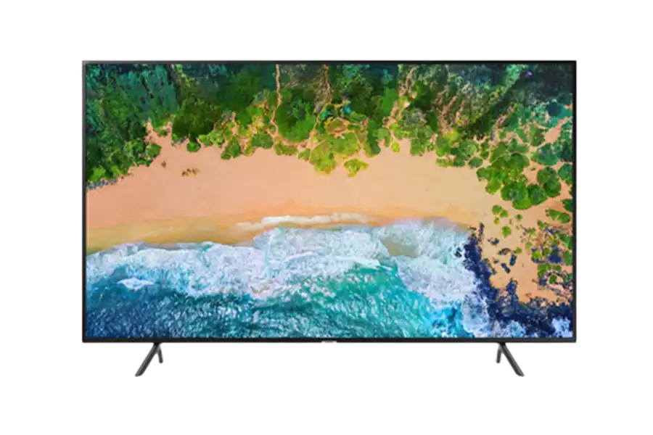
Potential Hardware Technologies
75+ inch TV & 50+ inch Monitor
Dual Camera Solution
In-Ceiling Microphone Array
Digital Control Panel
22
Notes:
Dhruv
Met with the ITSL group and they generally agree with this collection of technologies and are preparing a professional configuration and official speak

Slide 23
Possible Configuration of Video & Exhibition Rooms
23
Notes:
Istan

Slide 24
Thank You!

