Slide 1
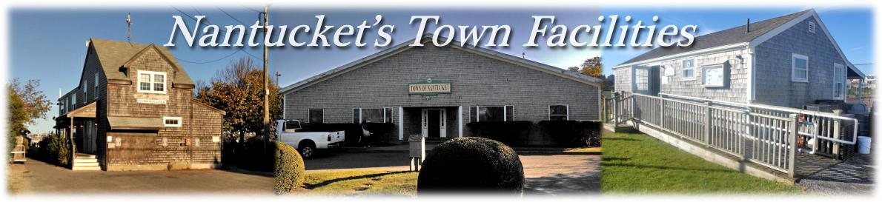

Stephen Arata
Abigail Brakenwagen
Brittany Colcord
George Kuegler
Sponsors:
Gregg Tivnan
Larry Kester
Notes:
Steve
Questions can wait until end

Slide 2
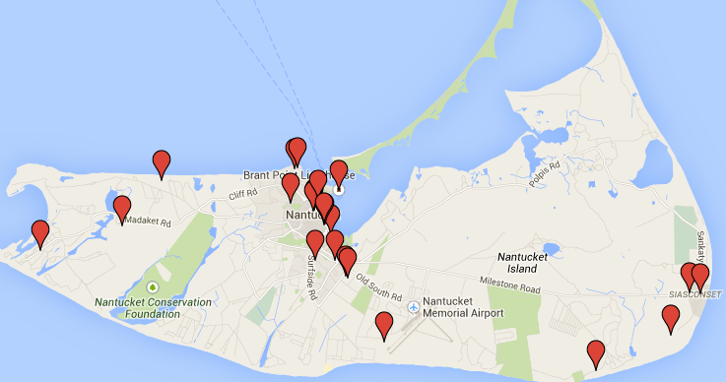
Introduction
Lack of Centralized Information
Growing Demands
Limited Budgets
High Cost of Off-Island Resources
Notes:
The Town of Nantucket is confronted with the issue of maintaining and improving its 25 municipal facilities. You can see their locations on this map. The town faces growing demands, like the fluctuating population due to tourism and the harsh sea weather. Additionally, the town faces limited budgets, the high cost of off-island resources and, perhaps most importantly, a lack of centralized information.

Slide 3
Project Goal
"to evaluate Nantucket’s town facilities,
organize information in a centralized database,
and provide a basis and justification for future maintenance and space planning purposes"
Notes:
Steve

Slide 4
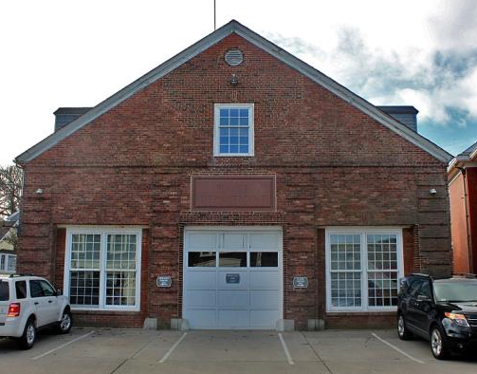
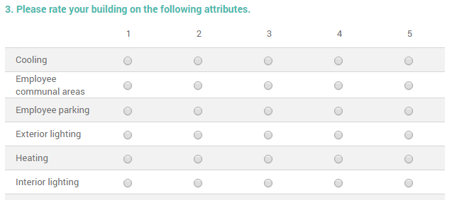
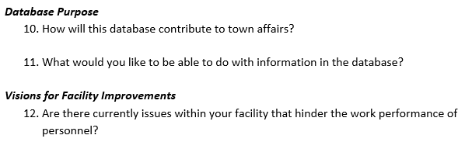
Methods
CREATE PILOT DATABASE
CONDUCT FACILITY INVENTORY
DETERMINE PUBLIC NEEDS
EXTERIOR | INTERIOR
Structure | Maintenance & Components
Surroundings
Energy | Energy
GAUGE STAKEHOLDER PREFERENCES
Renovations & Repairs
Space Needs
Database
Other
MAKE RECOMMEND-ATIONS
1-Unusable 2-Poor 3-Fair 4-Good 5-New
Notes:
Abby
Table for exterior and interior
Talk about lack of survey results for all buildings
Gauged stakeholder preferences through interviews regarding the database layout and content
Created a pilot database that we presented to sponsors (contained info from first site visit which was 20 South Water St, had most info for it)
Conducted a facility inventory through site visits to 19 facilities and populated the database with all the information we gathered
Determined public needs and opinions by sending out online surveys to town employees [and the public] <--may or may not be included
Made recommendations for the structures of buildings, the relocation & consolidations of departments, and future uses of database

Slide 5
DATABASE
Notes:
George

Slide 6
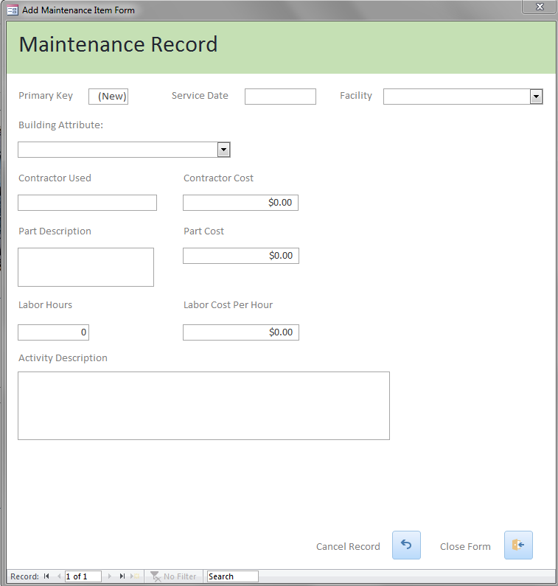
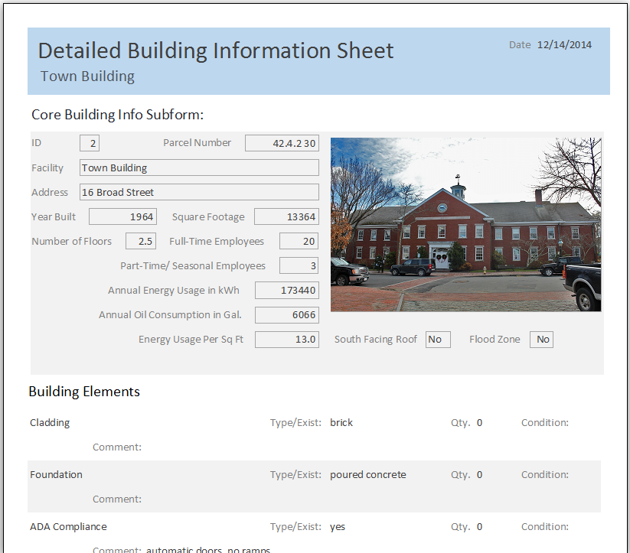
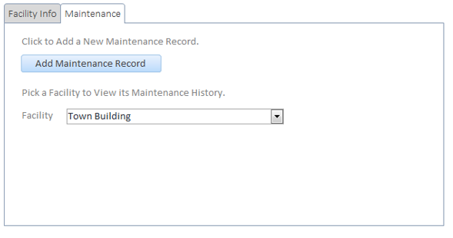
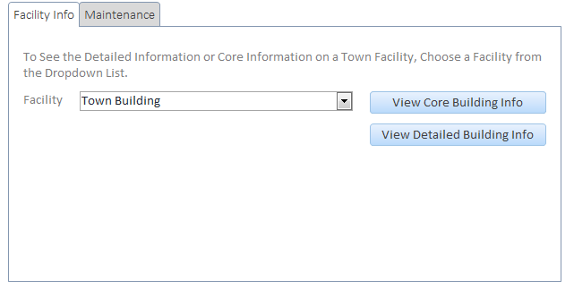
Notes:
George

Slide 7
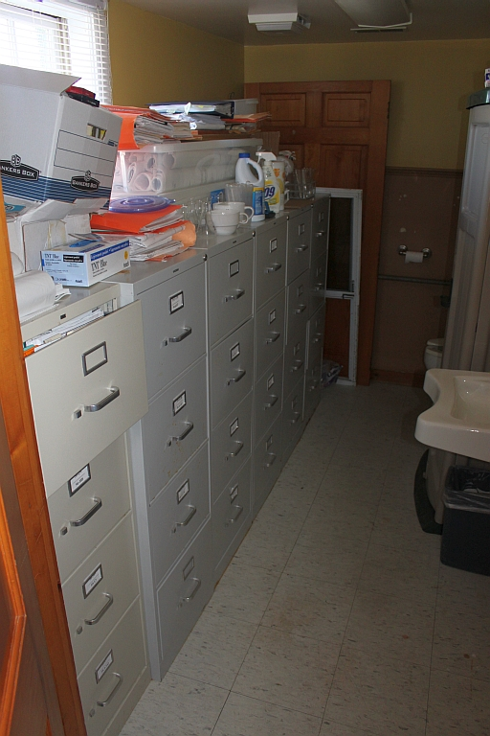
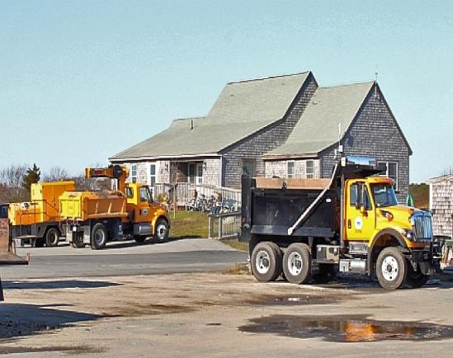
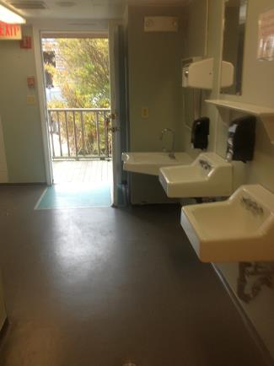
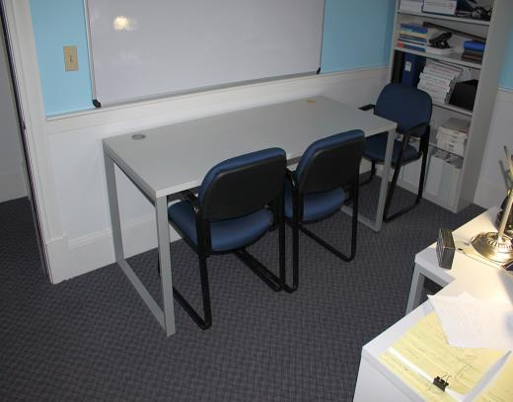
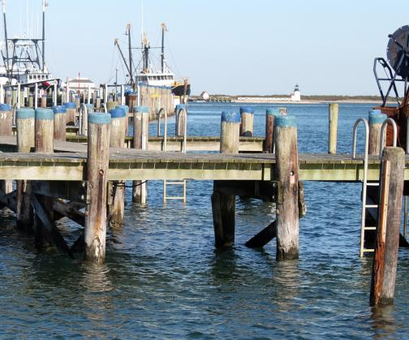
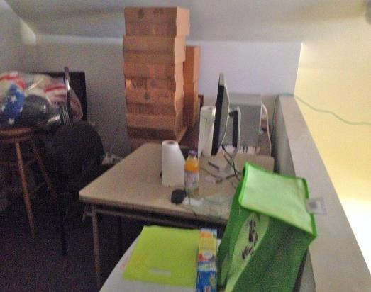
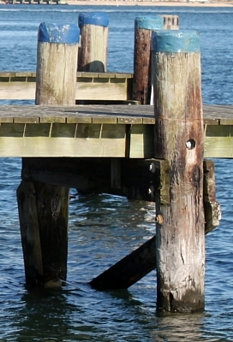
General Findings
Finance Department
Town Pier
Visitor Services
Town Pier
Natural Resources Department
Department of Public Works
Harbormaster Bathrooms
Notes:
Fix DPW
Circle around pylons

Slide 8
LEVEL I - FACILITIES IN POOR CONDITION
Planning and Land Use Services 20 South Water St (Old Police Station) Town Building Fire Station Town Pier
LEVEL II - FACILITIES IN MODERATE CONDITION
Visitor Services DPW Sheds DPW Garages Harbormaster Building Bathrooms Children’s Beach & Concession
LEVEL I
FINDINGS &
RECOMMENDATIONS
BUILDING PRIORITY LEVELS
LEVEL III - FACILITIES IN GOOD CONDITION
Finance Building Natural Resources Building Madaket Fire Station DPW Administrative Building Jetties Beach Concession Female Lifeguard Housing
LEVEL IV - NEWLY CONSTRUCTED, RECENTLY RENOVATED, OR UNDER-RENOVATION FACILITIES
Public Safety Facility Community School Shellfish Research Laboratory Siasconset Fire Station Male Lifeguard Housing
Notes:
Steve
Talk more
Make sure to say these are only the ones we visited
White background and black text??

Slide 9
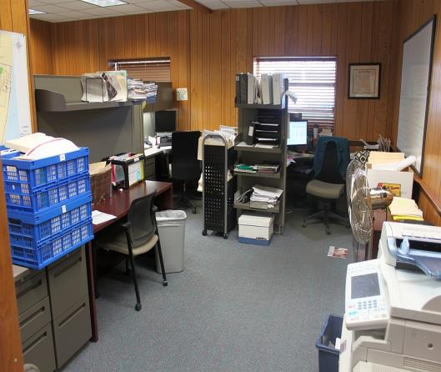
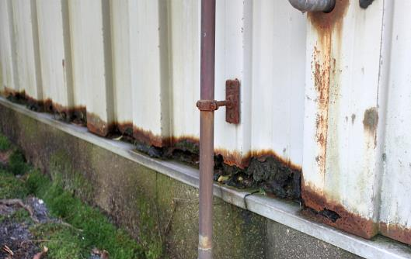
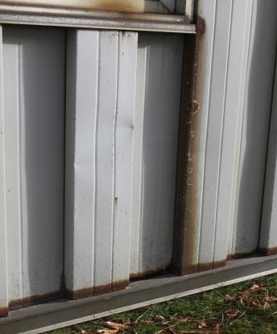
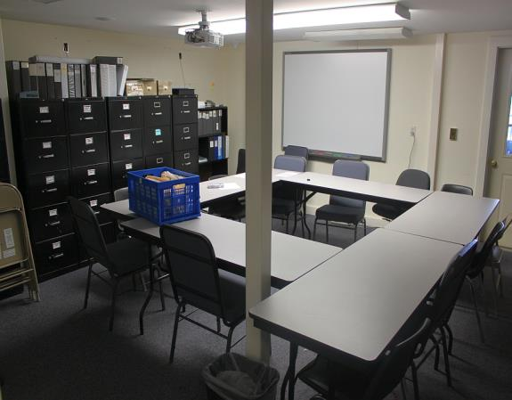
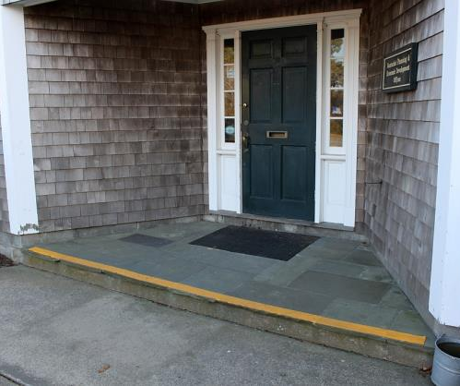
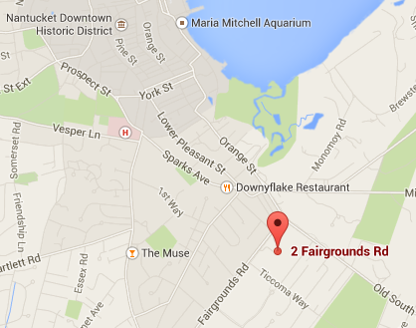
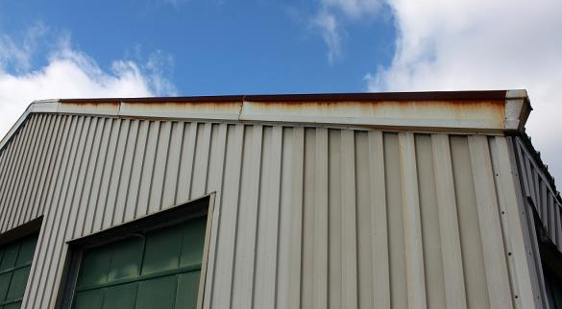
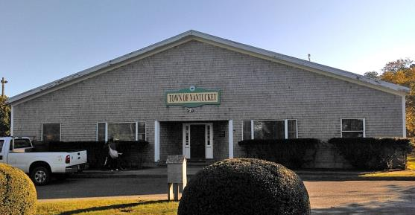
PLANNING AND LAND USE SERVICES
PlUS
Notes:
The Planning Office suffers significantly from both structural and space issues. The shell of the facility is becoming outdated and is rusting in many places. This poorly insulated shell with high ceilings, combined with the use of electric heat, is highly energy inefficient. The building was designed for an electric company that used the rear end as storage for equipment and maintenance vehicles, not to be used as heated file storage and office space. The facility is also non handicap accessable as you can see by the large step at the main entrance. The bathrooms are nonaccessible as well. There is also very limited office and meeting space in the facility, both of which cause a lack of noise control. Because of this, we believe that it would be most efficient for the town to build a new facility altogether with increased employee areas, a nonelectric heating system, and better insulated interior and exterior walls.

Slide 10
Notes:
This is a graph of the results of our Town Employee Survey, specifically those working at the PLUS. We asked them to rate each of the attributes along the bottom for their facility with 1 being poor and 5 being in excellent condition. For all but parking and storage space, at lease 6 of the 12 responses were a 2 or below . This highly supports our claim that the Planning Office is in need of serious attention.

Slide 11
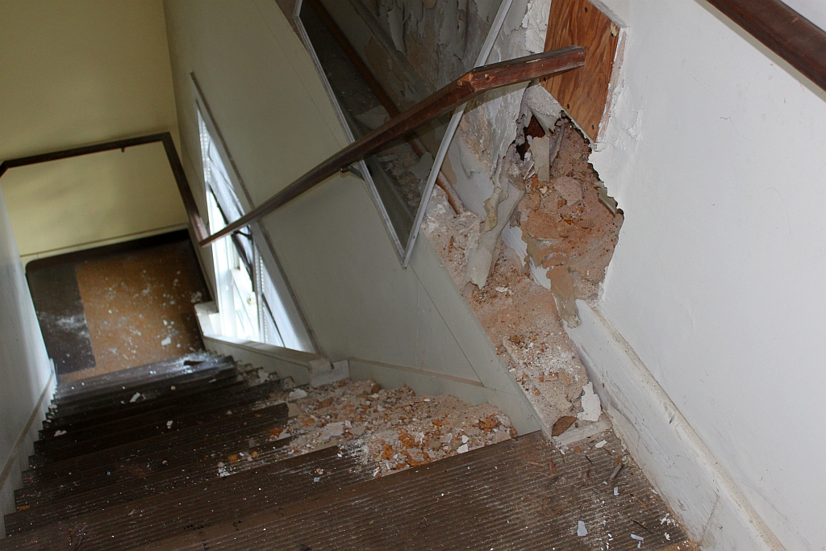
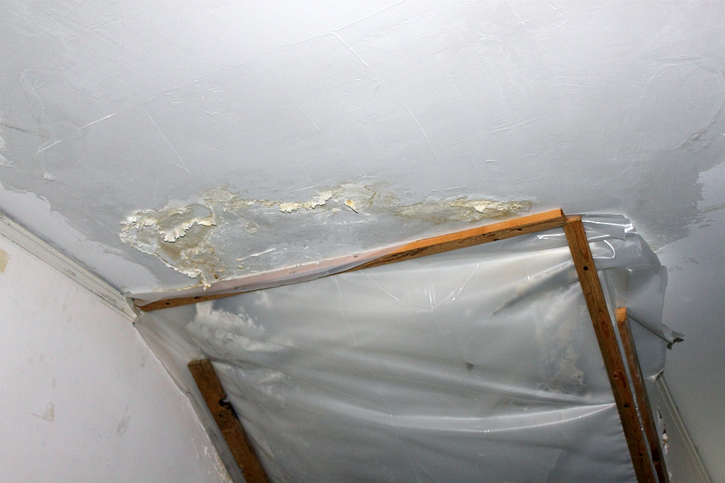
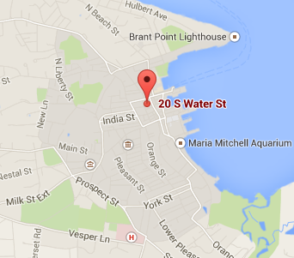
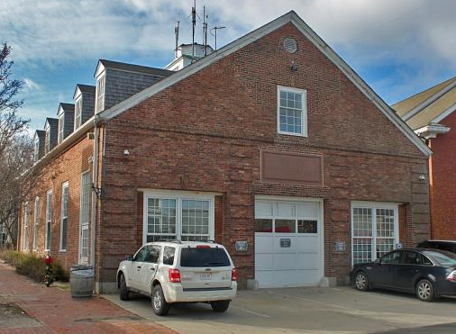
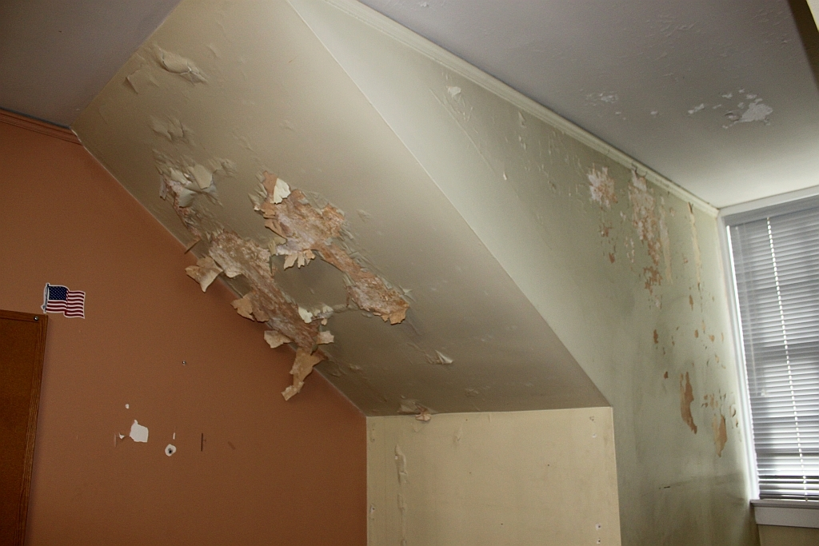
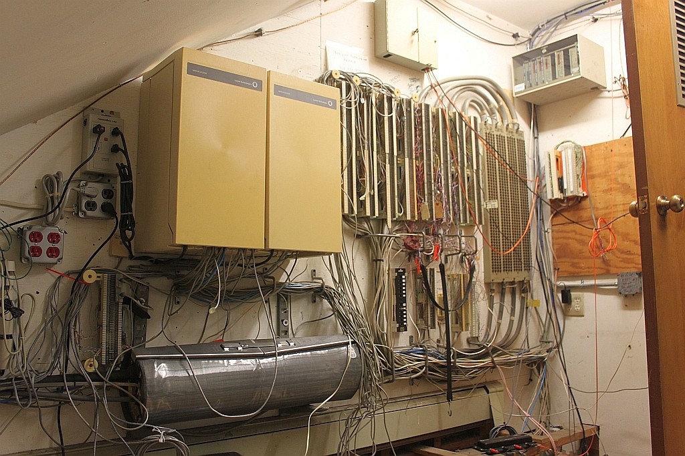
20 South Water St
20 S. Water
Notes:
Steve
Roof leaks
staircase
IT room
3 employees for over 5000 sq ft
cost and energy inefficient
renovate the interior
top floor- overflow/meeting space for town hall

Slide 12
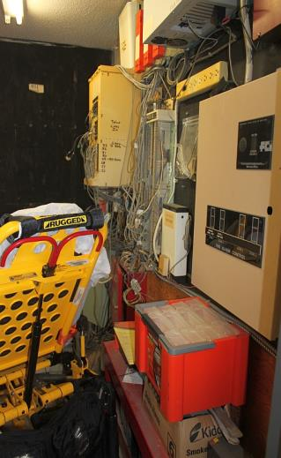
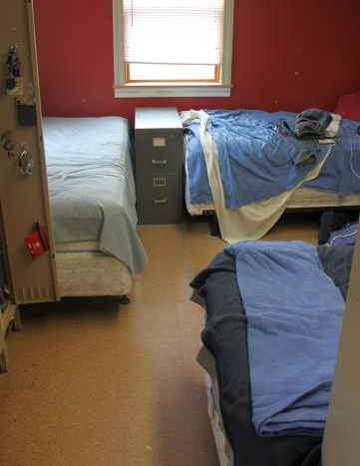
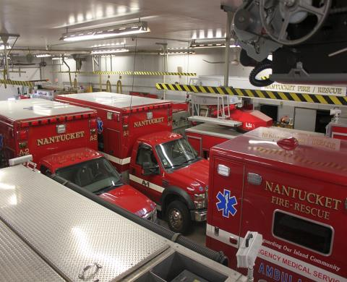
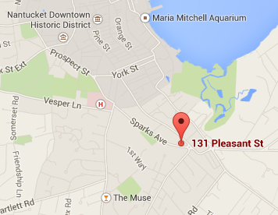
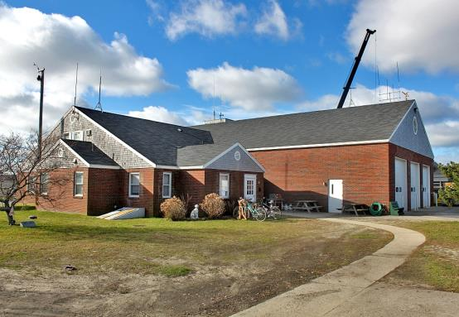
Central Fire Station
Fire
Notes:
George
Outer shell needs repairs
Wooden frame holds moisture that seeps through brick
not big enough to handle demand or growth
can’t house male and female firefighters separately-deputy chief gave up office
rebuild at 4FG

Slide 13
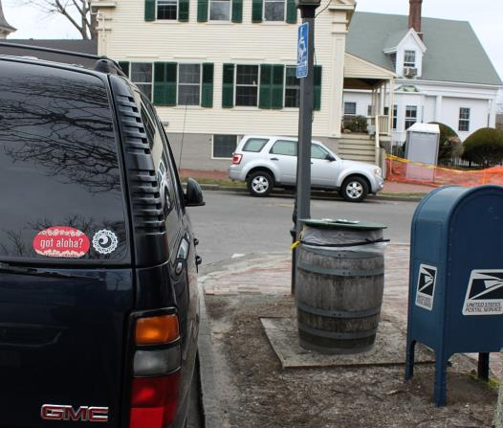
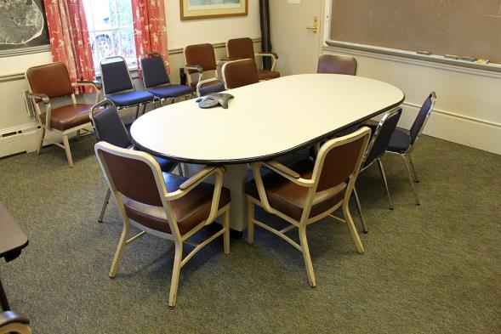
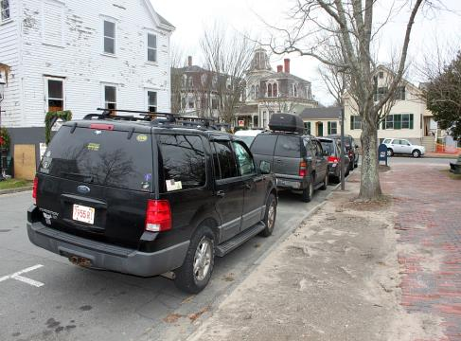
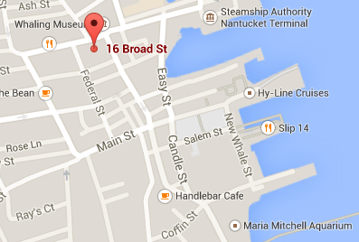
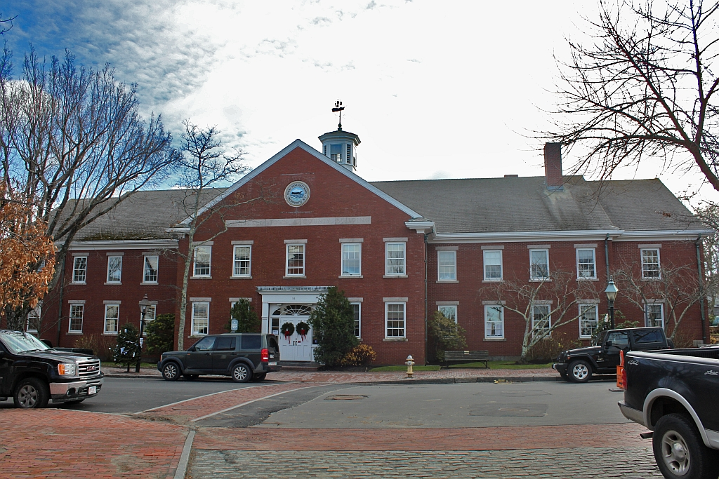
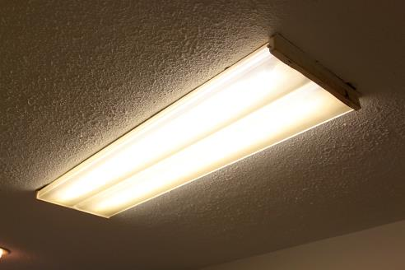
Town Building
Town Building
Notes:
Abby
Frame on building picture
Asbestos is not hazardous to people in building but they can’t install energy efficient lights
parking!!!​
public overflow in hallways from RMV and courts (lack of waiting space)​
lack of meeting space​
hazardous material (asbestos and lead paint in ceiling tiles that if disturbed, could be toxic to employees and public)​
clear out asbestos and more efficient windows

Slide 14
Notes:
Add in new slide for random recommendations for level 2, 3, 4

Slide 15
RECOMMENDATION
As Needed
5+ Years
3-5 Years
Major & Minor Repairs
    Structural
Space Needs
Accessibility
Aesthetics
Minor Repairs
Communal Areas
Storage Space
Structural
LEVEL IV - NEWLY CONSTRUCTED, RECENTLY RENOVATED, OR UNDER-RENOVATION FACILITIES
Public Safety Facility Community School Shellfish Research Laboratory Siasconset Fire Station Male Lifeguard Housing
LEVEL III - FACILITIES IN GOOD CONDITION
Finance Building Natural Resources Building Madaket Fire Station DPW Administrative Building Jetties Beach Concession Female Lifeguard Housing
New
Under Renovation
Plans in Place
LEVEL II - FACILITIES IN MODERATE CONDITION
Visitor Services DPW Sheds DPW Garages Harbormaster Building Bathrooms Children’s Beach & Concession
Notes:
Concerning the level 2 facilities, we made recommendations on both major and minor repairs. We recommended structural repairs, like better sheds for the DWP, space needs, such as a new garage to house the remaining DPW equipment, accessibility, and aesthetics.
For level 3 facilities, we recommended more minor repairs, like increased communal and storage areas, and small structural fixes like roof leaks.
Finally, for the level 4 facilities, we recommended that they be looked at as needed. Some, like the public safety facility, are brand new, while others are undergoing major renovations, but only to specific things in facilities.

Slide 16
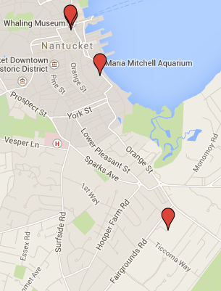
General Space Needs
Assessor
Finance
Human Resources
Procurement Office
Registry of Deeds
Tax Collector
Town Administration
Town Clerk
to Town Building
Visitor Services
to 20 S Water St
Possible parking garage location:
37 Washington St
RMV, Court, and Sheriff to FG Complex
Top floor of 20 S Water St as meeting space and Town Building overflow
Fire Station
to 4 FG
Notes:
Brittany
Concerning space needs:
The results of our Town Employee Survey showed that these functions would be most convenient if located in the same place. We selected the Town Building because the importance of maintaining a presence downtown was expressed by many
The same survey showed that the RMV, Court, and Sheriff’s office would be better located at the Fairgrounds complex for the increased parking and close proximity to the police station .
As was mentioned earlier, the Fire Department would have much more room if moved into a new facility at 4FG, which is already equipped to handle such an addition.
There is ample room on the ground floor of 20 South Water St. to house Visitor Services, including private offices for employees, as well as meeting and storage space that their current facility lacks.
We recommend that the top floor of the facility at 20 South Water St. be used as meeting space and overflow for the Town Building.
We would also suggest the town look into parking garage as a solution to the parking issue. One possible location is 37 Washington Street where the current finance lot is.

Slide 17
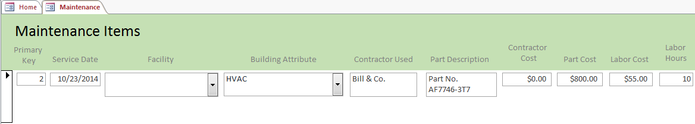
Database and other Recommendations
Energy
Saving
Techniques
Public
Input
Notes:
Abby
Kill bottom pictures
Using the database to track maintenance, reports, and building info will greatly improve facilities management
Energy saving techniques
Public input

Slide 18
SPECIAL THANKS TO:
Gregg Tivnan
Larry Kester
Libby Gibson
Heidi Bauer
Diane O'Neil
Dave Fredericks
Rachel Chretien
David Gray
Sheila Lucey
Chief Mark McDougall
Deputy Chief Ed Maxwell
Richard Ray
Lauren Sinatra
Jeff Carlson
Leah Cabral
Tara Riley
Lynell Vollans
Caitlin Waddington
David Sharpe
Kate Hamilton
Kara Buzanoski
Erika Mooney
Martin Anguelov
Deputy Chief Charlie Gibson
Jason Bridges
Cindy Clarkson
Paula Leary
Harvey Young
Andrew McKenna-Foster
Notes:
We would like to thank everyone who helped us throughout this process, including our sponsors, Gregg and Larry, Libby Gibson, all of those who allowed us to interview them, those who gave us facility tours, and everyone who helped us during our stay here.

