Slide 1
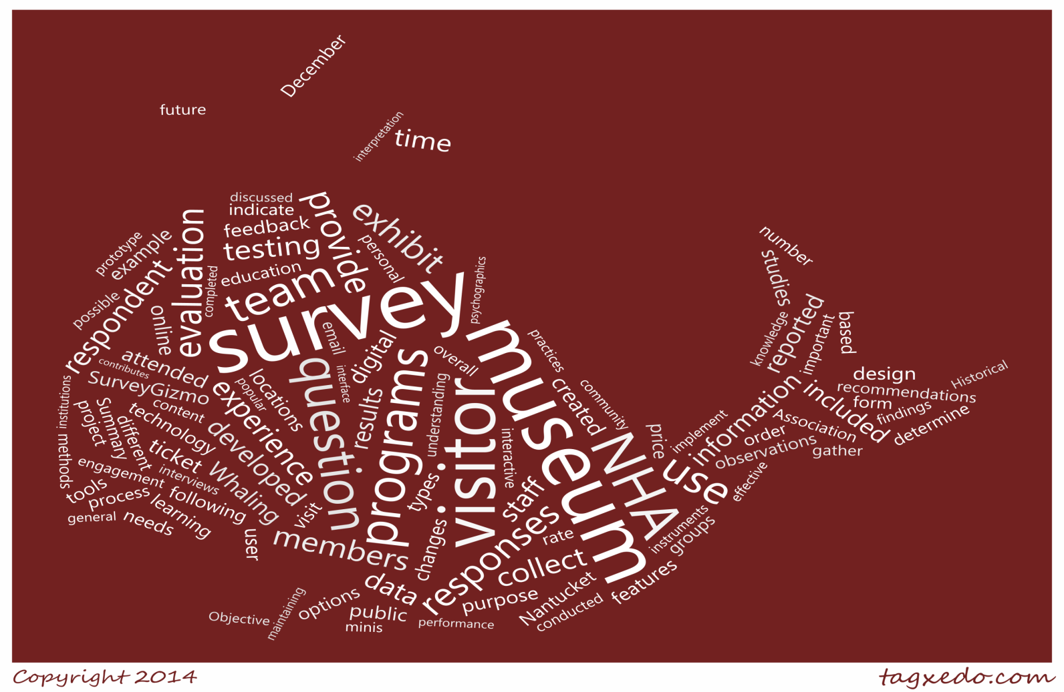
Digital
Evaluations
at the
Visitor
NHA
Catherine Bonner • Adam Karcs • Emily Perry
16 December 2014

Slide 2
Overall Project Goal
Explore ways in which digital technologies can be used to enhance the visitor evaluation capabilities at the Nantucket Historical Association

Slide 3
Background
Nantucket Whaling Museum
People
Digital
Visitor Expectations
Self-Guided Learning
Visitor Feedback
Surveys

Slide 4
Goals and Objectives
Objective 1: Determined state-of-the-art surveying practices in the
museum
industry
Objective 2: Examined the current and preferred visitor evaluation methods
of the
Nantucket Historical Association
survey
Objective 3: Developed a suite of technology-assisted instruments
recommendations
Objective 4: Provided for the use and maintenance of the instruments developed.
NHA
Survey
Industry
Recs

Slide 5
Initial Findings
Primary Needs
Staff Interviews
Programs
Visitor Experience
Communications
Membership
Education
Curating
Research
Price of Membership
Source of Member Acquisition
Emailed Surveys
Ages of Visitors
Discovery Room
Field Trip Satisfaction
Visitor Expectations
Museum Scope
Diversity
Non-Visitation
Outcomes-Based Evaluation
Outcomes-Based Evaluation
Grant Writing
Discovery Room
Museum Scope
Emailed Surveys
Satisfaction with Programs
Advertising
Satisfaction with Programs
Advertising
Paper Surveys
Online Ticketing
Marketing Avenues
Price of Admission
Standing iPad Surveys
Advertising
Social Media
Branding
Pricing
Standing iPad Surveys
Branding
Online Ticketing
NHA
Survey
Industry
Recs
pricing

Slide 6
Survey Provider Games
Features
Price
Qualtrics
Survey Gizmo
Survey Monkey
Snap Surveys
NHA
Survey
Industry
Recs

Slide 7
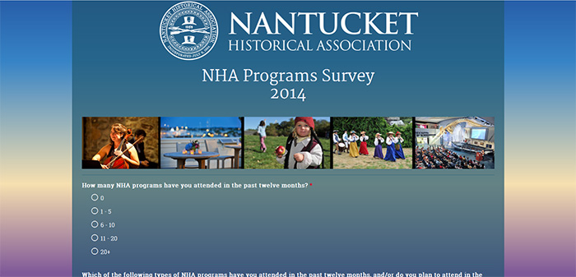
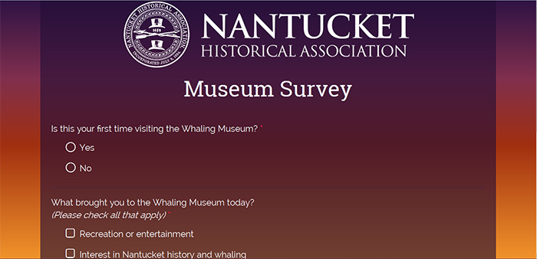
Surveys Created
Programs Survey
Museum Survey
Initial Membership
Museum Survey
2014 NHA Programs Survey
Collect useful information about the visiting body, as well as feedback regarding the museum’s exhibitions, galleries, and daily programs
Collect program attendees’ opinions on the previous year’s public programs, as well as generate feedback to guide the next year’s programming
Individual Programs Survey
Membership Renewal Survey
NHA
Survey
Industry
Recs

Slide 8
NHA Interests
NHA
NHA
Nantucket Whaling Museum
1800 House
Greater Light
Nantucket Whaling Museum
Oldest House
Quaker Meeting House
…
NHA
Survey
Industry
Recs
branding
pricing

Slide 9
NHA Interests
Museum Survey
Encouragement of Further Participation
Subtle Advertisement
Have you visited any of the other NHA historic sites available with your All-Access Pass?
If you would like to stay up-to-date on Nantucket Historical Association events … please provide your email address below:
Yes
No, but I plan to
No, and I don’t plan to
13.6% Provided an Email Address
Recommendation:
Continue requesting email addresses
NHA
Survey
Industry
Recs
branding
pricing

Slide 10
NHA Interests
Programs Survey
Subtle Advertisement
Not-So-Subtle Advertisement
Which of the following types of NHA programs have you attended … and/or do you plan to attend…?
13 out of 15 questions contained the acronym “NHA”
Concerts
Festivals
Parties
Etc.
NHA
Survey
Industry
Recs
branding
pricing

Slide 11
NHA Interests
Programs Survey
Results from Open Text Responses
n = 25
Comments On:
Programs
Respondents are aware of the scope of the brand
Museum Exhibits
Use of Historic Sites
Value of Membership
NHA
Survey
Industry
Recs
branding
pricing

Slide 12
NHA Interests
Programs Survey
Methods/Modes
of advertisement
Recommendations:
Future years
By residency, age, etc.
Museum Survey
NHA Material
“How do you usually hear about NHA Programs?”
Newspapers
Visit/Voice
NHA
Survey
Industry
Recs
branding
advertising

Slide 13
NHA Interests
How did you purchase?
Would you use online?
Benefits:
visitor information
audience size
supplies/preparations
How did you purchase the majority of your program tickets?
If available, would you use online ticketing for all NHA programs?
Should we expand our online ticketing?
Recommendation:
Further exposure to online options
Analyze this data throughout the summer season
NHA
Survey
Industry
Recs
advertising
online ticketing

Slide 14
NHA Interests
How much should we charge for our services?
Programs
and
Events
Museum Admission
1
+
2
3
Indirect Approach
Semi-Direct Approach
Direct Approach
Rate the value of the price of admission compared to your museum experience.
Poor Value - - - - - Great Value
The price of admission was:
Much too low - - - - - Much too high
Rate the following:
The price of admission was reasonable.
Strongly Disagree - - - - - Strongly Agree
NHA
Survey
Industry
Recs
online ticketing
pricing

Slide 15
NHA Interests
Direct Approach
Programs Survey
1
Rate the value of the price of admission compared to your museum experience.
Poor Value - - - - - Great Value
How do you feel about the value of the programs you have attended … in relation to their admission prices?
Poor Value - - - - - Great Value
Indirect Approach
2
Semi-Direct Approach
Museum Survey
3
Rate the following:
The price of admission was reasonable.
Strongly Disagree - - - - - Strongly Agree
NHA
Survey
Industry
pricing
Recs

Slide 16
NHA Interests
Museum Survey
NHA Member?
Rate the following:
The price of admission was reasonable.
Strongly Disagree - - - - - Strongly Agree
$
No
Yes
Question Routing
NHA
Survey
Industry
pricing
Recs

Slide 17
NHA Interests
Programs Survey
Satisfaction with Program Pricing
Vs. Age Group
Older age groups are more satisfied overall
Overall Satisfaction
Vs. Age Group
Older age groups are more satisfied with Program Pricing
Very Satisfied
Great Value
Implications:
Programs are geared more towards older age groups
Dissatisfied
Recommendation:
Increase focus on 26 to 35 year- old age group in future
Older age groups have more disposable income
Poor Value
n=59
pricing

Slide 18
Larger Findings and Recommendations
NHA
NHA
Survey
Survey
Industry
Industry
Recs
Recs
pricing
recommendations

Slide 19
Museum Survey
9.5%
Had difficulties with iPad delay
94%
Had no problem with the length of the survey
1
64
Museum Visitors
87.5%
Own a smartphone or tablet
55.5%
Had difficulties with iPad delay
Public Testing Results
2
Administer surveys on iPad minis
3
Ask Follow-Up Questions
Analyze Results
4
Modify Survey Accordingly
Recommendation:
Administer Standing ‘Kiosk’ Surveys in the Whaling Museum
WiFi Speed Tests Determined Best Location
WiFi Connectivity Issues caused delay
NHA
Survey
Industry
Recs
recommendations

Slide 20
Programs Survey
Recommendations:
Social Media Blasts
Reminder Emails
Offer Incentives
59
completed responses
Sent to 5,000 people
1,100 opened the email
5.36%
effective response rate
NHA
Survey
Industry
Recs
recommendations

Slide 21
Thank You
Director of Visitor Experience
Manager of Visitor Operations
Membership Coordinator
Manager of Education
Public Programs Coordinator
Communications Coordinator
FR & Research Prospect Coordinator
Robyn and John Davis Chief Curator
Collections & Systems Manager
Photograph Archives Specialist
Admin Assistant & Soup Specialist
And Many Museum
Marjan Shirzad
Katie Schoorl
Molly Mcllvaine
Claire White
Corey Fabian Borenstein
Lindsay Scouras
Karyn Lindsay
Michael Harrison
Tony Dumitru
Ralph Henke
Julianne Kever
Interpreters

Slide 22
Questions, Comments, Concerns
Question Development
Stylistic and Technical Design
Two Digital Surveys

Slide 23
NHA Interests
Museum Survey
Programs Survey
Satisfaction with Program Pricing
Vs. NHA Membership Status
NHA members rate their satisfaction with the pricing of NHA Programs more highly than non-members
Recommendation:
Rephrase this question for members in future Programs Surveys

Slide 24
NHA Interests
Programs Survey
Great Value
Poor Value
Dissatisfied
Satisfied
Overall Experience Rating
NHA
Survey
Industry
pricing
Recs

Slide 25
 | SURVEY GIZMO |  |  |  | SNAP SURVEYS | QUALTRICS
 | Solo | Basic | Professional | Enterprise
Survey Building
Number of Question Types | 19 | 19 | 19 | 19 | 12 | >100
Unlimited Responses | X | X | X | X
Logic, Actions & Piping |  | X | X | X | X | X
Theme Customization |  | X | X | X | X | X
Reporting
Automatic Summary Reporting | X | X | X | X | X | X
Export Reports to CSV, XLS, PDF | X | X | X | X | X | X
Export Reports to PPT |  |  |  |  | X | X
Data Encryption |  |  | X | X | X | X
Customer Service
Email Support | X | X | X | X | X | X
Phone Support | X | X | X | X | X | X
Survey Development Consultation |  |  |  |  | X | X
Sharing
Email Campaign |  | X | X | X | X | X
Custom Branded Links |  |  | X | X | X | X
Offline Capability | X | X | X | X | X | X
Kiosk Mode | X | X | X | X | X | X
Price | $15/mth | $35/mth | $75/mth | $199/mth | 5,000 reponses: $1,121/yr 10,000 responses: $1,646/yr | 5,000 responses: $7,000/yr 10,000 responses: $13,000/yr
Price | $15/mth | $35/mth | $75/mth | $199/mth | 5,000 reponses: $1,121/yr 10,000 responses: $1,646/yr | 5,000 responses: $7,000/yr 10,000 responses: $13,000/yr

