Slide 1
Reinforcing
Nantucket’s Customs
Notes:
Hi I’m [Name] and I am a [Major]... We are the nantucket customs group and our project is on reinforcing Nantucket’s customs

Slide 2
Project Purpose
Protect Nantucket’s Customs from Cultural Erosions
Notes:
Our overarching goal is to protect Nantucket’s customs and conventions from cultural erosions.

Slide 3
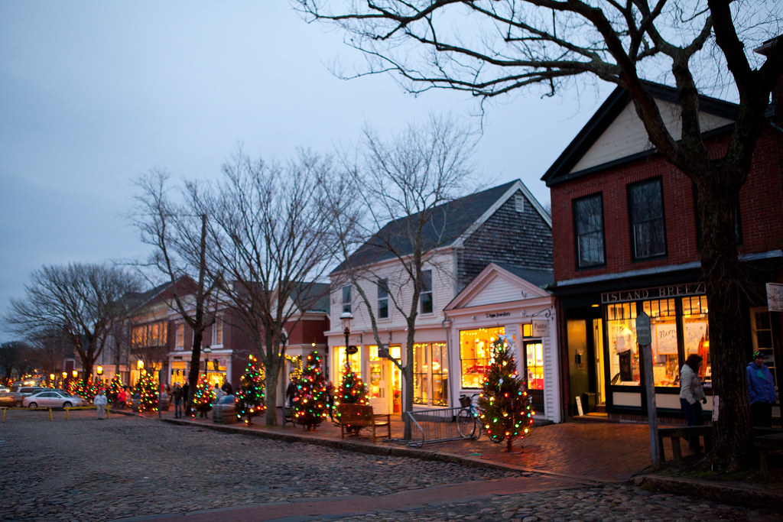
Nantucket
More than an “elbow of Sand”
Notes:
Nantucket has a unique culture but people have noticed that some of the town’s cultural bylaws are not being respected like they have in the past.
"Nantucket Holiday Stroll - Nantucket" by Massachusetts Office of Travel & Tourism is licensed under CC BY-ND 2.0

Slide 4
Project Goals
Define Customs
reinforce Customs
Evaluate Erosions
Notes:
We have three main sub-objectives for our project: *Click Now and after each subgoal topic*
Identify what makes Nantucket “Nantucket”
Evaluate ways Nantucket’s culture may be eroding
Develop educational materials and outreach strategies to reinforce Nantucket’s distinct cultural identity.

Slide 5
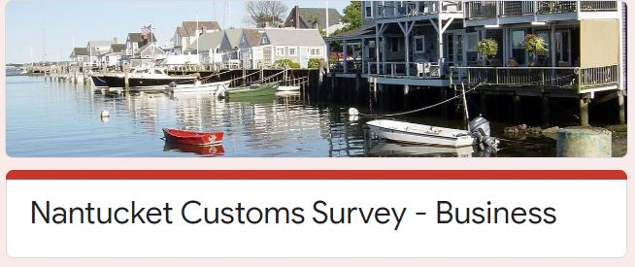
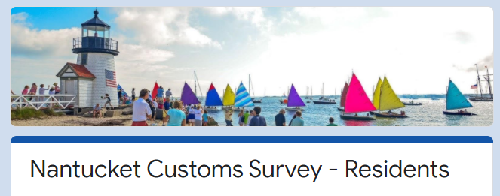
What’s up Nantucket?
Notes:
To get a sense of Nantucket’s culture we created two informational surveys, one for businesses and one for residents. In the resident survey, we wanted to get peoples’ opinions on a number of practices the town has allowed during COVID, and see if they should continue after the pandemic. These include outdoor merchandise displays, sandwich boards, public art, outdoor dining and more. In our business survey, we asked business owners what additional steps they have taken advantage of during the pandemic, and if they would like to continue them in the future.

Slide 6
26 Interviews
195 Residents
6 Businesses
Notes:
Here is size of our dataset. For our 26 interviews, we interviewed town officials, business owners, locals and nonprofits. Thanks to everyone who participated in our interviews and surveys. Moving on,

Slide 7
Key Findings
What makes Nantucket Unique
Highlight Community Concerns
Problems with Overtourism
Response to COVID
Issues with Enforcement
Notes:
Throughout our interviews and surveys, we have been introduced to a wide range of topics. We will first present what makes nantucket great, then highlight community concerns and overtourism. And Lastly we will look at the town’s response to covid and look at some issues with nantucket’s bylaw enforcement.

Slide 8
Defining Nantucket
Notes:
We have heard that people cherish many things about the island

Slide 9
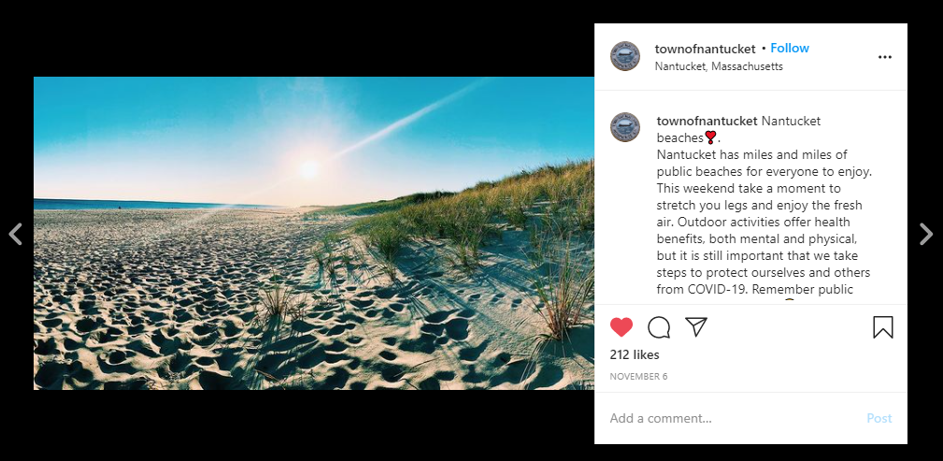
Beautiful Landscape (Place images)
Beautiful Landscape
Notes:
One of them is Nantucket’s beautiful natural landscape with long beaches and large open spaces.
ATown of Nantucket [@townofnantucket]. (2020, November 5). Nantucket Beaches[Instagram photograph]. Retrieved from https://www.instagram.com/p/CHQoaBoj5Y2/

Slide 10
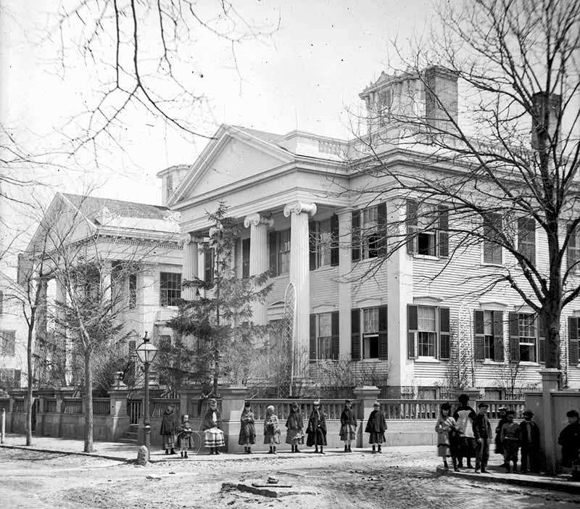
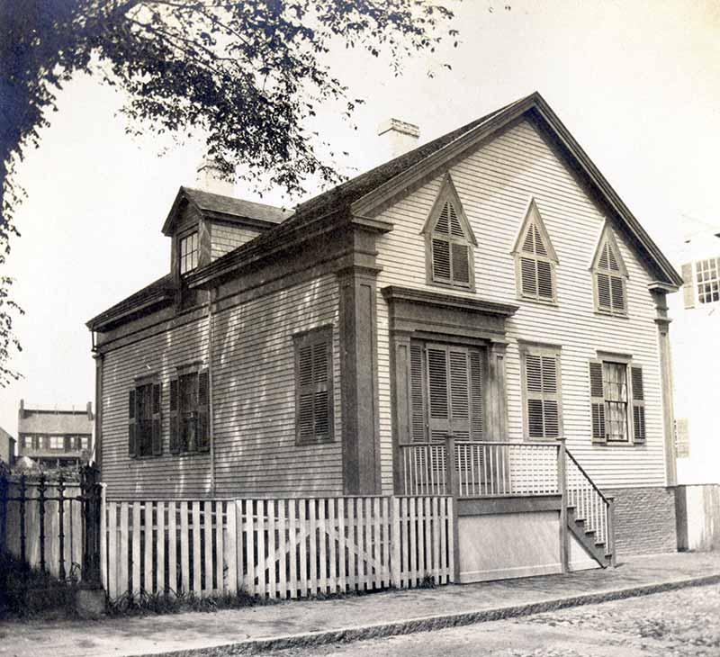
Rich History & Architecture
Historic buildings
Nantucket preservation trust
Notes:
People have also mention Nantucket’s rich history and its well preserved 17th and 18th century architecture.
94 Main Street An NPT House History. (2014, July). Retrieved December 08, 2020, from https://www.nantucketpreservation.org/househistory/94-main-street/
https://www.nantucketpreservation.org/househistory/94-main-street/

Slide 11
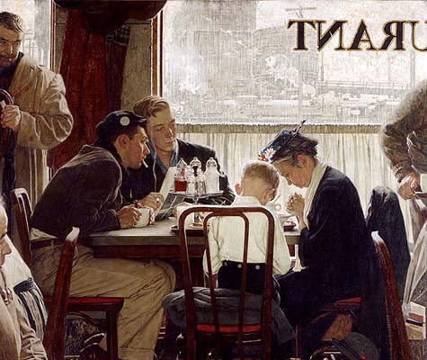
“A Norman Rockwell painting
come to life” - Jamie Holmes
Notes:
The island as a whole is very charming. As Jamie Homes puts it, it’s “a Norman Rockwell painting come to life.
https://www.nrm.org/2009/04/the-art-of-norman-rockwell-highlights-from-the-collection-currently-on-view/
Left:
Norman Rockwell (1894-1978), Saying Grace, 1951. Cover illustration for The Saturday Evening Post, November 24, 1951. Private Collection. © 1951 SEPS: Curtis Licensing, Indianapolis, IN. All rights reserved
Right:
Norman Rockwell (1894-1978), Spring Flowers, 1969. Oil on canvas, 30 3/8″ x 25″ Story illustration for McCall’s, May 1969. Norman Rockwell Museum Collection. ©Norman Rockwell Family Agency. All rights reserved.

Slide 12
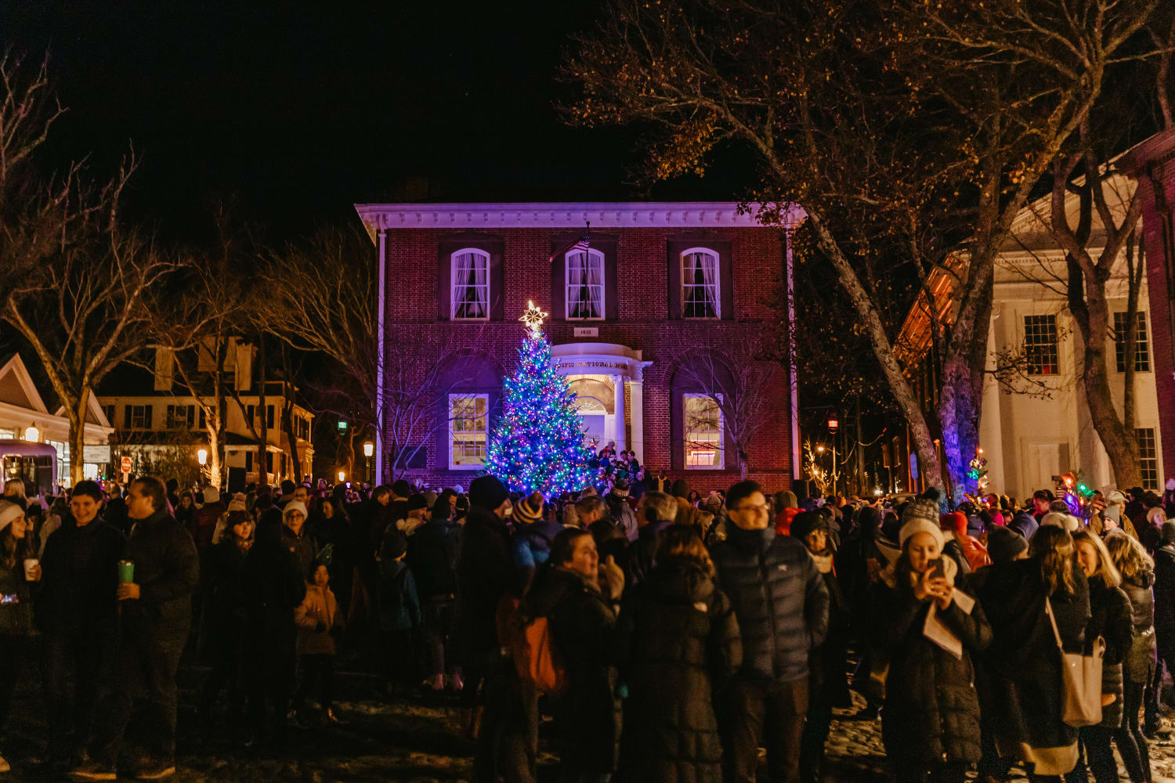
Supportive Community
Incorporate small town charm
The Annual Christmas Tree Lighting 2019
Notes:
And of course you can’t forget about Nantucket’s close-knit supportive community
The Annual Christmas Tree Lighting 2019
https://www.nantucketchamber.org/nantucket-noel
Nantucket Noel November 27&nbsp;- December 31, 2020. (n.d.). Retrieved December 08, 2020, from https://www.nantucketchamber.org/nantucket-noel

Slide 13
Community Concerns
Notes:
Through our interviews and surveys, our team assembled a list of issues Nantucketers think are detracting from the island culture, and researched their possible solutions.

Slide 14
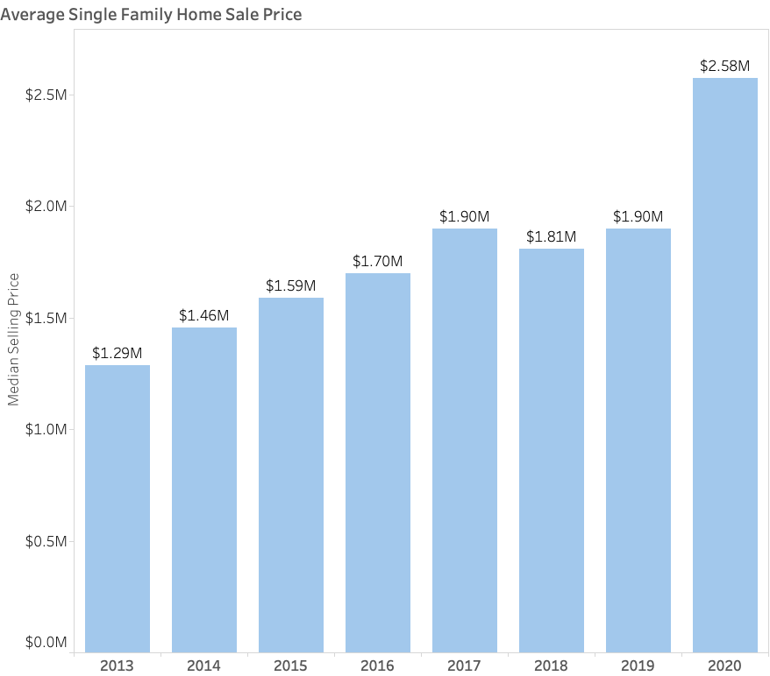
Nantucket Housing
Costs
Nantucket
Average Single Family Home Sale Price
Fisher Real Estate
Costs
Median Household Income 2014-2018 $105k
Notes:
It’s no mystery the price and availability of housing is a common concern on Nantucket, and it has only increased with the housing boom that’s come with COVID. We were surprised at how often interviewees expressed concerns this has on culture, but several noted how rising costs makes it harder for families to afford to live on the island, as well as people like artists, craftsmen, and local entrepreneurs. Thus, several worry that Nantucket is losing a piece of its culture by losing these people.
https://fishernantucket.com/how-much-does-a-house-in-nantucket-cost/
https://www.census.gov/quickfacts/fact/table/nantucketcountymassachusetts/BZA010218

Slide 15
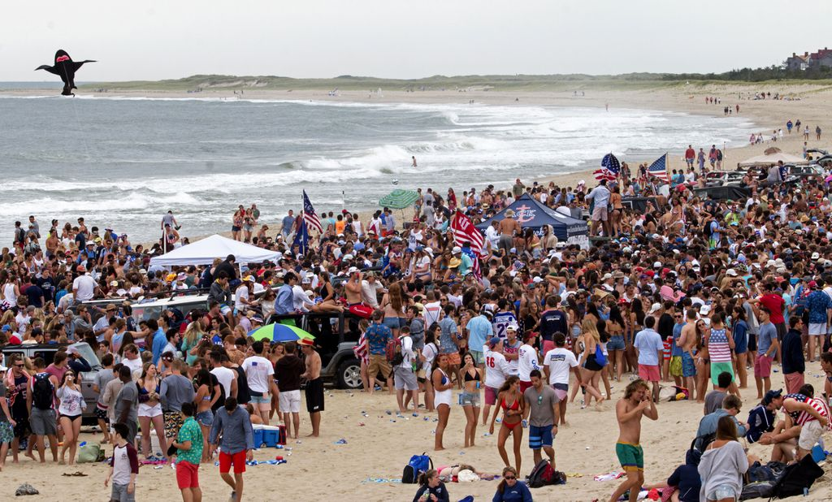
Overtourism
Nantucket should Appeal more towards Families
“Nantucket is a Victim of Its own Success”
Notes:
Additionally, many interviewees have expressed some events and parties have become more rowdy over the years, which is having an impact on Nantucket’s family-friendly culture. This combined with rising housing costs make it harder for Nantucket to attract families to the island. *PLAY FIRST TEXT BOX* Therefore, We suggest that Nantucket seek to appeal more towards families through its messaging and advertising campaigns, and apply our housing and event recommendations which we’ll go over later. *CLICK SLIDE TWICE* Crowds like this illustrate a central theme interviewees thought detracts from Nantucket’s culture - Overtourism. Two examples of overtourism can be shown on the next slide:
https://www.bostonglobe.com/metro/2016/06/30/nantucket-crackdown-rowdy-july-beach-party/1aA7k0EE1QCLdFfAYnKLOM/story.html

Slide 16
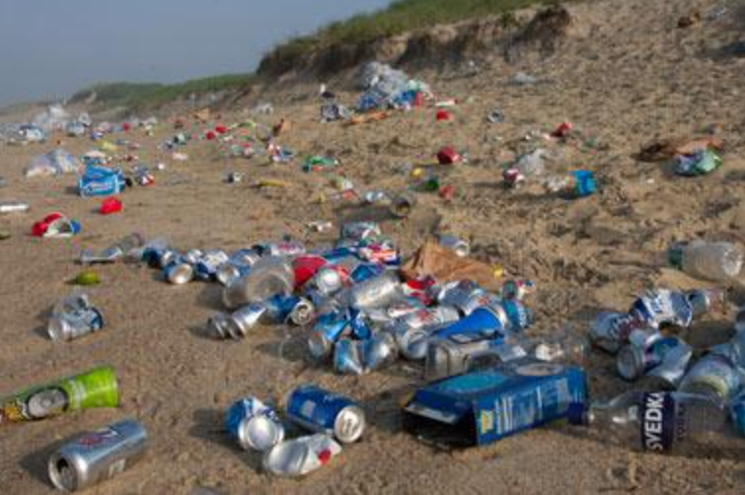
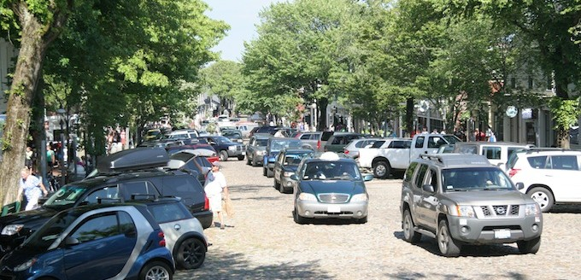
Effects of overtourism
Notes:
Some examples of overtourism can be seen through beaches and parking. Our survey of almost 200 residents showed that 93% of respondents think litter is a problem on Nantucket beaches, and more than 70% of respondents view overcrowding as an issue. Survey respondents were also concerned about a number of other beach-related issues, including disregard for wildlife nesting sites, trampling dunes, keeping dogs on leashes, and illegal beach driving. Additionally, many respondents mentioned parking and traffic as growing concerns; this includes parking in non-permitted spaces, on private property, and speeding. Furthermore many interviewees and survey respondents were concerned with bicyclists riding on sidewalks, and disregarding traffic signs. We found effects of overtourism not only threaten Nantucket’s community identity but also put a strain on the island’s resources and infrastructure.
://www.ack.net/article/20110811/NEWS/308119983 (TRASH)
https://www.leerealestate.com/blog-post/dude-wheres-my-car-on-nantucket/ (PARKING)

Slide 17
COVID
Notes:
With the coming of COVID-19, the island has faced an even greater strain to balance economic growth and cultural preservation. COVID has required businesses to take more steps to ensure the safety of their patrons, and, as a result, the Town has relaxed or suspended many other regulations to ensure businesses have enough opportunities to get by. However, many in town were concerned that it relaxing restrictions may disturb Nantucket’s culture and make it difficult to return to normalcy after COVID ends. Notably, there were differing opinions on the increase of commercialization in public spaces, favorably in the case of outdoor dining, and unfavorably in the case of outdoor signage and merchandise displays.

Slide 18
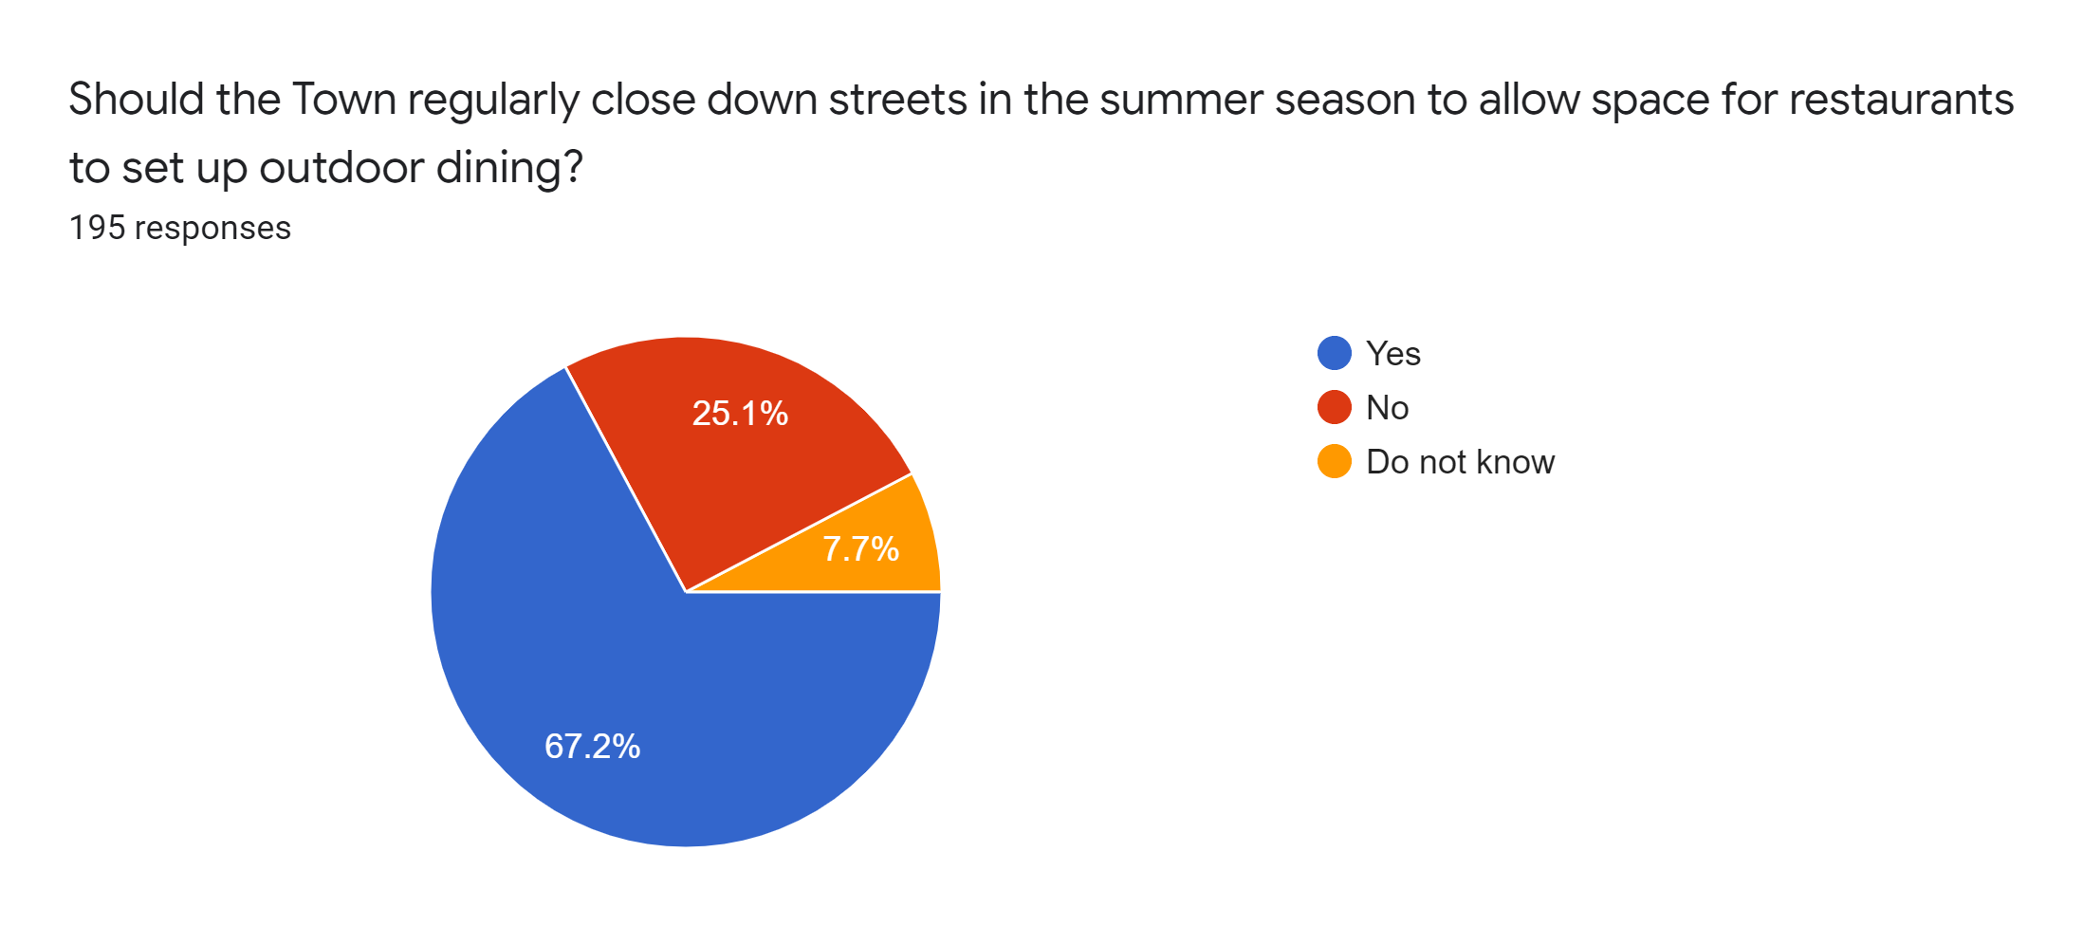
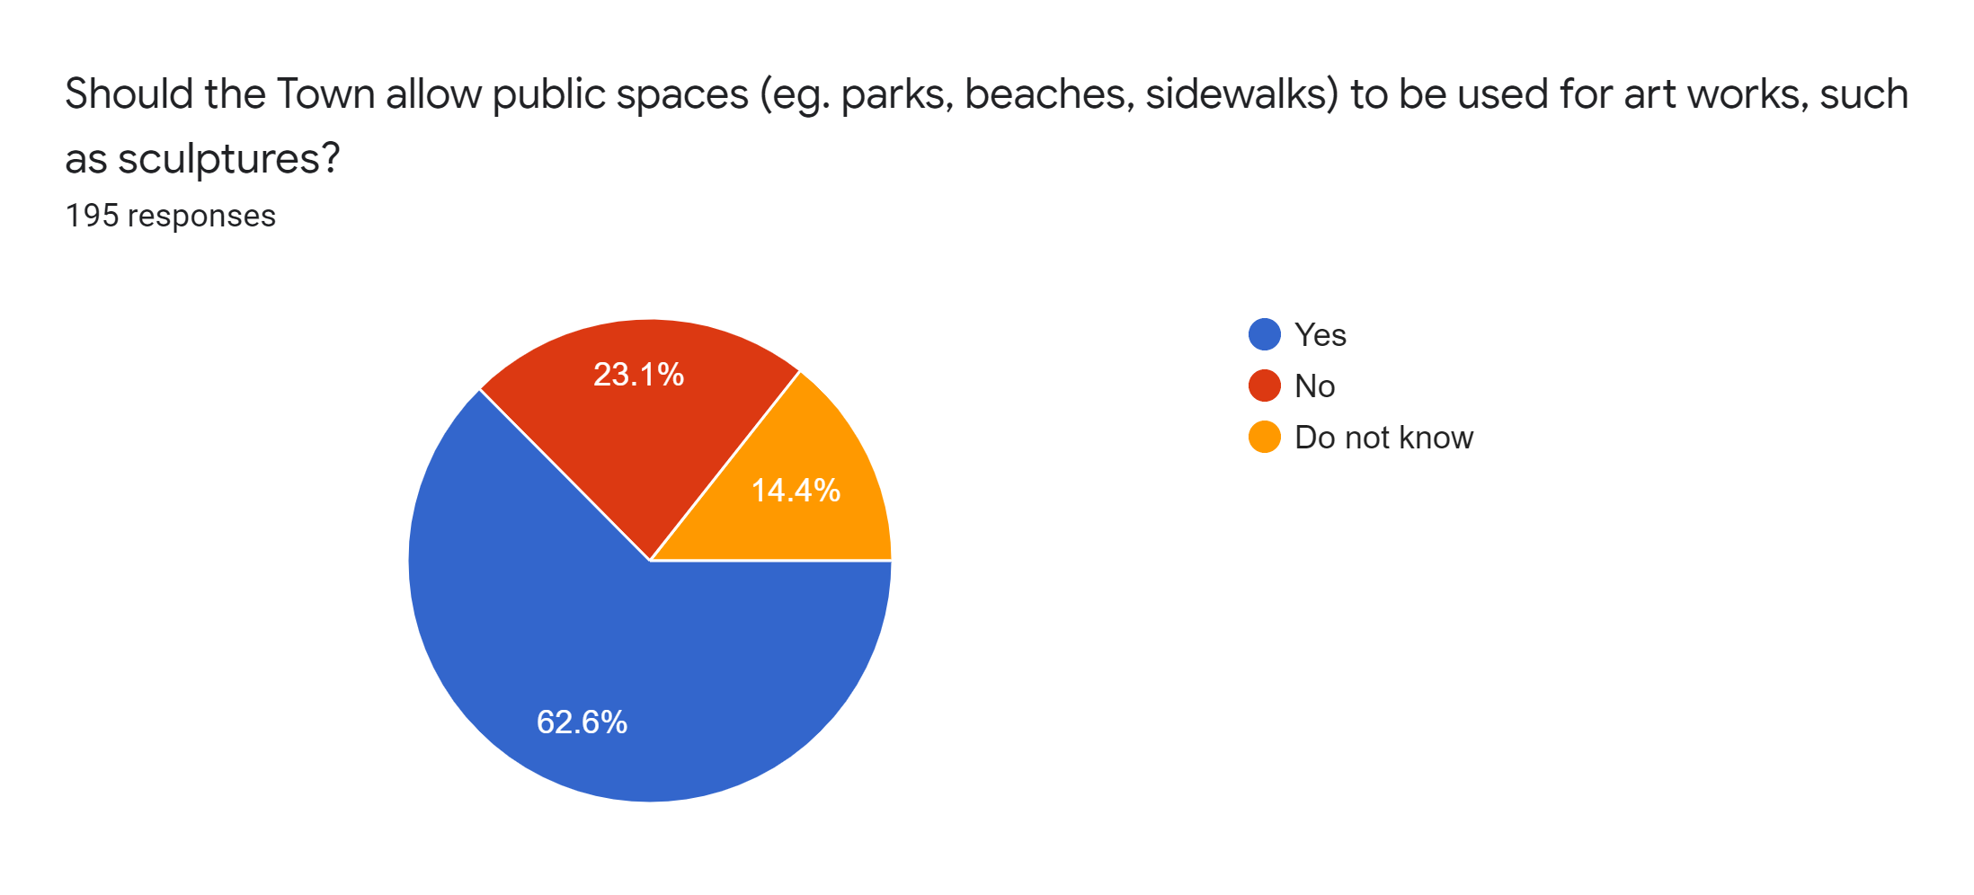
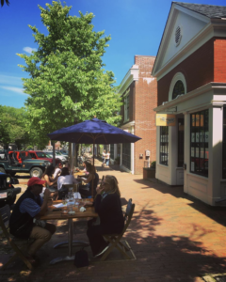
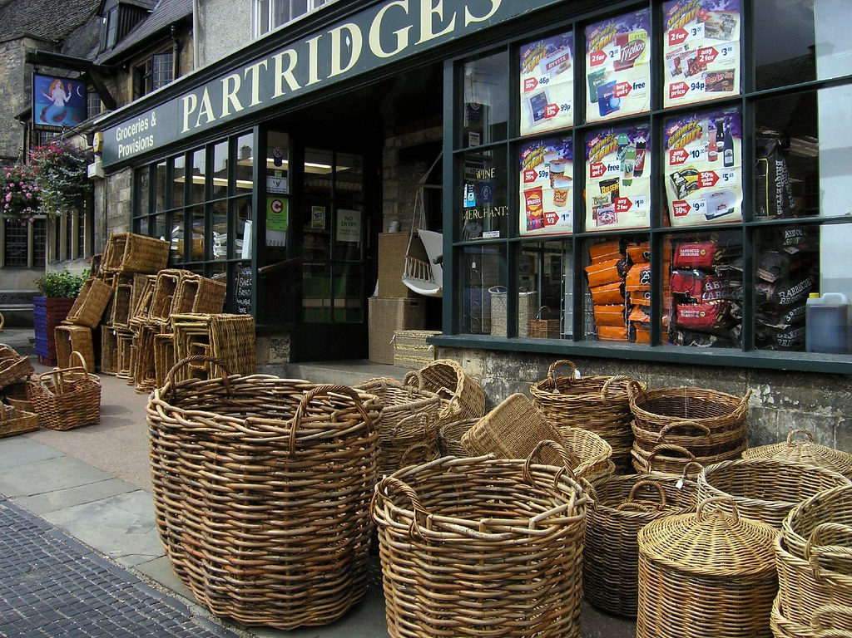
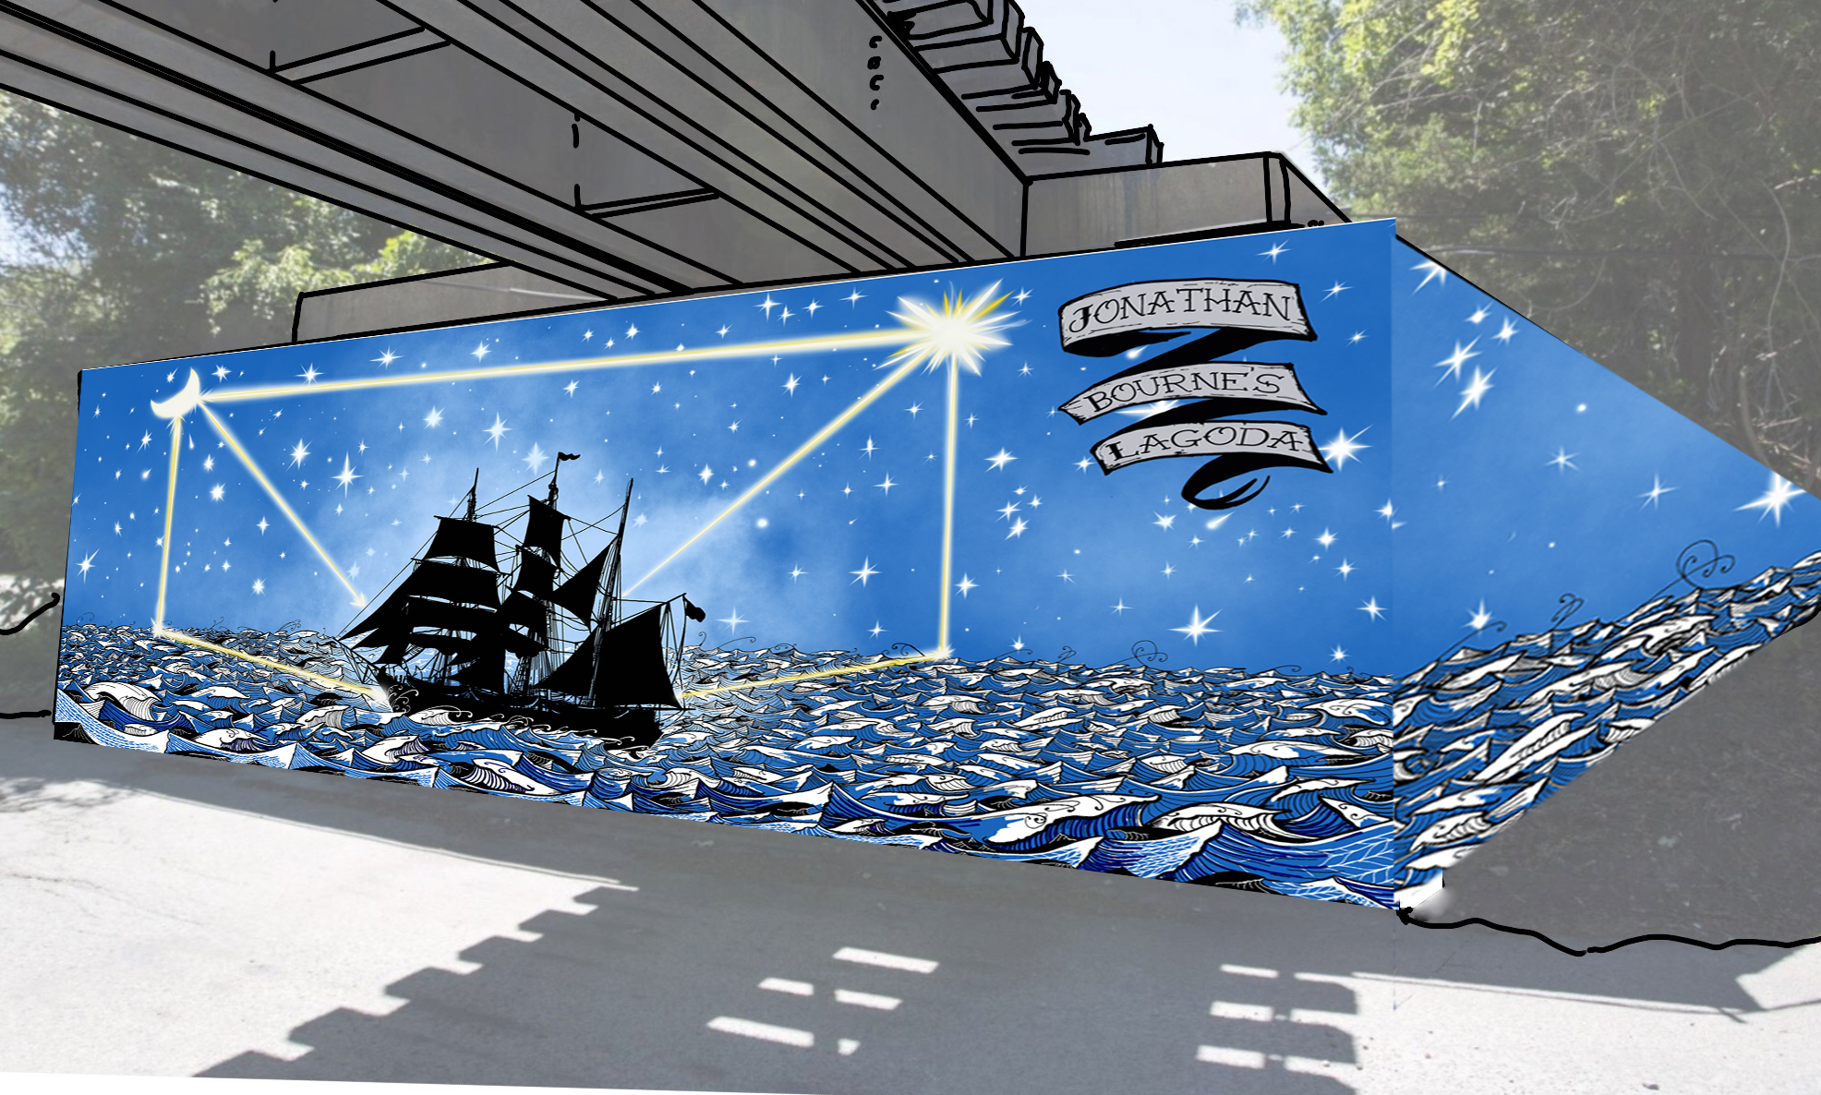
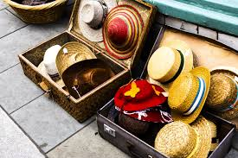
Or, The Whale
Outdoor Art
Outdoor dining
Artist: Timothy Cole, ig: @partner_projects
Outdoors
Notes:
The majority of people surveyed favored allowing outdoor dining in public spaces, and many interviewees loved it. Interviewees claimed that outdoor dining brought a renewed vibrancy downtown, and contributed positively to Nantucket’s culture. Several interviewees indicated they had concerns about crowding and traffic if streets were allowed to be closed down in the future. Since Nantucket saw a decrease in visitors this season, it is possible that issues of crowding or traffic were not seen. However, most people would keep outdoor dining going into the future.
Click!
The majority of survey respondents disagreed or strongly disagreed with allowing businesses to place sandwich boards and merchandise displays in the public way. Notably, people do not want to see this covid precaution stay, in contrast to outdoor dining. Signage and merchandise displays are just not part of Nantucket’s culture, and should no longer be allowed once the pandemic ends according to interviewees.
Click!
We have heard that during the pandemic, a number of art installations have been put on public property this year, though not formally permitted. Interviewees routinely mentioned how Nantucket is an “artist colony” and several people we spoke to were artists themselves. We asked survey respondents if the Town should allow the use of public spaces for art in the future. The majority of respondents were in favor of the proposition, and many left comments on how art improves Nantucket’s visual appeal. Several people disagreed with placing art on sidewalks, and others worried about “bad art” being put up. However, art is a defining part of Nantucket’s cultural identity, and artists should be allowed to display their art in in public spaces.
Click on slide to show different materials
On the right is an image of concept art for a mural by Tim Cole at the Historical Society Museum Complex on Cape Code.
21 (Ventuno) Nantucket Patios for Al Fresco Dining this Summer. (2020, August 07). Retrieved December 07, 2020, from https://fishernantucket.com/21-nantucket-patios-for-al-fresco-dining/
"P8120047-A storefront in Burford, England" by Gail Frederick is licensed under CC BY 2.0

Slide 19
Enforcement
Bylaws too complicated to handle efficiently
Deterrence is an issue
Violations can occur and recur easily
Penalties can be insignificant
Process can take too long
Notes:
It can be difficult to enforce some of Nantucket’s bylaws because they are incredibly detailed, and complicated to handle efficiently. Ex. Putting up a sign on private versus public property is not always clear to business owners, though they cannot put signs on public property (sidewalks)
Deterrence is an issue
Violations can occur, and recur easily again (put the same sign back out!)
Penalties can be insignificant (civil fines can be small in some instances , ex riding bike wrong way, and in other case businesses are willing to pay hundreds in fines when their revenue is in millions)
Process can take too long, give notice, allow time for correction, escalate issue, then give fine. Businesses leave!

Slide 20
Recommendations
Notes:
We conclude that Nantucket is a unique place, but many people feel that character is threatened by overtourism and the recent changes due to COVID. We have developed a set of recommendations to preserve Nantucket’s unique culture both now and as we transition back to normalcy after COVID.

Slide 21
Recommendations
1
Encourage the family-friendly nature of the island through advertising campaigns.
Notes:
Nantucket is developing a reputation as an emblem of social status and for partying. Branding needs to realign its reputation for being a family friendly destination to relax, unwind, and explore local culture. Using advertisement campaigns that promote this message will help.

Slide 22
Recommendations
2
Develop a community integration program for new and prospective homeowners.
Notes:
There are many customs, conventions, bylaws, and regulations that residents need to know! With Nantucket’s growing popularity, helping new residents integrate into the island will help strengthen appreciation and respect for Nantucket’s unique culture.

Slide 23
Recommendations
3
Expand affordable housing programs while limiting the impact from off-island investors.
Notes:
The Town needs to identify ways to reduce competition or increase the buying power for residents by expanding affordable housing programs. Building more houses may not be the best solution as there is stiff competition for land. At the same time, the town must limit the influence that off-island investors and businesses have in short-term renting on the island.

Slide 24
Recommendations
4
Limit the number of new events and alcohol permits
Notes:
While events are valuable to Nantucket’s economy, many Nantucket residents are facing “festival fatigue” and would like to see fewer events or keep the number of events on the island the same. Additionally, some major events on the island are becoming saturated with alcohol and public drinking, making downtown unpleasant to visit for locals. The Town should consider reducing the number of new events permitted and the associated alcohol permits, deemphasize the need for alcohol consumption at current events, and bolster enforcement towards public alcohol consumption

Slide 25
Recommendations
5
Continue communication with the Chamber of Commerce after COVID-19 to ensure opportunities for local businesses.
Notes:
We heard that communication between the Town and the Chamber of Commerce was wonderful this year, and would like to see this continue in the future. Initiatives like allowing outdoor dining have helped businesses during these troubling times, and they need the continued support in the future.

Slide 26
Recommendations
6
Promote beach etiquette with summer education materials.
Notes:
The Town needs to promote beach etiquette to visitors, which can be accomplished through educational materials in the summer
End of Sam’s Section

Slide 27
Recommendations
7
Adjust bylaws to allow outdoor dining in public spaces during summer months on a regular basis.
Notes:
Outdoor dining in public spaces was popular this year, and the town should adjust bylaws to allow it to happen on a more regular basis in the future. Important concerns such as parking, crowding, accessibility, and litter must be considered when developing an plan to enable outdoor dining. Additionally businesses without locations favorable for outdoor dining must be provided equal opportunities when considering this change.

Slide 28
Recommendations
8
Phase-out outdoor signage and merchandise displays after the COVID pandemic has ended(ERTF).
Notes:
It is clear that unapproved signage and merchandise displays in the public way are not part of Nantucket’s culture, and should be phased out in the future when the COVID pandemic has ended, when deemed appropriate by the Economic Recovery Task Force. This should be a gradual and clearly communicated process to allow businesses a grace period for announcing reopenings.

Slide 29
Recommendations
9
Consider a temporary program for occasional outdoor retail markets.
Notes:
Following the lead of outdoor dining, we asked about whether or not retail stores should be given the same opportunities as restaurants by allowing outdoor retail markets in public space. Since public opinion was split on this issue, the town should continue gathering the public’s opinions, and consider developing a program to allow outdoor retail markets in an acceptable manner.

Slide 30
Recommendations
10
Develop permitting process for art installations.
Notes:
The Town should develop a pathway to permit art in public spaces on a rotating basis. Art contributes positively to Nantucket's ideal scenery and streetscapes. Public spaces can be appropriate venues for art installations on a rotating basis to allow equal opportunities for Nantucket’s own artists to have their own displays

Slide 31
Recommendations
11
Gather public opinion on what culture the community wants to foster after the pandemic ends.
Notes:
We were not able to survey many business owners, and recognize that there are other interests involved on the island who may share unique perspectives on Nantucket’s cultural identity and how to move forward after COVID. The Town should continue gathering public opinion, through surveys and interviews, on the culture the community wants to promote now and in the future.

Slide 32
Recommendations
12
Provide more resources to enforcement agencies, strengthen deterrence capabilities, and expand cultural education campaigns.
Notes:
Enforcement agencies, voluntary and paid, should identify resources they need to make their agencies more efficient and versatile, and present their findings to the Town for reasonable accommodation of their needs. The Town should reevaluate the value of penalties and fines as necessary to develop meaningful deterrence without being excessive. Educational programs should be expanded and used routinely to remind visitors, business owners, and residents of Nantucket customs and conventions as well as its bylaws, rules, and regulations. We have already begun to develop new materials and revise old ones.

Slide 33
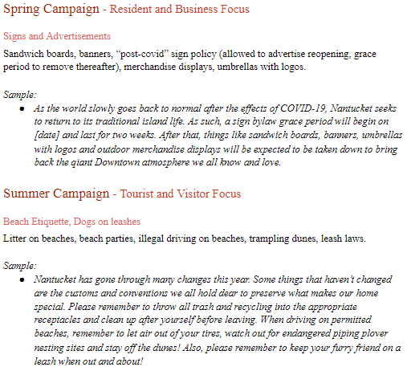
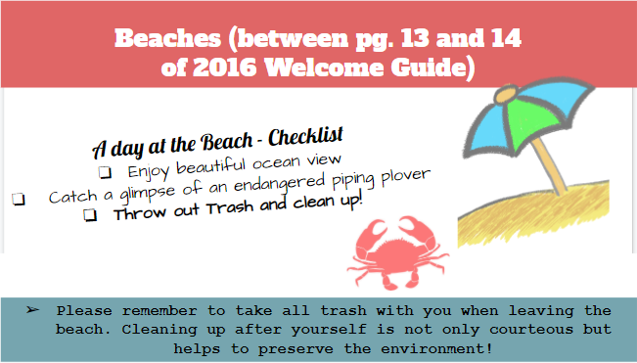
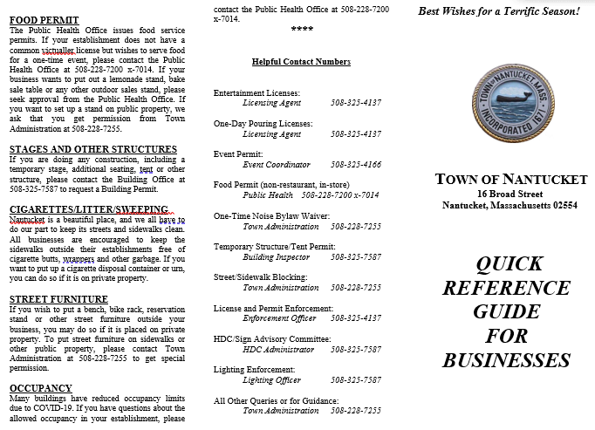
Materials in Development
Revised Business Guides
Island Welcome Guide revisions
Radio Ad Campaign
Timeline of Distribution
Notes:
Aside from our list of recommendations, These materials include - *FIRST QUE* two revised Quick Reference Business Guides, one for COVID-19 information and a “Back to normal” Guide, *SECOND QUE* revisions to the Island welcome guide geared towards visitors and new islanders, *THIRD QUE* a series of radio public service announcements according to the season, and *FOURTH QUE* an informational poster to be published in a local Nantucket newspaper.
Click on slide to show different materials

Slide 34
Thank you!
Sponsors: Nantucket Department of Culture and Tourism Janet Schulte Gregg Tivnan
Project Adviser: Dominic Golding
Special Thanks to: Nantucket Civic League Town Administration Chamber of Commerce
To all our interviewees and survey respondents,
Thank You!
Notes:
Thank you to the Chamber of Commerce for help distributing our business survey.

Slide 35
Questions?

Slide 36
Moving Forward - delivery of materials
Spring 2021
Airing of first radio PSA
Delivery of COVID-19 Business Guide through Chamber
Outsource revision of Island Welcome Guide based on our recommendations
Summer 2021
Airing of summer radio campaign
Dissemination of revised Island Welcome Guide
Publishing of informational poster in newspaper and online
Fall / Winter 2021
Airing of fall/winter PSAs as needed

Slide 37
Image references
"Nantucket Holiday Stroll - Nantucket" by Massachusetts Office of Travel & Tourism is licensed under CC BY-ND 2.0
Town of Nantucket [@townofnantucket]. (2020, November 5). Nantucket Beaches[Instagram photograph]. Retrieved from https://www.instagram.com/p/CHQoaBoj5Y2/
94 Main Street An NPT House History. (2014, July). Retrieved December 08, 2020, from https://www.nantucketpreservation.org/househistory/94-main-street/
Norman Rockwell (1894-1978), Saying Grace, 1951. Cover illustration for The Saturday Evening Post, November 24, 1951. Private Collection. © 1951 SEPS: Curtis Licensing, Indianapolis, IN. All rights reserved
Norman Rockwell (1894-1978), Spring Flowers, 1969. Oil on canvas, 30 3/8″ x 25″ Story illustration for McCall’s, May 1969. Norman Rockwell Museum Collection. ©Norman Rockwell Family Agency. All rights reserved.
Nantucket Noel November 27&nbsp;- December 31, 2020. (n.d.). Retrieved December 08, 2020, from https://www.nantucketchamber.org/nantucket-noel

Slide 38
Image references (continued)
Allen. S. J. Principal Broker, Fisher Real Estate. Personal Communication. (07 December 2020)
21 (Ventuno) Nantucket Patios for Al Fresco Dining this Summer. (2020, August 07). Retrieved December 07, 2020, from https://fishernantucket.com/21-nantucket-patios-for-al-fresco-dining/
"P8120047-A storefront in Burford, England" by Gail Frederick is licensed under CC BY 2.0
Cole, T. E. (2017). Aptucxet Murals. Retrieved December 08, 2020, from https://www.patronicity.com/project/aptucxet_murals
McCabe, K. (2016, June 30). Your rowdy beach party is not welcome on Nantucket—The Boston Globe. BostonGlobe.Com; Boston Globe. https://www.bostonglobe.com/metro/2016/06/30/nantucket-crackdown-rowdy-july-beach-party/1aA7k0EE1QC
Graziadei, J. (2011, August 11). Surfside residents rip Fourth of July Nobadeer party. The Inquirer and Mirror.
Dunlap, S. (2011, August 11). Dude, where’s my car on Nantucket? Lee Real Estate. https://www.ack.net/article/20110811/NEWS/308119983

Slide 39
Recommendation
Research methods to alleviate parking concerns Downtown.
Notes:
We recognize parking was the focus of a WPI project in the past, but more research is needed to develop additional plans and evaluate their effectiveness. Alleviating parking issues can help attract residents back into Downtown and improve accessibility to the island’s cultural center.

