Slide 1
LED STREETLIGHTING ON NANTUCKET
Brendan King, Luke Marcoux, Frederick “Forrest” Miller, & Samuel Sands
Notes:
Sam

Slide 2
Summary of Presentation
Our project goal
Summary of problems
Proposed solutions
Review of Best Practices
Conclusion and Recommendations
Notes:
Brendan
Now for a quick summary of our presentation. We will discuss...
The goal of our project, a summary of the problems related to our project, the proposed solutions, a review of best practices, and our final conclusion and recommendations.

Slide 3
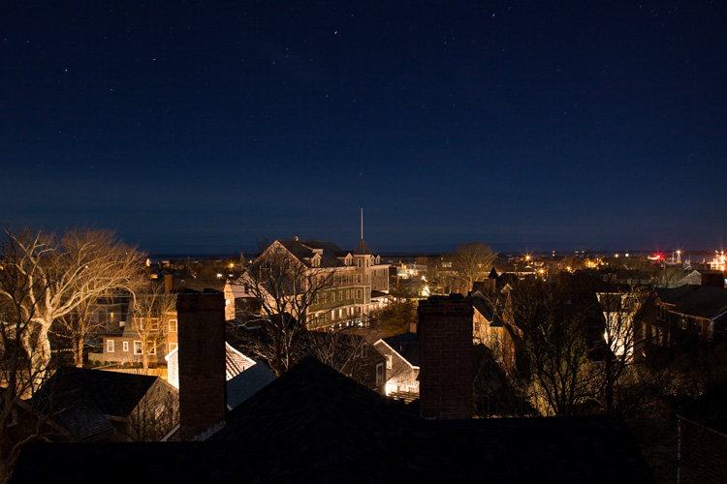
Project Goal
The goal of this project is to evaluate the best practices of an LED streetlight conversion, and how these practices can be applied on Nantucket.
Notes:
Sam
The town has conducted 2 LED pilot programs in the past with varying styles and specifications, such as color temperature, of LEDs on milestone road (2019) as well as in the historic downtown with some of the decorative streetlights (2014)
The reception of these two pilot programs helped lead the NEO towards approaching this project more holistically with our IQP team, researching other succesful projects in other communities.
For the decorative streetlights
The popular color was that closest to the existing orange color
They are scattered throughout the downtown
Some are burned out, others have been replaced with hps
2700K
For milestone road
4000K
Near the rotary and in other locations further down milestone road

Slide 4
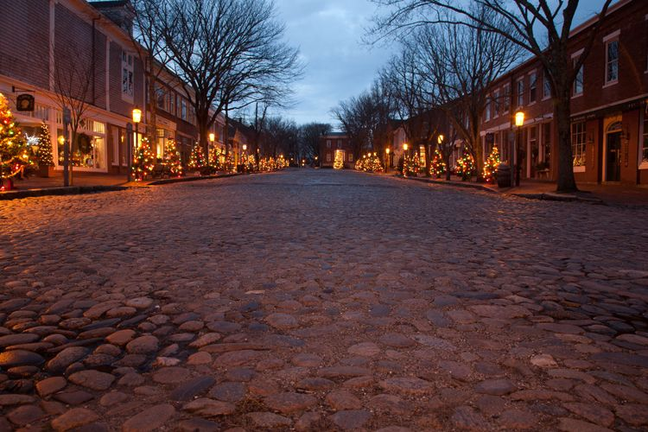
Objectives
Research best practices for streetlight replacement
Solicit input from stakeholders
Develop recommendations for conversion
Notes:
Sam
Research best practices for converting current streetlighting to LED, including an evaluation of Massachusetts towns that have already converted to LED streetlighting.
Solicit input from stakeholders on Nantucket regarding possible conversion of the existing cobra-style HPS streetlights to LEDs.
Develop a recommended set of processes and policies for the implementation of a LED conversion based on the findings from objective 1 and 2.

Slide 5
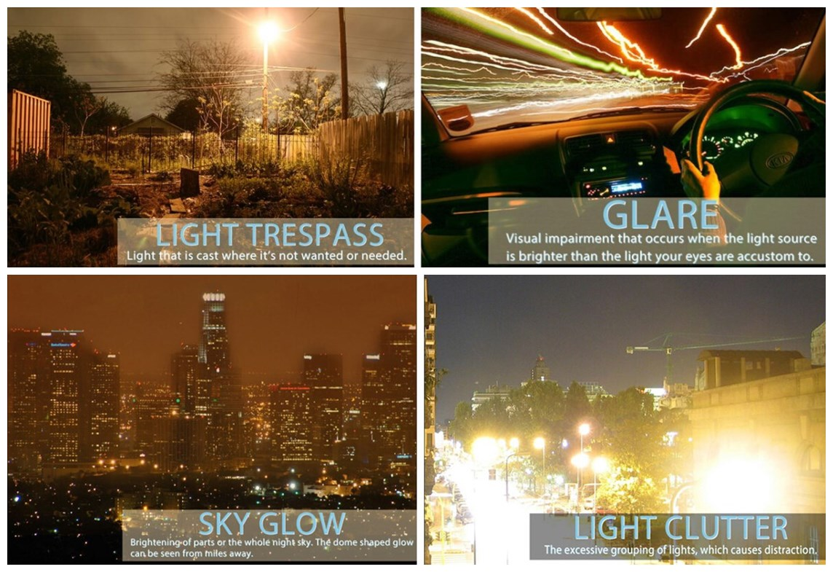
Light Pollution
What is light pollution?
2012 to 2021: 20% more light pollution
Adverse effects
Notes:
Sam
Light pollution is scattered artificial light, predominantly from streetlights and interior/exterior building lighting.
There are 4 main types of light pollution
Trespass: unwanted light being cast, especially into private residences
Glare: light visually impairing motorists and pedestrians
Sky glow: the entire night sky being brightened due to light pollution
Clutter: large grouping of many lights, big contributor to sky glow and an additional distraction
Based on the metrics that experts use to measure light pollution, they've seen about a 20% increase in surface brightness from 2012 to 2021.
Light pollution, specifically trespass interrupts sleep patterns and the natural circadian rhythm.
Light pollution also has a negative impact on wildlife
It can affect migratory patterns of animals whose natural indicators are interrupted by the presence of additional artificial light
One example for many coastal communities is how sea turtles rely on moonlight to navigate during their hatching and light pollution can disorient them and make them unable to return to the ocean.
For insects, light pollution leads to population decline.

Slide 6
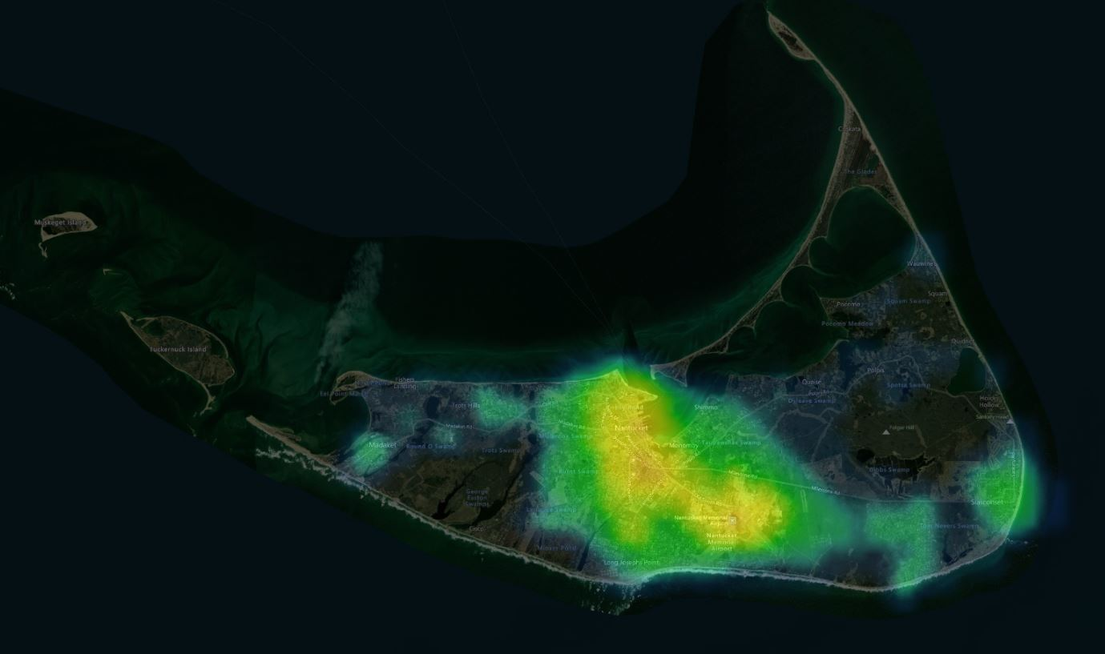
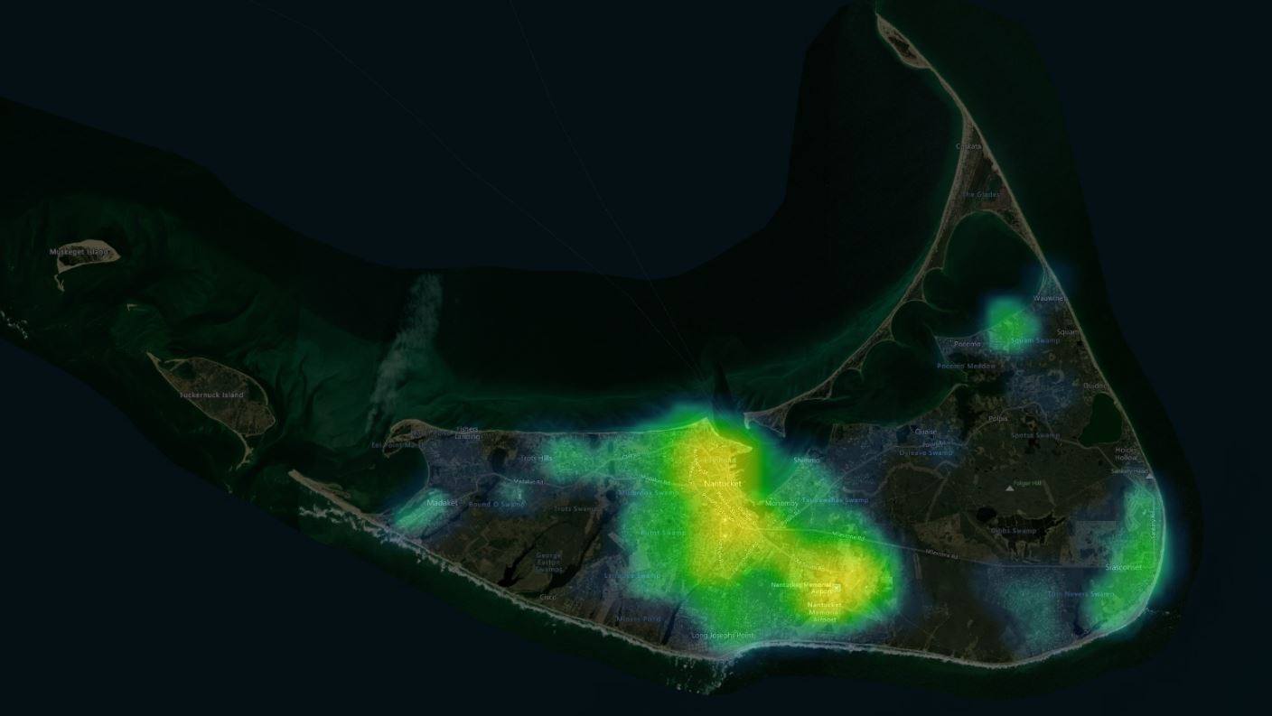
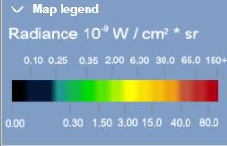
2012
2021
Nantucket
Madaket
Schools
‘Sconset
Airport
Notes:
Sam
To give a better visual of that 20% figure, here is the light pollution on Nantucket in 2012 versus in 2021
Note that it is concentrated around the most populated areas, downtown, the airport/school and 'sconset.

Slide 7
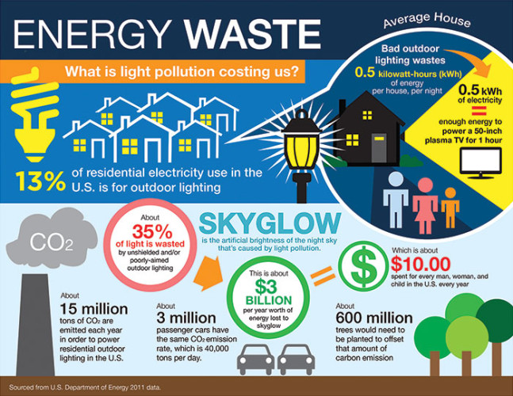
Energy Savings
Light pollution wastes about $3.5 billion each year due to excess lighting
LEDs offer high efficiency and long lifetimes
Can be dimmed
More directed
Notes:
Brendan
It is estimated that light pollution now costs the United States about $3.5 billion each year in terms of wasted energy alone as a result of improper, overly dense and basically poorly planned outdoor lighting (Van Der Put, n.d.).
We can reduce energy waste and boost savings using LEDs.
Compared to high pressure sodium (or HPS) bulbs which we are used to, these LEDs (or light emitting diodes) have high energy efficiency and will last much longer.
LEDs also have the ability to be dimmed, which can be used to reduce energy usage.
Any bit of mis-directed is energy which has gone to waste, as the light would no longer be fulfilling its purpose. LEDs can be more easily directed to a target area unlike HPS.

Slide 8
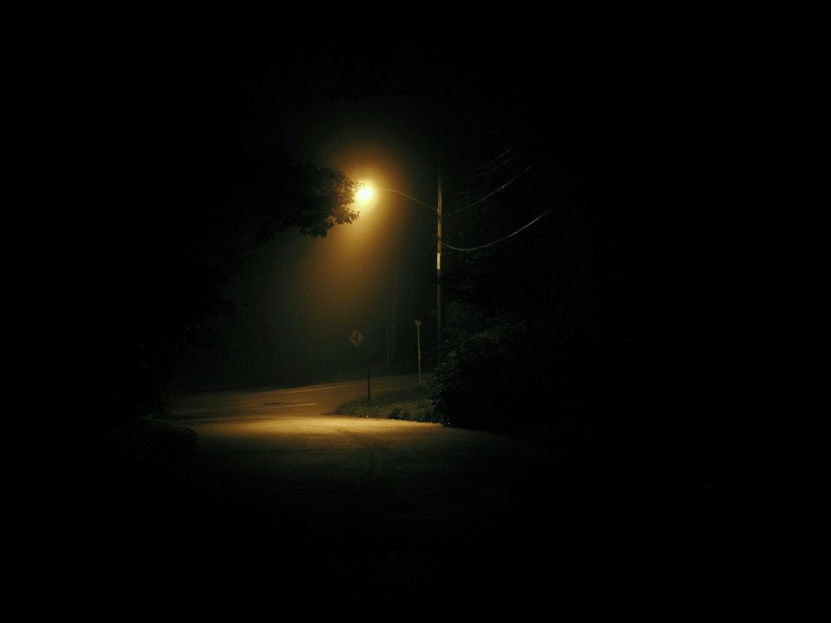
Responsibility & Maintenance
Streetlights are owned and maintained by Nantucket’s current electricity provider: National Grid
Nantucket pays ~$7,700 per month to maintain an estimated ~600 cobra-head streetlights
Notes:
Forrest
•National Grid owns & maintains the streetlights on Nantucket
•when there are streetlight issues, they must be reported directly to National Grid for them to resolve
•Currently, Nantucket pays ~$7700 monthly to maintain 594 cobrahead streetlights based on National Grid’s latest inventory
•Maintenance is one factor, others are supply & delivery that make up the full bill
•Of the 594 cobra head lights, 586 are HPS, and 8 are LED of various specifications and features

Slide 9
Color Temperature
10000 K
9000 K
8000 K
7000 K
6000 K
5000 K
4000 K
High Pressure Sodium lights are around ~2200K
LED streetlights typically range from ~4000K to 2700K
3000 K
2700 K
2200 K
(K = Kelvin)
Notes:
Luke
Color temperature is a metric used to measure the quality of light that lights give off and is measured in Kelvin.
For streetlights, we will only be concerned with 4000K lights and below.
…
When choosing streetlight color temperatures, its important to choose the correct temperature for the situation. Additionally, it is important to consider light pollution.

Slide 10
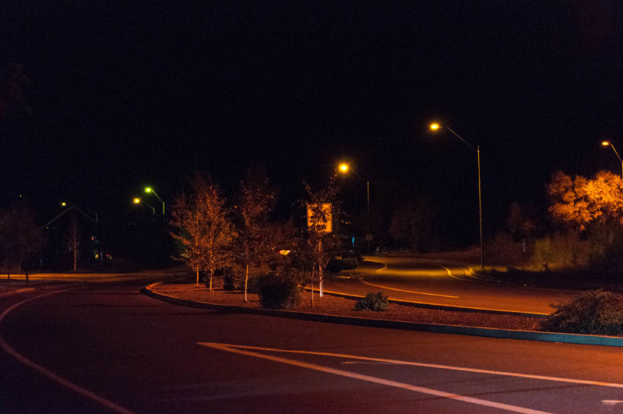
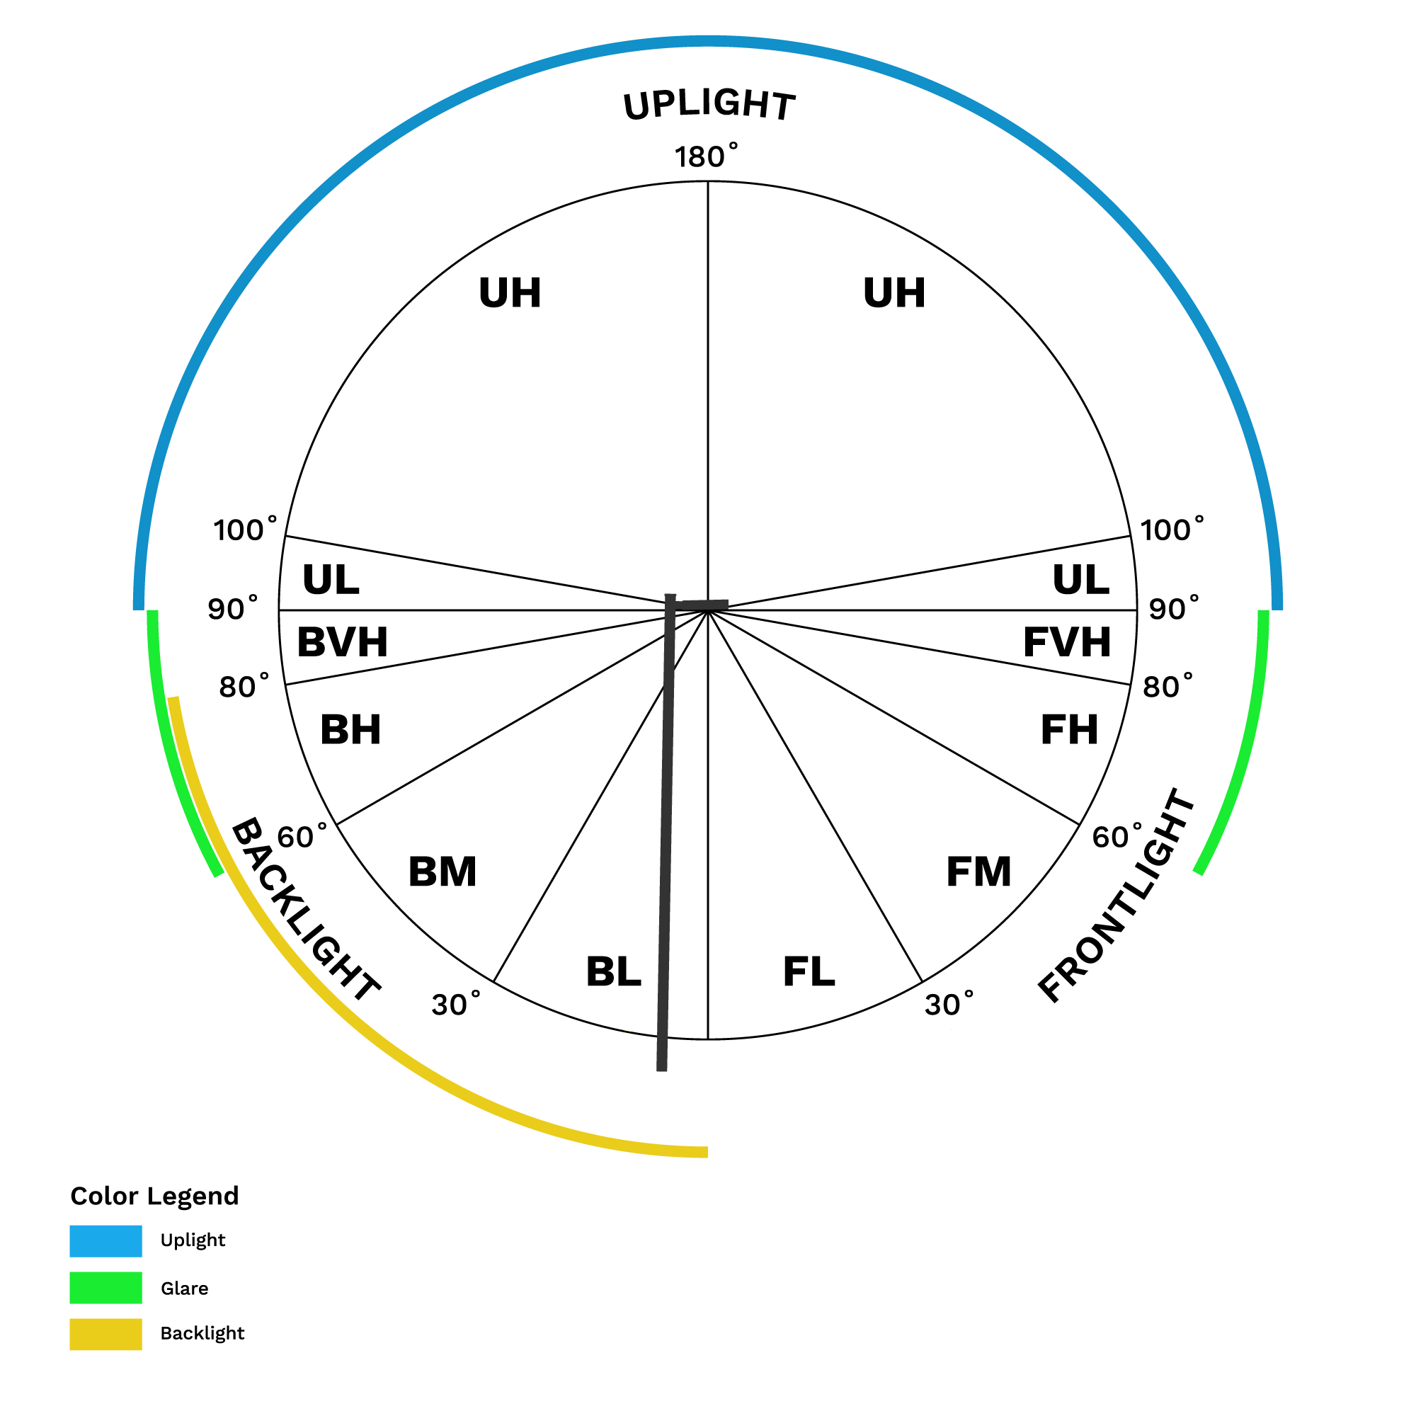
Managing Light Pollution
B.U.G. Rating
Backlight
Uplight
Glare
Shielding helps reduce light pollution
Shields no longer available for HPS lights
Dark-Sky compliance
2200K LEDs
Notes:
Luke
Another important metric for measuring streetlights is their BUG rating.
BUG rating is used by the International Dark Sky Association to determine how much light trespass a light produces
…
Additional shielding around lights can help to reduce this light trespass.
Now that you’ve heard the challenges we’ve faced, lets move on to some solutions.

Slide 11
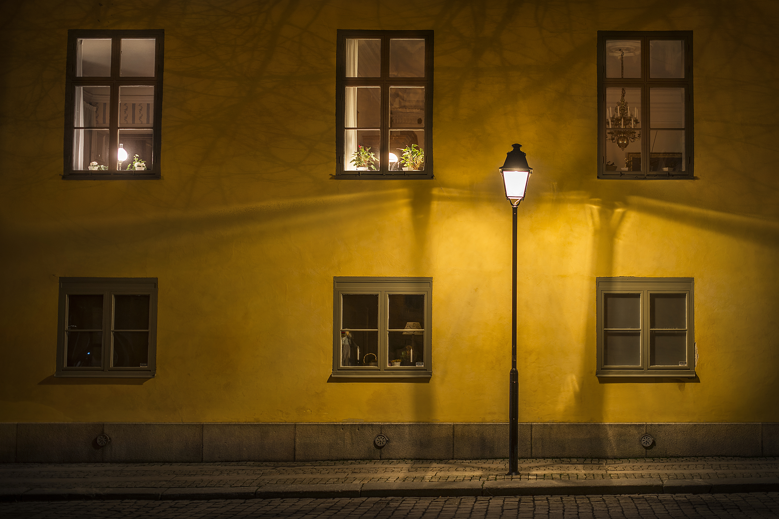
Ideal Streetlight Scenario
Reduced energy consumption
Minimal maintenance
Automatic dimming
Dark sky compliant fixtures
Significantly reduced light pollution
How do we get here?
Notes:
Luke
Here we have the perfect solution. Streetlights almost never need maintenance. They automatically dim after 10pm. Produce virtually no light pollution.

Slide 12
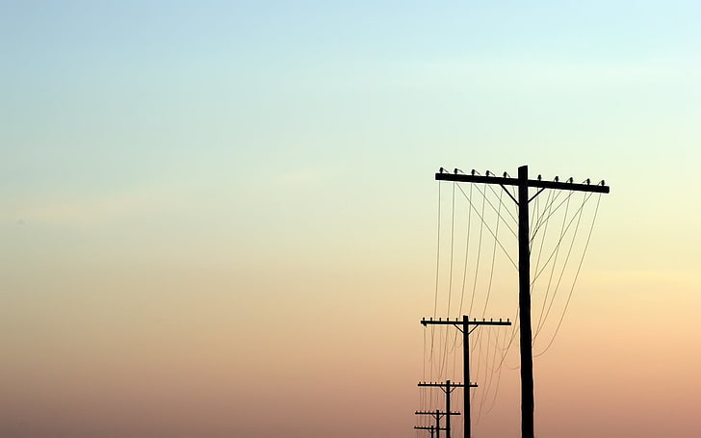
Option 1: Stay with National Grid
Allow NGrid to perform the conversion
3000K lights pilot program
Cost savings
Lower energy consumption
Lower maintenance
Notes:
Brendan
Well one option would be to consider the scenario where National Grid continues to own Nantucket's cobra-head streetlights. In this case Nantucket would stay with National Grid as the owner of the streetlights.
Nantucket could still perform an LED conversion, but they would have to ask National Grid to do it.
Nantucket can conduct a third LED pilot program by asking National Grid to install 3000K LEDs into a couple streetlights once available. After accumulating feedback, the town can either reject them and ask National Grid to convert back to HPS bulbs, or go ahead with a full conversion.
As a result of the conversion, there will be some cost savings in energy consumption and less need for maintenance because of the LEDs.
Downside: No guarantee National Grid will install the lights perfectly. Light pollution could get worse.
Downside: National Grid continued billing, making the savings much lower.

Slide 13
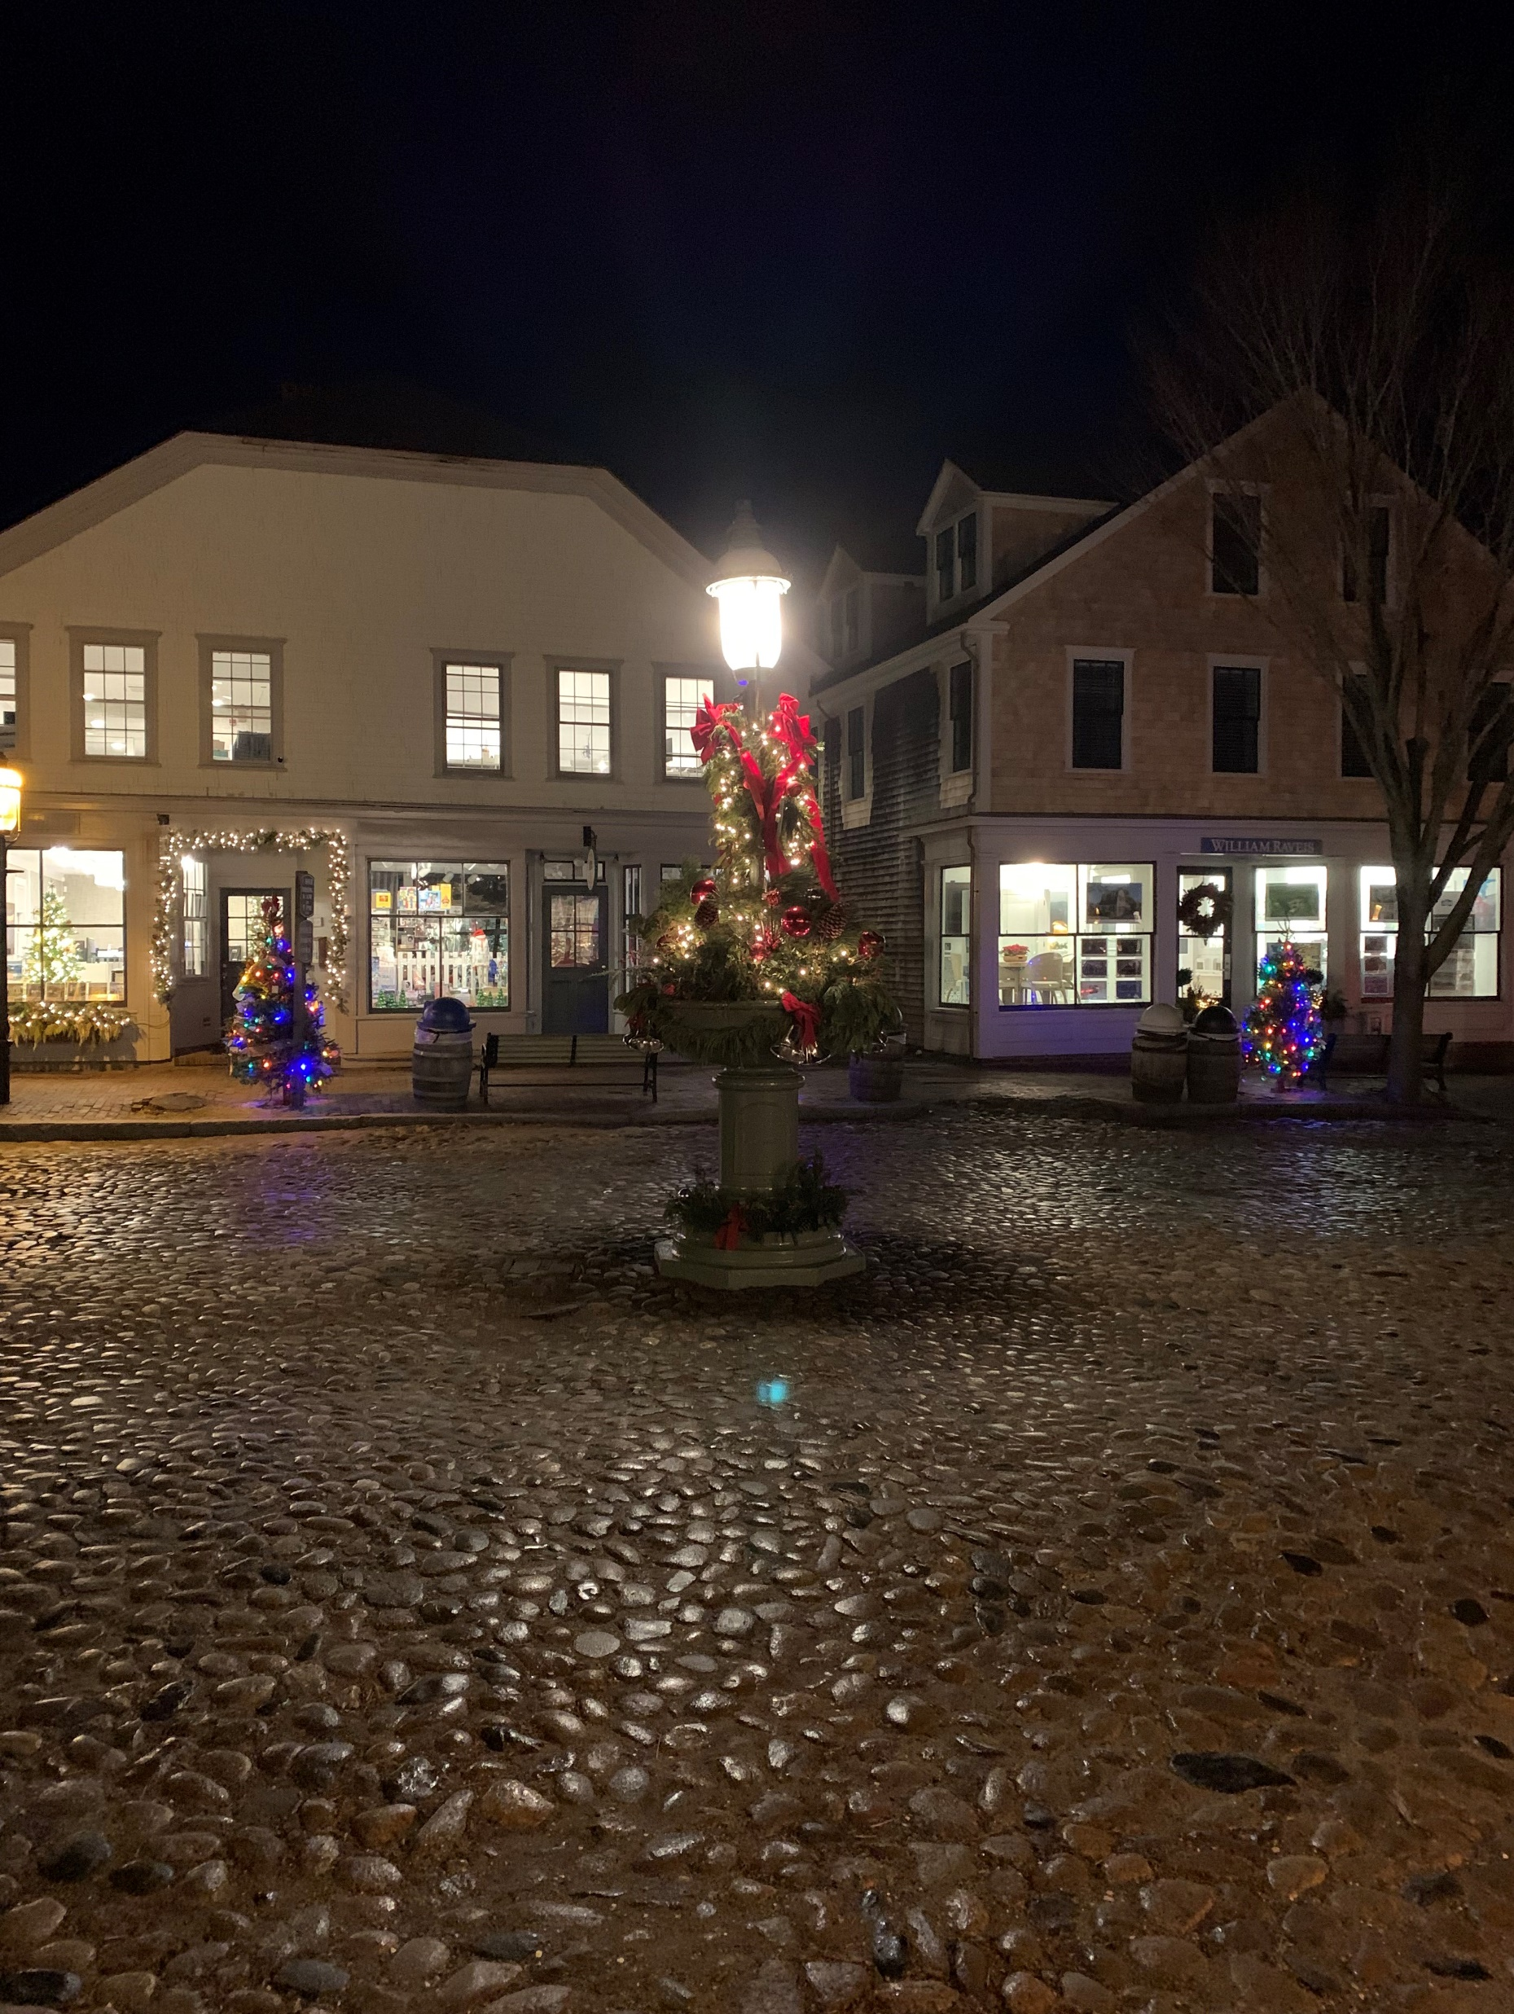
Option 2: Purchase the Streetlights
The Town of Nantucket assumes responsibility of the streetlights
Increased responsibility
Initial cost to buy the lights of $260,000
Greater long-term savings
Notes:
Forrest
•Nantucket buys the HPS streetlights from National Grid to install the right lighting for each location, mitigating light pollution and maximizing visibility
•Nantucket now must maintain the streetlights
•LEDs last a very long time, so this will be easier than HPS after a LED conversion
•Pilot the new LED streetlights
•Lots of long-term cost savings due to less energy consumption and less necessary maintenance
•There is an initial investment for this project, such as ~$260,000 to buy the streetlights from National Grid
•We learned these practices from many interviews with towns and experts

Slide 14
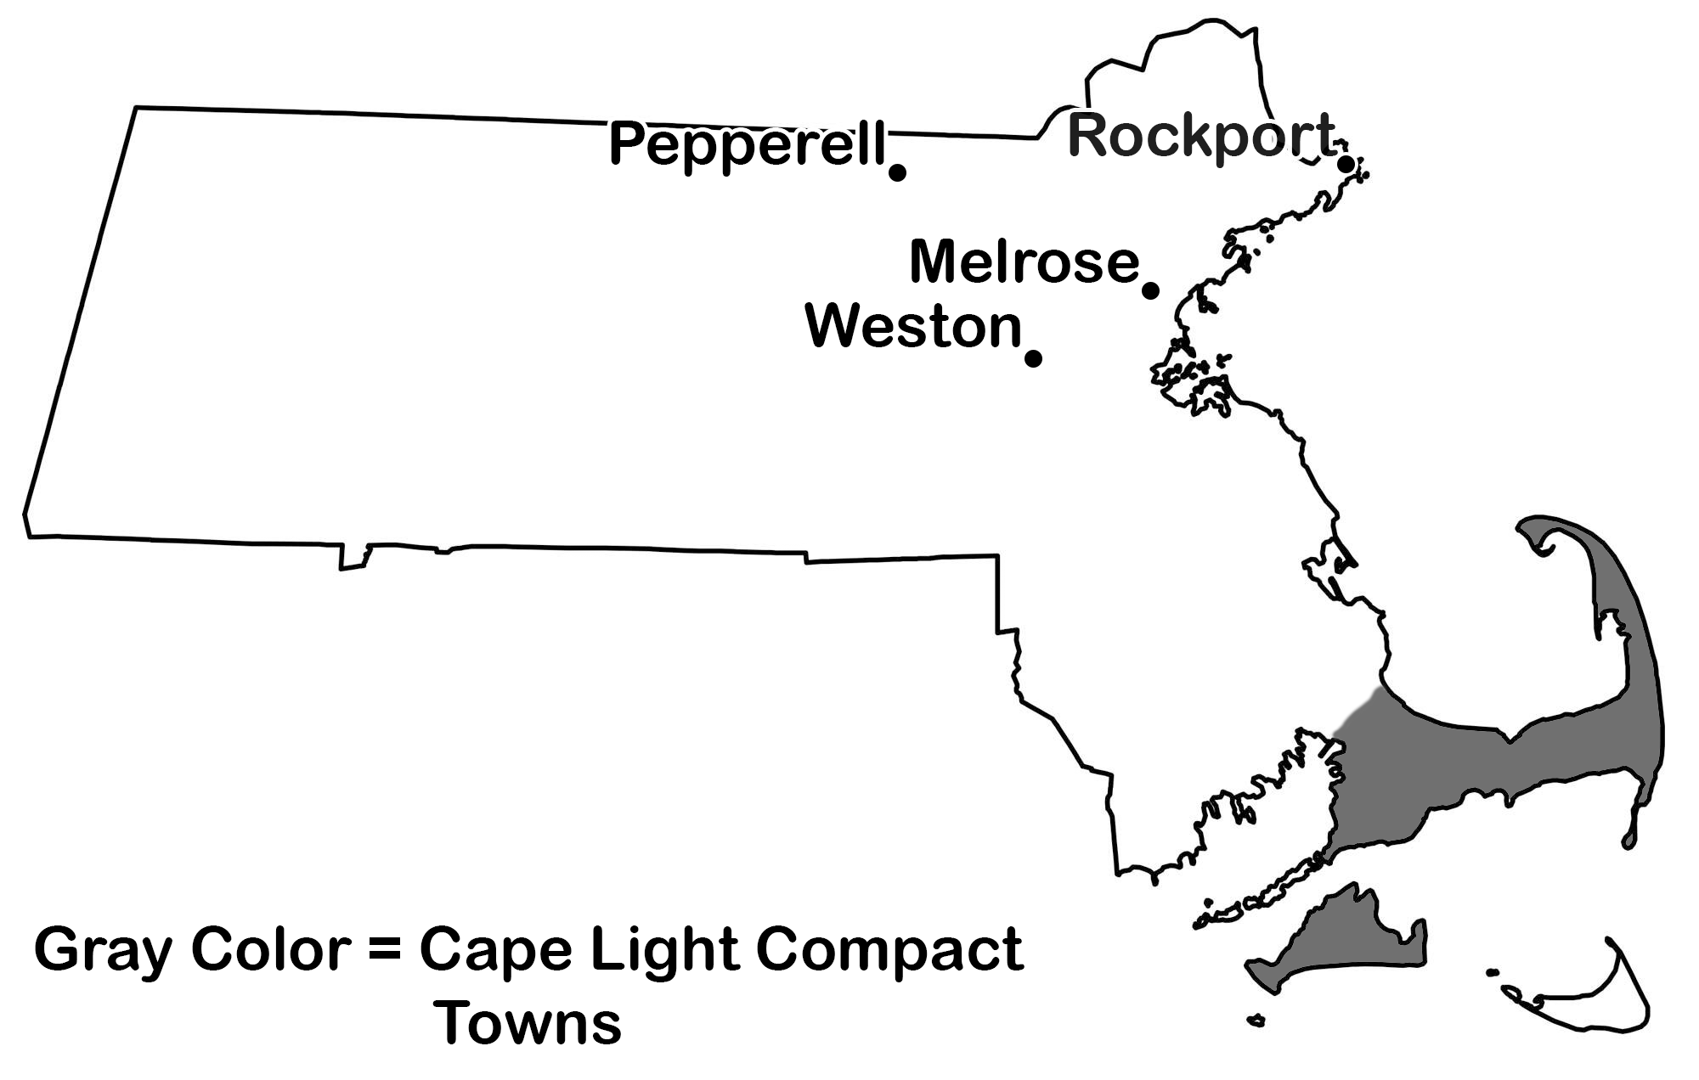
Interviews
Other Interviews:
Tanko Lighting, LightSmart Energy Consulting, Speclines, & IDA-MA
Notes:
Sam
This map indicates the communities and one of the regional planning committees we spoke with.
In addition to these, we spoke with several subject matter experts and professionals within the lighting and dark sky advocacy world.
We reached out to communities that we or our sponsors had identified for having LED conversion programs completed or underway.
We reached out to government officials in each community by email and scheduled phone and zoom interviews to ask them about their experience
Through these interviews we gathered an exhaustive list of best practices to develop our recommendations

Slide 15
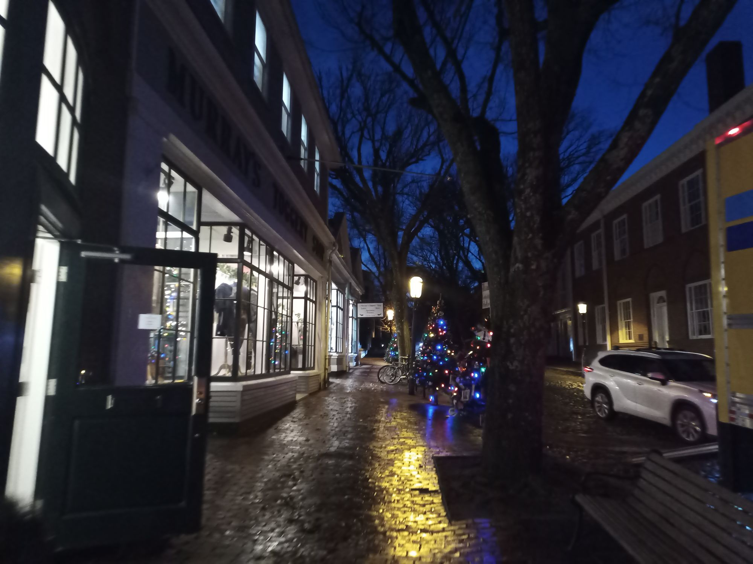
Best Practices Summary
Form a working group or committee
Hire a consultant and purchase streetlights
Pilot demo, install streetlights, & find a maintenance contractor
Regulate light pollution
Develop a relationship with a regional planning organization
Notes:
Luke

Slide 16
1. Create a LED Streetlighting Working Group
Gather the input of community stakeholders
DPW
Select Board
Town of Nantucket Energy Office
Dark-sky advocates
Notes:
Forrest
Municipal working group under town administration
The working group can be responsible for hiring a consultant and working with a streetlight conversion consultant
Some stakeholders include: DPW, select board, Nantucket Energy Office, Dark Sky advocates like Nantucket Lights, Planning and Land use services (PLUS)
Would have to advocate for budget to town meeting

Slide 17
2. Hire streetlighting conversion consultant
Perform a GIS audit
Conduct economic analysis
Create budget
Purchase the streetlights from National Grid
Notes:
Brendan
Our second best practice is to hire an LED streetlighting conversion consultant. A consultant will be able to help guide Nantucket through the conversion process. A budget to hire this consultant would be approved at annual town meeting.
They will help with the process of contracting outside organizations and perform a GIS audit (survey the island to update inventory of all current streetlights).
Using the newly updated inventory and other factors we've discussed, they can perform an accurate economic analysis of the savings the conversion will give Nantucket and the return on investment.
They can help the town plan the budget they will need to perform the conversion, which would occur before a town meeting, and lastly before anything further can be done they will recommend to purchase the streetlights from National Grid.

Slide 18
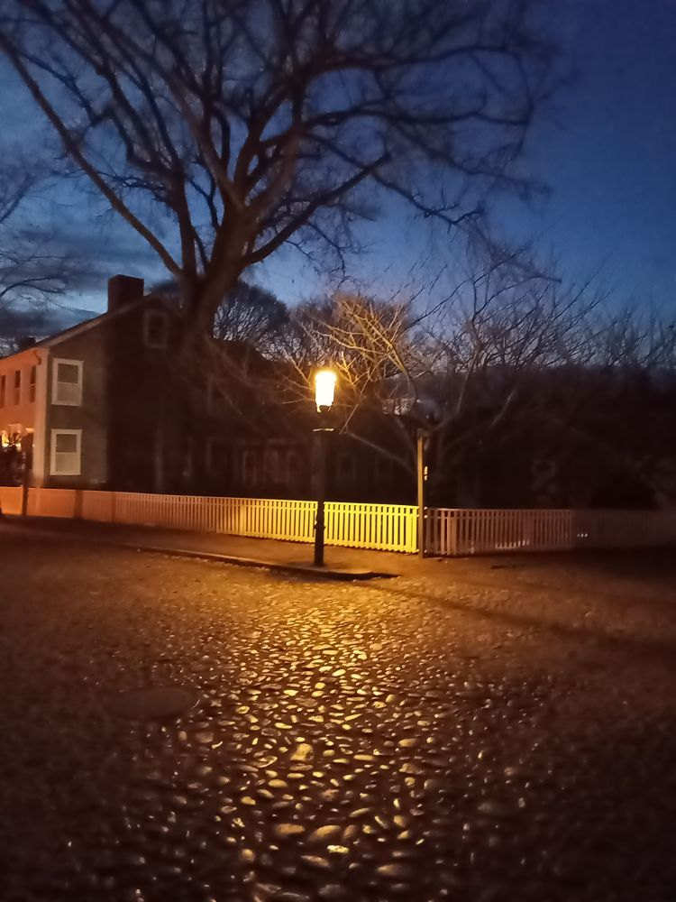
3. Installation Logistics
Run a demonstration
Install the streetlights
Obtain a maintenance contractor
Notes:
Sam
We've compiled a set of 3 recommendations regarding the installation of the actual LED lights.
Each community took special care to run a pilot demonstration with lights, and we are recommending that Nantucket setup a a demonstration with a variety of color temperature and fixture styles while engaging with the community to best gauge which lights are most popular with the community.
Using feedback from the pilot demonstration, the town can work with the consultant to install the new lights. Depending on the contractor hired, this will either be a service they provide directly or contracted out to another company. This phase of the project will include the installation where deemed necessary based on the GIS audit as well as the utilization of shielding to direct the light correctly.
Nantucket will need to obtain a maintenance contractor for both the interim period of the conversion as well as post-conversion. During the pilot demonstration as well as while the new LEDs are being phased in, the existing HPS streetlights will still need to be maintained either by the DPW or somehow factored into the future maintenance contract. Following the LED conversion, a maintenance provider for the LEDs will need to be found though with the caveat that LED's long lifespan means that maintenance is only necessary about once a year, bar extenuating circumstances.

Slide 19
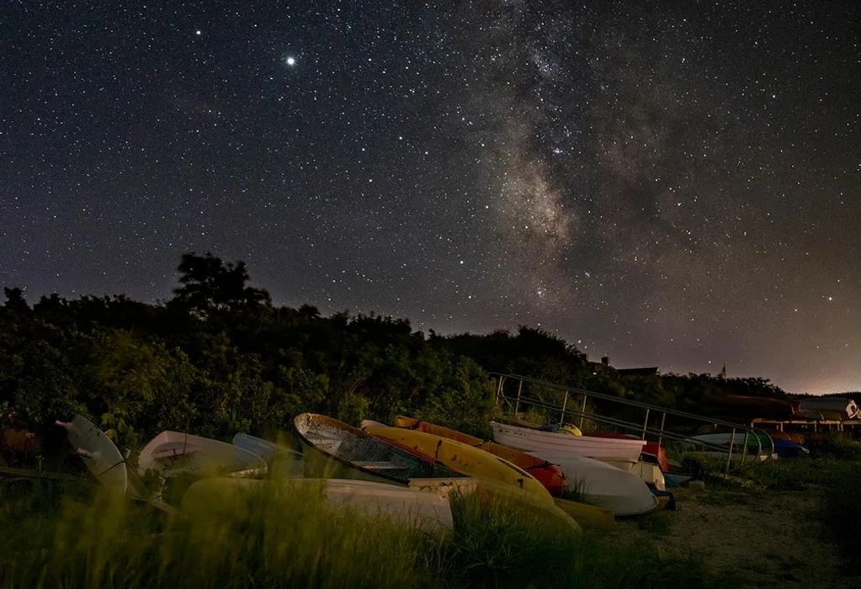
4. Mitigate light pollution
Choose the warmest color temperature
Choose the best control system
Install controls on each streetlight
Notes:
Luke
Once the lights have been installed, and a maintenance contractor is hired, the next step is to mitigate light pollution and to install an appropriate color temperature.
While higher color temperatures offer better visual clarity, warmer temperatures are much easier on the eyes at night.
Next is to choose which type of control system is best: daylight sensors, built in timers, or wireless dimming modules.
Lastly, the chosen sensors should then be installed into each of the streetlights.

Slide 20
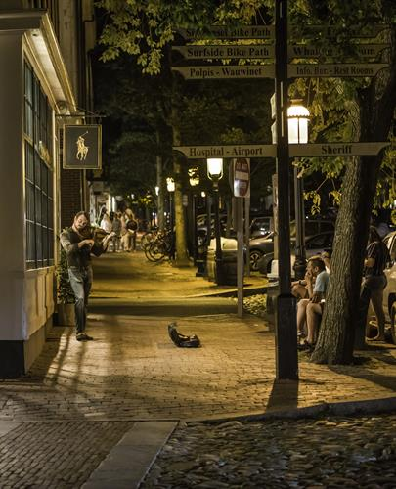
5. Other Recommendations
Develop a working relationship with a larger regional planning group
Have more say in negotiations
Better deals from contractors / distributors
Implement a system for resident feedback
Notes:
Forrest
•A relationship with a larger regional planning community like the Cape Light Compact will give the town the ability to:
•more easily call upon other experiences and network throughout the process
•Can get better deals when putting contracts out to bid for large conversion projects
•A system for resident feedback: currently, people must contact national grid for outages. Being able to submit a form on Nantucket's website would be much easier. And since maintenance is low, this allows the town to maintain a record for yearly LED streetlight maintenance trips

Slide 21
Cost Savings of the Conversion
Scenario | Staying with National Grid | Buying the Streetlights
Estimated costs post conversion | $56,000 | $43,000
% Savings with conversion project | 40% | 53%
Return-on-investment | N/A | ~ 4 – 8 year
The Status Quo:
~ $92,000 per year in delivery, supply, and maintenance
Notes:
Forrest
•We estimate that this conversion project will save the town approximately 40% in energy costs if they stay with national grid, where as 53% if they buy the streetlights
•Additionally allows for more effective lighting design that will better reduce glare, skyglow, and light trespass, the main components of light pollution
•Buying the streetlights comes with a return-on-investment period, which we estimate would be between 4 to 8 years

Slide 22
Final Recommendations
Based on best practices:
Create a working group
Hire a consultant
Purchase the lights
Alternatively
Have National Grid perform an LED pilot installation
Allow National grid to perform the conversion
Notes:
Forrest
•In summary, the best practices are to:
•create a working group for the conversion project
•buying the lights from National Grid,
•and hiring a streetlighting consultant
•Alternatively, Nantucket can work with National Grid and perform a conversion at 3000K, at risk of poor lighting design for residents

Slide 23
Acknowledgements
Lauren Sinatra of The Town of Nantucket Energy Office
Gail Walker, Founder of Nantucket Lights, https://nantucketlights.org
Dominic Golding & Fred J. Looft of WPI
Youngs Bicycles
Nantucket Yacht Club
Notes:
Brendan
To end this off, we would like to thank our sponsors... (Lauren and Gail), our advisors Dominic and Fred, Youngs Bicycles for letting us rent bikes for our stay, and the NYC for housing during our stay.

Slide 24
Any questions?
Notes:
Brendan
Thank you for listening today, any questions?

Slide 26
References
•Econlib. “Benefit-Cost Analysis.”. https://www.econlib.org/library/Enc/BenefitCostAnalysis.html.
•We Mean Business Coalition. “Company Profile: National Grid,” September 30, 2019. https://www.wemeanbusinesscoalition.org/blog/company-profile-national-grid/.
•WallStreetMojo. “Cost Benefit Analysis Examples,” May 28, 2019. https://www.wallstreetmojo.com/cost-benefit-analysis-examples/.
•CAI. “Keeping Nantucket Powered Is a Challenge as Electricity Demand Rises,” November 24, 2014. https://www.capeandislands.org/science-environment/2014-11-24/keeping-nantucket-powered-is-a-challenge-as-electricity-demand-rises.
•Liteharbor. “Knowledge News_China Leading Lighting Manufacturer, Supplier, Factory and Wholesaler of Recessed Downlights, Led Downlights, Can Lights, Pot Lights, Multiple Downlights, Trimless Downlight, Led Retrofit Can Lights, Track Lights, Mirror Lights, Led Lighted Mirror, LED Bathroom Mirror, Illuminated Mirror, LED Electric Mirror, Led Lighted Mirror, LED Bathroom Mirror, Smart Mirror, Emergency Exit Light,Led Wrap Light, Led Wraparound Lights, Led Wraparound Fixture,Wrap around Lights, Led Strip Fixture,4ft Led Strip Light,Led House Numbers, Illuminated House Numbers, Lighted House Numbers,Bluetooth Ceiling Light,Ceiling Light with Bluetooth Speaker,Led Music Lights,Music Ceiling Lights, Smart Ceiling Lights, Indoor Lighting, Commercial Lighting, Architectural Lighting, Residential Lighting, Industrial Lighting, Project Lighting, Outdoor Lighting and so on. Main for North America Market!” Accessed October 2, 2021. https://www.liteharborfactory.com/.
•International Dark-Sky Association. “Light Pollution Wastes Energy and Money.”. https://www.darksky.org/light-pollution/energy-waste/.
•Lights, Nantucket. “Welcome to Nantucket Lights.” Nantucket Lights.. https://nantucketlights.org/.
•“Maria Mitchell Association | Nantucket’s Science Center.”. https://www.mariamitchell.org/.
•“Nantucket Businesses – Nantucket Community Television.”. https://nantucketcommunitytelevision.org/tag/nantucket-businesses/.
•Nantucket Magazine. “Nantucket DPW ‘Crippled’ By Staffing Exodus,” August 18, 2021. https://n-magazine.com/nantucket-dpw-crippled-by-staffing-exodus/.
•Interreg Europe. “Policy Recommendations and Action Plans.” https://www.interregeurope.eu/innotrans/news/news-article/7338/policy-recommendations-and-action-plans/.
•Tribune, David Shaffer Star. “Xcel Energy Wants to Replace 100,000 Minnesota Streetlights with LEDs.” Star Tribune.. https://www.startribune.com/xcel-energy-wants-to-replace-100-000-minnesota-streetlights-with-leds/333137581/.
. http://www.ccas.ws/lightpollution.html.

Slide 27
Contact Info
You can reach us at gr-ACK21-NEO@wpi.edu
Report will be posted online in the coming days
Town of Nantucket Energy Office:
Lauren Sinatra – lsinatra@nantucket-ma.gov
Nantucket Lights:
Gail Walker – nantucketlights@gmail.com
For questions regarding WPI or IQP’s in general:
Dominic Golding- golding@wpi.edu
Fred J. Looft – fjlooft@wpi.edu
Notes:
Brendan
Thank you for listening today, any questions?

