Slide 1
Salvaging the Historical Nature of Nantucket:
Reducing Construction and Demolition Waste
Abigail Calistra, Jakob Misbach, Heather Oxford, and Anthony Vuolo III
December 7, 2021

Slide 2
Project Goal
Limit construction and demolition (C&D) waste in landfills by using alternatives to demolition while maintaining the integrity of historic buildings

Slide 3
Objectives
1
Identify current C&D policies on Nantucket
Evaluate best C&D waste-handling practices outside Nantucket
2
Determine incentives for C&D waste reduction
3

Slide 4
Background

Slide 5
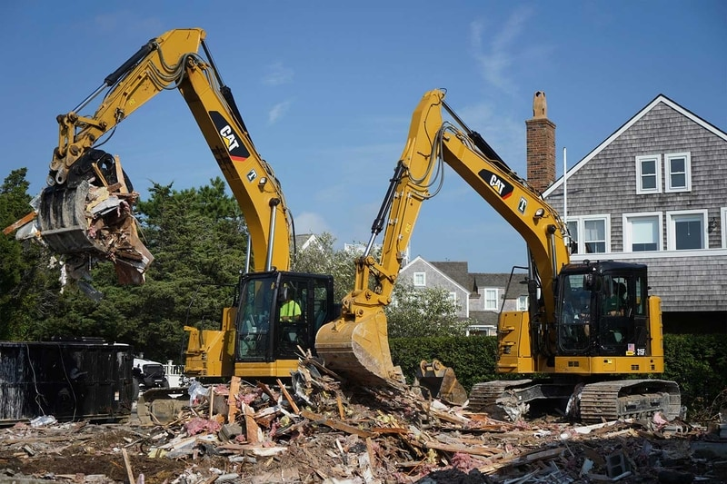
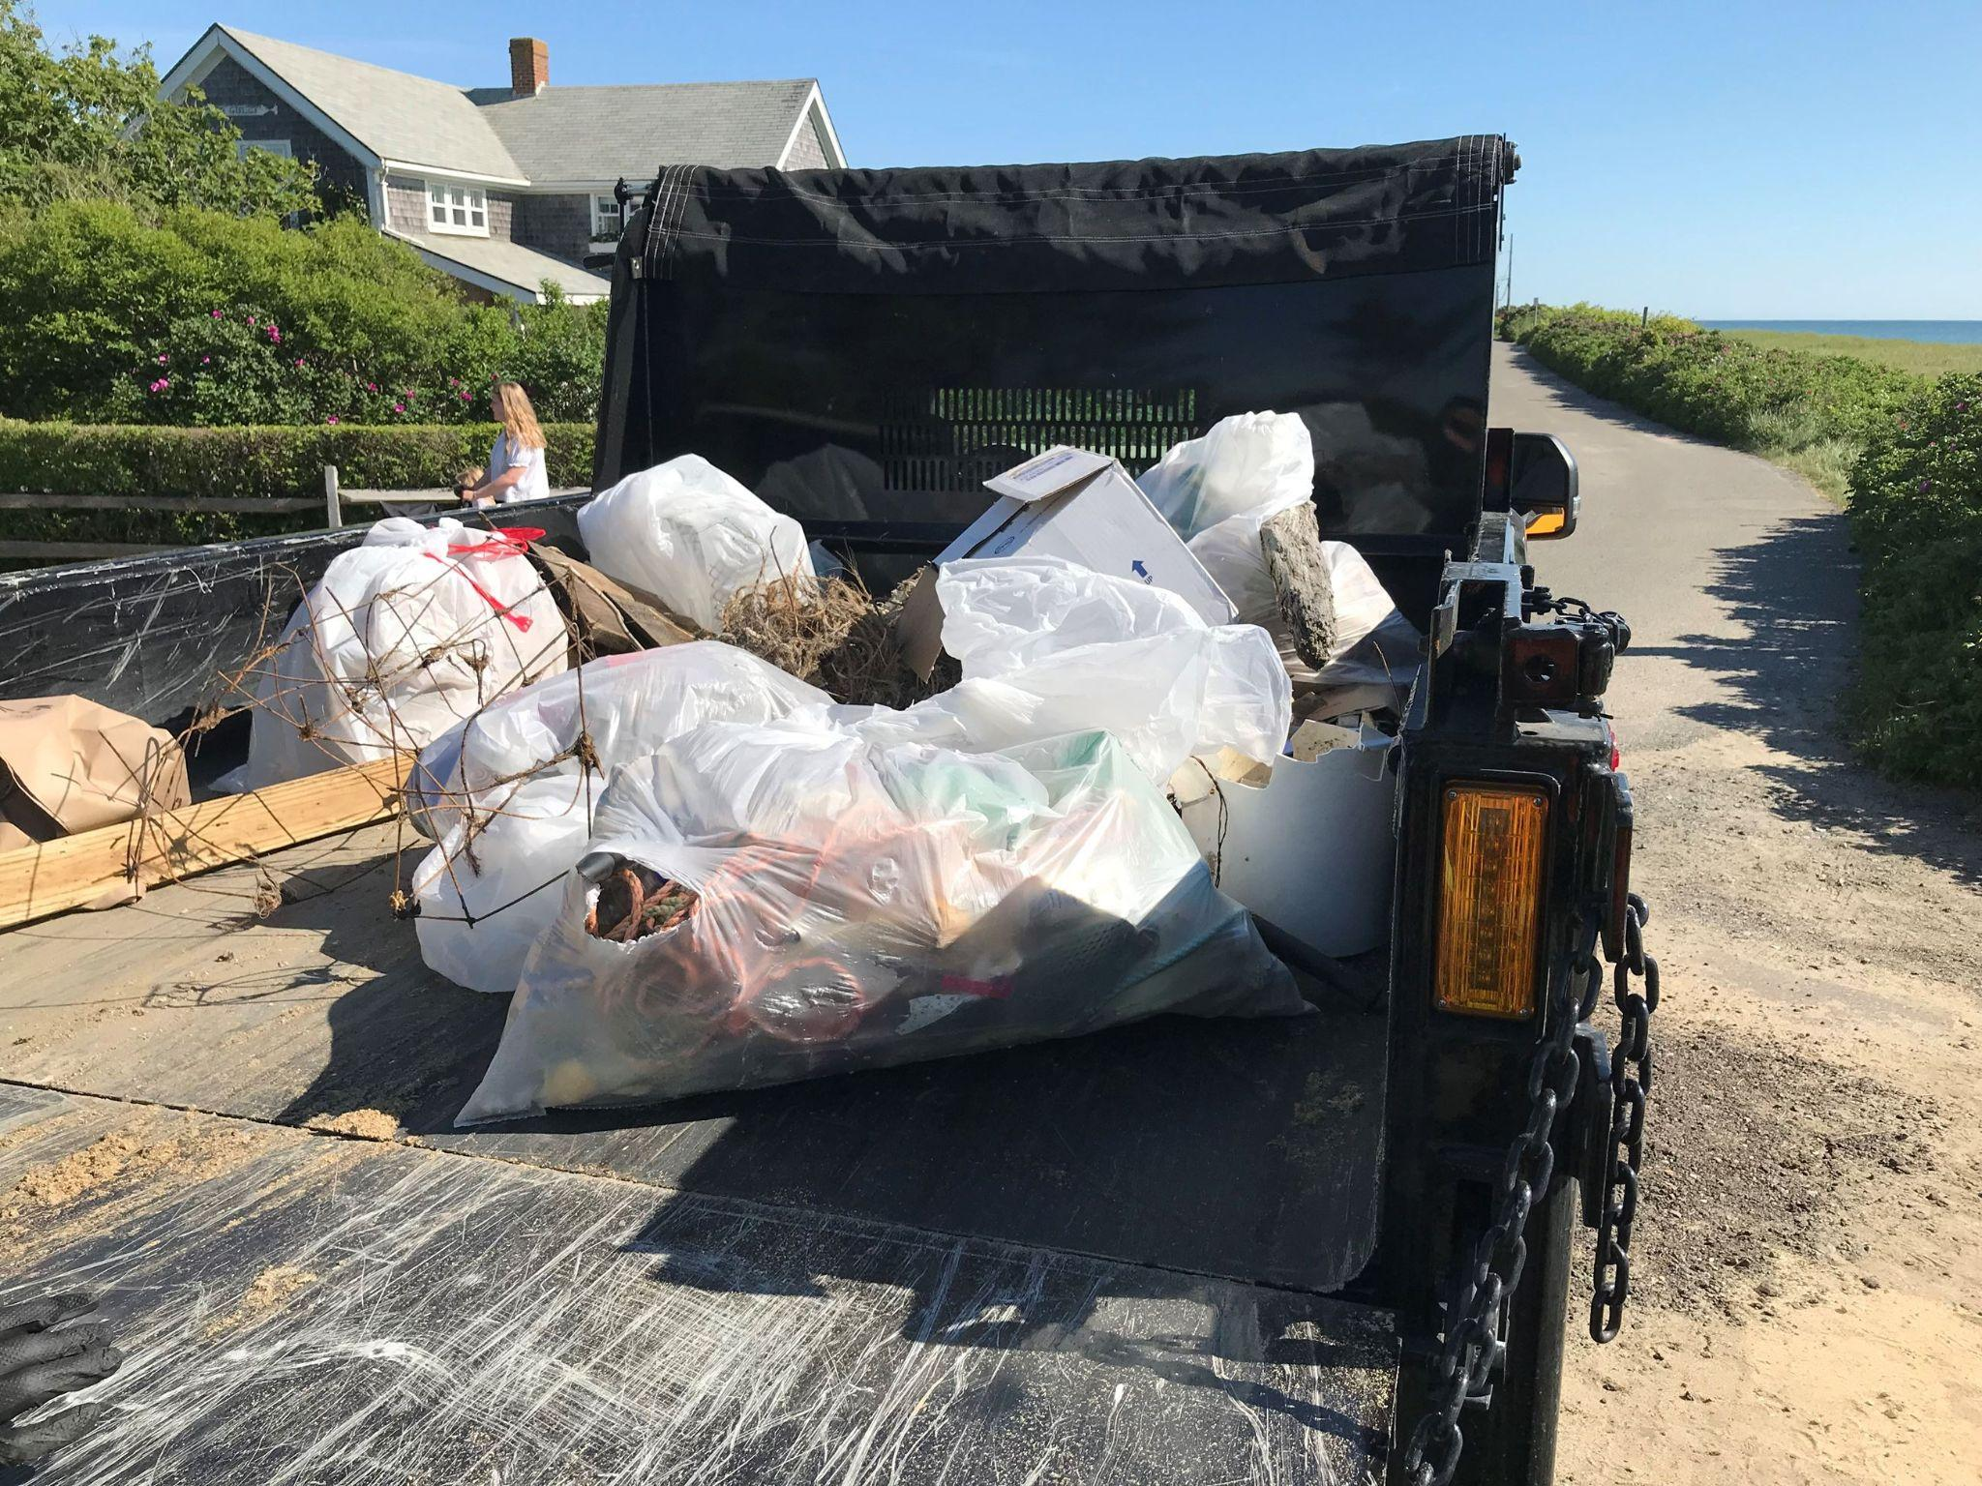
C&D debris accounts for ~67% of waste in the U.S.
600 million tons
<300 million tons
Notes:
According to the EPA

Slide 6
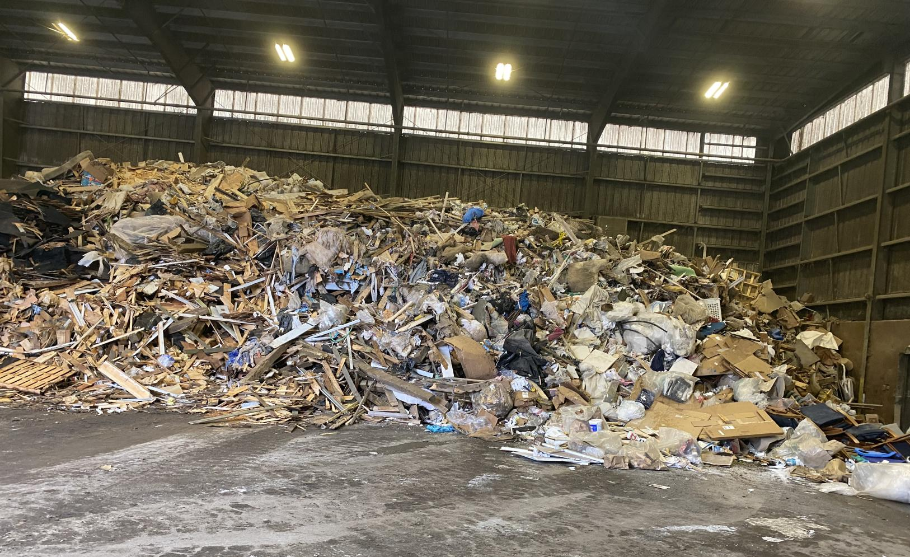
Nantucket sends C&D waste off island.
Notes:
This is a picture of the C&D waste building at the Nantucket landfill
All this material is shipped off-island

Slide 7
Methods

Slide 8
Interviews
H.D.C.
N.H.C.
Notes:
Don’t say queried

Slide 9
Findings

Slide 10
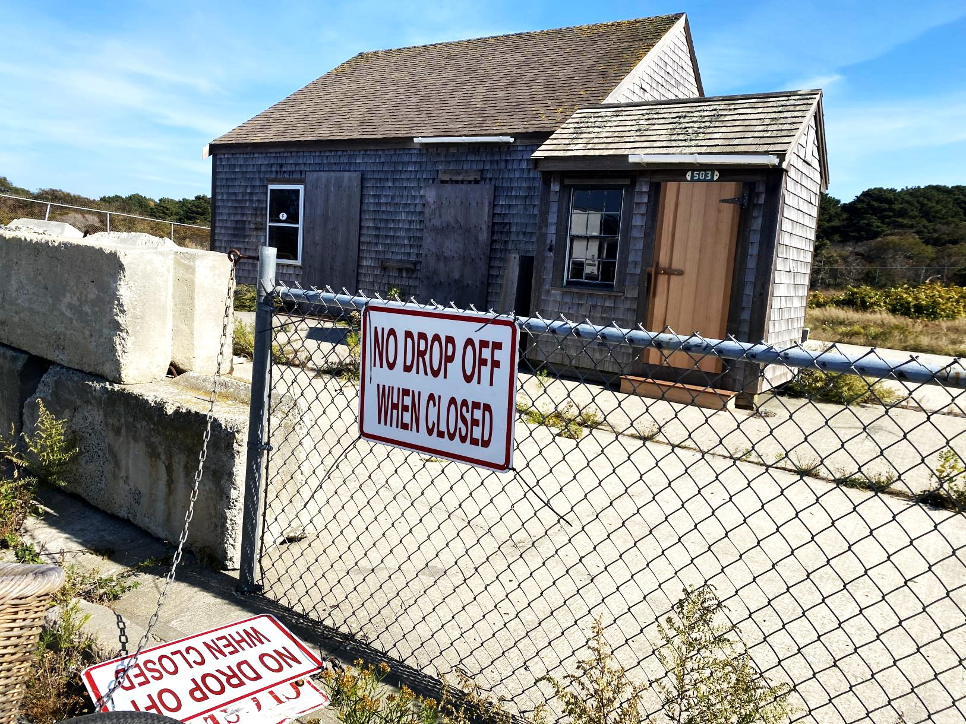
There is no physical market for salvaged building materials on Nantucket.
?
Notes:
Salvaged
Don’t say that “we all know and love”
Did you talk about the market the builders have?

Slide 11
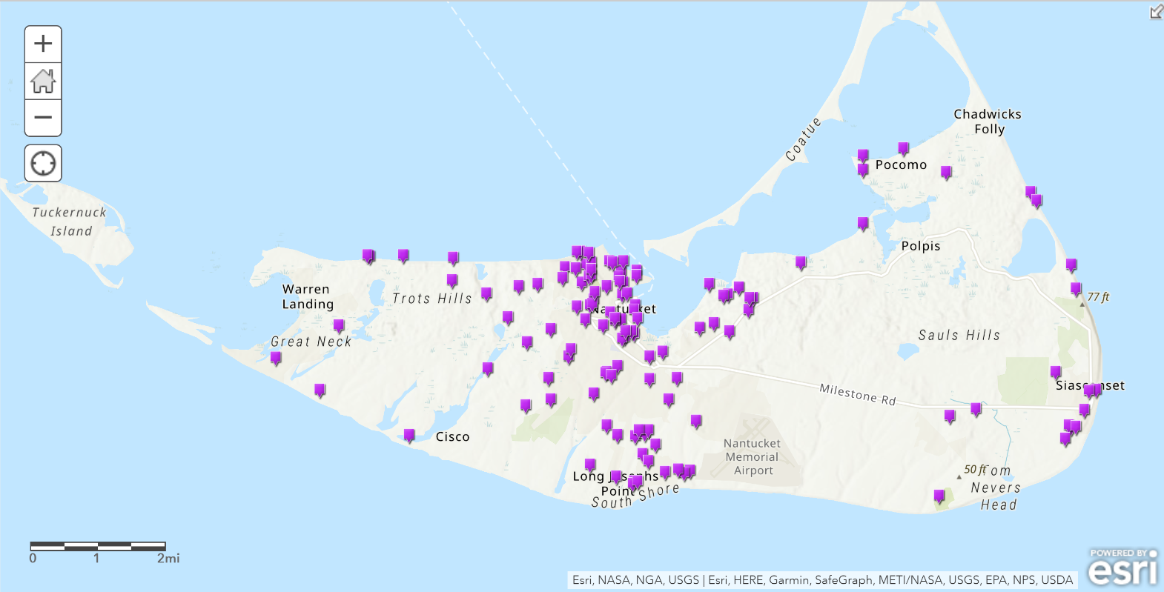
Demolition data over the past 3 years.
Notes:
Total and partial demos

Slide 12
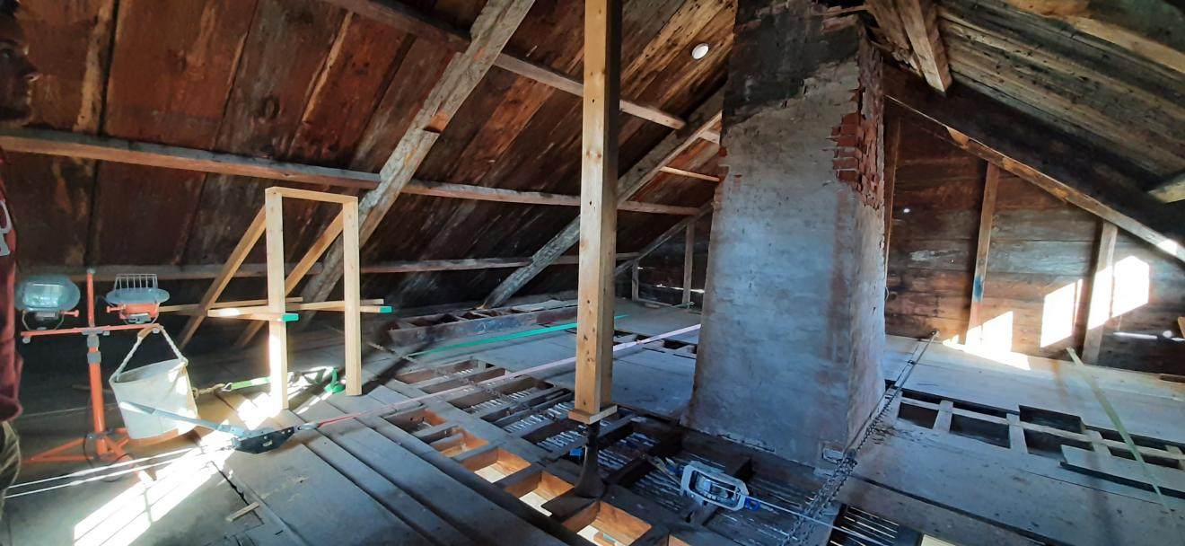
There is some interest in restoring historic homes on Nantucket.
Notes:
TALK ABOUT SARAH MCLANE HERE
Restoring windows or salvaging old ones where restorations are not possible

Slide 13
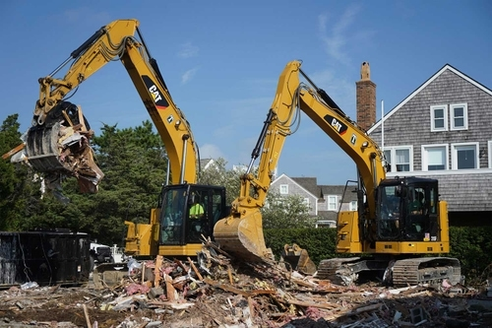
The current Nantucket demolition delay period is not long enough.
Notes:
Don’t talk about extending the demo delay period, that is a recommendation

Slide 14
Recommendations

Slide 15
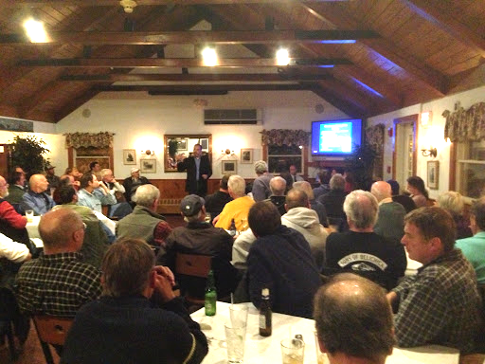
Create curricula that encourage more sustainable practices.

Slide 16
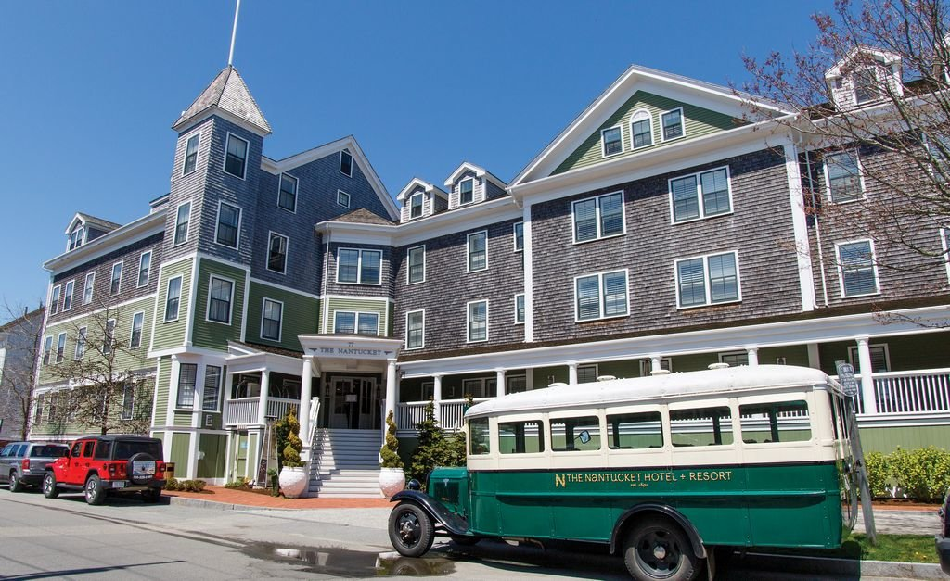
Create a program to increase public awareness of the historic tax credit.

Slide 17
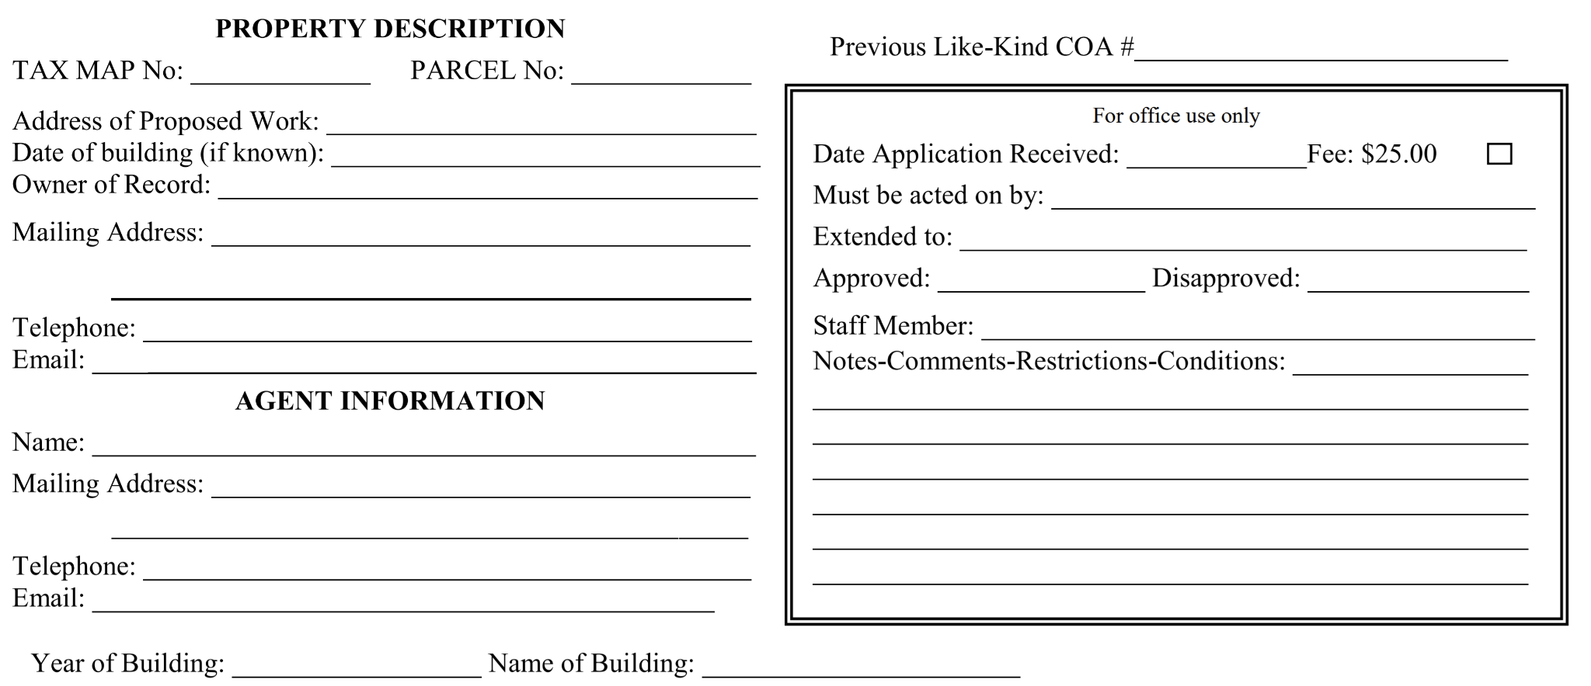
Require homeowners to submit a deposit upon receipt of a CoA.

Slide 18
Create a CoA review priority system for quicker approval of sustainable practices.
Restoration
Relocation
Deconstruction
Renovation
Demolition
Notes:
TIME OVER MONEY

Slide 19
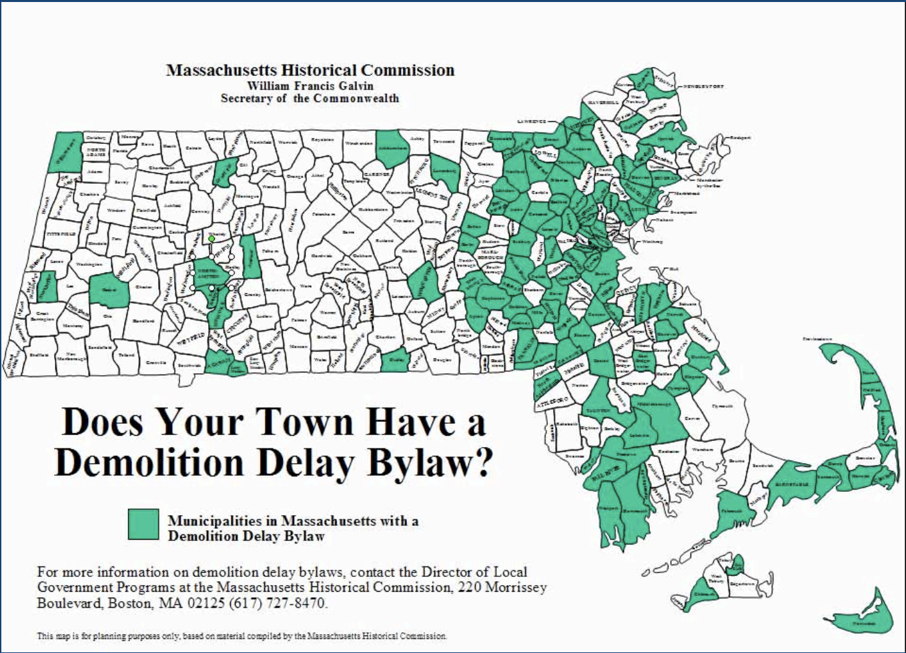
Amend the current demolition delay bylaws.
Notes:
Demo delay
Recommend town work with HDC to amend current demo delay bylaws
Currently: 60 days
Not enough time
Other towns in MA: 6mo, up to 18
Increase in delay period = fewer demos

Slide 20
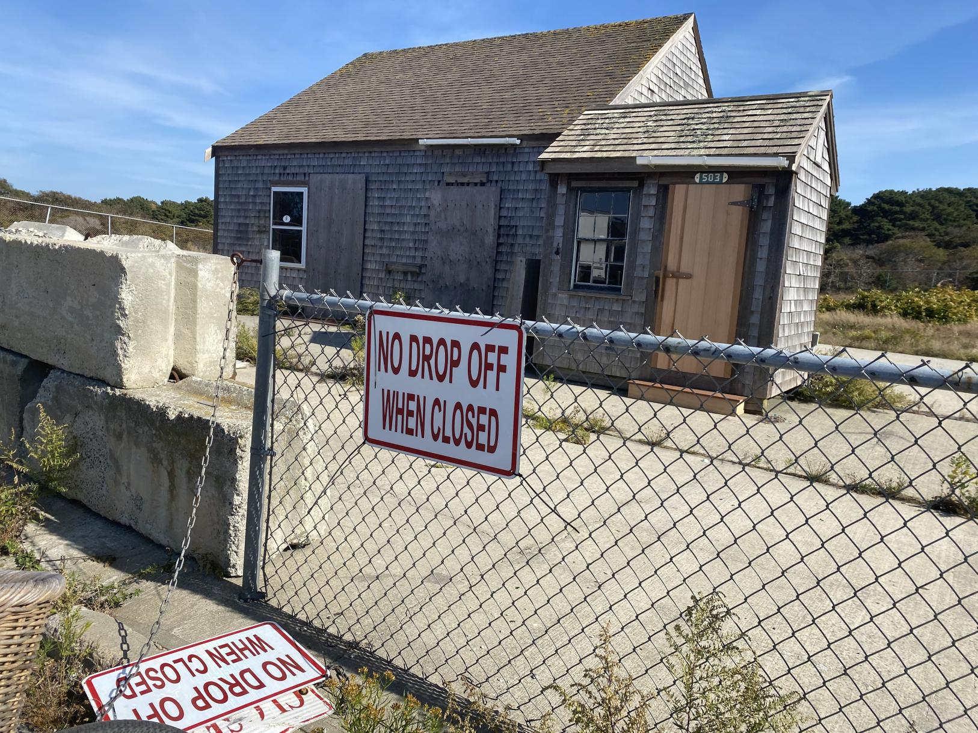
Facilitate the creation of a physical marketplace for salvaged building materials.
Notes:
DPW facilitate creation of Physical marketplace for sal bldg mtls
Builders have stockpiles
Not accessible to public
Recommend DPW set aside land @ landfill
Creation of a store (like H4H ReStore)
Donations, resold

Slide 21
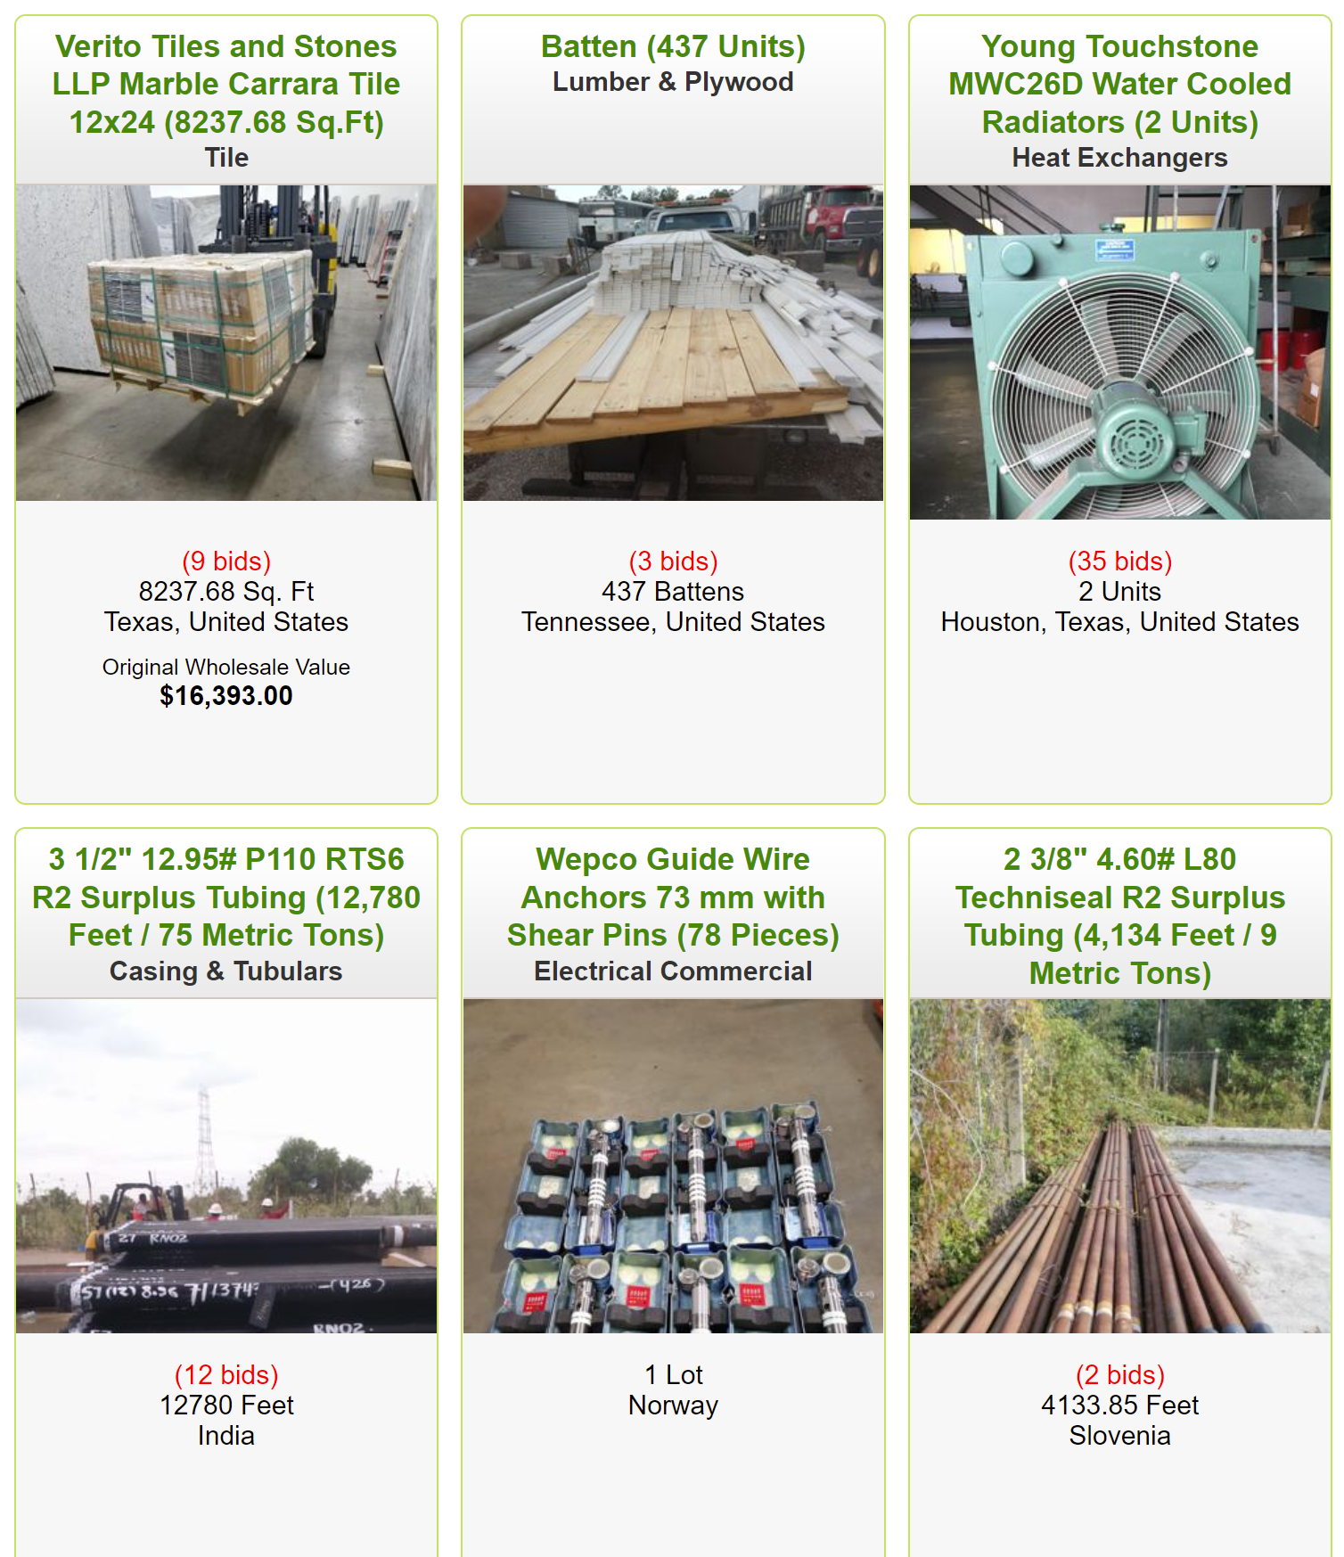
Facilitate the creation of an online resource for salvaged building materials.
Notes:
Online marketplace
Finding space is challenging
If no physical space, town facilitate creation of online marketplace
Existing: FB Marketplace, Reuse Exchange
Nothing for Nantucket bldg mtls
Creating online market would help reduce C&D landfilled

Slide 22
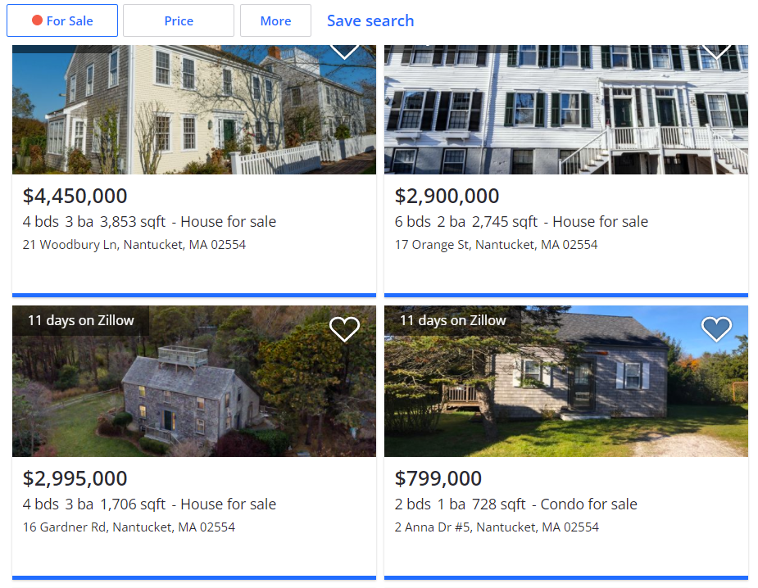
Facilitate the creation of an online resource for structures being advertised for relocation.
Notes:
Online house listing
Along similar lines…
Recommend Town & HDC facilitate creation of central online resource for structures being advertised for relocation
Currently: ad in paper
Doesn’t reach as many people
Town creates & maintains active record of structures
Anybody in community looking for structures can easily see everything available

Slide 23
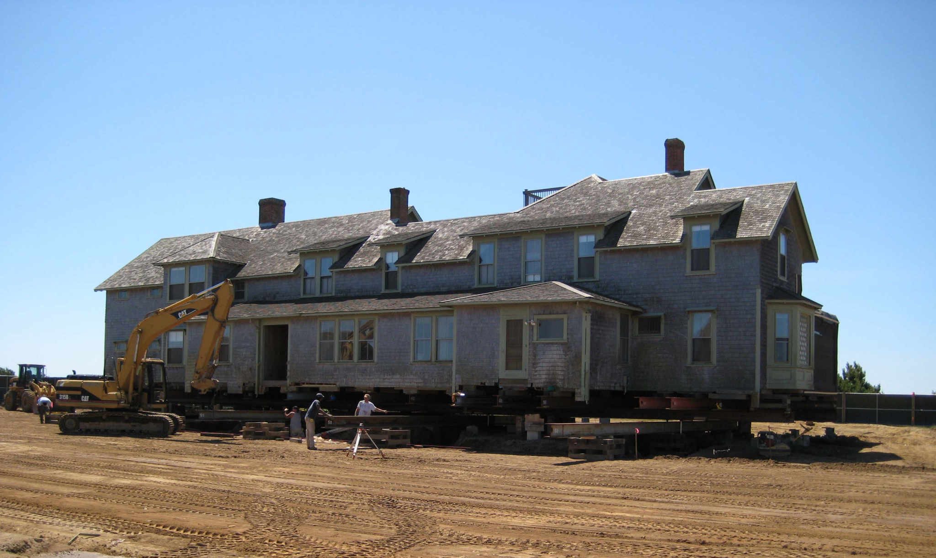
Modify ground cover policies and allocate land to allow for temporary staging of homes.
Notes:
Interim space & ground cover regulations
As before, available space is difficult to find
Lack of space can cause problems when moving a house
For most part, anybody who wants to move a structure has to have the new location already prepared (done within 60 days)
Recommend town modify ground cover policies to allow for temp staging of homes
Recommend town set aside interim space where structures can go while a more permanent location is being found

Slide 24
Future Research

Slide 25
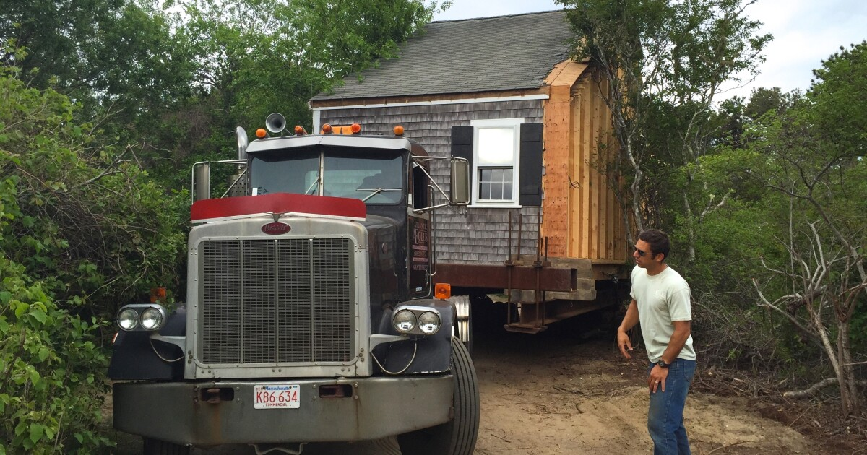
Analyzing the island’s transportation routes for structure relocations.

Slide 26
Examining the role of Nantucket’s waste contractors in the reduction of C&D waste.

Slide 27
Creating a guide for teaching the history and importance of preserving the island’s structures and historic context.

Slide 28
Acknowledgements
Our Sponsors
Graeme Durovich and Holly Backus
Our Advisors
Dominic Golding and Fred Looft
Our 17 Interviewees
Others
Nantucket Yacht Club and Young’s Bicycles

Slide 29
Thank you!
Questions?

Slide 31
References
https://historicboston.org/the-challenges-of-being-historic-nantucket/
https://www.toscanacorp.com/services/demolition
https://www.nantucket-ma.gov/1473/Construction-Site-Roadside-Coastal-Litte
http://www.nantucketbuildersassociation.org/
https://www.nantucketpreservation.org/
https://www.housingnantucket.org/
https://www.nantucket-ma.gov/2030/Coastal-Resilience-Plan
https://www.nantucket-ma.gov/184/Affordable-Housing-Trust

Slide 32
References
https://www.toscanacorp.com/
https://www.nantucketlandbank.org/
https://www.nareb-online.com/
https://www.nantucket-ma.gov/
https://www.toscanacorp.com/services/demolition
http://www.nantucketbuildersassociation.org/
https://cdn1.creativecirclemedia.com/ack/original/20210114-141115-NEWS_200509758_AR_-1_RSVIYINNWSHU.jpg
https://www.nantucket-ma.gov/DocumentCenter/View/29427/Like-Kind-Application-PDF

Slide 33
References
https://capecodcommission.org/resource-library/file/?url=/dept/commission/team/Website_Resources/historicpreservation/Workshop2009Skelly.pdf
https://www.habitat.org/stories/habitat-for-humanity-restores-faq
https://www.salvex.com/listings/index.cfm?catID=1003
https://www.zillow.com/nantucket-ma/
https://nantucketrealestate.com/building-moving-and-nantucket/
https://www.capeandislands.org/in-this-place/2015-07-28/psst-want-a-free-house-on-nantucket-just-pay-to-move-it
https://ackislandrubbish.com/
http://www.nantucketpreservation.org/wp-content/uploads/2015/10/RestoreBrochure.pdf

