Slide 1
The Story Map
Image: Courtesy of the Nantucket Historical Association, 1880s
Notes:
Jeremy

Slide 2
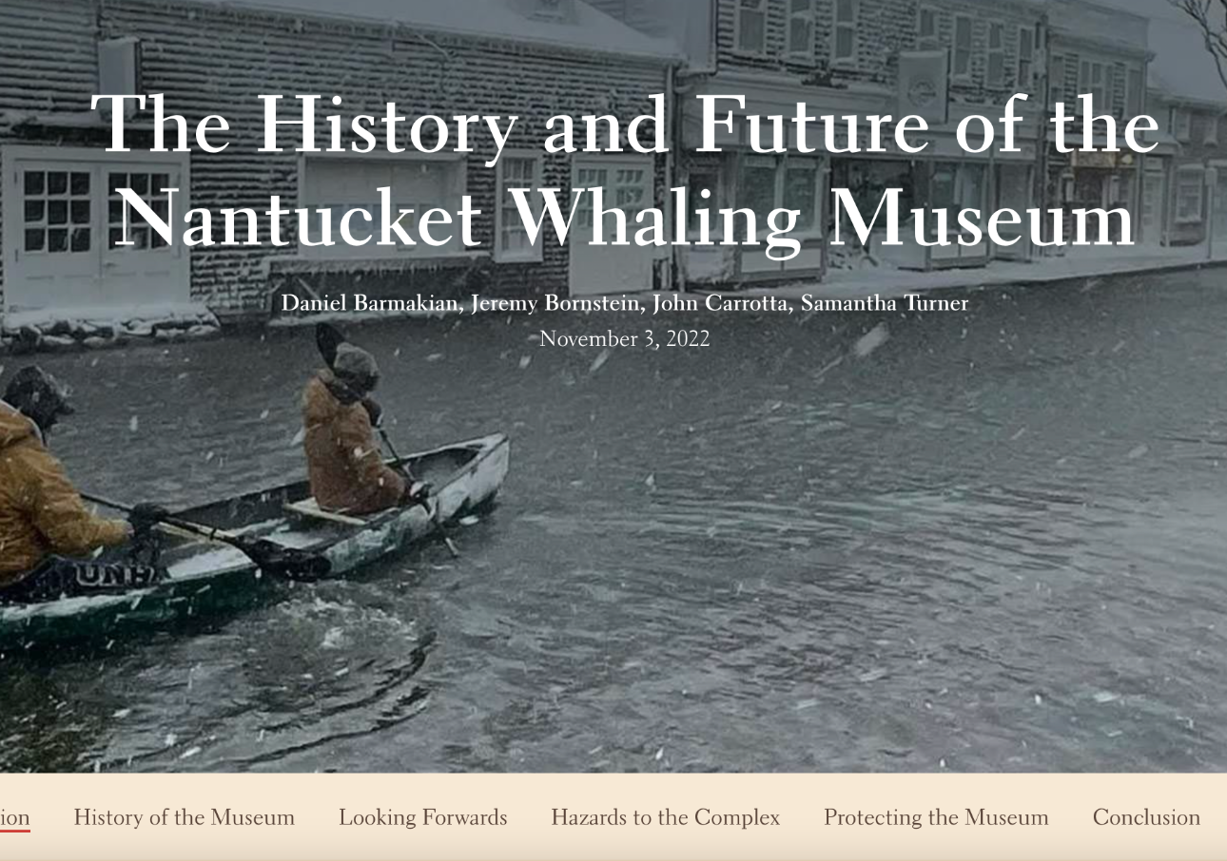
Story Map Breakdown
Four Main sections:
History of the Museum
Looking Forward
Hazards to the Complex
Protecting the Museum
Notes:
Jeremy

Slide 3
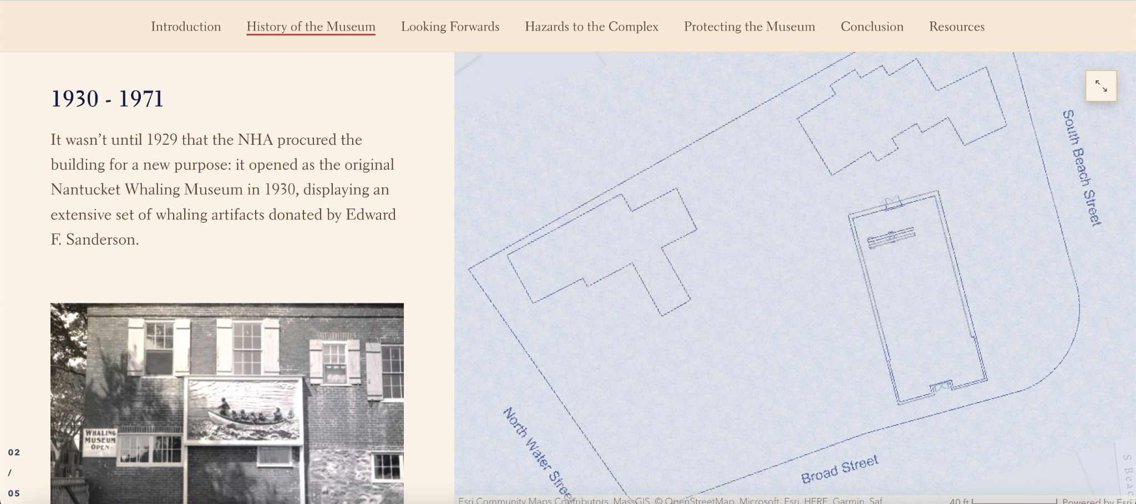
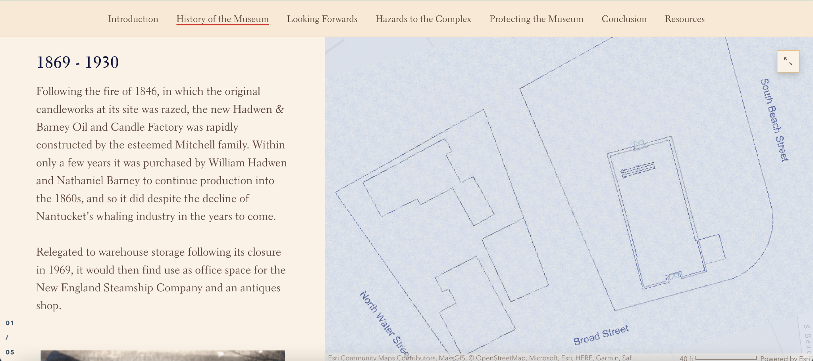
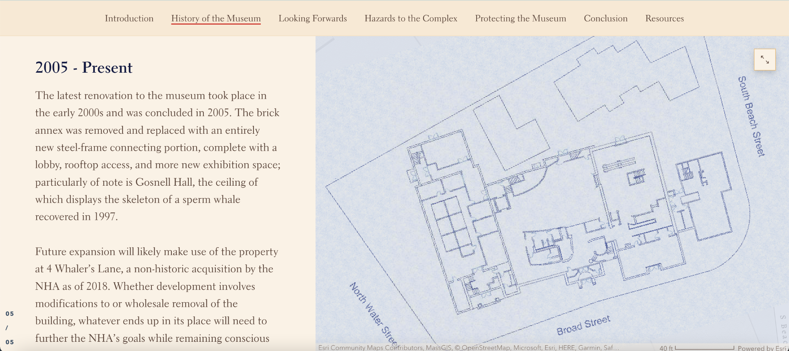
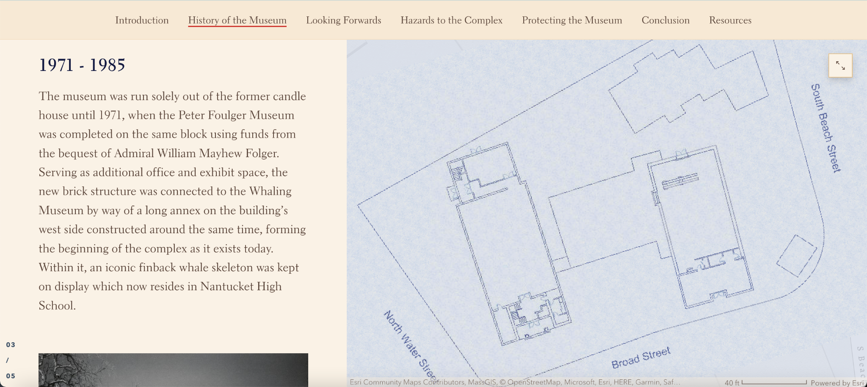
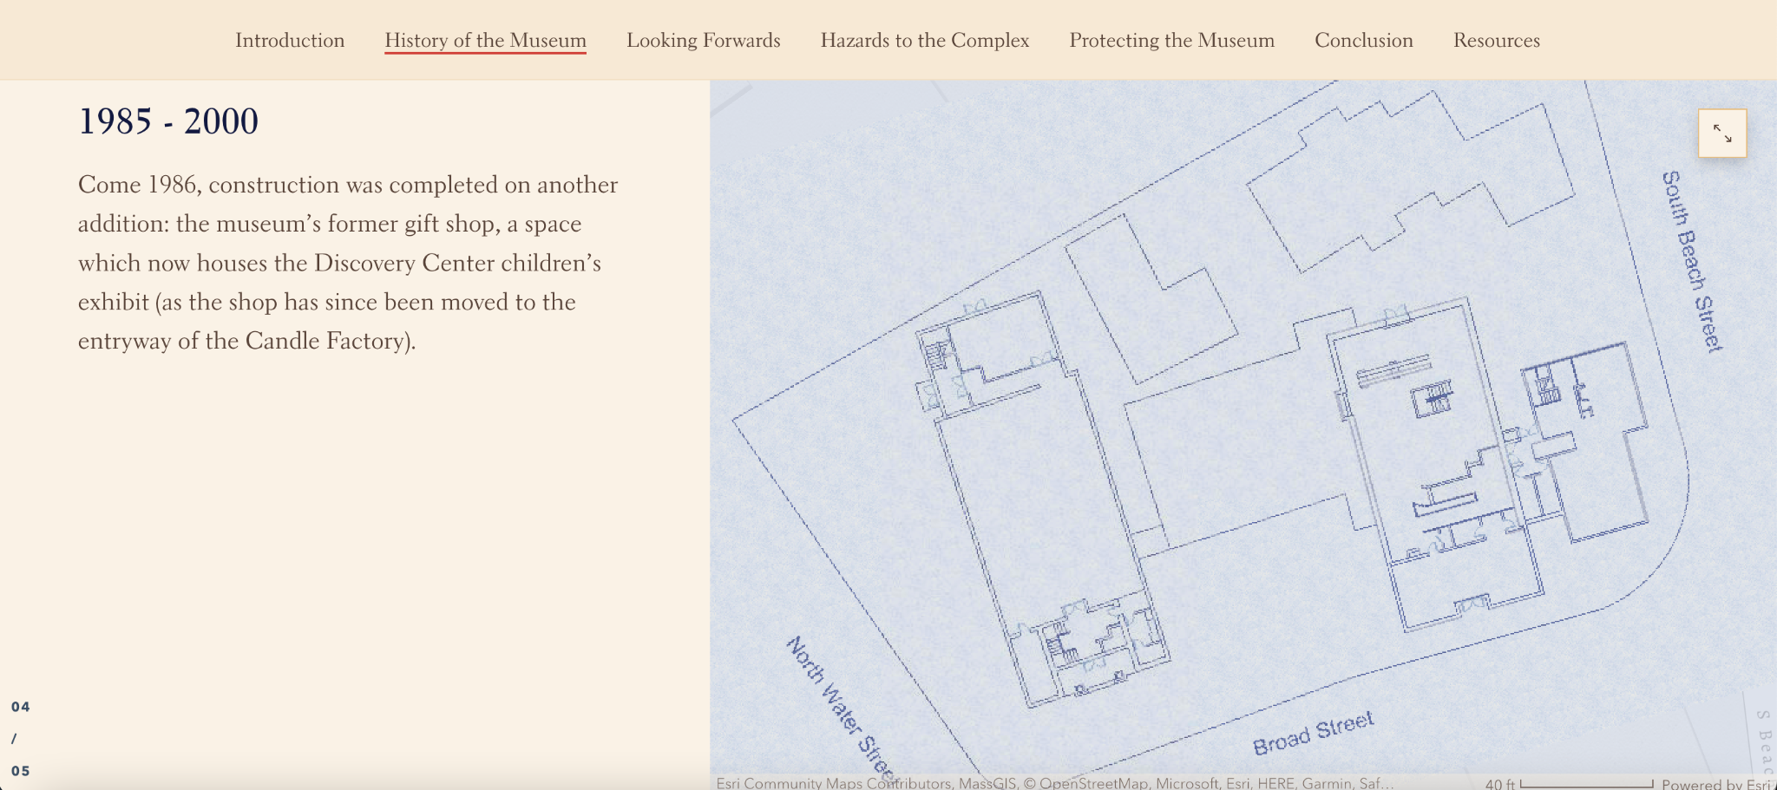
History Timeline
Notes:
John

Slide 4
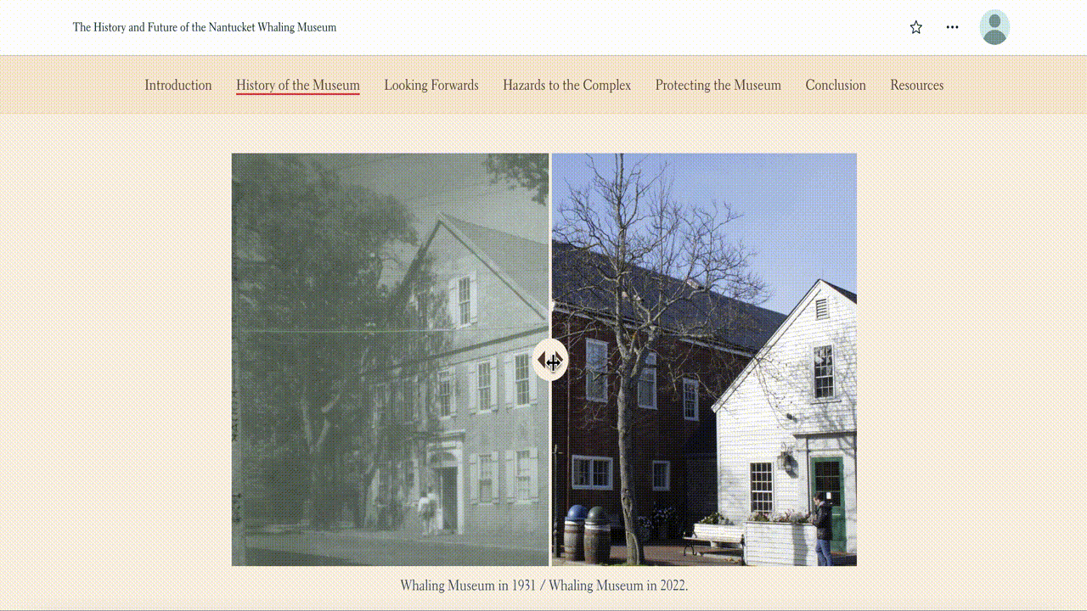
Notes:
Jeremy

Slide 5
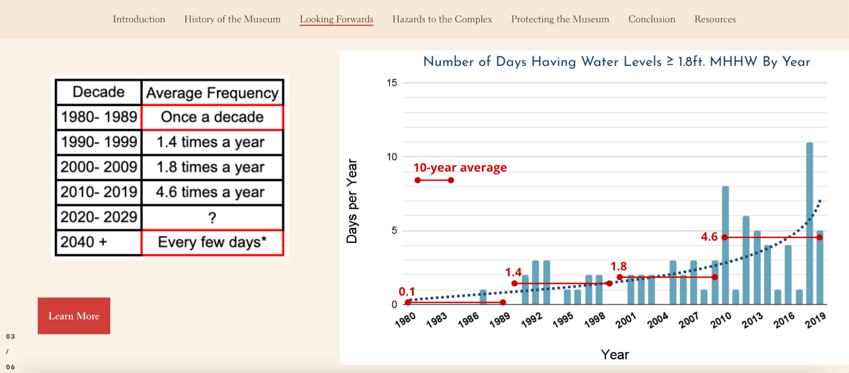
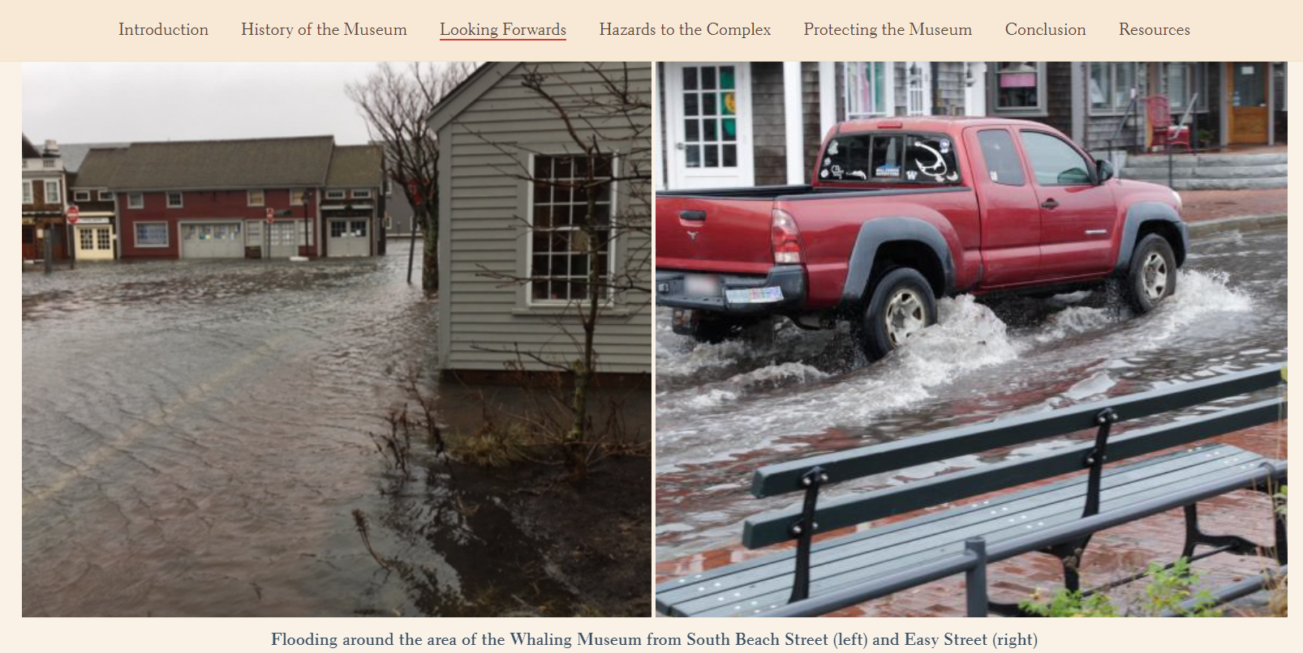
Looking Forwards
“WATER IS COMING”
Notes:
Jeremy

Slide 6
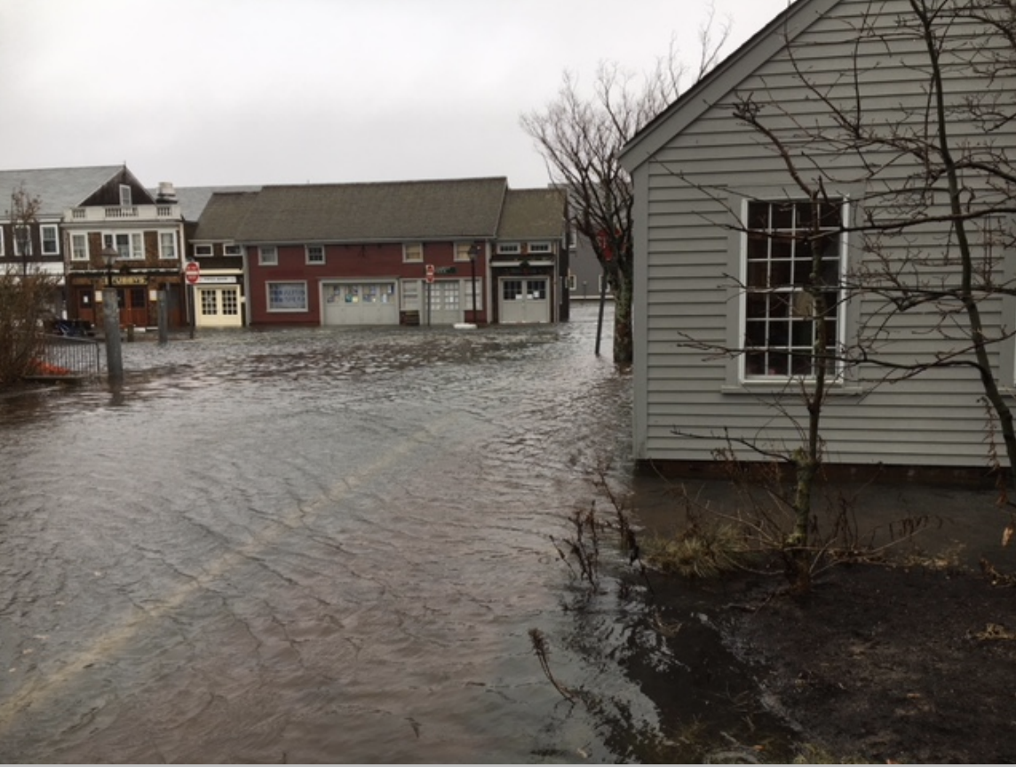
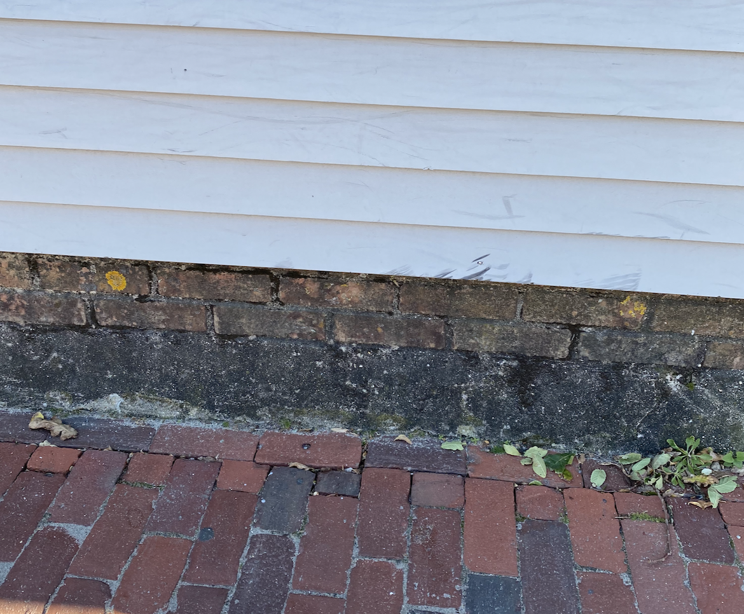
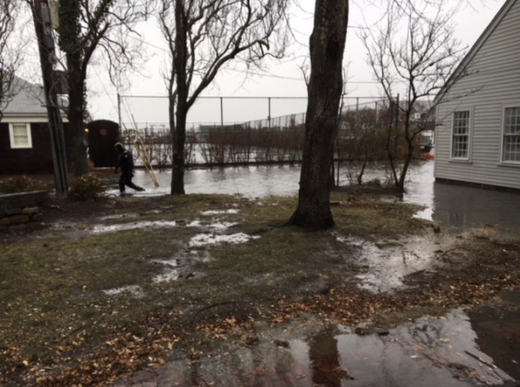
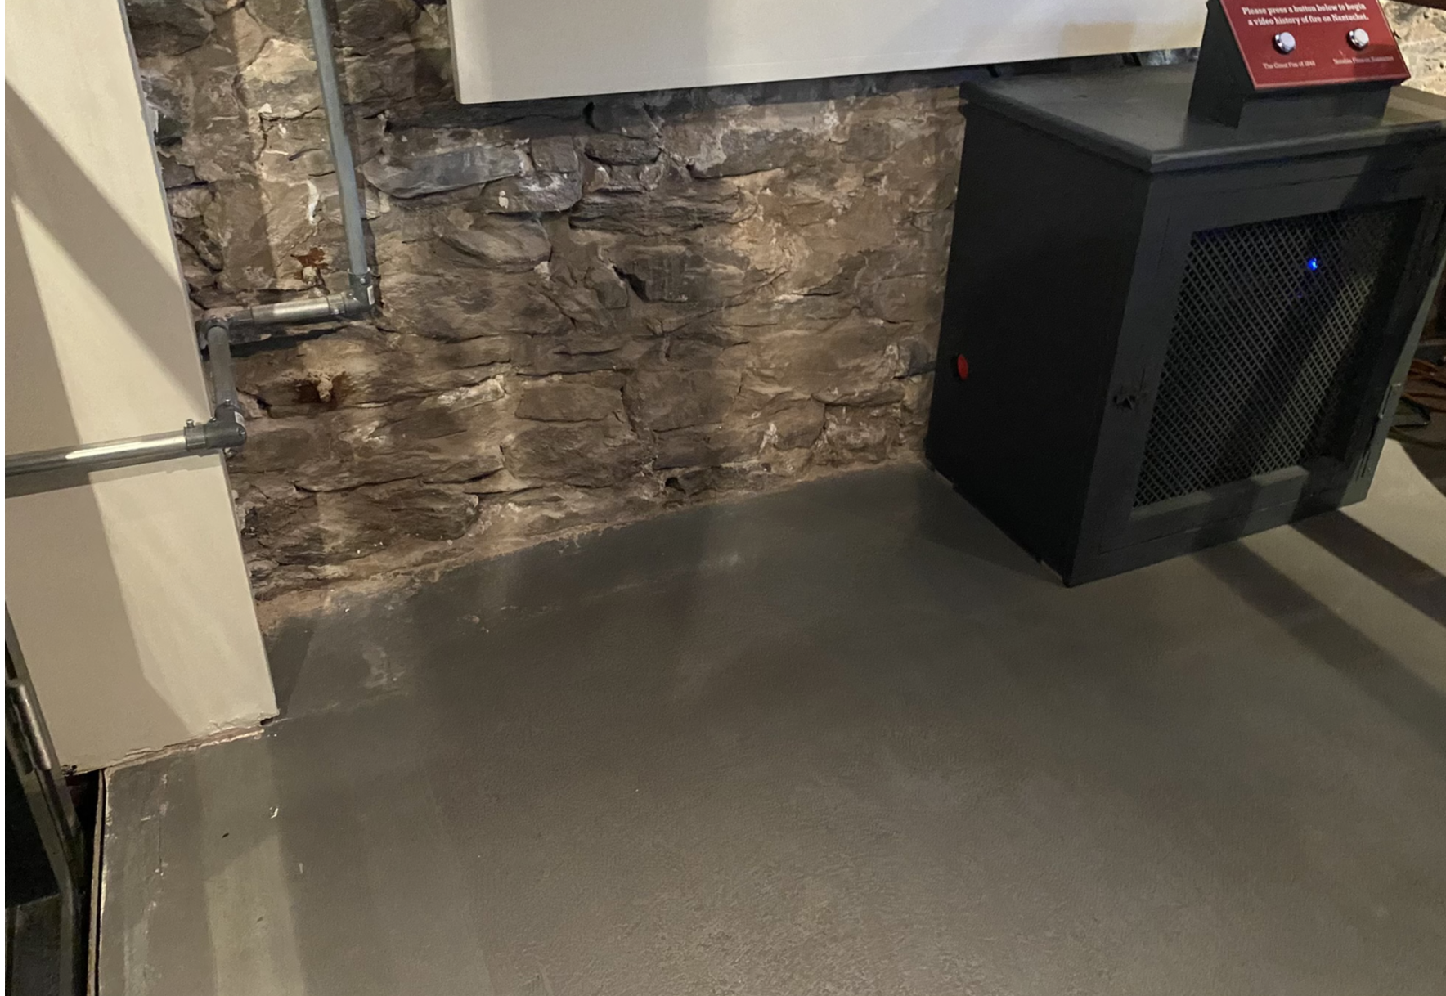
Issues the Museum Complex Faces
Flood Damage
2017
Foundation Erosion
2022
Wind and Debris
Damage
2017
Interior Flood Damage
2022
Photos: McGrath Architecture and Samantha Turner

Slide 7
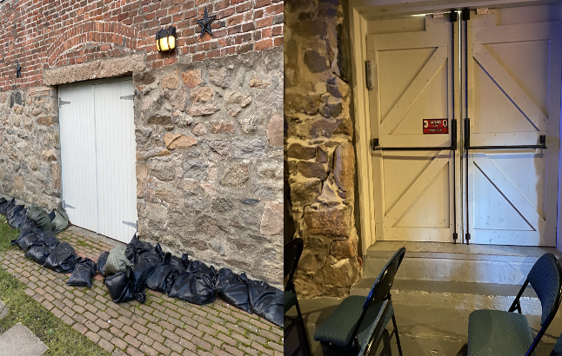
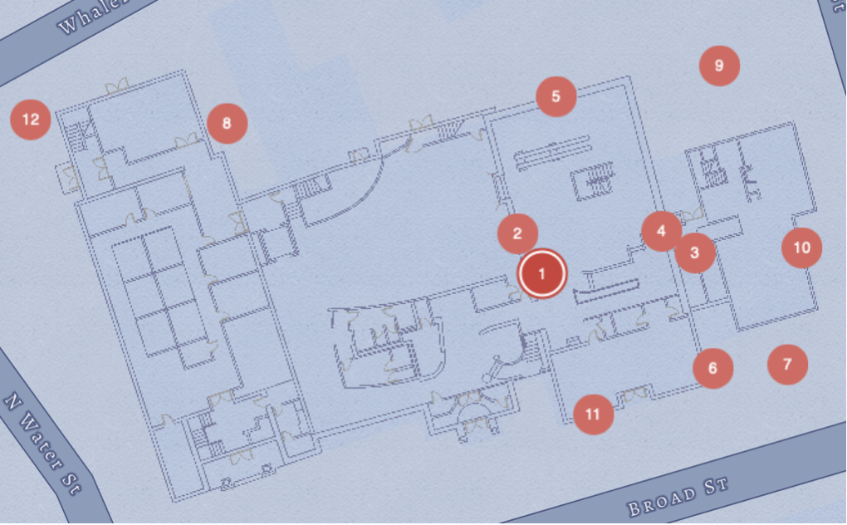
Hazards to the Museum
1. Elevator shaft flooding
2. Groundwater intrusion through wall
3. Toilets overflow
4. Cold joint
5. North elevation doorway flooding
6. Downspouts
7. Low drainage through pavement
8. Cistern filling up
9. Dated pipes
10. Foundation erosion
11. Cracking due to portland cement
12. Electrical transformer box
Notes:
st

Slide 8
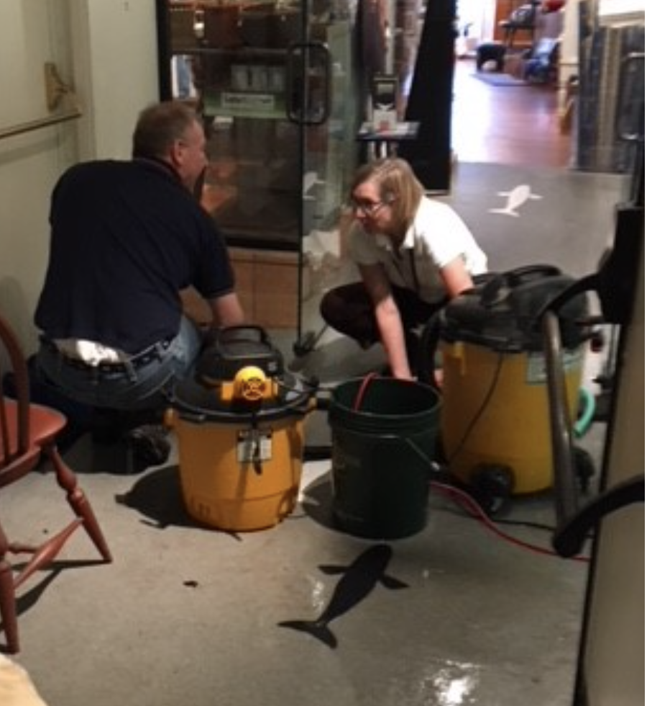
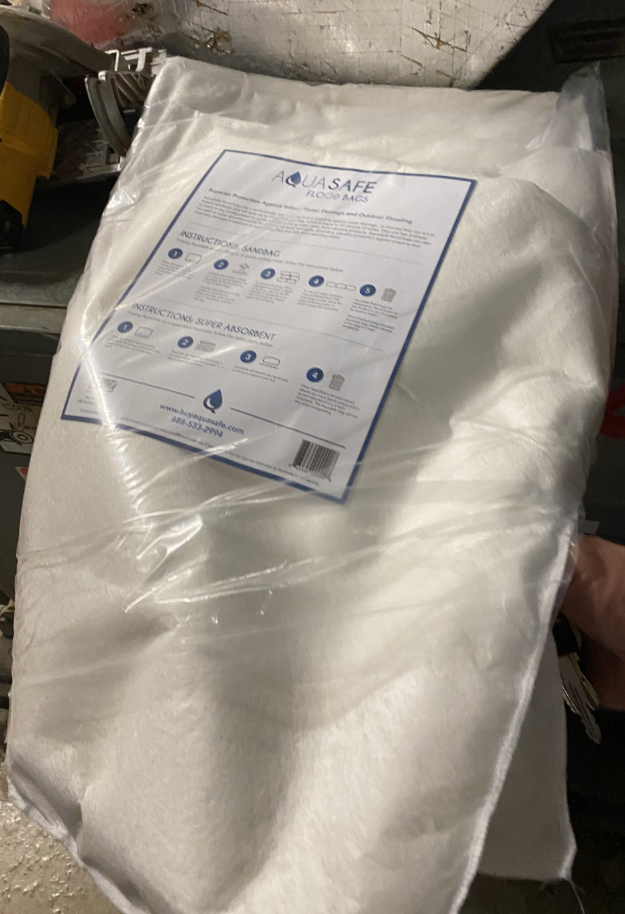
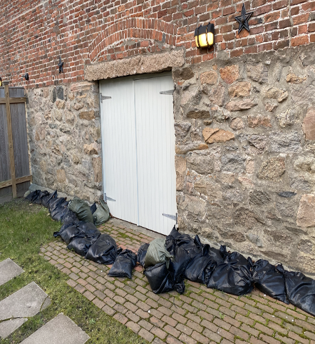
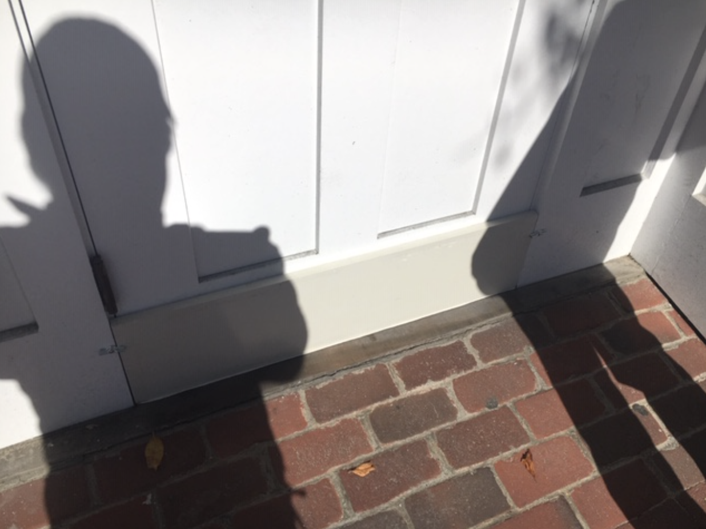
Current Flood Prevention Measures
Wet Vacs
Flood Sacks
Sandbags
Drop-in
Flood Barriers
Photos: McGrath Architecture, Ed Rudd and Samantha Turner
Notes:
st

Slide 9
Possible Solutions
Photo: Courtesy of the Nantucket Historical Association, December 1986
Notes:
https://nantuckethistory.org:443/permalink/?key=6000_i21471

Slide 10
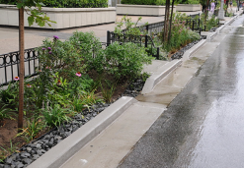
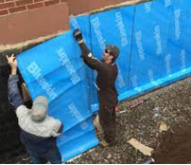
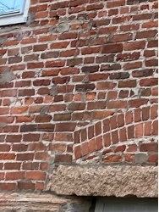
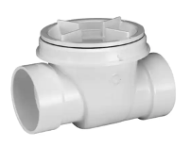
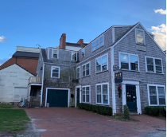
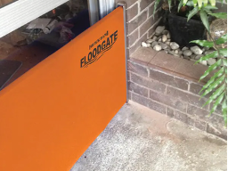
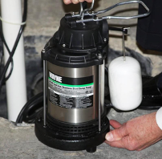
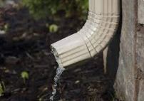
Potential Mitigation Strategies
Short Term (by 2030)
Landscape Adaptations
Dry Floodproofing
Rain garden
Self-adhesive membrane
Evaluate wall integrity and repoint
Install backflow valves
Elevation
Demolition and build elevated structure at 4 Whalers Lane
Flood gate in lower level bathroom
Sump pump
Clear downspouts
Notes:
st

Slide 11
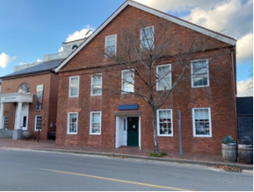
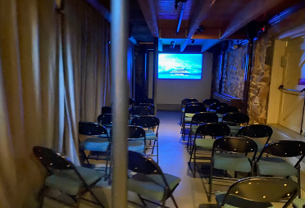
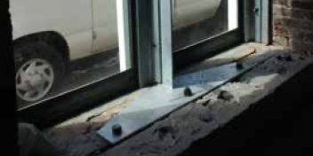
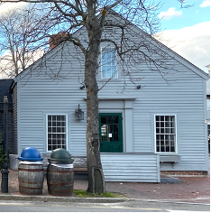
Potential Mitigation Strategies
Medium Term (2050-2070)
Dry Floodproofing
Wet Floodproofing / Elevation
Examine and maintain the structural integrity of the masonry
Raise floor to allow water to flow underneath
Elevate Discovery Center to aid with absorption
Structural reinforcement
Notes:
st

Slide 12
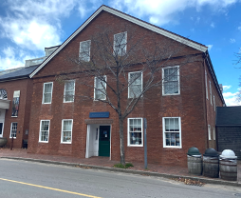
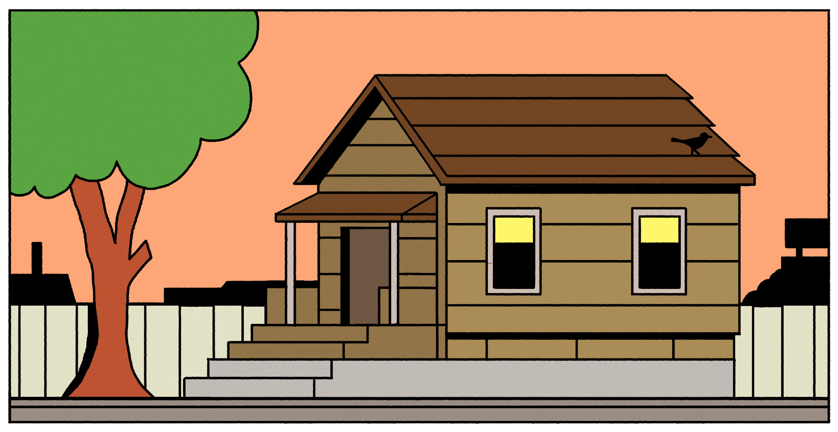
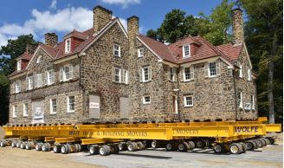
Potential Mitigation Strategies
Long Term (2100+)
Elevation
Assess feasibility to elevate structure
Adaptation
Retrofit with a Buoyant Foundation.
Retreat
Relocate structure to preserve and protect
Notes:
st

Slide 13
Acknowledgements
Nantucket Historical Association
Niles Parker
Ed Rudd
Staff of the Whaling Museum and Research Library
Vince Murphy
Holly Backus
Peter Morrison
Mary Novissimo
Advisors
Bruce Bursten
Dominic Golding
Photo: Ian Williams, January 2022

Slide 14
Thank you
Questions?
Photo: Ian Williams, January 2022
Notes:
st
https://www.ack.net/stories/winter-storm-watch-friday-night-through-saturday,27370

Slide 15
References:
Agresti, S. (n.d.). Illustration Of Amphibious Architecture - gif. A Floating House to Resist the Floods of Climate Change. Retrieved from https://www.newyorker.com/tech/annals-of-technology/a-floating-house-to-resist-the-floods-of-climate-change.
Backflow Valve. (n.d.). photograph. Retrieved from https://www.homedepot.com/p/OATEY-3-in-PVC-Backwater-Valve-43900/303424700..
Downspout. (n.d.). photograph. Retrieved from https://mastershield.com/downspout-facts/.
Petrella, L. (n.d.). Structural Reinforcement. photograph, Baltimore, MD; National Park Service. Retrieved from https://www.nps.gov/orgs/1739/upload/flood-adaptation-guidelines-2021.pdf.
Quick Dam Flood Gate. (n.d.). photograph. Retrieved from https://www.homedepot.com/p/Quick-Dam-Flood-Gate-Side-Rails-QDFGSIDES/306863276.
Rain Garden. (2019). photograph. Retrieved November 11, 2022, from https://rew-online.com/rain-garden-plan-will-kick-sewer-overflow-to-the-curb/.
Rudd, E. (n.d.). Enlargement - Bricks over North Elevation Doors Candle Factory. photograph.
Self Adhesive Membrane. (n.d.). photograph. Retrieved from https://www.waterproofmag.com/2013/01/choosing-a-peel-and-stick/.
Sump Pump. (n.d.). photograph. Retrieved from https://www.bobvila.com/articles/best-sump-pump/.
Turner, S. (2022). 4 Whalers Lane. photograph, Nantucket, MA.
Turner, S. (2022). Candle Factory - South Elevation. photograph, Nantucket, MA.
Turner, S. (2022). Candle Factory Lower Level Theater Area. photograph, Nantucket, MA.
Turner, S. (2022). Discovery Center - South Elevation. photograph, Nantucket, MA.
Walker Mansion Relocation. (n.d.). photograph, Edgeworth, PA. Retrieved from https://www.wolfehousebuildingmovers.com/project/walker-mansion-relocation/.
Nantucket Historical Association. (n.d.). Online Catalog. Nantuckethistory.org. Retrieved December 12, 2022, from https://nantuckethistory.org/
Photo: Ian Williams, January 2022

