Slide 1
Project Team Dynamics: Looking in the Mirror
Charles Morse, MA, LMHC
Associate Dean for Student Development
Director of Counseling
Worcester Polytechnic Institute
cmorse@wpi.edu
WPI SUMMER INSTITUTE FOR
PROJECT BASED LEARNING
JUNE 18, 2020

Slide 2
Overview
A few exercises which will help you reflect on your team dynamics
Highlight the theme of differences as a source of tension within groups, but also a group’s greatest asset
Avoidance of tension/conflict is the most common factor in breakdown of group functioning

Slide 3
How good do you want this to be?
Willingness to engage…
Willingness of many to share video.
Willingness of some to periodically “Unmute” when asked (and respond).
Willingness of others to use chat function
Have some fun while learning…

Slide 4
Stages of Group Development
Forming
Storming
Norming
Performing
Adjourning
Synergy

Slide 5
Personality Differences and Teams
Myers Briggs Type Indicator (MBTI)
What is it?
What it is not.
The four MBTI personality dimensions
I/E – Introversion/Extroversion (Attention)
S/N – Sensing/Intuiting (Observation)
T/F – Thinking/Feeling (Decision Making)
P/J – Perceiving/Judging (relationship with time)

Slide 6
What’s my type?
I/E – test
Link
What does it mean?
P/J test
Link
What does it mean?

Slide 7
MBTI Exercise I/E Answer Key

Slide 8
MBTI I/E (cont.)

Slide 9
MBTI P/J

Slide 10
MBTI P/J (cont.)

Slide 11
Group Work in Breakout Rooms
Talk about your I/E and P/J types and how they might be affecting team dynamics now or in the future?
If your group is over-represented in one aspect or the other, how might this affect team functioning? Potential blind spots?

Slide 12
Conflict Resolution Styles

Slide 13
Conflict Resolution Styles
If you chose #1, your conflict resolution style is evader. This is a lose-lose strategy. When one partner avoids a conflict, neither partner has an opportunity to resolve it. Both partners lose.
If you chose #2, your conflict resolution style is fighter. This is a win-lose/lose-win strategy. Either you win and your partner loses, or you lose and your partner wins. It’s survival of the fittest. But conflicts are not contests, and this style precludes the possibility of finding a fair solution.
If you chose #3, your conflict resolution style is negotiator. This is a win-win strategy. Both you and your partner have the chance to express your needs and resolve the conflict in a mutually acceptable way. While this strategy may sound simple, it’s actually the most difficult to use. It requires each of you to articulate, prioritize, and satisfy your own needs while also addressing the other person’s needs.
If you chose #4, your conflict resolution style is harmonizer. This is a lose-win strategy. You lose because your needs aren’t met. Your partner’s needs are met, but the partnership suffers because you eventually become resentful and unsatisfied.
If you chose #5, your conflict resolution style is compromiser. This is a lose-lose strategy. Both you and your partner give up something you need just to make the conflict “go away.” Invariably, you end up addressing the same issues later.

Slide 14
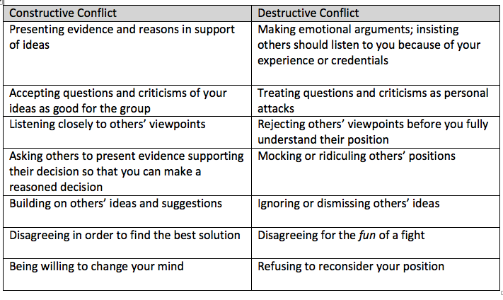
Constructive vs. Destructive Conflict
From Joanna Wolf “Team Writing: a guide to working in groups” pg. 54

Slide 15
Differences and Diversity
Our minds tend to react to differences as “wrong” and/or “bad”
Our minds aren’t always our best asset
Diversity can be seen through a lens of how we relate to differences
Accept, Allow, Make room for… (passive)
vs.
Invite, Embrace, Curiosity (active)

Slide 16
Summary
Truly embracing differences will be messy, uncomfortable
Differences also provide the fuel which drives Synergy
Synergy requires psychological safety
The ability to read and react to other people in the group (social sensitivity)
Equal opportunity to participate in the group

Slide 17
Thoughts and questions?
Charlie Morse
Associate Dean/Director of Counseling
cmorse@wpi.edu

