Slide 1
Connecting Assessment to Learning Objectives for Faculty and Students
Kimberly LeChasseur, PhD (she/her/hers)
Research & Evaluation Associate
Center for Project-Based Learning
Morgan Teaching & Learning Center

Slide 2
What are our learning objectives?
Illustrate a variety of assessment types appropriate for project-based learning
Apply backward design to assessing project-based learning
Formulate a plan to develop supports for student or faculty learning (or at least begin to do so!)
Notes:
I am a resident educational researcher and evaluator housed across the Center for PBL and our Morgan Teaching & Learning Center. In my role, I provide consultations for faculty members and administrators – working with somewhere between 70 and 90 people each year here at WPI. When people ask me if they can meet with me, I ask what their learning objectives are. What do they want to learn how to do as a result of working with me? One lovely consequence is that this question severely limits the number of unnecessary meetings on my calendar.
If they want to work with me on assessment for a particular course, I ask them to send me their student learning objectives. If they can’t do that, because they don’t have any in their syllabus or the ones they have don’t really work for the learning activity they want to assess – which is usually because it’s an active learning or PBL activity – then I tell them they’re not ready to talk about assessment. I refer them to one of our instructional designers and tell them I would welcome a conversation about how to assess student learning once they are clear what type of learning that should be. I wanted to start this afternoon with sharing this practice to highlight a few things: First: Having clarity about what you are trying to learn makes it easier to reach your goal. This is why we ask faculty to include student learning objectives in their syllabi and course assignments. I’d like you to take a few minutes to reflect on what YOUR learning objectives are for attending this workshop. Go ahead and write down your professional goals for thinking about options for assessing PBL [give 2 min]
Next: I’d like to share three learning objectives I had in mind while designing this talk.

Slide 3
What’s your plan to backwards design assessment of an experiential education activity?
Learning Objectives: What do you need to learn with this assessment?
Ownership Allies: Who needs to “own” these learning objectives? Who can support you in making decisions and implementing them?
Assessment Needs: What must be involed for your assessment to be successful?
Notes:
2:08 start

Slide 4
Example 1: Assessing Ethics in Action
Student Learning Objectives
Theory
Demonstrate the ability to identify ethically complex situations in their professional lives;
Be able to identify conflicts between relevant ethical philosophies or professional codes of ethics and potential courses of actions they may take in response to a particular ethically complex situation; and,
Be able to select and justify their selection of the most ethical course of action in response to a particular ethically complex situation.
Lecture (~2 days in a semester)
An example of the consequences of ethical failures in engineering
Class discussion of multiple professional codes of ethics
Role-playing game, the Sand Mafia (~2 days in a semester)
Background content on the Sand Mafia
Stakeholder Role Cards
A Stakeholders Meeting
Optional: Complications Cards
And Practice
Notes:
Take 30 seconds or so and notice the key verbs in these SLOs
Stakeholders include:
An employee of a multinational construction firm
Local environmental activist
Spokesperson for the targeted town
Low-ranking Sand Mafioso
Local police chief
Journalist

Slide 5
Example 1: Assessing Ethics in Action
Student Learning Objectives
Initial Assessment Plans
Demonstrate the ability to recognize ethically complex situations in their professional lives
Be able to identify relevant ethical philosophies or professional codes of ethics
Choose potential courses of actions they may take in response to a particular ethically complex situation
Be able to select and justify their selection of the most ethical course of action in response to a particular ethically complex situation
“The instructor has the option to assess the student achievement of these learning outcomes as consistent with the rest of their course (ie, quiz, exam, take-home exam, discussion, etc.)”
“A final reflection assignment is recommended, combined with a brief survey to assess student attainment or progress towards learning outcomes.”
Notes:
Stakeholders include:
An employee of a multinational construction firm
Local environmental activist
Spokesperson for the targeted town
Low-raking Sand Mafioso
Local police chief
Journalist

Slide 6
Assessment Design Choices: An Organizer Using Bloom’s Taxonomy
Bloom’s Taxonomy Level | Common Verbs Used in Learning Objectives | Exam Question Types | Process & Product Assessment Options
Creating Can the learner create a new product or perspective? | Design, create, develop, formulate, construct, assemble, generate | Not recommended | Stakeholder assessment, peer review, value proposition
Evaluating Can the learner justify a stand or decision? | Evaluate, argue, appraise, select, propose, assess, determine | Not recommended | Conference proposal, poster, position paper, peer review
Analyzing Can the learner identify relationships among parts? | Critique, differentiate, distinguish, examine, test, compare, contrast | Problem sets | Poster, infographics, lab reports/ team activity reports
Applying Can the learner use information in a new way? | Choose, demonstrate, illustrate, interpret, solve, operate, employ | Labeling diagrams, problem sets, short response prompts | Demonstrations, infographics, observation, skills checklists
Understanding Can the learner explain ideas or concepts? | Describe, classify, explain, discuss, identify, locate, translate, report | Identification questions, short response prompts | Journal entries, lab reports/ team activity reports
Remembering Can the learner recall important information? | Define, list, repeat, recall, state, indicate, choose the correct option | Exams & quizzes (fill-in the blank, multiple choice, definitions) | Not recommended

Slide 7
Assessment Design Choices: An Organizer Using Bloom’s Taxonomy
Which levels of Bloom’s Taxonomy are the student learning objectives for this role-playing game?
Demonstrate the ability to recognize ethically complex situations in their professional lives
Be able to identify relevant ethical philosophies or professional codes of ethics
Choose potential courses of actions they may take in response to a particular ethically complex situation
Be able to select and justify their selection of the most ethical course of action in response to a particular ethically complex situation
Bloom’s Taxonomy Level | Common Verbs Used in Learning Objectives | Appropriate Exam Question Types | Non-Exam Assessment Options
Creating Can the learner create a new product or perspective? | Design, create, develop, formulate, construct, assemble, generate | Not recommended | Stakeholder assessment, peer review, value proposition
Evaluating Can the learner justify a stand or decision? | Evaluate, argue, appraise, select, propose, assess, determine | Not recommended | Conference proposal, poster, research paper, peer review
Analyzing Can the learner identify relationships among parts? | Critique, differentiate, distinguish, examine, test, compare, contrast | Problem sets | Poster, infographics, lab reports/ team activity reports
Applying Can the learner use information in a new way? | Choose, demonstrate, illustrate, interpret, solve, operate, employ | Labeling diagrams, problem sets, short response prompts | Demonstrations, infographics, observation, skills checklists
Understanding Can the learner explain ideas or concepts? | Describe, classify, explain, discuss, identify, locate, translate, report | Identification questions, short response prompts | Journal entries, lab reports/ team activity reports
Remembering Can the learner recall important information? | Define, list, repeat, recall, state, indicate, choose the correct option | Exams & quizzes (fill-in the blank, multiple choice, definitions) | Not recommended

Slide 8
Assessment Design Choices: An Organizer Using Bloom’s Taxonomy
Bloom’s Taxonomy Level | Common Verbs Used in Learning Objectives | Exam Question Types | Process & Product Assessment Options
Creating Can the learner create a new product or perspective? | Design, create, develop, formulate, construct, assemble, generate | Not recommended | Stakeholder assessment, peer review, value proposition
Evaluating Can the learner justify a stand or decision? | Evaluate, argue, appraise, select, propose, assess, determine | Not recommended | Conference proposal, poster, position paper, peer review
Analyzing Can the learner identify relationships among parts? | Critique, differentiate, distinguish, examine, test, compare, contrast | Problem sets | Poster, infographics, lab reports/ team activity reports
Applying Can the learner use information in a new way? | Choose, demonstrate, illustrate, interpret, solve, operate, employ | Labeling diagrams, problem sets, short response prompts | Demonstrations, infographics, observation, skills checklists
Understanding Can the learner explain ideas or concepts? | Describe, classify, explain, discuss, identify, locate, translate, report | Identification questions, short response prompts | Journal entries, lab reports/ team activity reports
Remembering Can the learner recall important information? | Define, list, repeat, recall, state, indicate, choose the correct option | Exams & quizzes (fill-in the blank, multiple choice, definitions) | Not recommended

Slide 9
Ethical Reasoning VALUE Rubric – Modified
 | Exceeds Professional Expectations (5) | Meets Professional Expectations (4) | Meets Minimum Expectations (3) | Approaches Expectations (2) | Does Not Meet Expectations (1)
Recognizing Ethical Issues | Student understands ethical issues when presented in a complex, multilayered, ambiguous context. | Student acknowledges basic & obvious ethical issues & grasps the full complexity & situational conditions around them. | Student acknowledges basic & obvious ethical issues & grasps some of the complexity &/or situational conditions, but incompletely articulates the full complexity of the dilemma. | Student acknowledges basic & obvious ethical issues, but fails to grasp complexity or situational conditions around them. | Student does not acknowledge basic & obvious ethical issues as dilemmas.
Understanding Different Ethical Perspectives/ Concepts | Student names a major perspective/concept in describing the ethical dilemma & accurately explains the details of the perspective/concept while justifying their analysis. | Student names a major perspective/concept in describing the ethical dilemma, presents the gist of the perspective/ concept, and gives some explanation of the details to justify their analysis, but has some inaccuracies in details &/or in argumentation. | Student names a major perspective/concept in describing the ethical dilemma & presents the gist of the perspective/ concept, but does not go into sufficient detail to justify their analysis. | Student names a major perspective/concept in describing the ethical dilemma, but does not provide even a basic description of what that perspective/concept entails. | Student describes an ethical dilemma without referencing any specific ethical perspective/ concept.

Slide 10
Ethical Reasoning VALUE Rubric – Modified
 | Exceeds Professional Expectations (5) | Meets Professional Expectations (4) | Meets Minimum Expectations (3) | Approaches Expectations (2) | Does Not Meet Expectations (1)
Evaluating Different Ethical Perspectives/ Concepts | Student states a position & its alternatives, accurately describes the objections to, assumptions, & implications of each, connects them, & provides an effective defense of the final position. | Student states a position & its alternatives, describes the objections to, assumptions, & implications of each, & connects them, but there are some inaccuracies. | Student states a position & its alternatives & describes the objections to, assumptions, & implications of each, but without relating them to each other or justifying the final position. | Student states a position but does not state objections to, assumptions, & limitations of the declared position & its alternatives. | Student fails to clearly state a position regarding a particular ethical issue.
Applying Ethical Perspectives/ Concepts | Student independently applies ethical perspectives/concepts to an ethical question accurately & considers the range of implications in their full complexity. | Student provides an original ethical stance & applies ethical perspectives/ concepts accurately, but does not consider the specific implications of the application in depth. | Student provides an original ethical stance & applies ethical perspectives/ concepts, but with some inaccuracies &/or underdeveloped argumentation. | Student applies ethical perspectives/concepts to an ethical question when prompted with an ethical dilemma, but cannot provide & analyze a new position independently. | Student does not apply ethical perspectives/ concepts to an ethical question when prompted to do so.

Slide 11
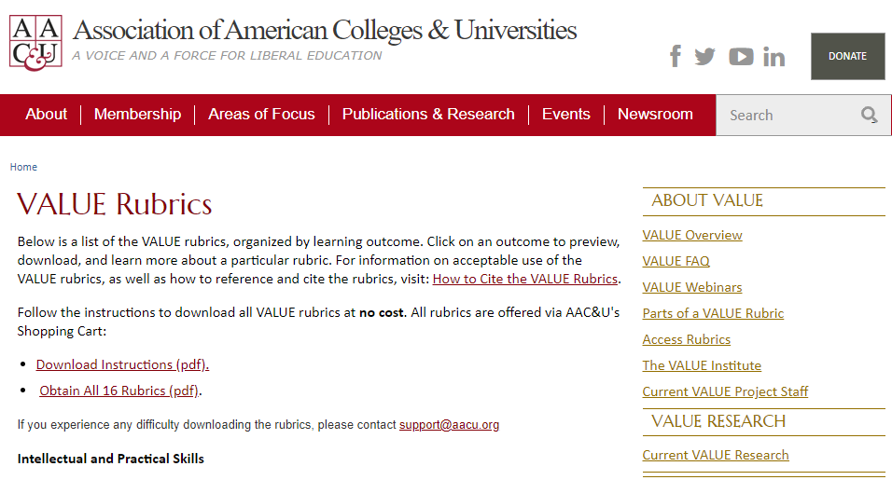
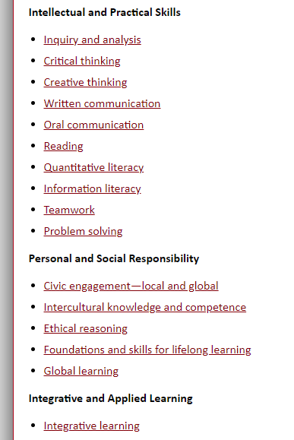
Rubrics for Student Learning Outcomes in Process & Product Assessment
Notes:
Rubrics have their pros and cons. In this example, the professor was looking for a meaningful project to insert into a course…but was mindful of not taking up too much time.

Slide 12
Example 2: Assessing Leadership & Team Skills
Change in ABET Requirements
Practice
Old Learning Objective: “an ability to function on multi-disciplinary teams”
New Learning Objective: “an ability to function effectively on a team whose members together provide leadership, create a collaborative and inclusive environment, establish goals, plan tasks, and meet objectives”
Senior lab courses
7 labs over 2 terms/full semester
Teams of 3-4 students
Prelab, written report, presentation
Capstone
1 open-ended design project
Teams of 3-4 students
Final written report
Intervention for dysfunctional teams only
Document the problem, strategies to fix issues, the outcomes
Notes:
Old way of working was based on the logic that “the project was successful so the team functioned effectively”
New nuances in the revised learning objective required more systematic, regular assessment
The department was interested in maintaining a formative assessment function, in addition to the need for summative assessments, and in making the process pragmatic for students, particularly in courses with rapid turnaround in iterative lab cycles. They were also skeptical of peer assessments and self-reports that felt too subjective.

Slide 13
Ownership Allies
University Community
Accreditation processes
Value proposition of our signature PBL pedagogy
Faculty
Each course relates to the “Big Picture”
Students
Skills as an explicit goal
Framing expectations for the learning experience
Don’t go it alone!
Notes:
Sometimes the folx who shape learning objectives are part of formal structures: Accrediting bodies, official university-wide learning objectives. Faculty learning might be supported by roles like mine in a Teaching & Learning Center or Instructional Designers. However, there are also important, informal relationships that support the design and assessment of learning objectives. In both examples provided today, faculty worked with formal supports to provide assessment tools aligned with student learning objectives to other faculty; both did this in ways that promoted the flexibility to customize for their fellow colleagues.

Slide 14
What’s your plan to backwards design assessment of an experiential education activity?
Learning Objectives: What do you need to learn with this assessment?
Ownership Allies: Who needs to “own” these learning objectives? Who can support you in making assessment decisions and implementing them?
Assessment Needs: What must be involved for your assessment to be successful?
Notes:
2:08 start

Slide 15
Weekly Team Reports
Data Collected
Assessment Practice
Team member roles
Requires students to specify leader, teamwork reporter, assignment preparer, & workers
Prompts students “to be rotated, some roles have multiple team members)
Goals for the Week & Task Planning
Worker Responsibilities
Successes/Accomplishments
Problem Areas
Comments (if any)
Flexibility to Customize Implementation in Courses
Three Functions
Educative: Sets explicit expectations and builds good habits (eg, self-awareness, attention to team dynamics)
Formative: Provides opportunities for regular feedback (eg, “Damien has been team leader each week; remember to rotate”)
Summative: Provides evidence of trends in student outcomes & faculty responses to issues for ABET accreditation process

Slide 16
What’s your plan to backwards design assessment of an experiential education activity?
Learning Objectives: What do you need to learn with this assessment?
Ownership Allies: Who needs to “own” these learning objectives? Who can support you in making decisions and implementing them?
Assessment Needs: What must be involved for your assessment to be successful?
Notes:
2:08 start

Slide 17
Questions?
kalechasseur@wpi.edu
Center for Project-Based Learning
Notes:
2:20 start
10 minutes for questions

