Slide 1
Ahmet Can Sabuncu, PhD
Assistant Teaching Professor
Mechanical Engineering Department
Worcester Polytechnic Institute

Slide 2
Projects: Anytime, Anywhere
“MacGyver's most-used item is his Swiss Army Knife. He usually carries a roll of duct tape in his back pocket, flattened out to make it fit. Other items he often has on hand are: an ID card, a Timex Camper watch, strike-anywhere matches, a few paper clips, chewing gum, and a flashlight…”
Wikipedia

Slide 3
Projects: Anytime, Anywhere
Tuition costs/financial aid rate is monotonically increasing.
Capital cost to start an experimentation lab (30 students) is $150,000.
The student profile is changing and there is a need to accommodate different schedules and locations.
Online education could be a solution to the above but hampered by the problems around it.
Some problems around online education:
Hands on project work
Experimentation and lab-oriented studies
Collaboration
Student Motivation
Extracurricular work

Slide 4
Projects: Anytime, Anywhere
Currently teaching labs for engineering are constrained by many factors. These include,
High capital and operating cost of the experimental setups. Capital cost to start an experimentation lab (30 students) is $150,000.
The immobility of the experimental setups, requiring all students to be on campus.
Lack of student engagement as labs are too structured and students follow a given recipe.
Experiments in one institution are not easily transferable to other institutions.

Slide 5
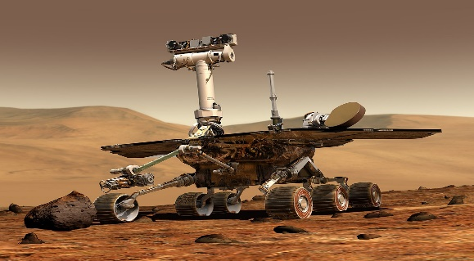
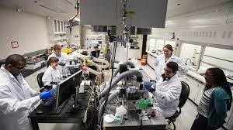
Solution Space for Engineering Experimentation
remote
local
 | Conducted | Simulated
Location of the student
Nature of Interaction

Slide 6
Our Approach and Potential Impact
APPROACH
Our solution is to change the current paradigm in lab-oriented courses such that there is spatial and temporal mobility.
Students use low-cost materials to conduct experiments anywhere (spatial independency).
We design experiments and making activities that are doable in everyday situations (temporal independency).
Student learning culminates in an open-ended project activity where they also use making skills.
IMPACT
Experiments are more accessible.
Experiments and making efforts are easily transferrable from one institution to another.
Cost is not a limiting factor in adapting this approach to making and experimental studies.
Could be superior to simulations relative to the “realness” of the experiment.

Slide 7
ME3902: Project Based Experimentation Course
This 7-week online course is structured to have,
5 learning or formative experimentation modules, followed by a summative open-ended experimentation project.
The contents of the formative modules are designed to teach the most essential experimental skills.
Formative modules prepare students to construct complex experimentation setups that involve integration of several measurement sub-systems.

Slide 8
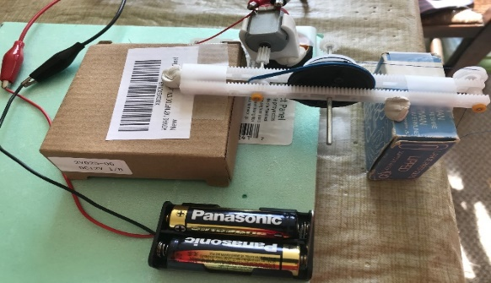
Formative Module
Example Module:
Determining the torque characteristics
of a motor
Formative Modules
Students develop proficiency in developing experimental setups.
In each module a physical measurement type is addressed (Temperature, distance, concentration, etc.).

Slide 9
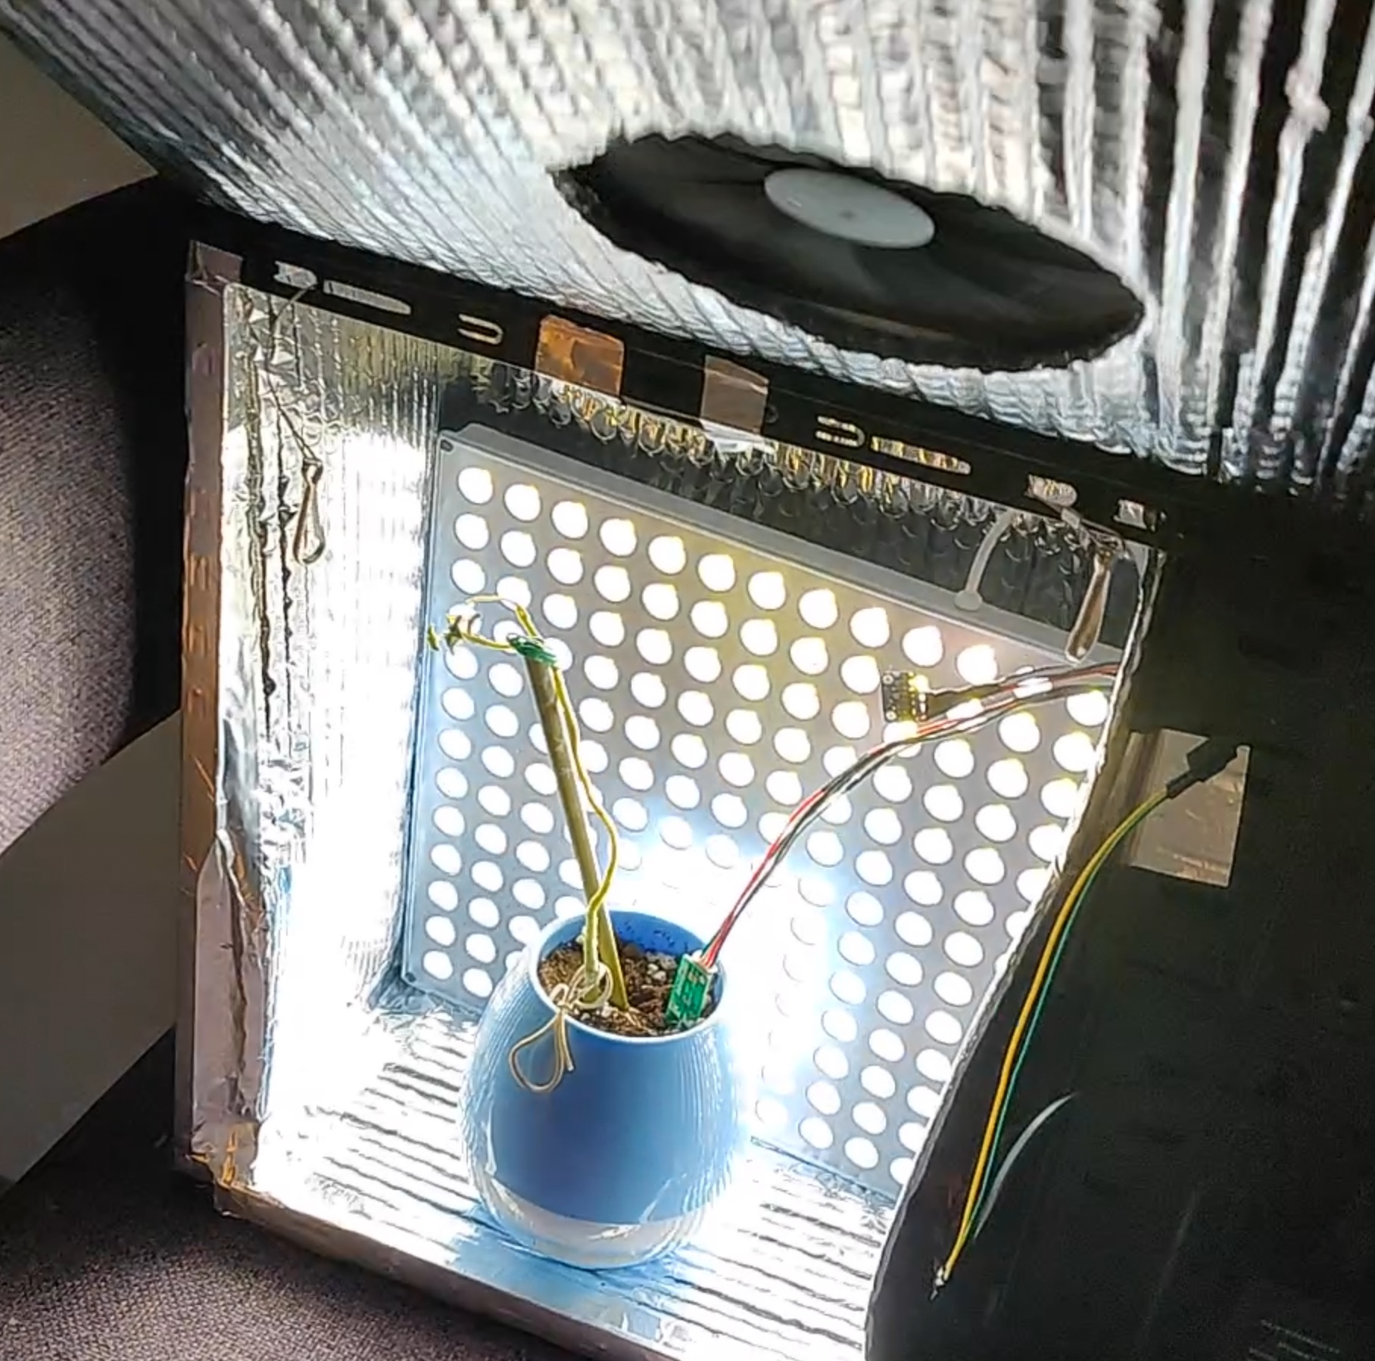
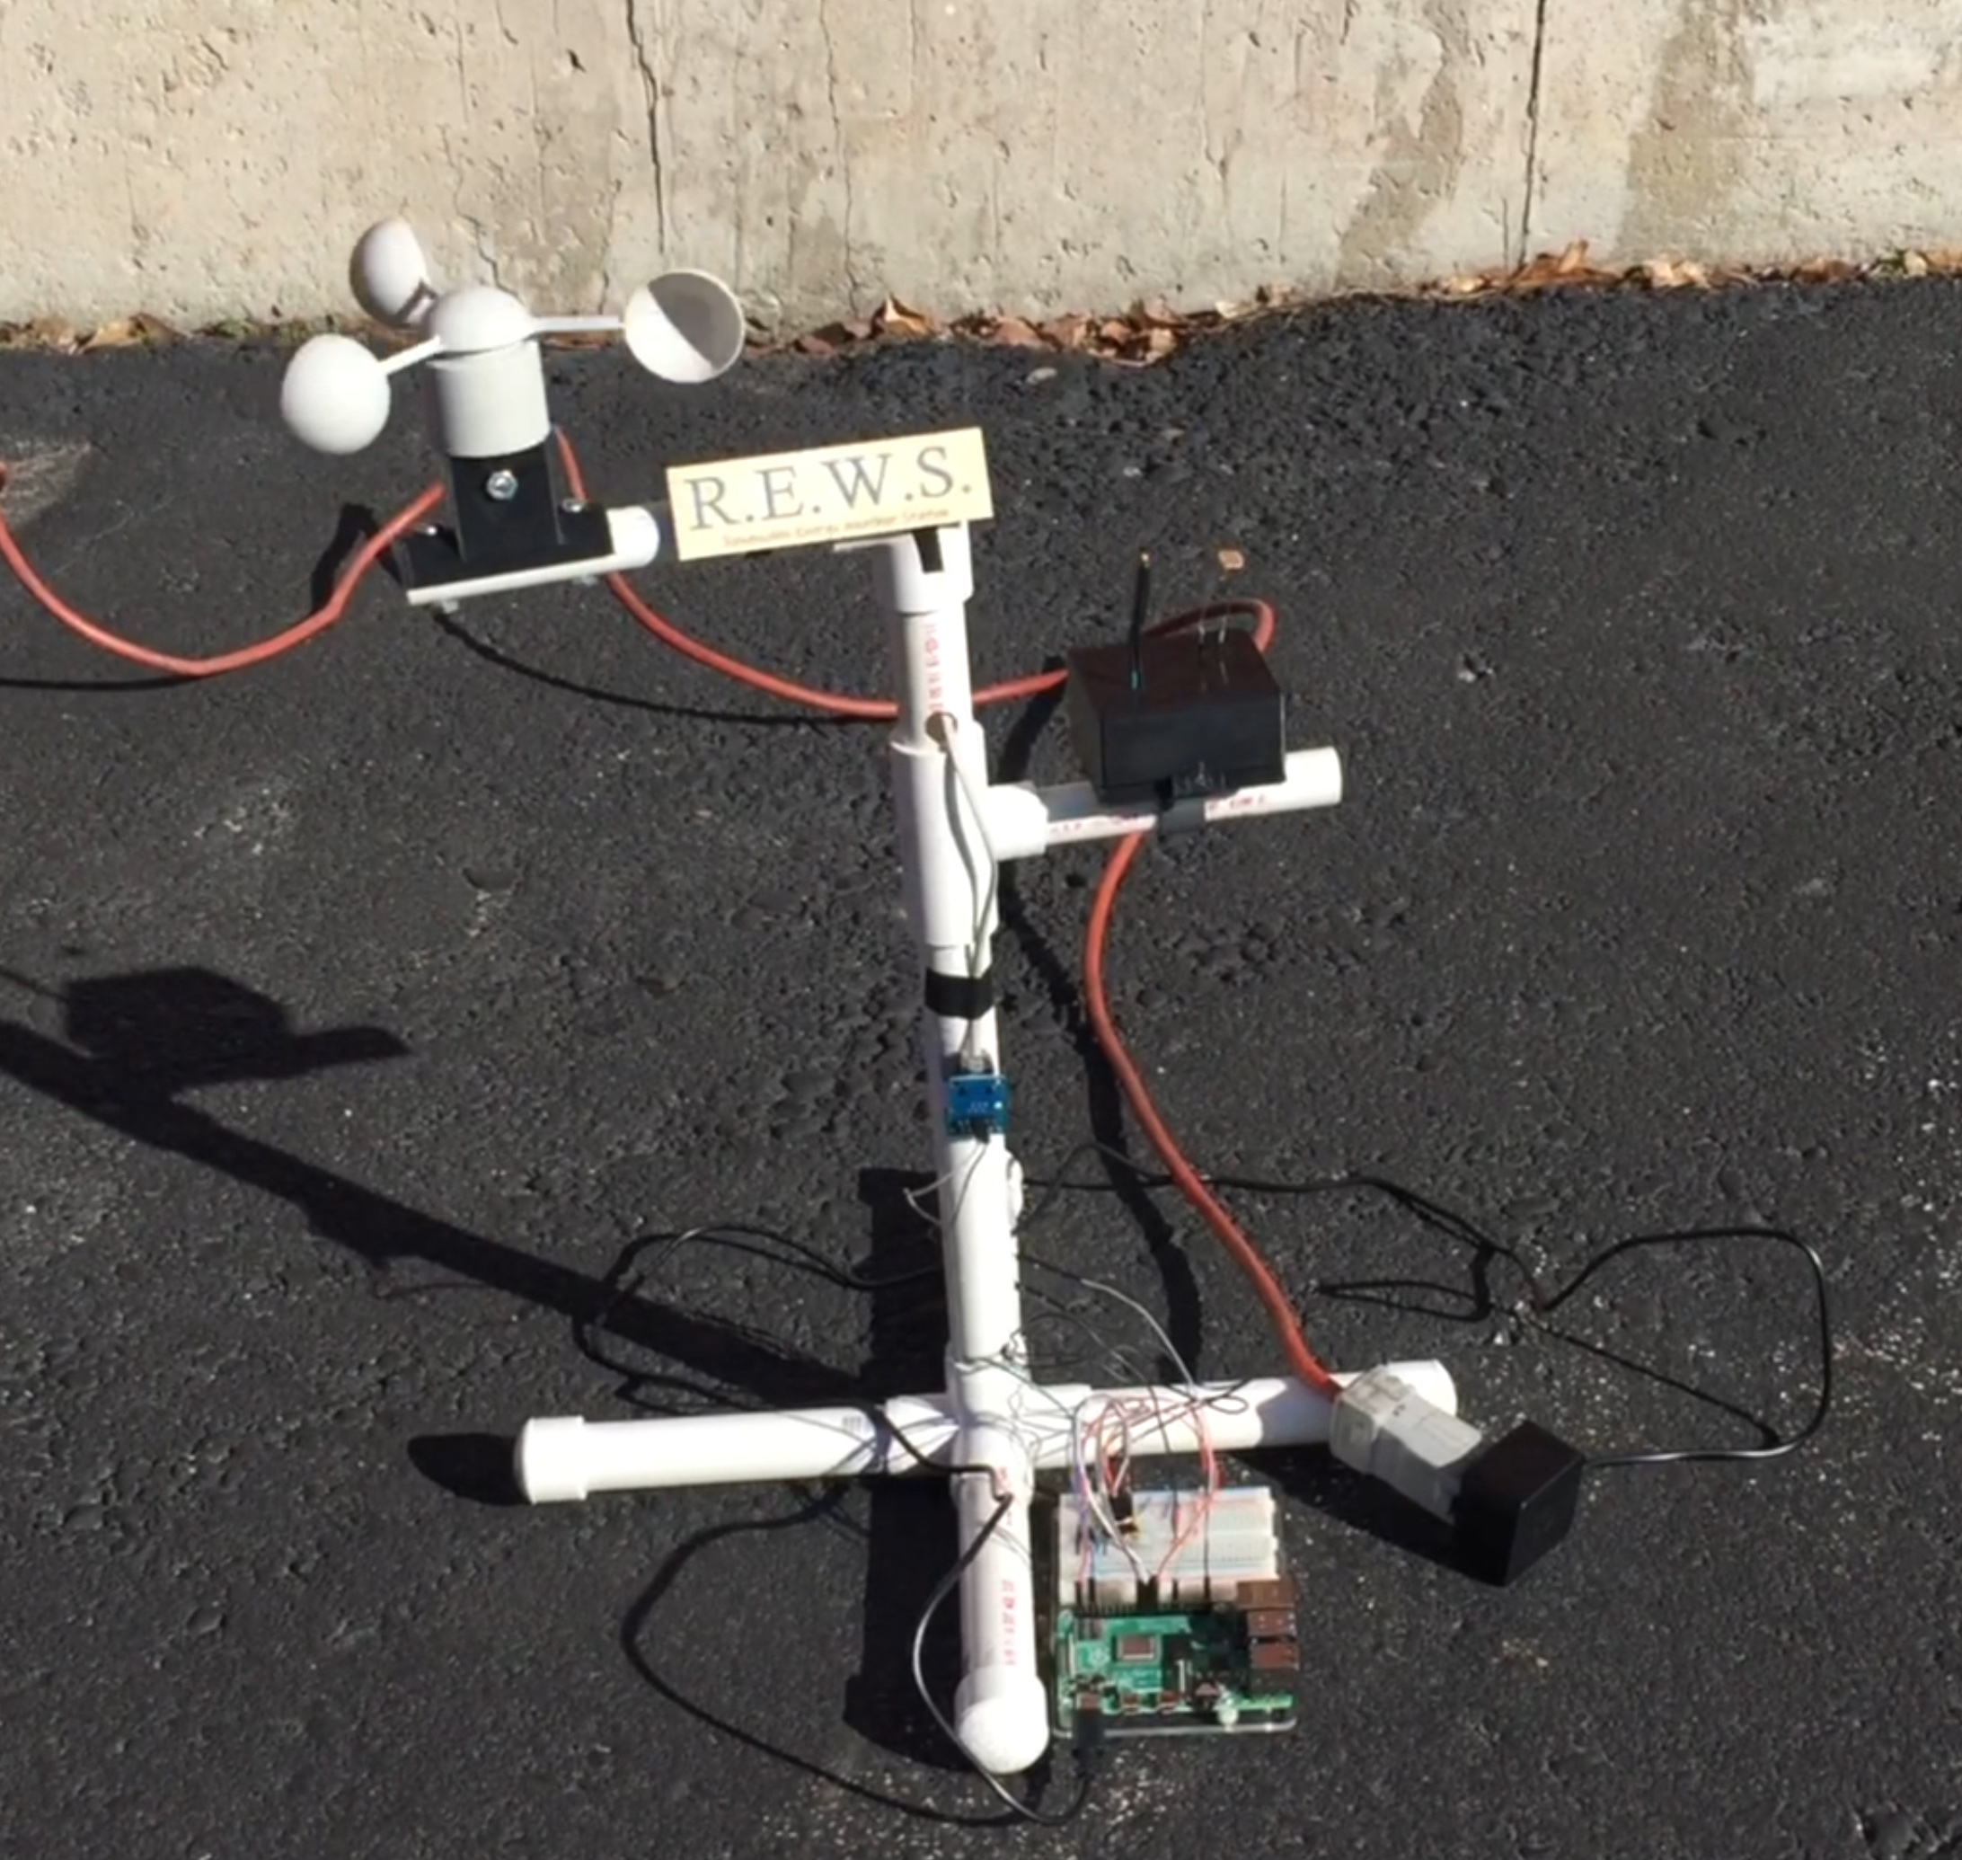
Summative Module
The Open Ended Project
utilized a minimum of 3 sensors and/or controllers
Students proposed their projects and the instructors restrained the ideas to realistic endeavors.
(b)
(a)
(c)
Example Projects:
Tabletop Kitchen Bioreactor (a)
Plant Maintenance System (b)
Renewable Energy Weather Station (c)

