Slide 1
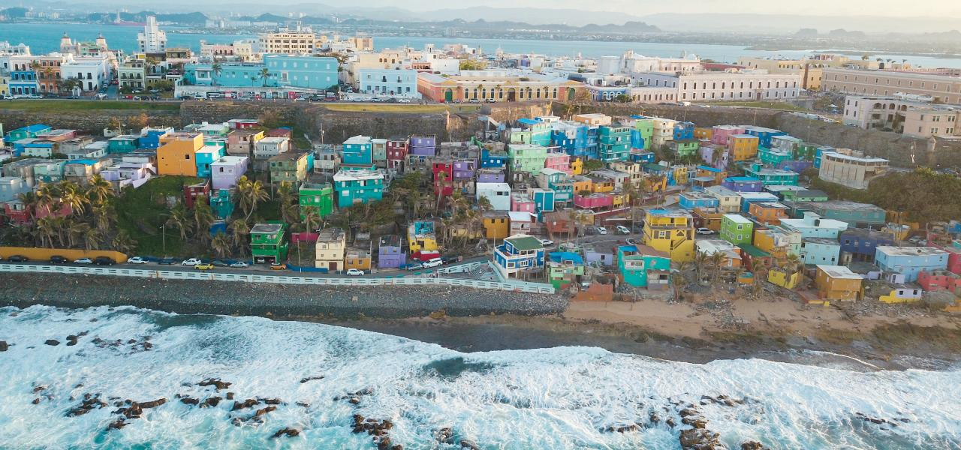
(“Visiting La Perla Neighborhood”, n.d.)

Slide 2
Agenda for Today - Agenda para hoy
Introduce Our Team/WPI - Presentar nuestro equipo/WPI
What have we been doing - ¿Qué hemos estado haciendo?
Why Mapping? - ¿Por qué mapear?

Slide 3
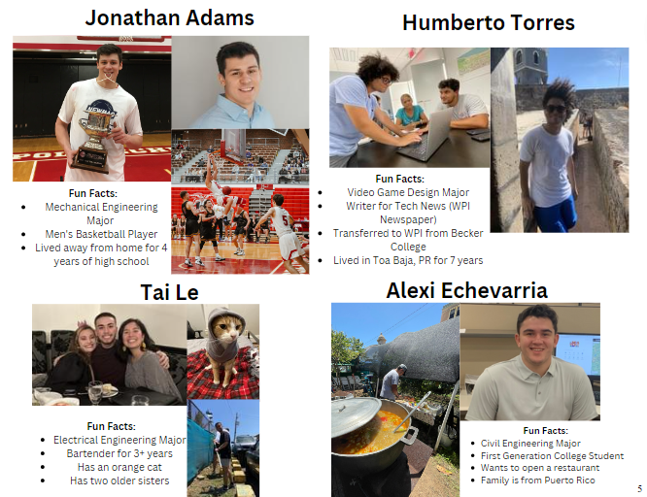
Not possible without:
Lourdes Diaz Pabón
Lourdes Lopez
Scott Jiusto
Leslie Dodson
The entire community of La Perla
Our friends and families

Slide 4
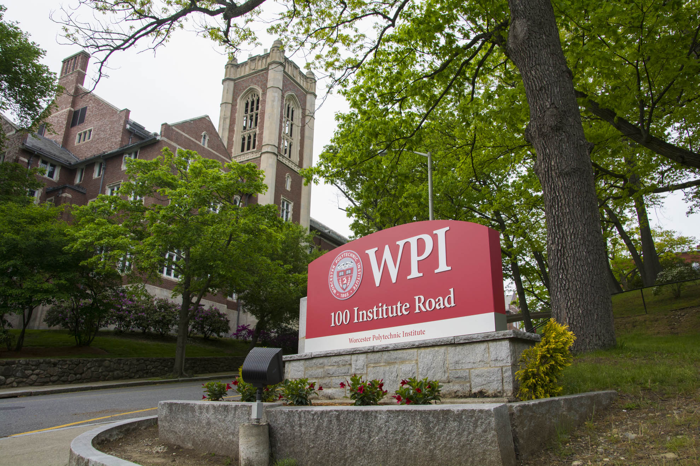
WPI
Worcester Polytechnic Institute (WPI) has been collaborating with Puerto Rico for more than 30 years, carrying out all kinds of projects to help the communities of the island.
This is the first project that students from WPI are working with La Fondita de Jesús and La Perla. We hope that these partnerships continue, and future student groups can further the work we have started.

Slide 5
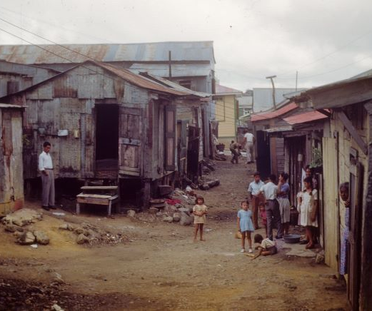
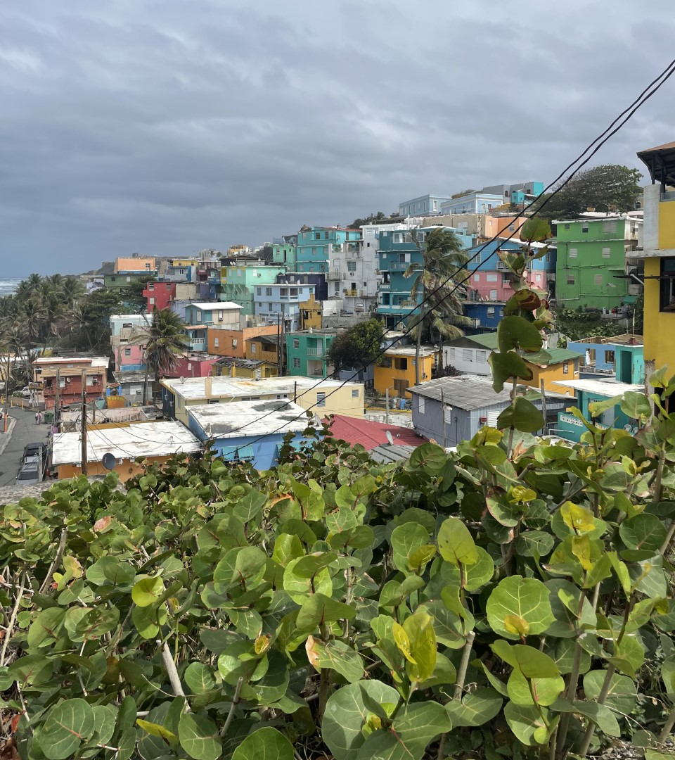
La Perla Through the Years
(Concepcion, 2023)

Slide 6
Timeline of La Perla
18th Century
Founded as a slaughterhouse shanty town
Populated mostly by slaves
1940s
"Slum Clearance" attempts to displace residents
Population dips from 4500 to 1200
2010–2015
2011 - Drug raid displaces 114 residents
2017
Houses painted in bright colors
"Despacito" music video in La Perla
Hurricane Maria
Present
3 Sectors
General distrust of official governments
Arts to fight for rights
~ 200 Households
19th Century
More people began to immigrate from the countryside
Stigma grew/formed due to marginalized population
Notes:
2011 – 114 people to be exact

Slide 7
Our 3 Main Goals
Build
1
Build a foundational relationship with La Fondita and La Perla
Talk
2
Talk with community members and explore mapping ideas
Create
3
Create maps and guides for mapping software

Slide 8
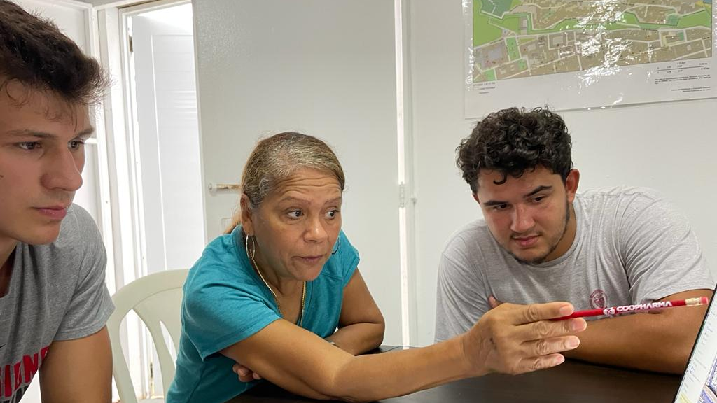
What have we been doing - ¿Qué hemos estado haciendo?

Slide 9
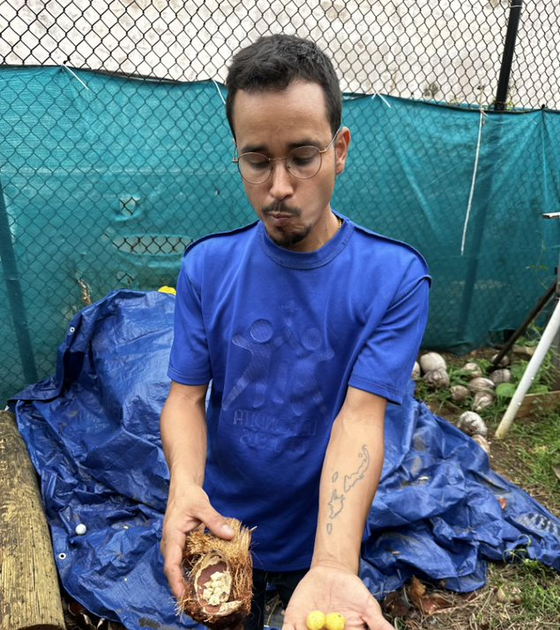
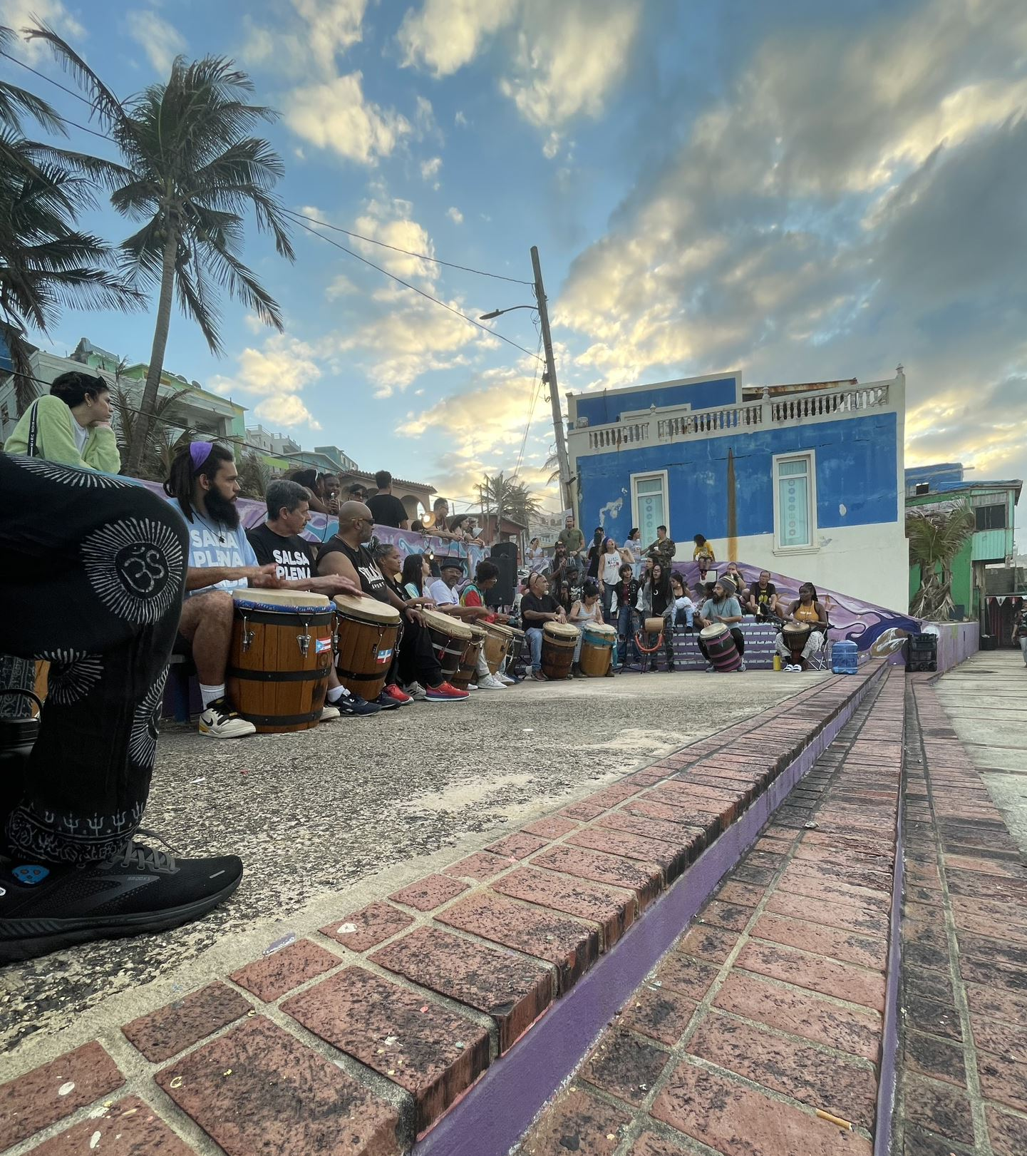

Slide 10
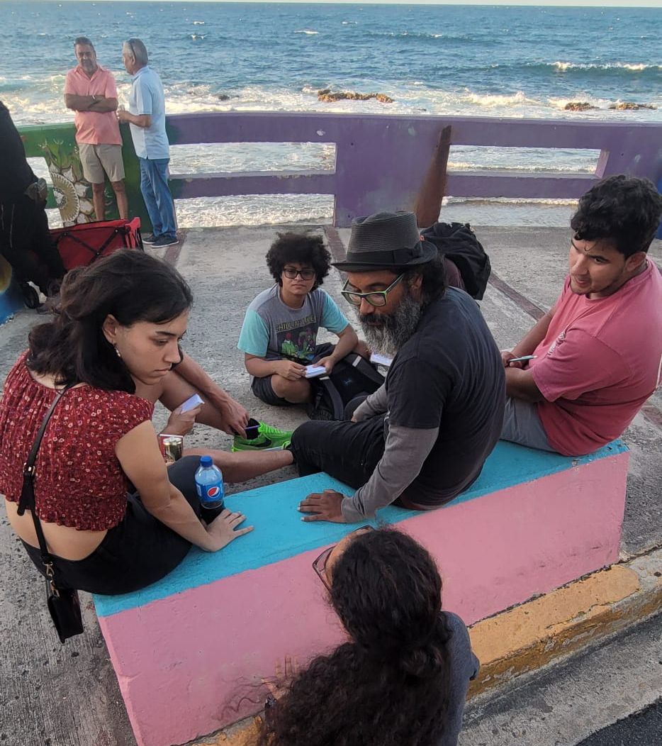
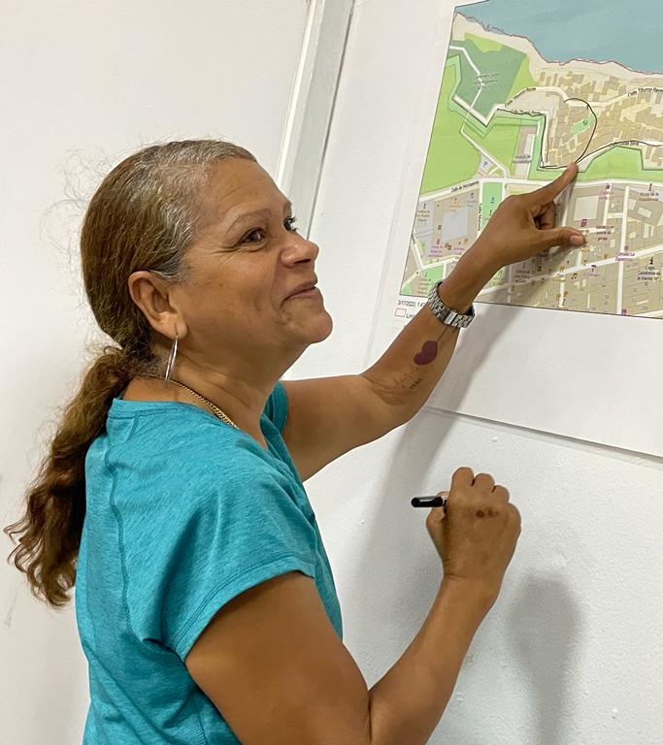

Slide 11
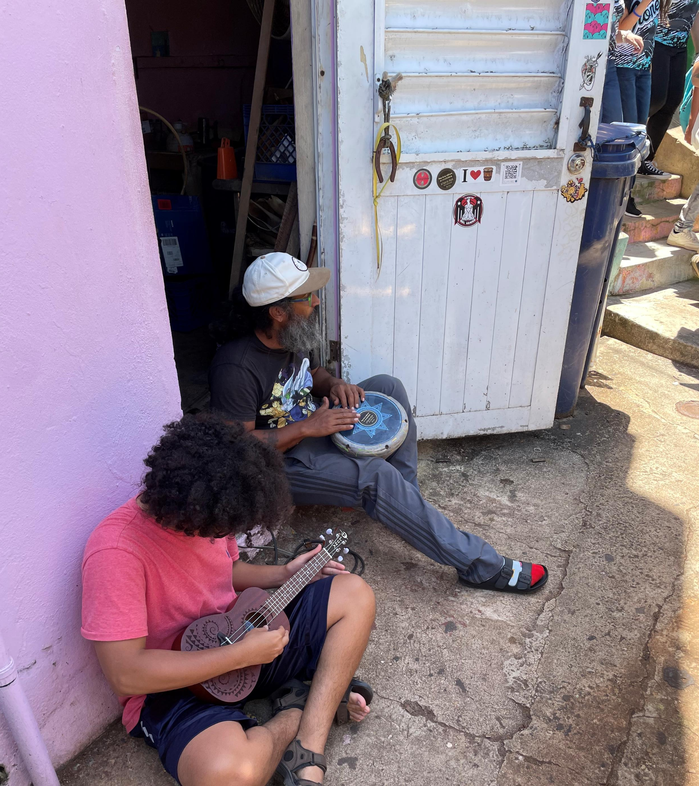
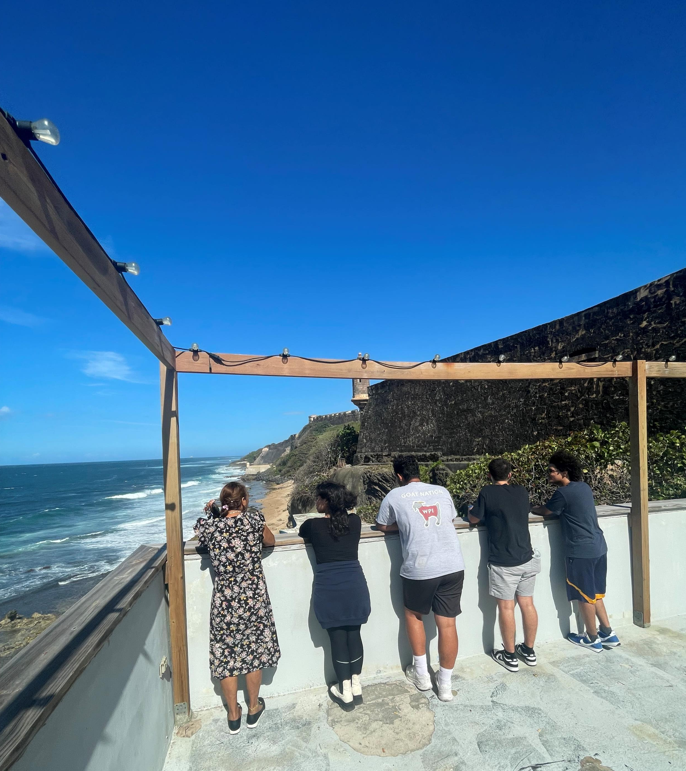

Slide 12
Why Mapping? - ¿Por qué mapear?
Highlights areas for oppurtunity - Áreas destacadas para la oportunidad
Identifies assets in the community - Identifica activos en la comunidad
Visual way to show and represent information - Forma visual de mostrar y representar información
Bring people together - reúnen a las personas

Slide 13
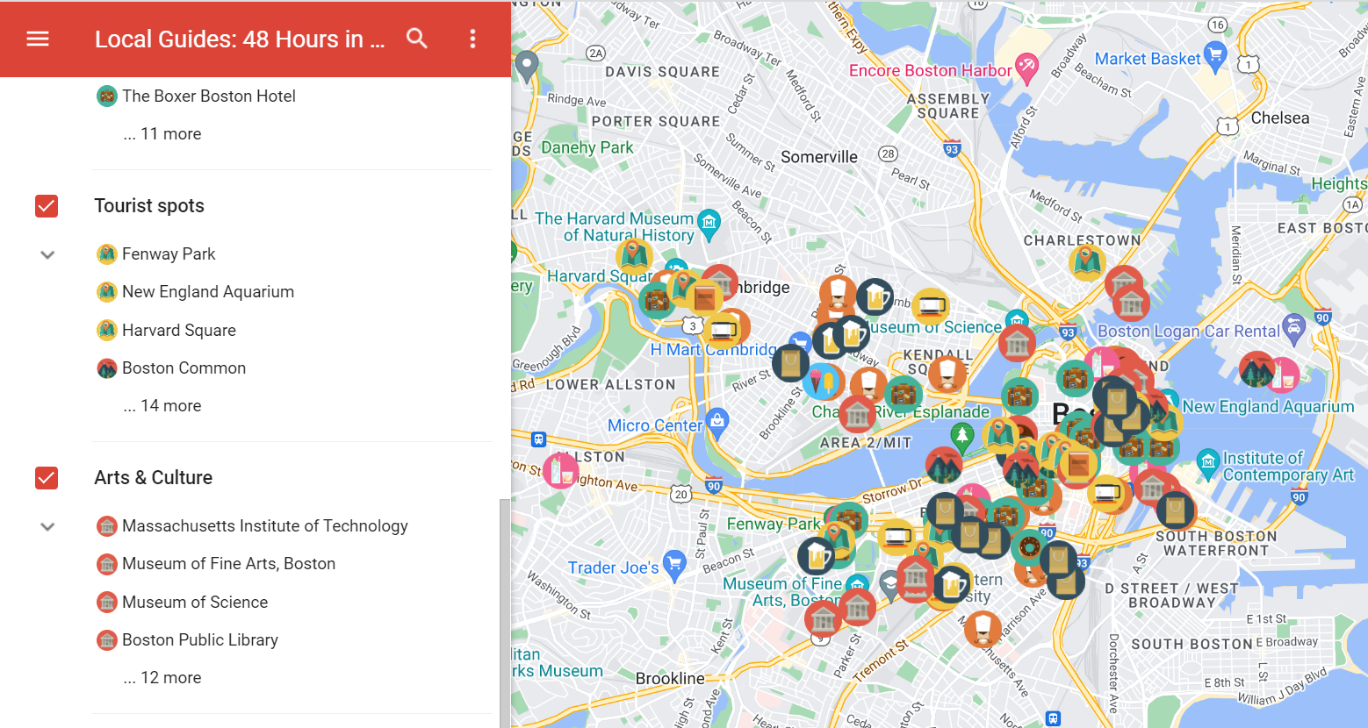
(“48 Hours in Boston”, 2017)
https://www.localguidesconnect.com/t5/Travel-and-Advice/48-Hours-in-Boston-with-a-custom-map/m-p/156441

Slide 14
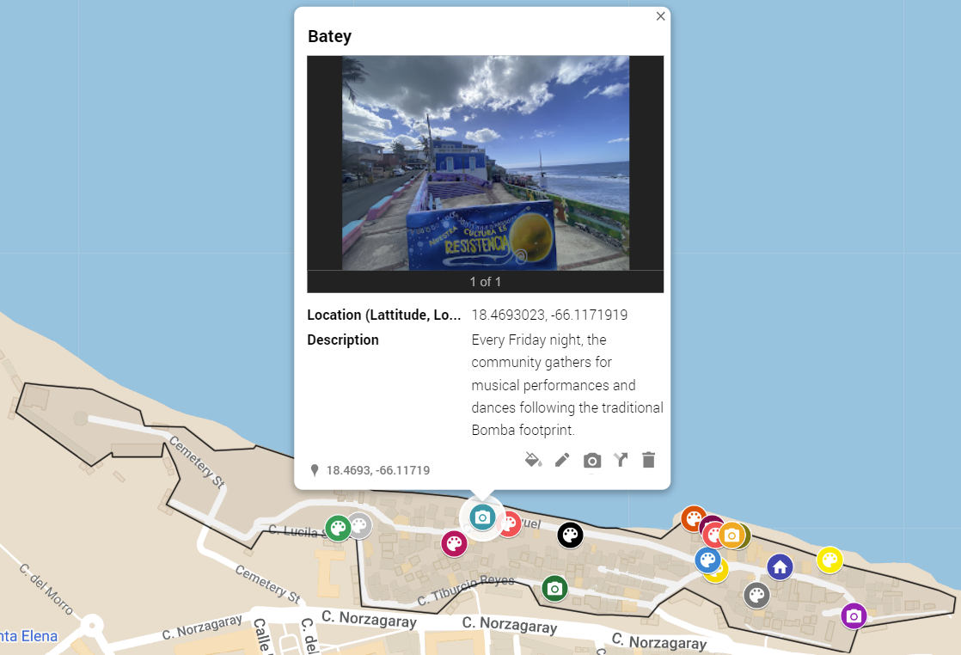
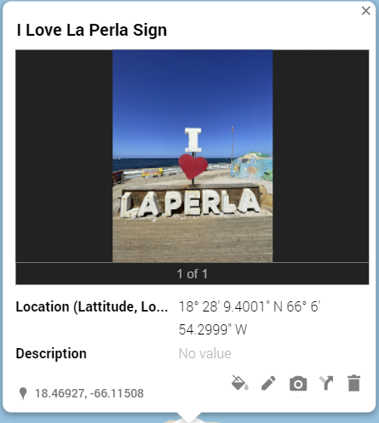
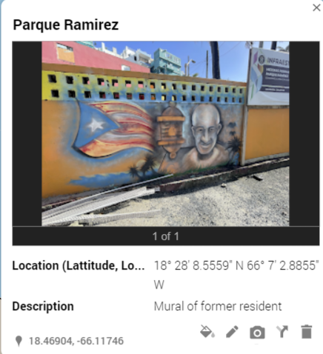
Art & Mural Map - Interactive map that highlights the beaty of La Perla through art, murals, and tourist attractions

Slide 15
Sectors Map – Interactive map that highlights the three main sectors of La Perla
Lucila Silva
Guaipao
San Miguel

Slide 16
Evacuation Route Map – Interactive map that begins to organize possible driving and walking evacuation routes from different areas in La Perla

Slide 17
Conclusion
Training Session
2 Facilitator Guides
Journey Book
4 Map Templates

Slide 18
"To work with communities in vulnerable situations is to enter spaces of deep introspection, contemplation, and all of the transformative aspects that facilitate real personal and professional growth."
- Lourdes Diaz Pabón, Equity and Social Justice Coordinator, Corporacion La Fondita De Jesús

Slide 19
5 –10 Minute Break
Next Up: Our Google My Map Training Workshop

