Slide 1
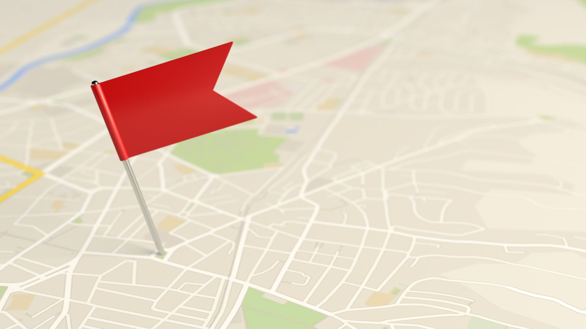
Welcome - ¡Bienvenidos!

Slide 2
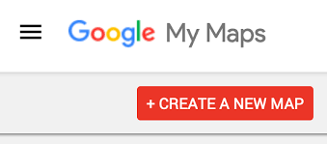
Google My Maps Facilitators Guide
Process of Creating a Map

Slide 3
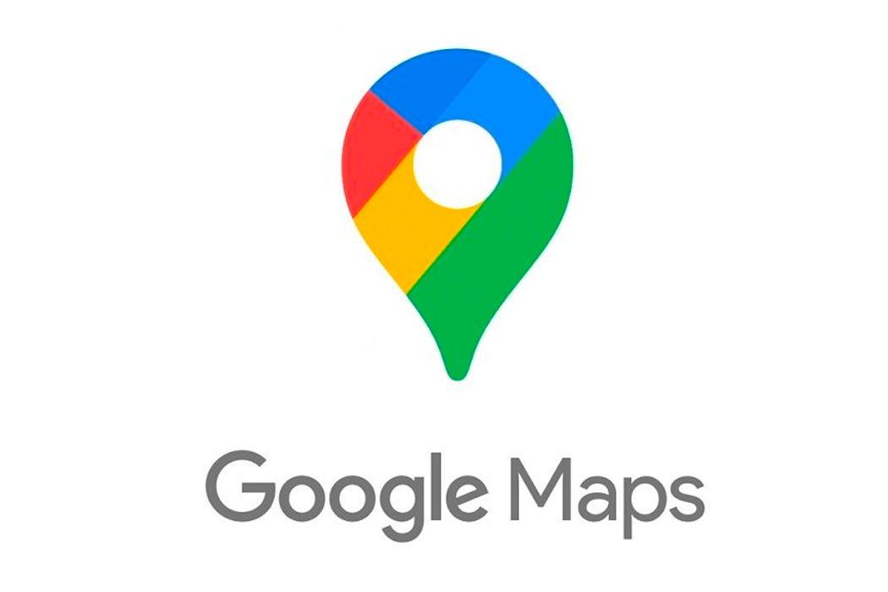
Google Maps v. Google My Maps
Google Maps
Public Information
Only published by Google
Can suggests edits
Corporations can register
Ability to restrict/privatize
Ability for collaboration
Customizable
Needs WiFi

Slide 4
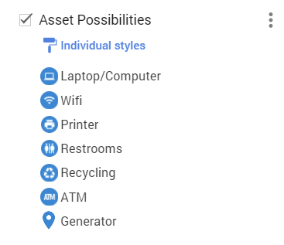
Asset Map – Interactive map that highlights the strengths of La Perla. Asset maps change outside impressions of a community and internally help communities find strengths and work together.

Slide 5
Accessing Google My Maps
https://mymaps.google.com/

Slide 6
That is all for Today...
Thank you
Open for Discussion
Coming Up Next for Us: Training Workshop with La Perla Residents

