Slide 1
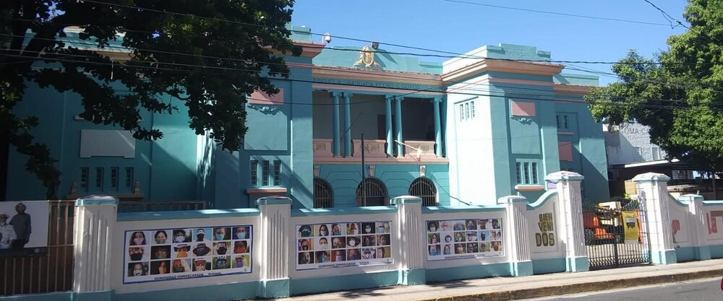
Supporting La Goyco's Volunteer Program
May 2nd, 2023
Authors: Ryan Chesanek, Andrew Kerekon, Hunter Lassard, and Evan Russell
Advisors: Leslie Dodson and Scott Jiusto
Liaison: Mariana Reyes, Executive Director of Taller Comunidad La Goyco
Notes:
Presenter: Evan (1) - Everyone introduce themselves individually
Good evening, everyone, thank you all so much for coming out today, my name is…

Slide 2
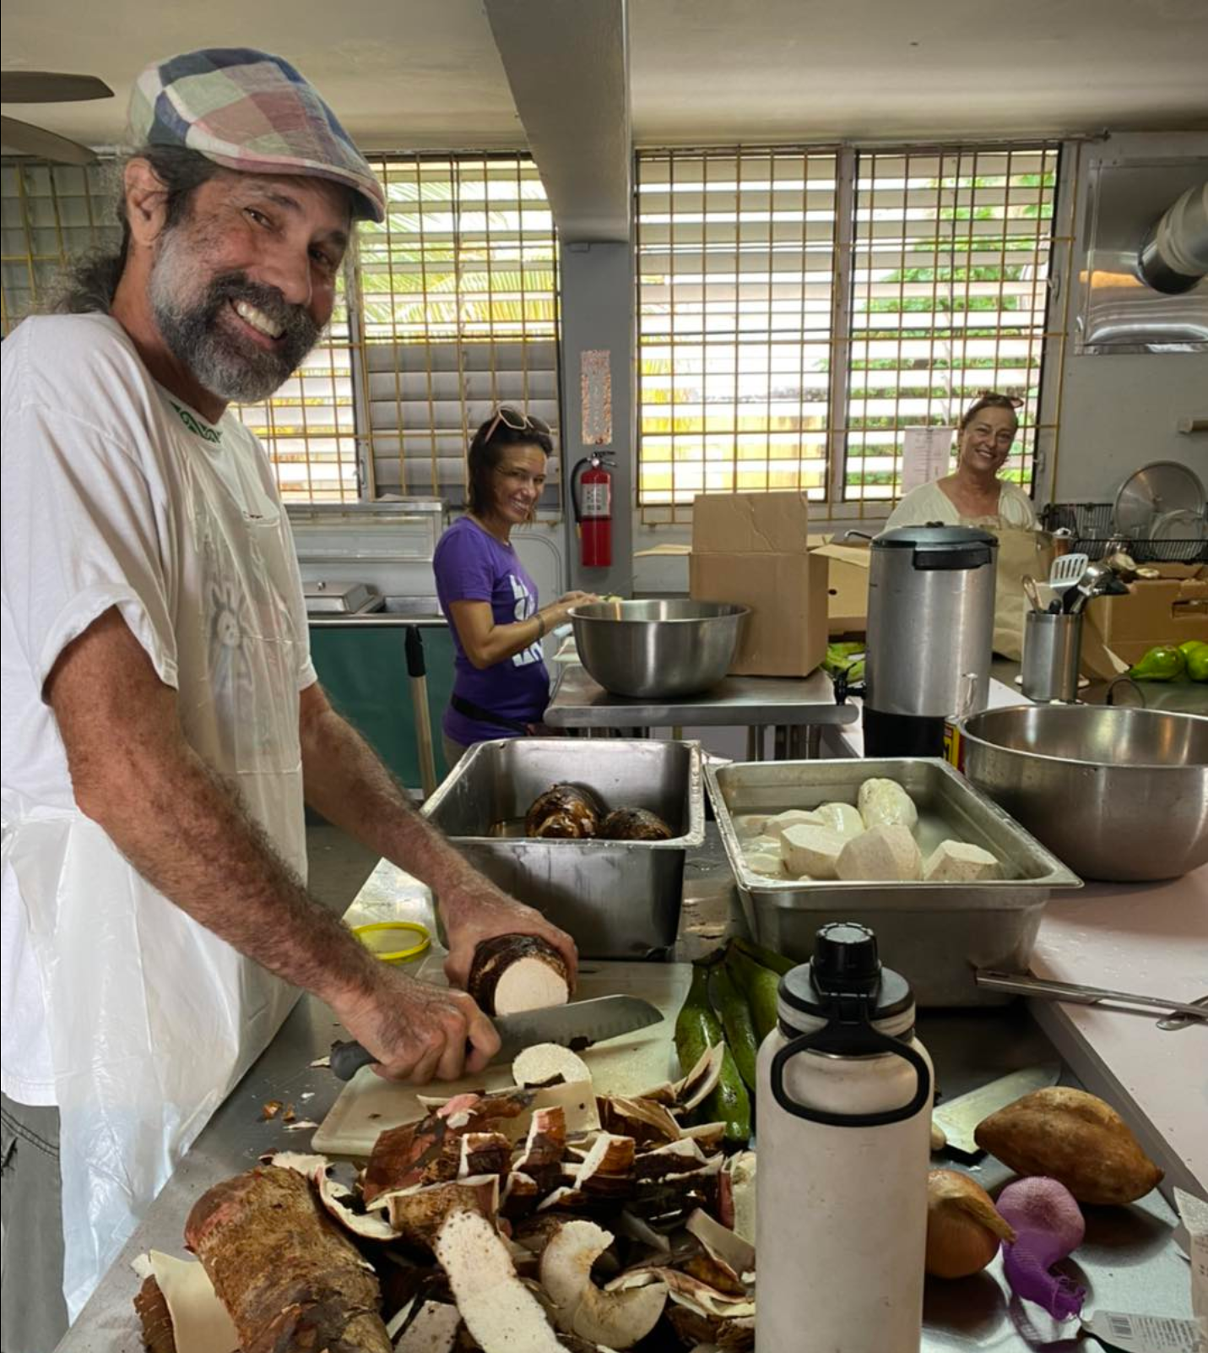
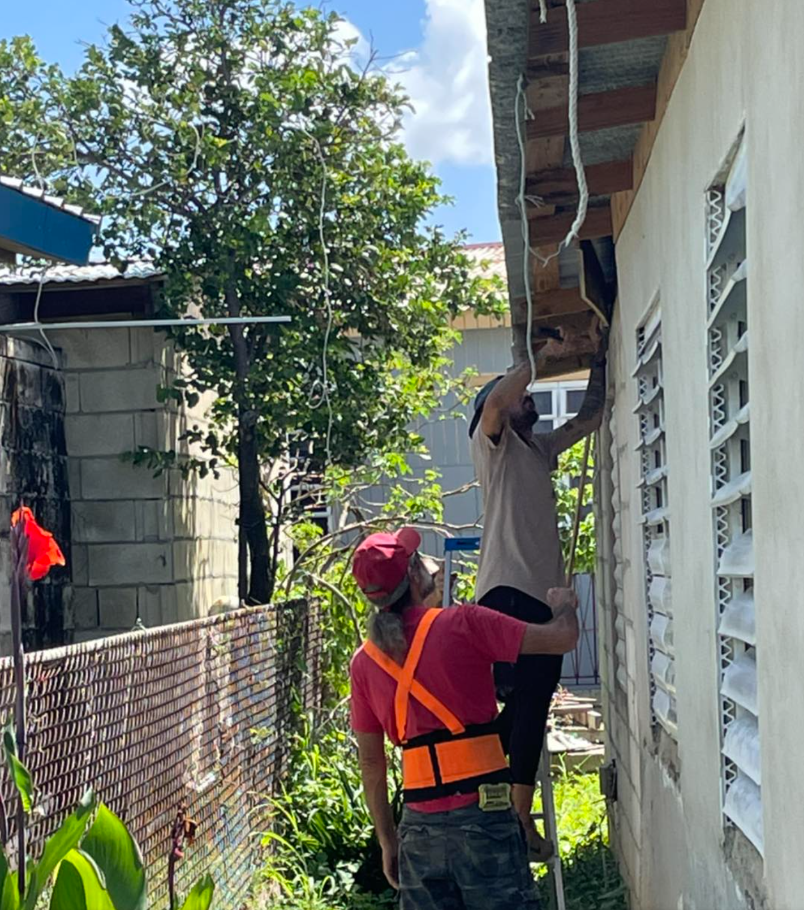
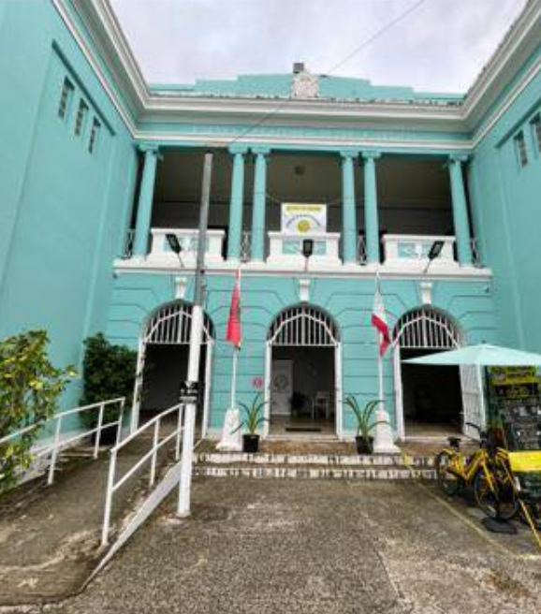
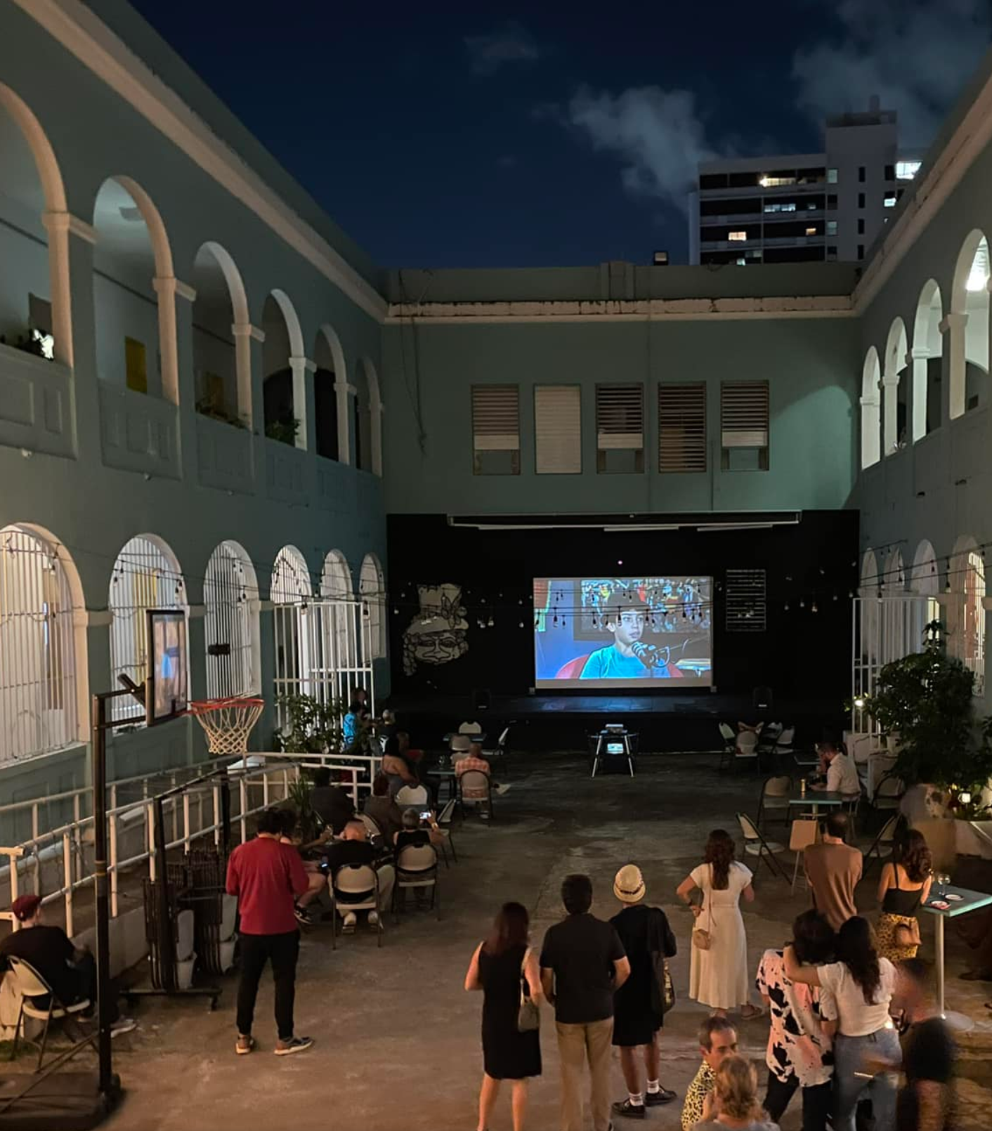
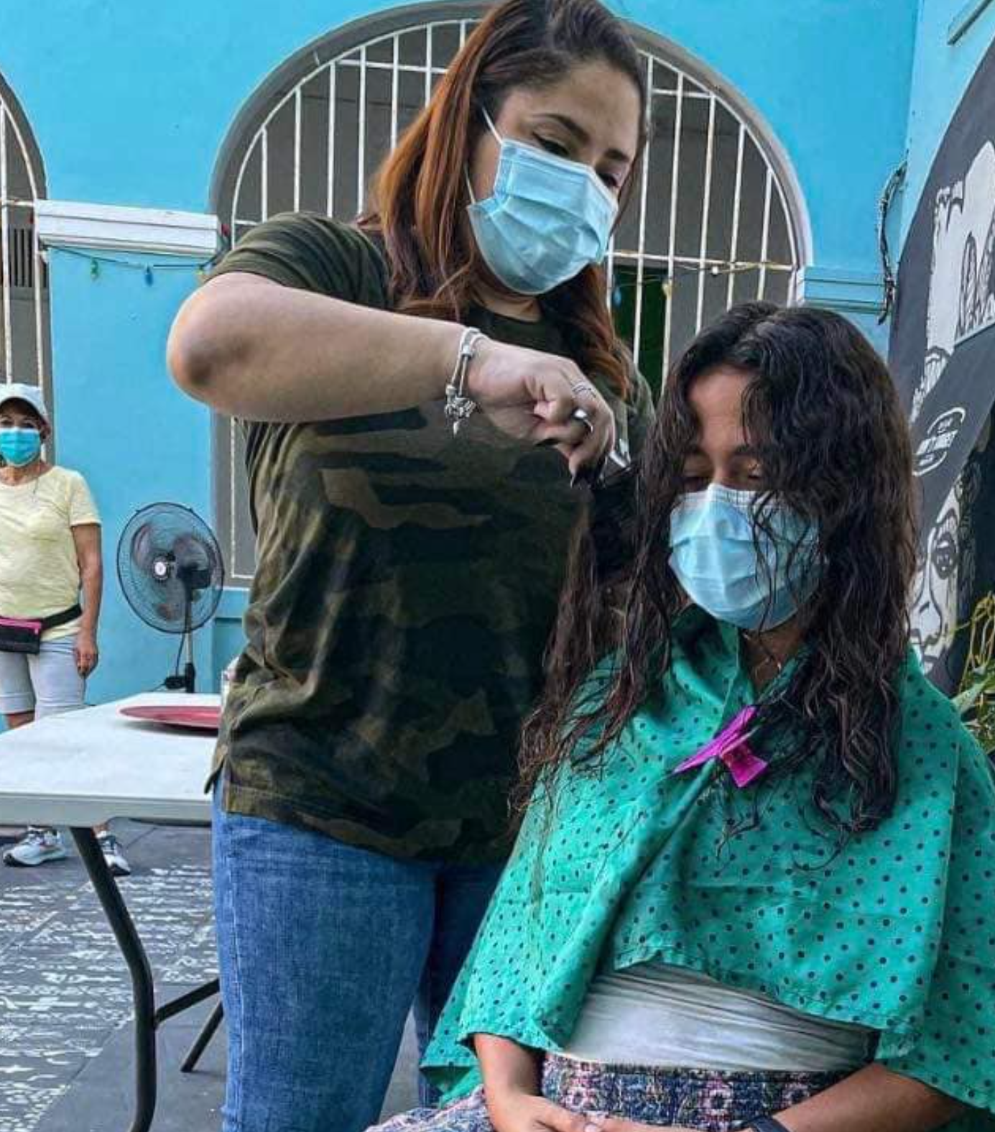
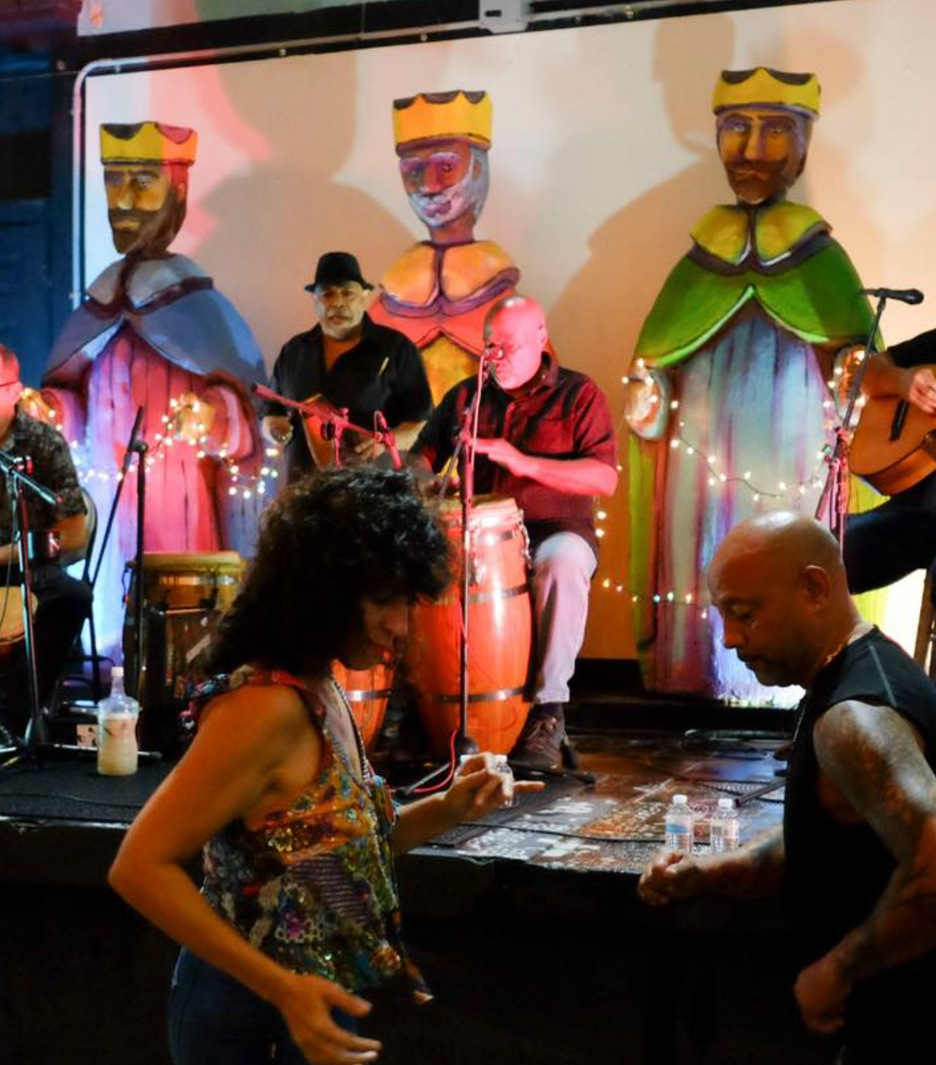
La Goyco
(La Goyco, n.d.)
Notes:
Over the past 7 weeks we have had the privilege to work alongside the administration, staff, and volunteers of La Goyco. Through this experience and working at volunteer events we were able to better understand the operations at La Goyco and what elements of their volunteer program we can best support. This is crucial as they are rapidly expanding and heavily rely on volunteers

Slide 3
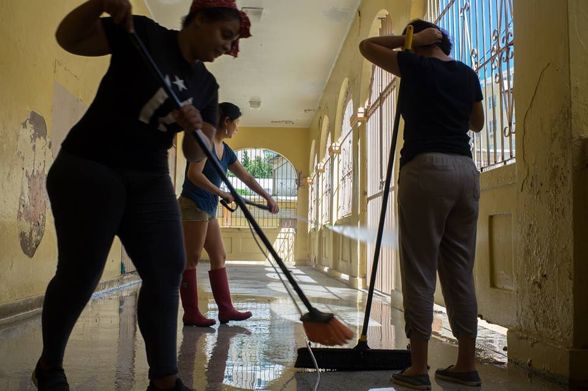
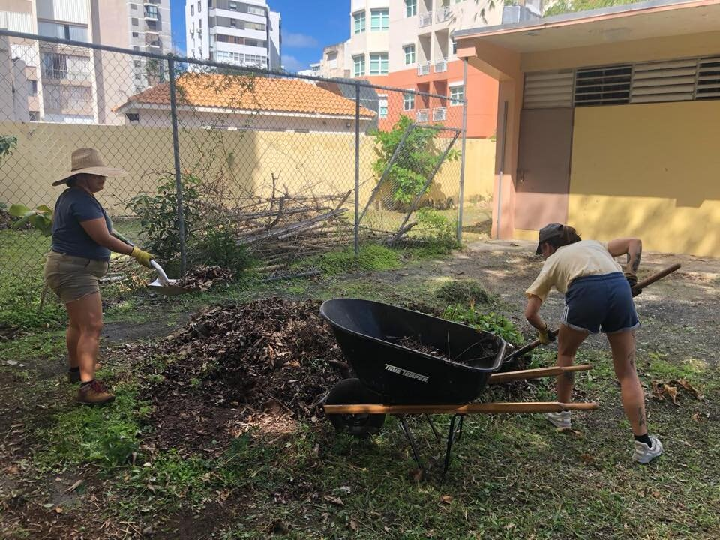
Mission Statement
Our goal is to support Taller Comunidad La Goyco in further developing their volunteer program to encourage community members to participate in health, environmental, and cultural initiatives.
Notes:
Presenter: Hunter (2)

Slide 4
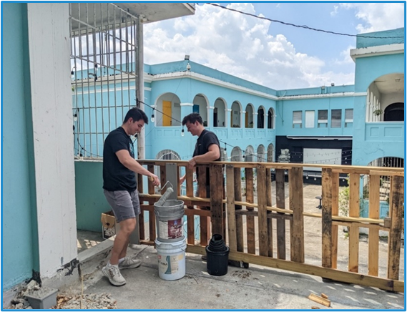
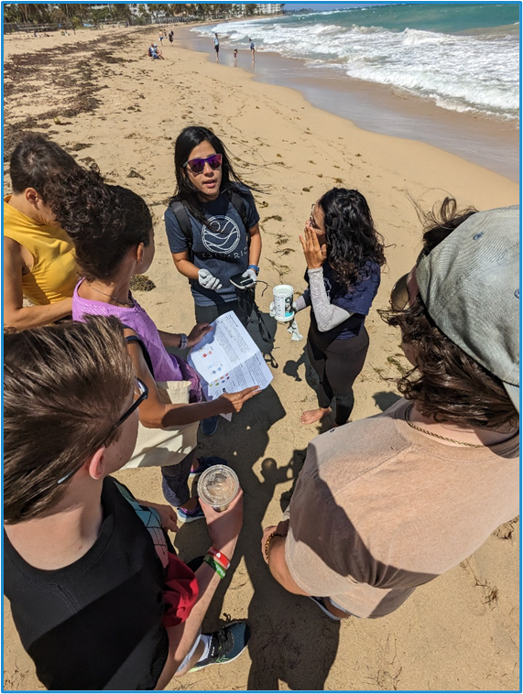
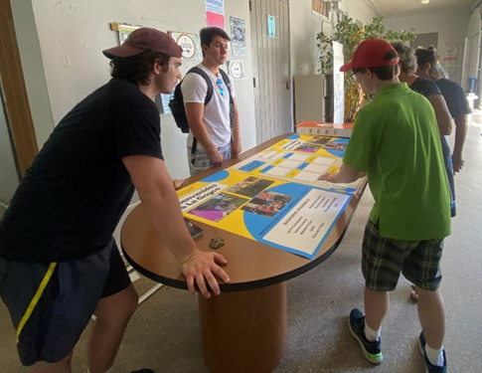
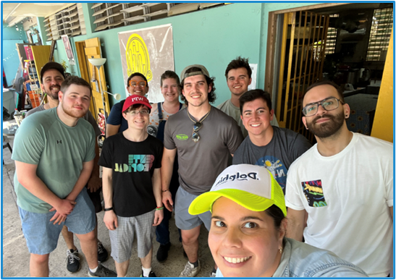
Objectives
Understand the role of volunteers at La Goyco
Analyze the current volunteer program
Strengthen the volunteer program
Implement a Volunteer Management System
Develop resources for La Goyco to use in gaining business partnerships.
Initiate volunteer opportunities for WPI student cohorts
Notes:
Presenter: Ryan (1)

Slide 5
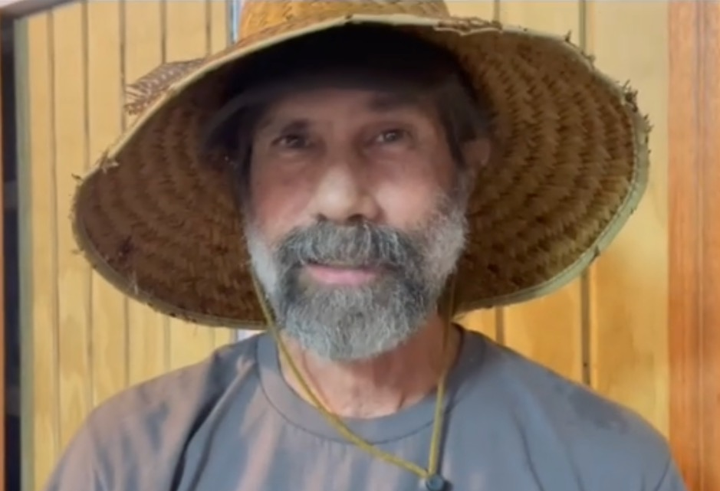
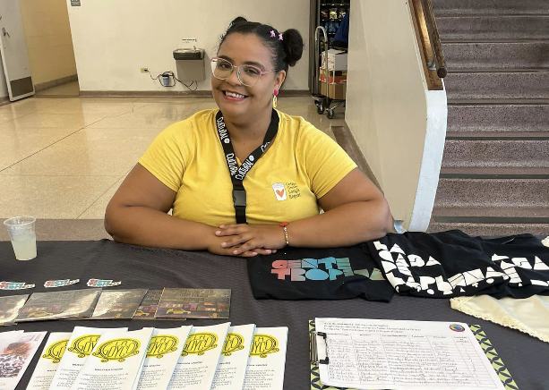
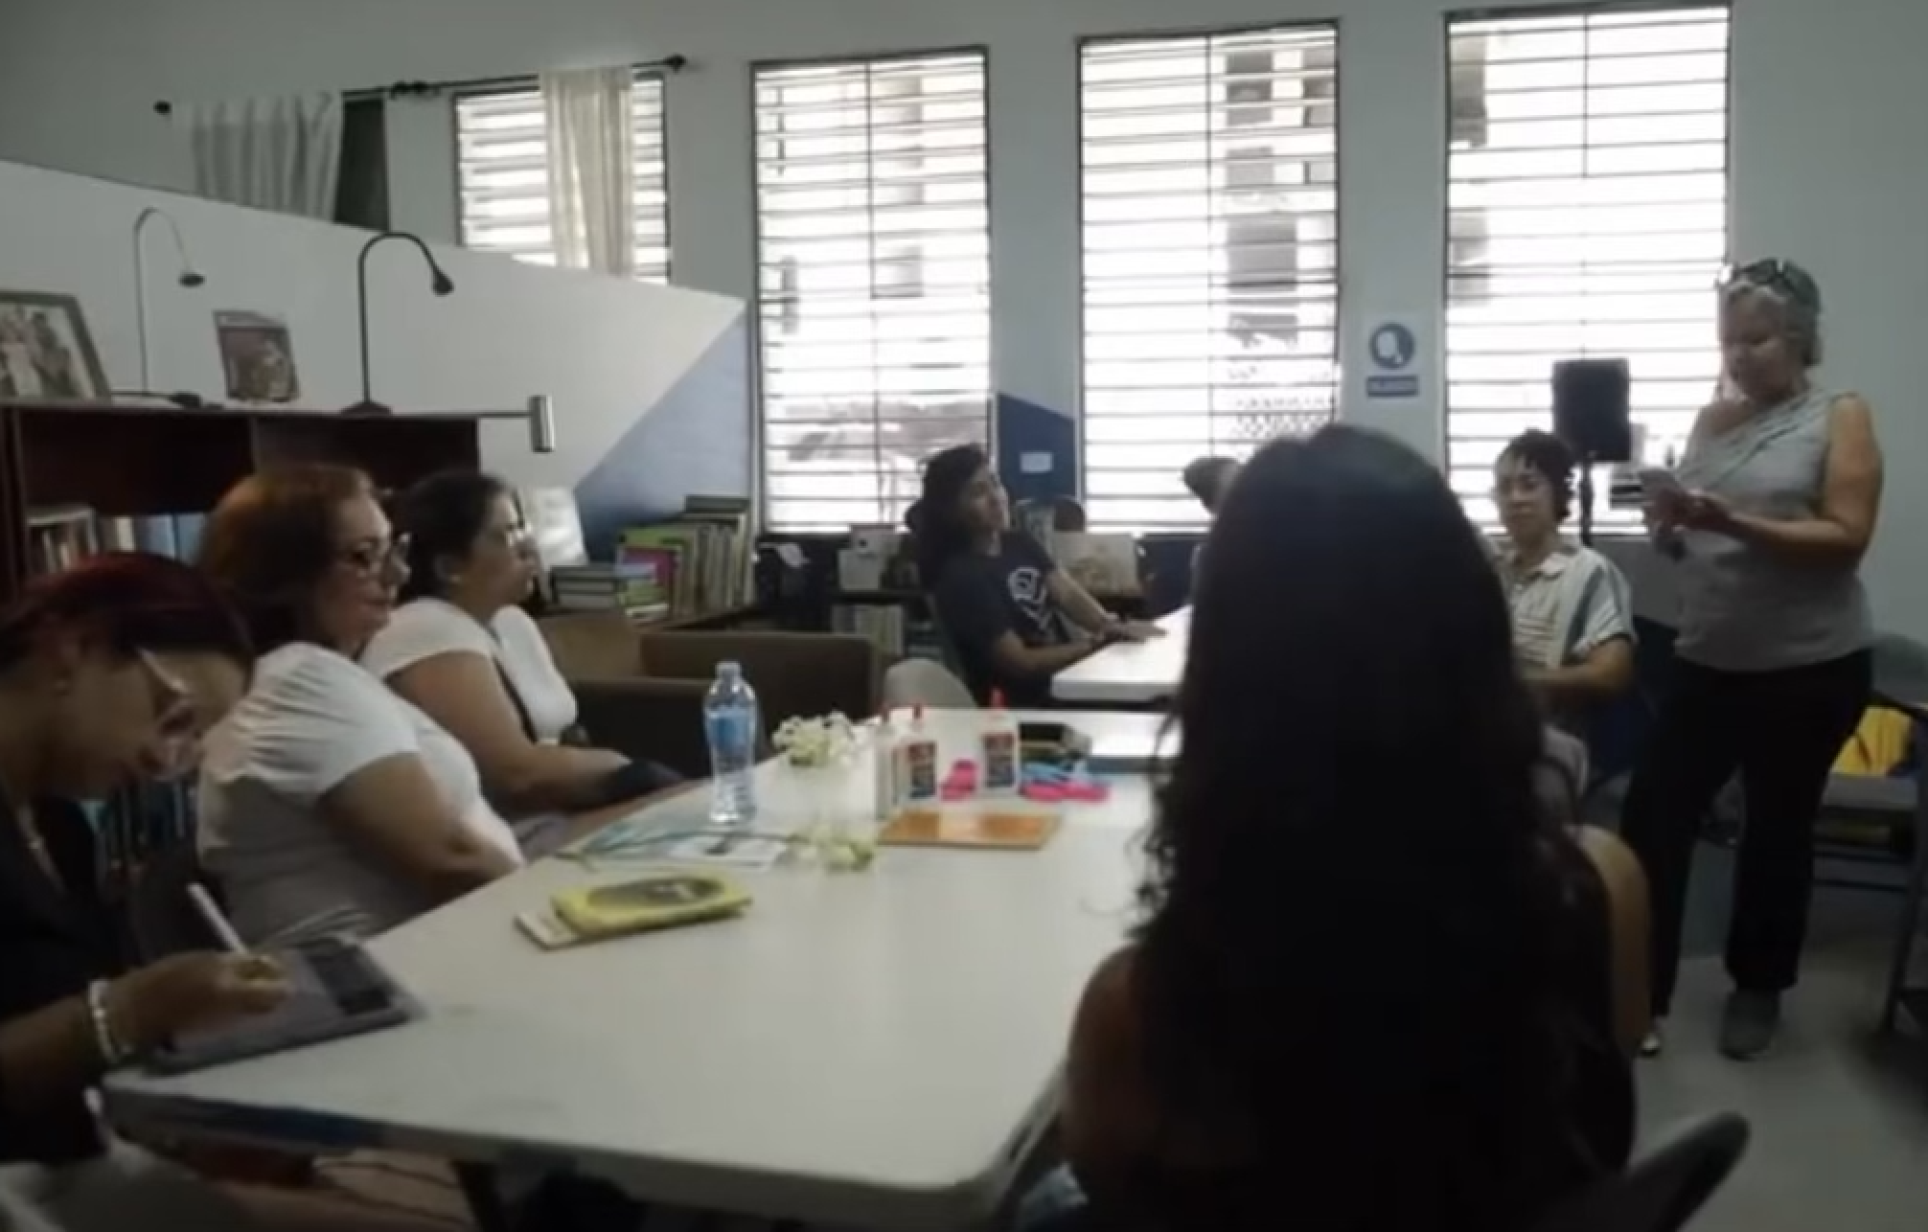
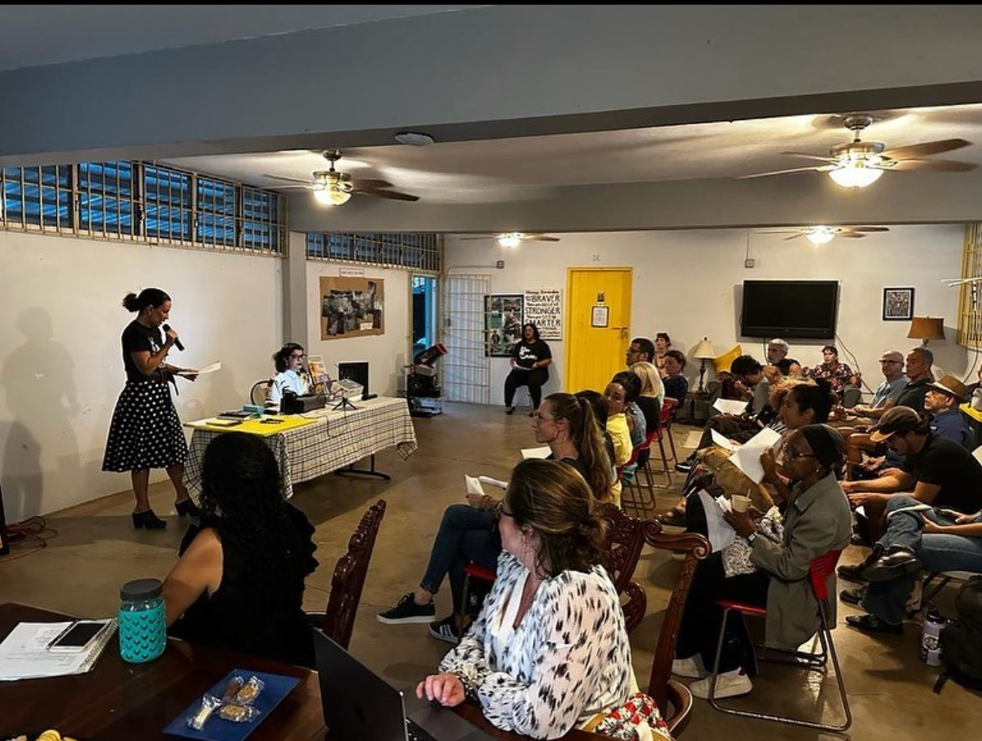
Findings
Less structured volunteer program
In transition to a more professionalized organizational structure
The importance of feedback to developing an effective volunteer program
Notes:
Presenter: Evan (2)
From those objectives, we were able to meet a great number of people along the way, each of whom provided tremendous help towards our project.
The first being Mariana, who was able to help us with understanding La Goyco’s current volunteer program when we first arrived and seeing which components needed further improvements.
The second being Ricky, who was able to help us understand how he manages the Saturday Work Brigades and the volunteers that show up to those events.
The third being Iliana, who was able to help us understand how she manages her volunteers in the library and how she tracks their contributions.
Lasty, we were lucky enough to get to know both Johana and Eunice who we were able to meet with on multiple occasions to explain to them our VMS, how it works and any changes they would like made.

Slide 6
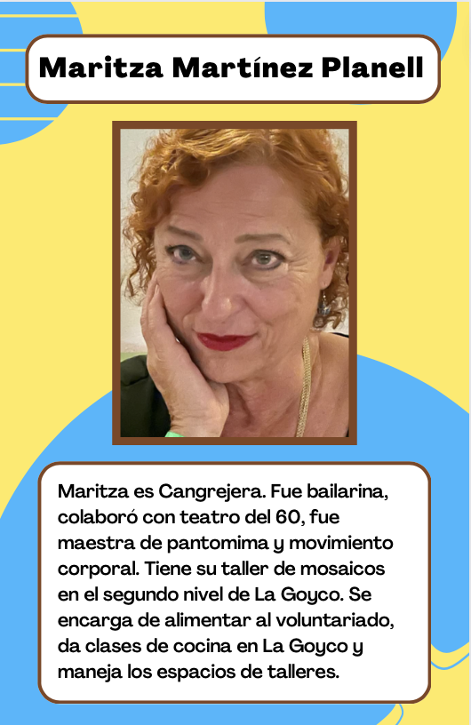
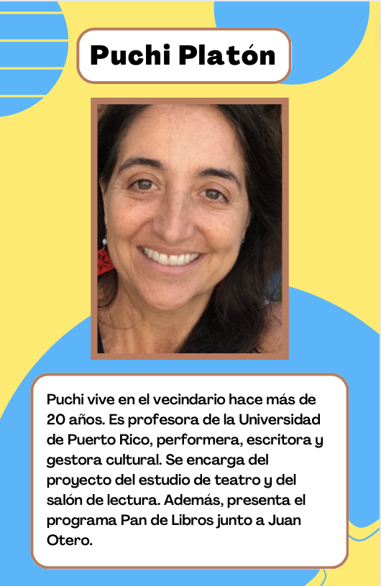
La Goyco Profiles
Notes:
Presenter: Evan (3)
Remind the volunteers that they are a part of this organization and everything it accomplishes
Remind them that their contributions are invaluable to this organization and its success and do not go unnoticed

Slide 7
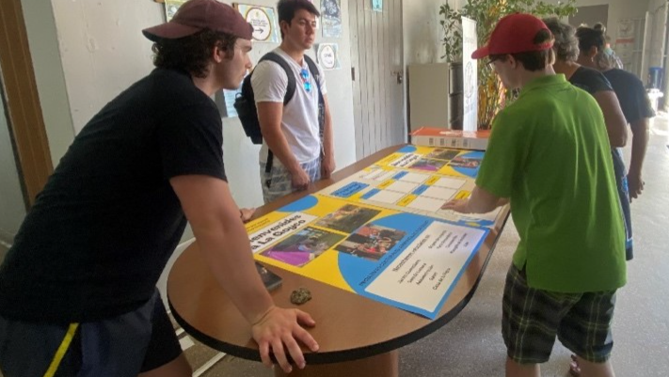
Welcoming & Greeting Package
Notes:
Presenter: Evan (4)

Slide 8
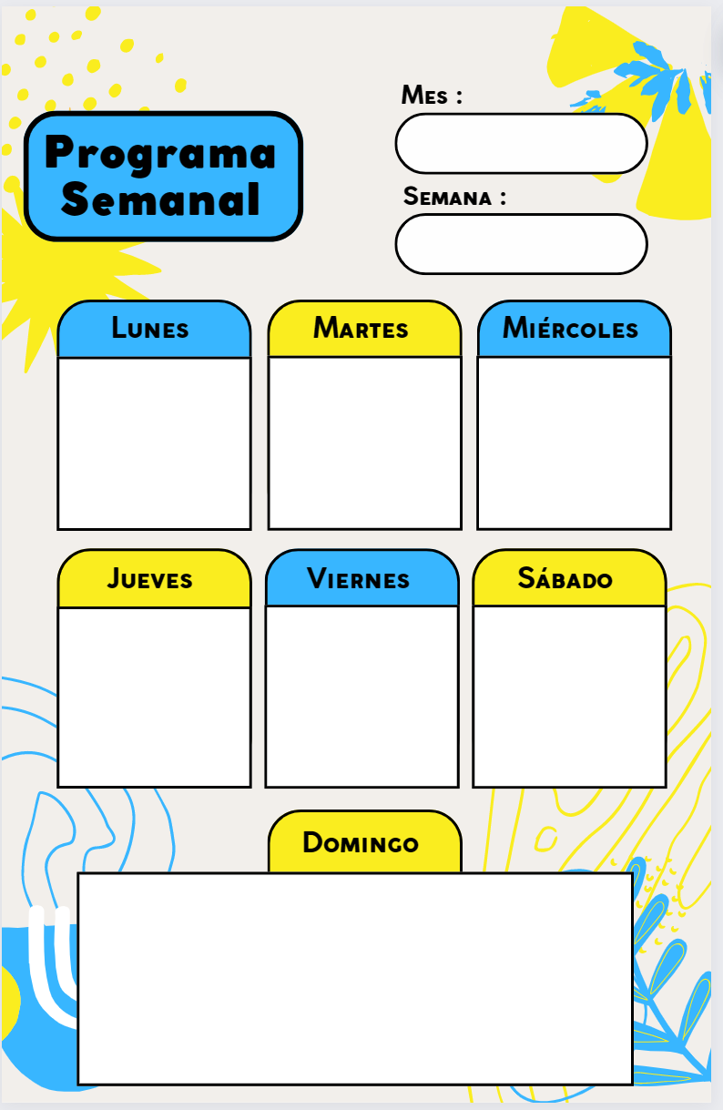
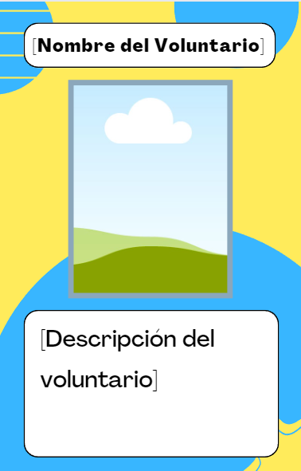
Notes:
Presenter: Evan (5)
Two things we wanted to further structure within this component were
directing and informing volunteers of the various volunteering opportunities offered here at La Goyco
and the entire welcoming aspect and recognition of volunteer efforts.

Slide 9
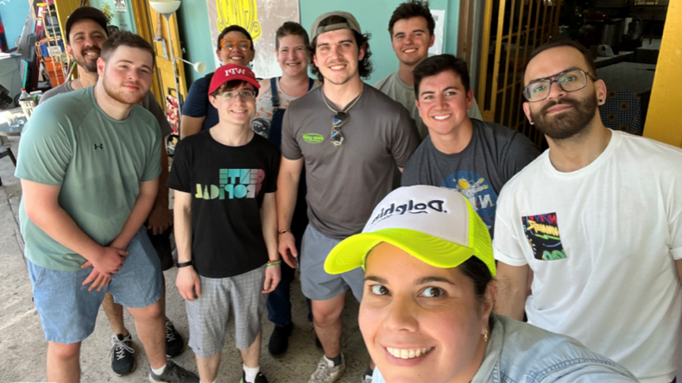
Volunteer Management System (VMS)
Notes:
Presenter: Andrew
As La Goyco continues to grow, Mariana asked if we could develop a system that could keep track of all volunteer contributions across their many volunteer programs.
In order to do this, we expanded on a Volunteer Management System (or VMS for short) developed by a previous group of WPI students for the Caño 3.7 organization.

Slide 10
Notes:
Presenter: Andrew (2)
This VMS uses three main components:
- The first is a Google Form that volunteers can fill out on a phone, with an attached paper form for volunteers who do not have a phone.
All of the information is sent to a Google Sheet that stores the responses collected
From there, we developed a central dashboard using a software known as Retool that can display all of the collected information using graphs and charts, to allow La Goyco administration to track data about volunteer contributions in an accessible format

Slide 11
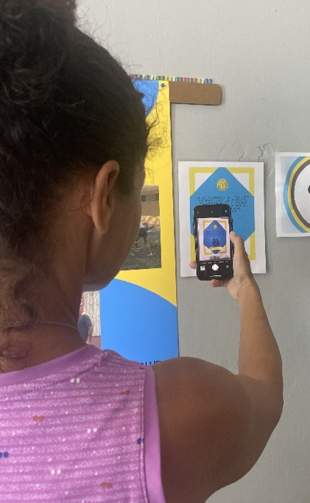
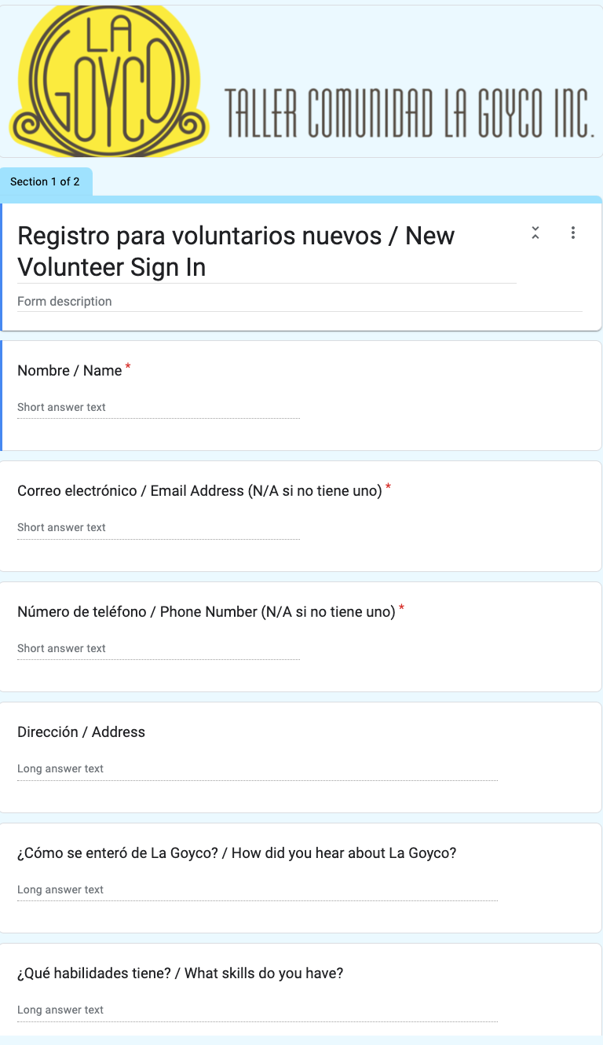
Google Forms
Interest Form for New Volunteers
Tracking Volunteer Hours
Notes:
Presenter: Andrew (3)
A volunteer begins by scanning a QR code that links to

Slide 12
Google Sheets
Notes:
Presenter: Andrew (4)

Slide 13
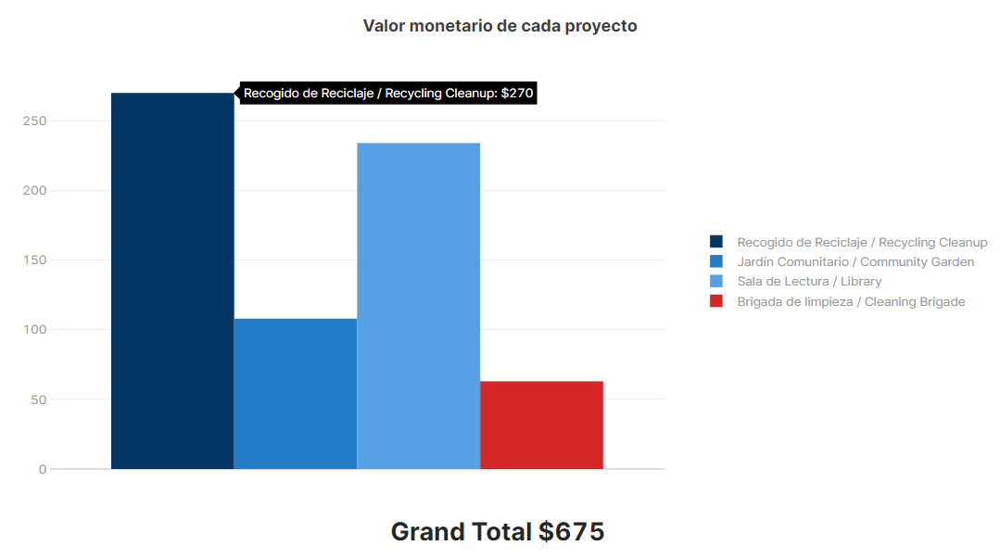
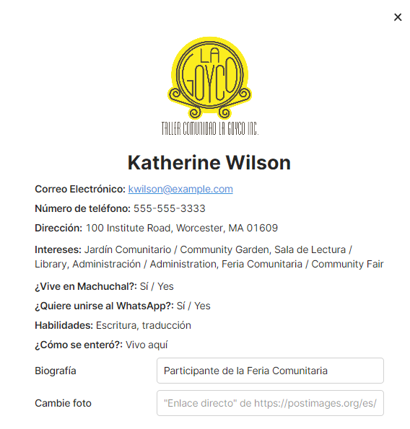
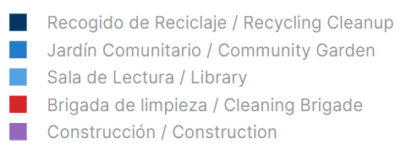
Data Analysis Using VMS
Notes:
Presenter: Andrew (5)

Slide 14
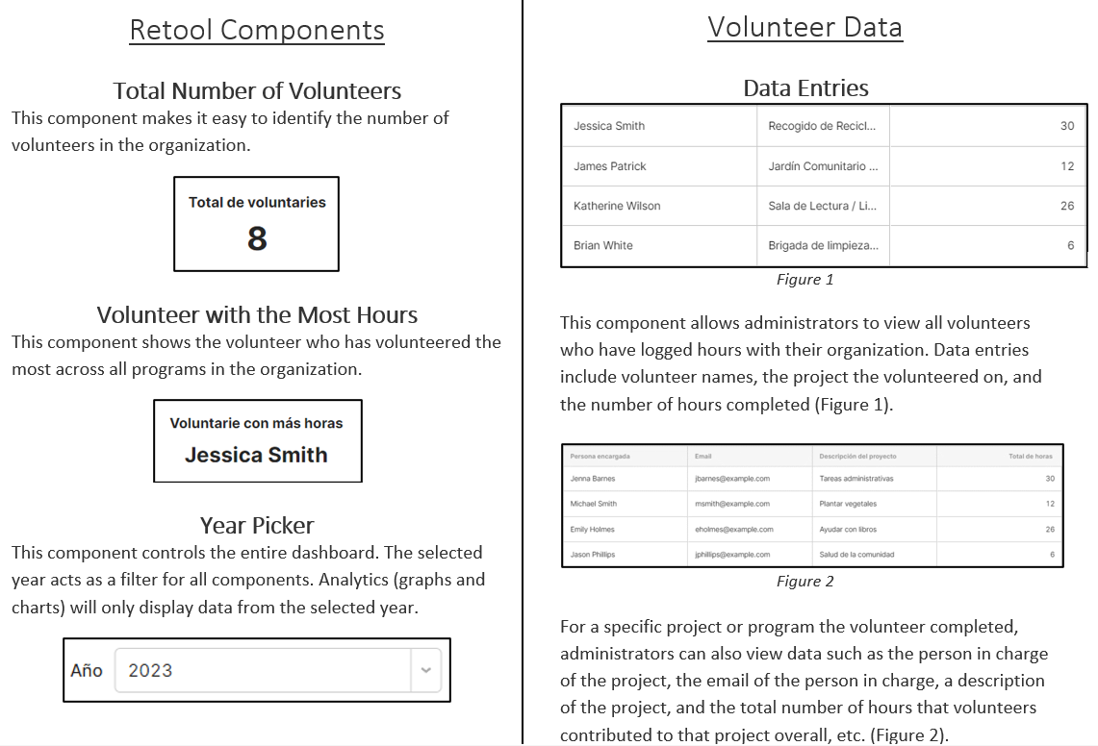
VMS Manual
Notes:
Presenter: Andrew (6)

Slide 15
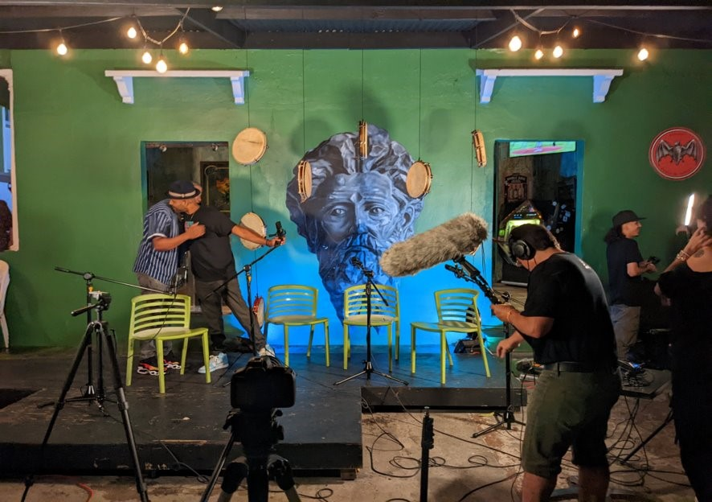
Business Partnership Resource Package
Notes:
Presenters: Hunter

Slide 16
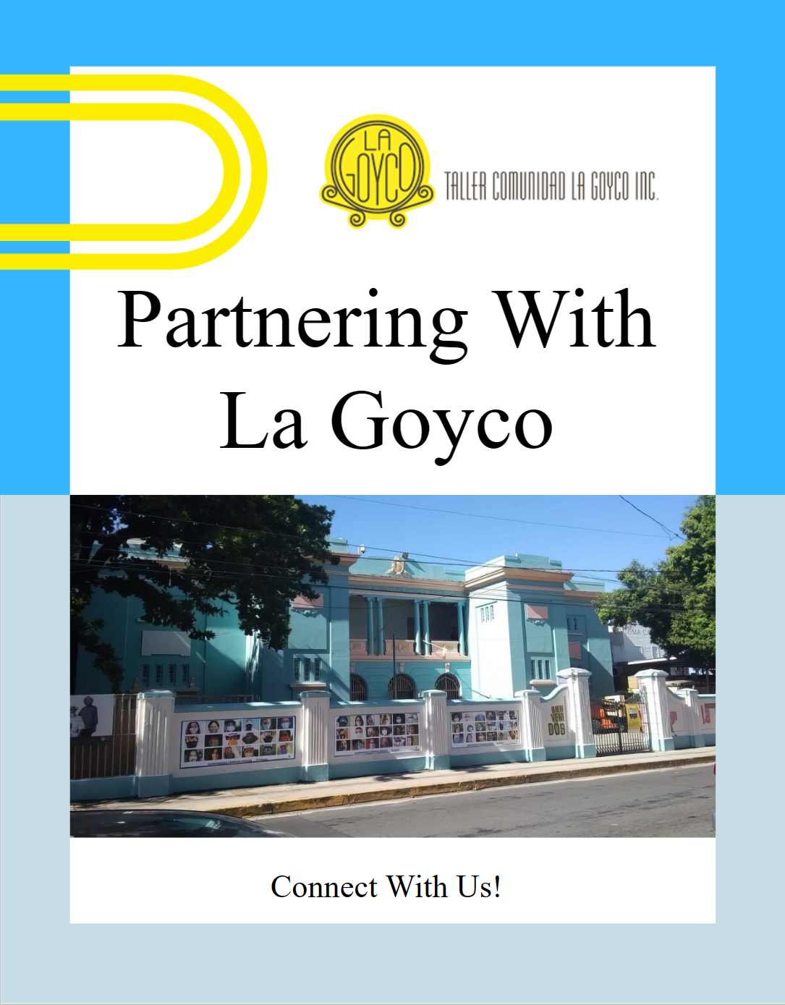
Partnership Resource Package
La Goyco's Background
Ongoing Partnerships
Community Collaboration Opportunities
Event Opportunities
Sponsorship Opportunities
Donation Opportunities
Notes:
Presenter: Hunter (2)

Slide 17
Gente Tropical Podcast at El Boricua
Notes:
Presenter: Hunter (3)

Slide 18
Notes:
Presenter: Ryan (2)

Slide 19
Recommendations
Assign previously determined dollar values to each volunteer task
Use statistics available on the VMS when applying for grants
Leave a summary sheet of partnership opportunities with the business representative

Slide 20
¡Muchas Gracias!
Advisors
Professor Scott Jiusto
Professor Leslie Dodson
Liaison
Mariana Reyes
Additional Staff and Volunteers
Ricardo Otero Garabís
Eunice Jiménez Emmanuelli
Johanna Dominguez
Iliana García
All the volunteers at La Goyco!
20

