Slide 1
SGA Financials 101
A guide to navigating SGA Financials
12/01/22

Slide 2
Who is on SGA Financials?
Treasurer | is responsible for overseeing the scheduling, distribution and record keeping of the SGA Treasury
Appropriations Chair | is responsible for overseeing the budgeting process, recommending changes to the student life fee to Senate, maintaining club classifications and recommend Mandatory transfers for the next FY
Financial Responsibility and Assistance chair | is responsible for ensuring proper use of appropriated funds; both in budgeted and funding requests, club audits, and recommend actions based on audits conducted
Accountant | is responsible for maintaining records of all financial activities of organizations, inform the financial board regarding past board actions and precedent

Slide 3
Club Classifications
Class I - Special Interest
Class II - Club Sports
Class III - Campus Wide
Class IV - Selective Membership
Class V - Greek Life
Class VI - Provisional
Class VII - Non-Funded
Budgeted Organizations

Slide 4
Budgeting
Is open right now! (11/29/22)
Will close mid-C term
A club rep. MUST attend a budgeting training
A club rep. MUST meet with SGA Financial Senator before the budget is approved for FY24
Receive approved budget (early D term)
Appeal if desired

Slide 5
Budgeting Timeline
Email the Gr-SGAappropchair@wpi.edu
We will Schedule a meeting based on your availability in outlook
SGA will check you off an you can submit your budget
Budgeting
is open
11/29/22
Portal Closed
Mid-C term
If you submit your budget before meeting with someone from SGA we will send your budget back to you until a meeting is scheduled

Slide 6
What can be in your budget?
Line items and events that are integral to the purpose of the club
Must have been approved either
(a) in a budget in the past two years
(b) as a funding request in the past two years
(c) as a budget reallocation in the past two years
All line items must abide by SGA bylaws and SAO guidelines (i.e. must benefit undergraduates, cannot purchase alcohol, etc.)

Slide 7
Common Reasons for Budget Cuts
Not previously approved in past two years
Not an annual cost/cost varies from year to year
Funds not being used for undergraduates
Not integral to the purpose of the club or the success of the event
Unjustified increase in cost from previous years
Bussing costs should be increased in budgets this year
LNL costs should be increased in budgets this year
Lack of detail

Slide 8
Funding Requests
Sponsored by an SAO recognized organization
For items not in your annual budget (events, apparel, trips/conferences/competitions/etc.)
Does not have to be an annual cost
Check out SGA’s bylaws for all fiscal policies
Two weeks before funds are required
Don’t spend any funds before getting approval
Be proactive!

Slide 9
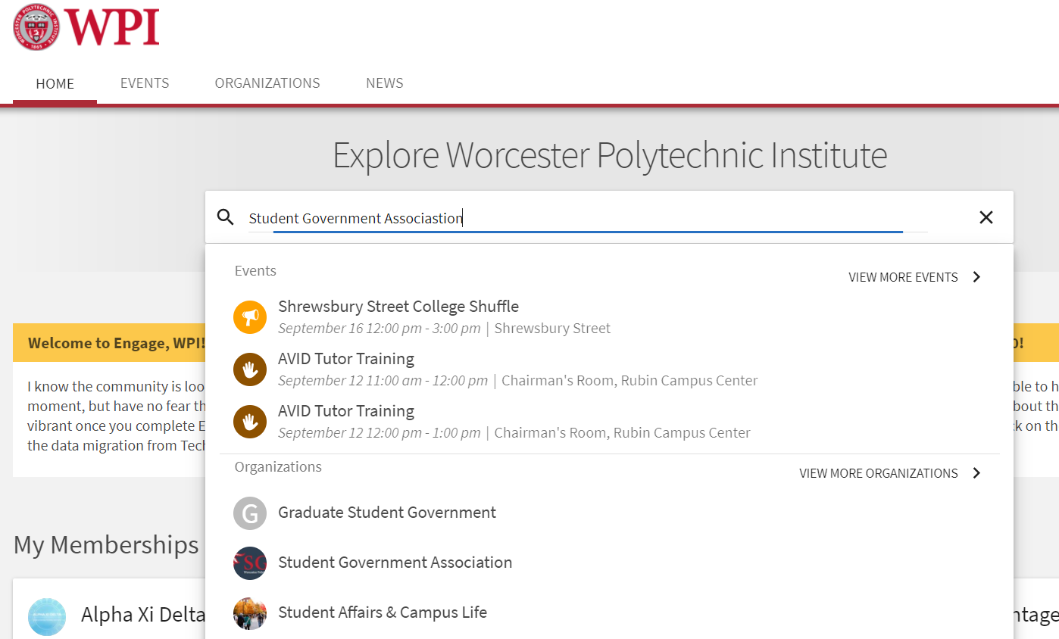

Slide 10
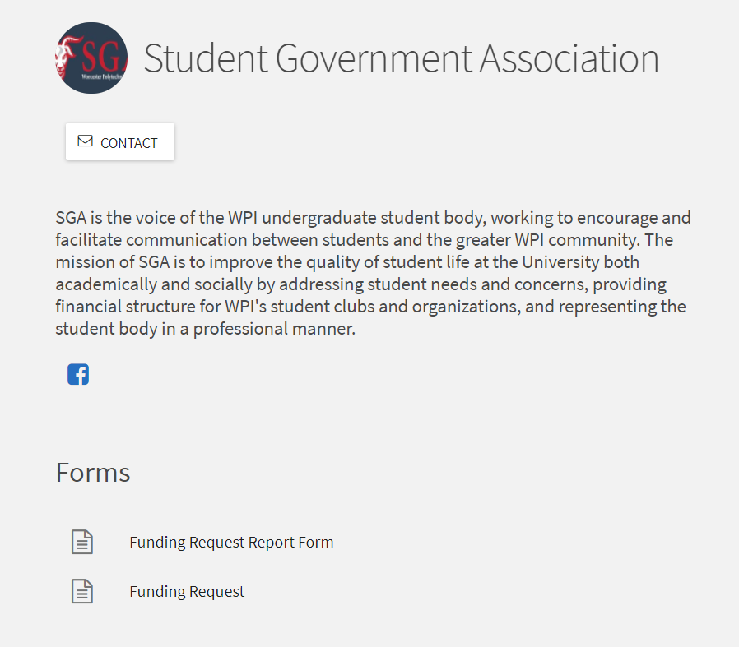

Slide 11
Financial Board
Requests heard by SGA Exec, Senate, or Financial Board depending on size and urgency
Wednesday’s at 6 pm, typically in the CC Taylor Room
Casual attire
5 minute PowerPoint presentation followed by questions
Club representatives leave and the board discusses and votes
Club are emailed decision after the meeting

Slide 12
What happens after my FR is approved?
Spend the funds
Report form!
As soon as possible
Attach proof of purchase
Reach out with any questions
Get reimbursed
This is in workday!
Appeals process
Email sgatreasurer@wpi.edu within 24 hours of hearing result

Slide 13
Reallocations
When to reallocate?
Unused funds in budget (i.e. cost of an event was lower than expected)
How to reallocate?
Submit “Budget Reallocation” Form on SGA’s Techsync page
If reallocating to a new line item/event, will be heard similar to an FR
If reallocating to an existing line item/event, will be heard internally by SGA (do not need to come to Financial Board or prepare a presentation)
Why reallocate?
No report form required

Slide 14
SGA Bylaws updated 11/2022
Apparel: 1 item/year, 50% up to $25
Trips/Conferences/Competitions
Full cost: ground transportation
66%: registration fees and accomodations
Not funded: food and airfare

Slide 15
SGA Rules of Thumb
Promotional materials: $200/year
Printing: $40/year
Retreats: 2/year (max 1 off-campus)
Prizes: $1/attendee
Donations: not funded
Academic projects: not funded

Slide 16
Financial Tips
If your club cannot submit payment through Work Day and/or it causes a financial hardship on members to be reimbursed, SAO can work with the club to support the purchase
Keep Techsync officers up to date
Utilize Techsync events (Weekly Campus Events email)
Reach out to other funding sources
SGA website: sga.wpi.edu
SGA Treasury: Treasury.wpi.edu
Email to get any questions answered!

Slide 17
Questions?
SGA Treasurer, sgatreasurer@wpi.edu
SGA Appropriations Chair, gr-sgaappropchair@wpi.edu
SGA Fiscal Responsibility and Assistance Chair, gr-sgacfrachair@wpi.edu
Student Activities Office, sao@wpi.edu

