Slide 1
FY24 Budgeting Process
Budgeting Workshop

Slide 2
Important Dates
Budgeting Portal Opened
Monday, November 28, 2022
One on One Budget Reviews/ Budgeting Workshops
Dates will be Sent on SGA Club Financials Slack and TechSync for Budgeting Workshops
One on One Reviews can be Done at Workshops or Email sgaappropchair@wpi.edu
if You’d like to Meet Outside of Them.
Budgets Due
Friday, February 3, 2023 at 11:59 PM
Budget Proposals Returned to Clubs
Friday, March 17 2023
Appeals Due
Friday, March 31, 2023
Appeals Board
Monday, April 3 - Friday, April 7, 2023

Slide 3
Who Can Have a Budget?
Organizations belonging to Classes 1, 2, and 3 may receive a budget from SGA.
Class 1 Organizations are Special Interest Groups.
professional societies, international/diversity organizations,
hobby interests, etc.
Class 2 Organizations are Club Sports Teams.
Class 3 Organizations are Campus-wide Organizations.
programming, publications/media, services,
and performing arts.
Ex. SocComm

Slide 4
What Should You Put in Your Budget?
The ONLY things that should go into your budget are annual costs that have been passed as a funding request or in the club’s budget by the SGA Financial Board within the last two years.
Common annual costs include, but are not limited to:
Club T-shirts
Campus Events that you host every year
If this is the only year that your club will pay an expense or you will not pay it again until two years from now it does not belong in your budget.

Slide 5
Bylaws and Rules: Apparel and Banquets
Apparel: SGA may only fund 50%, up to $25, per item of apparel that will be for the club members to keep.
This does not apply to uniforms that will be staying with the club. Apparel of these types will be funded in full if it meets the requirements to the discretion of the financial board.
Each club may request one apparel item per year
Banquets: Only Class III organizations are eligible to apply for a banquet funding request, up to $20 per student and $800 per event. SGA will fund the full amount of land transportation costs, not be included in the aforementioned maximum total of $800.

Slide 6
Bylaws and Rules: Food Meetings and Conferences
Trips, Conferences, and Competitions: SGA may fund any of the following:
Official Transportation Cost in Full (Except for Airfare)
Up to 66% of Registration Fees and Accommodations
Full Amount of Application Fees,
SGA will not fund food cost while at the event.
Travel arrangements must be approved for travel more than 120 miles or of more than 17 members.
Food: SGA will not fund food for internal general body meetings and non-food related events. SGA may fund food if it is deemed integral to the success of the event/ related to the club’s purpose.

Slide 7
Bylaws and Rules: Retreats
Retreats: SGA will provide funding for up to two retreats for eligible clubs. A maximum of one off campus retreat can be requested, but must show more value than on-campus retreats.
Up to the full amount of official land transportation costs and food costs while at the retreat
Up to 66% of accommodations and all other costs

Slide 8
Bylaws and Rules: Ticket Sales
All SGA funded events must be free to all undergrads. Exceptions include:
All income must be used to offset a portion or the entirety of the overall cost for the request but must not exceed the approved request amount
Income may be used to pay for products and/or services provided by a 3rd party vendor

Slide 9
Bylaws and Rules: SAO Restrictions
The following items cannot be requested for in a budget due to restrictions of the Student Activities Office.
Alcoholic Beverages
Casino Nights with participation charge not pre approved and licensed through the SAO
Movies for public viewing without confirmation that appropriate royalty fee procedures are being taken.
Anything with the WPI logo or seal on it that hasn't been pre approved by marketing.
Overnight trips within 120 miles , unless pre approved by SAO.
Trips with over 20 participants traveling by personal vehicles.
Passenger Vans.
For detailed information refer to https://wpi.campuslabs.com/Engage/organization/student-activities/documents and clicking on Policy and Procedures.

Slide 10
Things SGA is Looking For:
Club Collaboration
Example: If 30 clubs are having barbecues, we can’t approve all of them
Events with fewer giveaways
People should go to events to participate not just to get a free T-shirt
Just because you have done an event for the last ten years, doesn’t mean you shouldn’t reevaluate it. Campus interest may have shifted.

Slide 11
Submitting your Budget
Submit your budget on the Budgeting Portal in the Finances section of Techsync
Select your club, by clicking on its logo → Right side dropdown → select Finances → Create Request on top right → Create Budget Request → 2023-2024 Budget → Enter Request Title as “FY 24 Club Name”
More specific directions on how to fill out budgets will come in future budgeting workshops
Prepare for budgeting by reviewing your club’s budget and funding requests from the past two fiscal years (FY 23 and FY 22)- they should be good references
Past budgets for your club will appear after clicking “Budget” on the same page of the “Create Request” button

Slide 12
Budget Process on Techsync
Create Budget
Add Revenue Funds

Slide 13
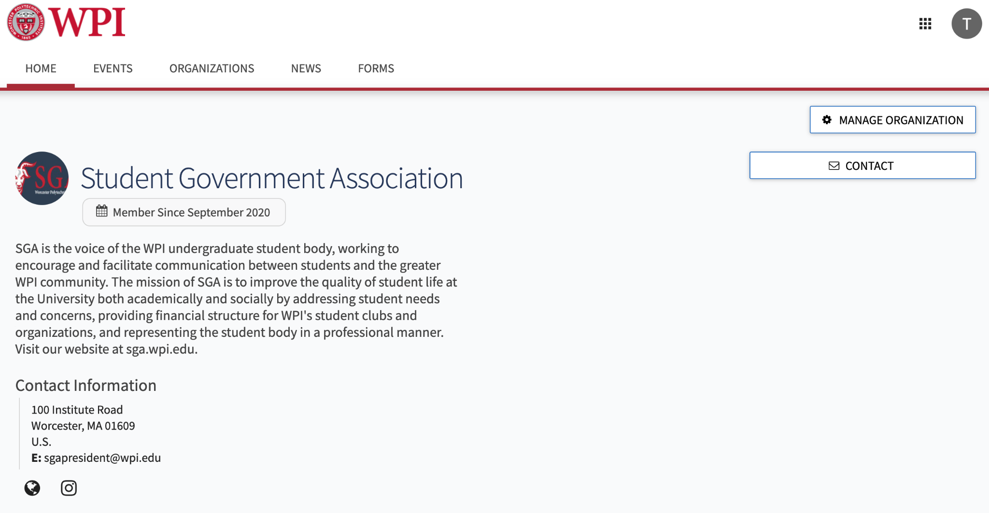
Navigating Techsync
On your organization’s Techsync page:

Slide 14
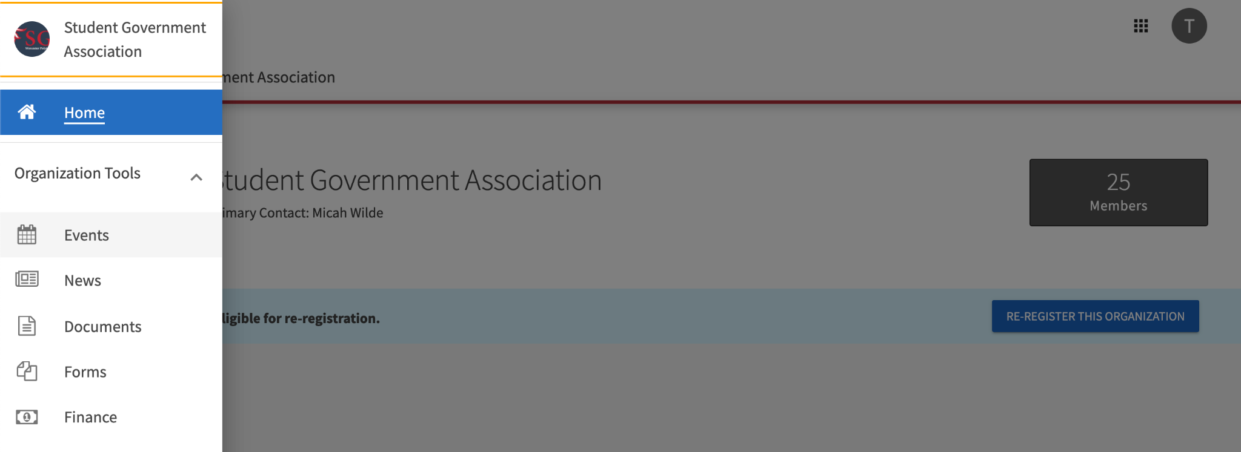
Navigating Techsync
On your organization’s Techsync page:

Slide 15
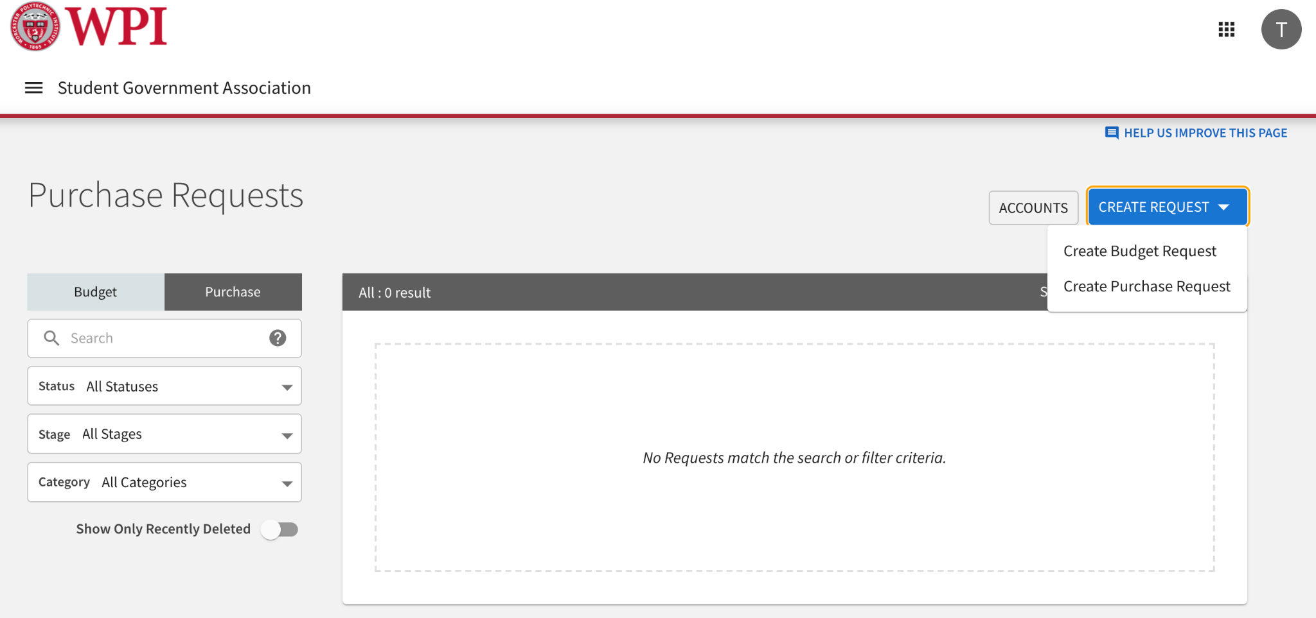
Navigating Techsync
On your organization’s Techsync page:

Slide 16
Deadlines
Budget proposals are due February 3, 2023 @11:59pm
Returned to you on March 17, 2023

Slide 17
Important Contacts
If you have any questions, contact SGA, we are here to help!
Please use SGA Financials Website as a resource!
Join SGA Club Financials Slack for announcements!
SGA Treasurer: Katie Bowles
Email: sgatreasurer@wpi.edu
General Financial Concerns and Budgeting Questions
Appropriations Chair: Rayna Jacob
Email: sgaappropchair@wpi.edu
General Budget Questions
Notes:
add my office hours

Slide 18
SGA Updates
If you would like to be added to the Financial Board
Minutes/ Senate Minutes alias, please email
sgasecretary@wpi.edu
Please email sgaappropchair@wpi.edu to schedule a
one-to-one meeting with a Financial Senator

