Slide 1
Financial Information Workshop

Slide 2
Who Makes Up Financials
Katie Bowles
Treasurer
Theo Barnes-Cole
Interim Appropriations Chair
Felicia Link
Fiscal Responsibility and Assistance Chair
Plus a bunch of amazing senators!
Lauren Abraham
Accountant

Slide 3
Funding Requests

Slide 4
Funding Requests

Slide 5
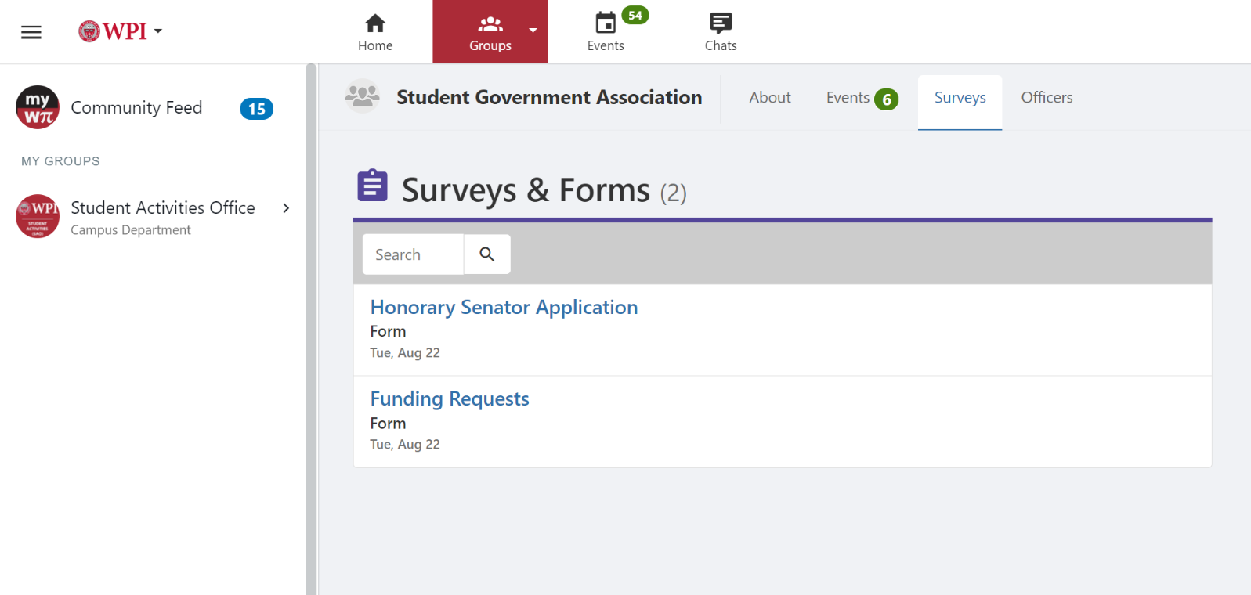
Funding Requests
This is where the rest of the forms will be

Slide 6
Funding Requests
For items not in club’s annual budgets (events, apparel, trips/conferences/competitions/etc.)
Use your budget funds first!
Follows SGA bylaws
Submitted two weeks before funds are required
Can only be approved if funds have not yet been spent
We do not fund fundraisers*

Slide 7
Common Questions
Apparel 1 item/year, 50% up to $25
Full cost ground transportation
66% registration fees
66% accommodations
Airfare is not funded

Slide 8
Funding Request Presentations
Super casual, don’t stress about it!
Five minutes to present
Go over details (lots of details, please!) about the event
When, where, who, cost w/ breakdown
Then questions
Be prepared!

Slide 9
What Happens After An FR Is Approved?
Spend the funds
Report form!
Get reimbursed
This is in workday!
Appeals process
Email sgatreasurer@wpi.edu within 24 hours of hearing result

Slide 10
Where to Find Information
Google: “WPI SGA”

Slide 11
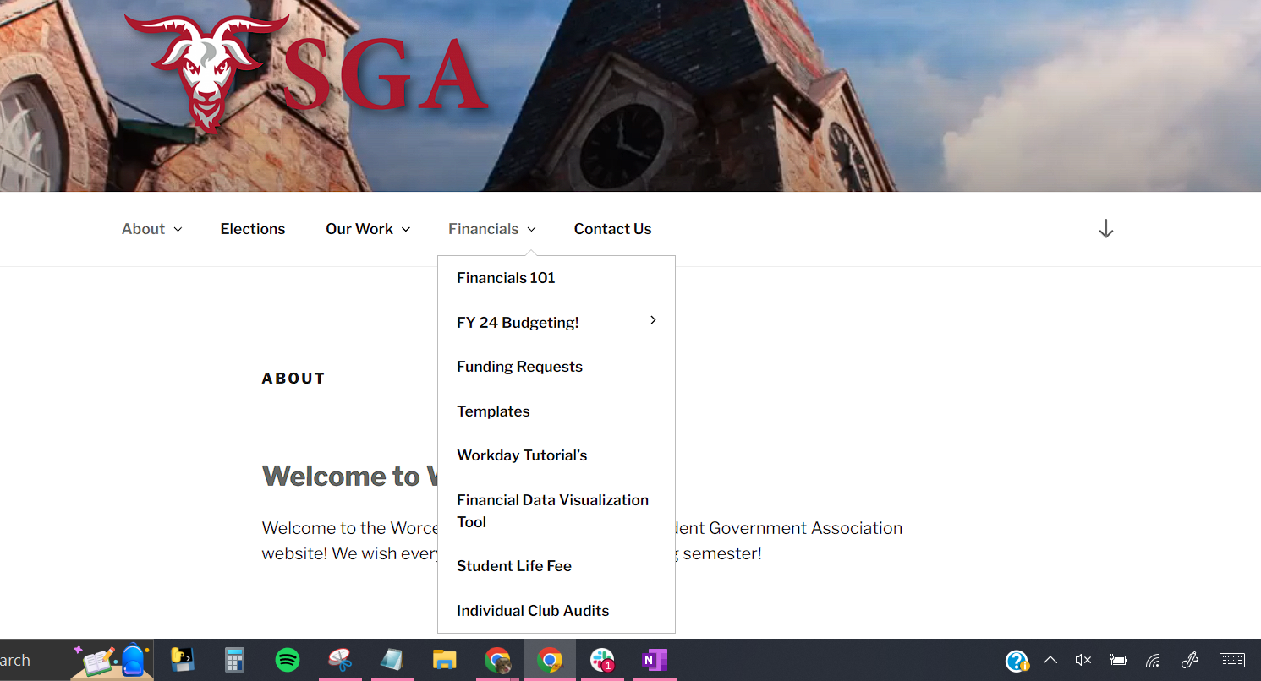
Where to Find Information

Slide 12
Where to Find Information

Slide 13
Budgets
Approp Chair will be holding information sessions next term
Budgets are due in C term
FY24 Budgets
Keep thorough track of expenses

Slide 14
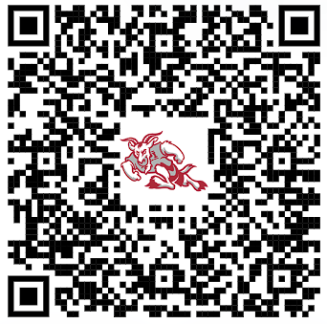
Thank you all
Contact: sgaexecs@wpi.edu
Join the SGA Financials Slack!

