Slide 1
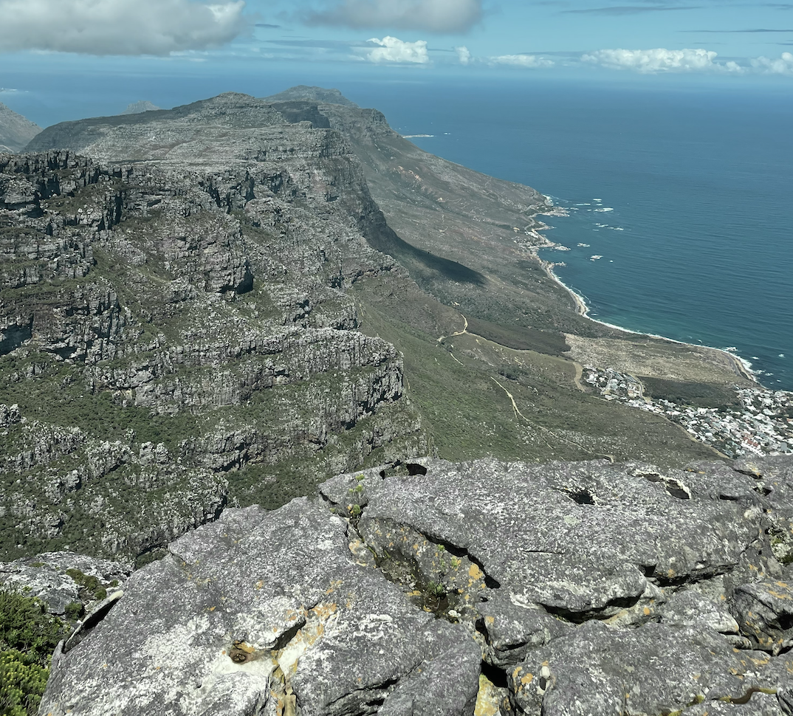
A MOBILE MUSEUM EXHIBIT
Trevor Faber, Grace McCarthy, Patrick McKenna, Grace Solod

Slide 2
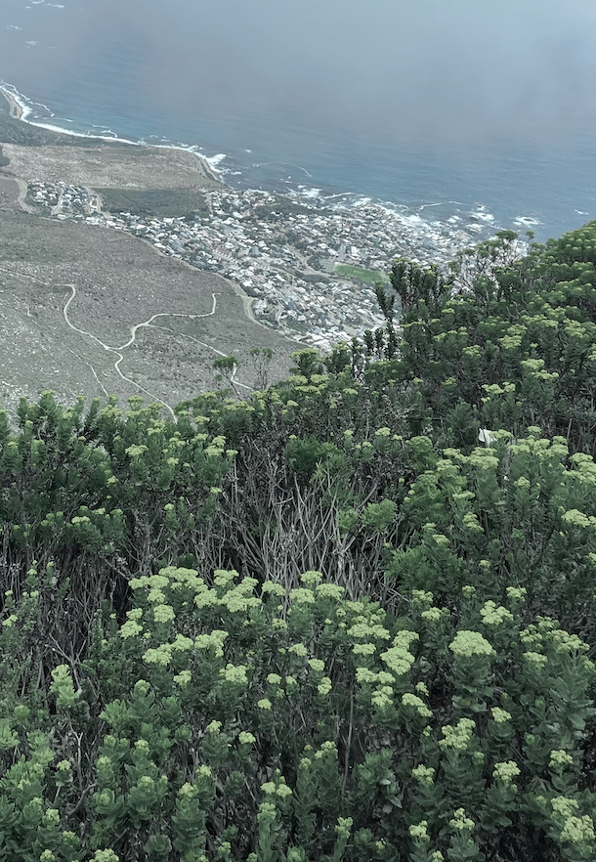
TABLE OF CONTENTS
01
BRIEF BACKGROUND
OUR PROCESS
02
03
THE FINDINGS
04
THE RESULTS
05
CONCLUSIONS AND QUESTIONS
Project goals and objectives
The methods utilized for data collection and message development
Data analysis and key takeaways
Our recommendations for exhibit implementation

Slide 3
BRIEF PROJECT BACKGROUND
01

Slide 4
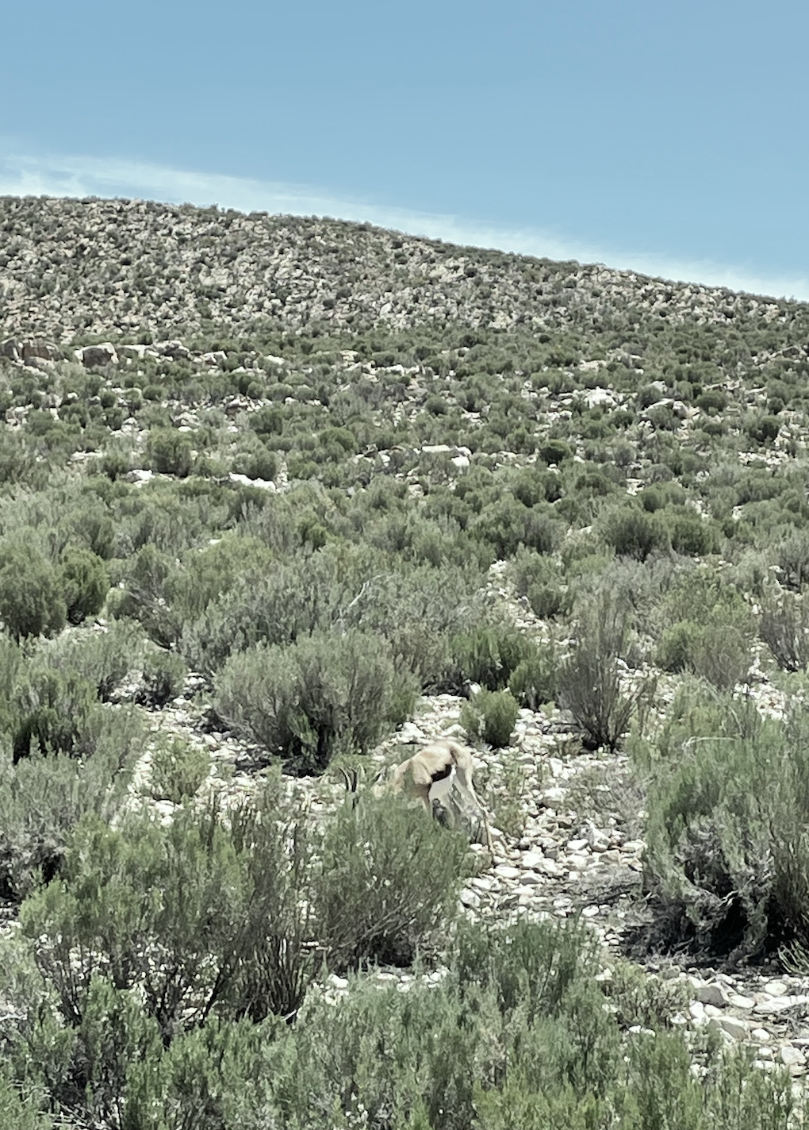
THE GOAL
The goal of the project was to collaborate with the Museum of Childhood in developing a mobile exhibit platform to share the museum’s message of celebrating childhood with communities outside their reach.

Slide 5
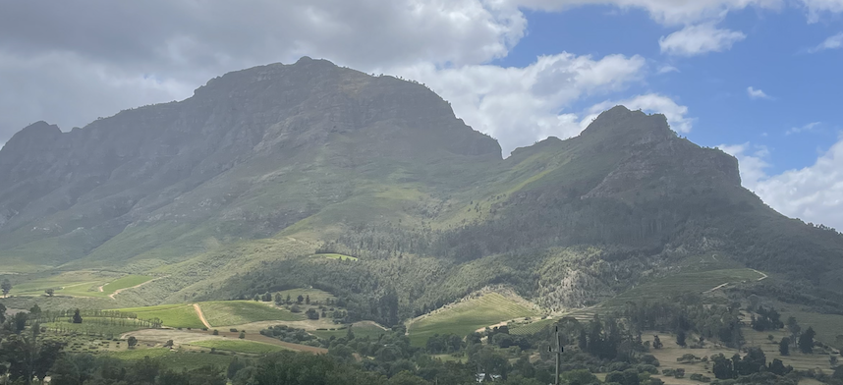
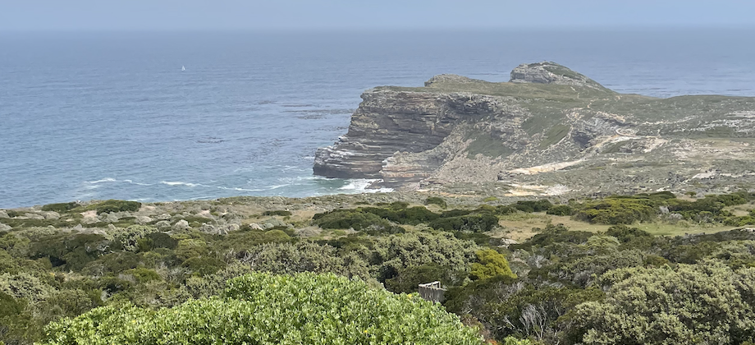
PROJECT OBJECTIVES
Objective 1
Objective 2
Objective 3
Assess the community’s interest in a mobile exhibit platform
Identify the potential message of the mobile exhibit
Design a prototype which addresses the message of the mobile exhibit

Slide 6
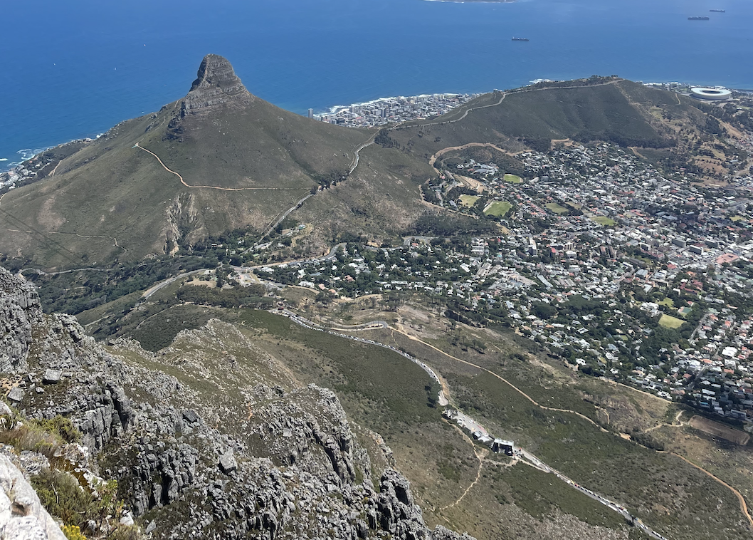
KEY TAKEAWAYS FROM PRELIMINARY RESEARCH
Importance of interactivity
Importance of cultural relevance

Slide 7
OUR
PROCESS
02

Slide 8
VISITOR SURVEYS
INTERVIEWS
OUR APPROACH
DESIGNER TEMPLATE
VIRTUAL TOUR

Slide 9
THE
FINDINGS
03

Slide 10
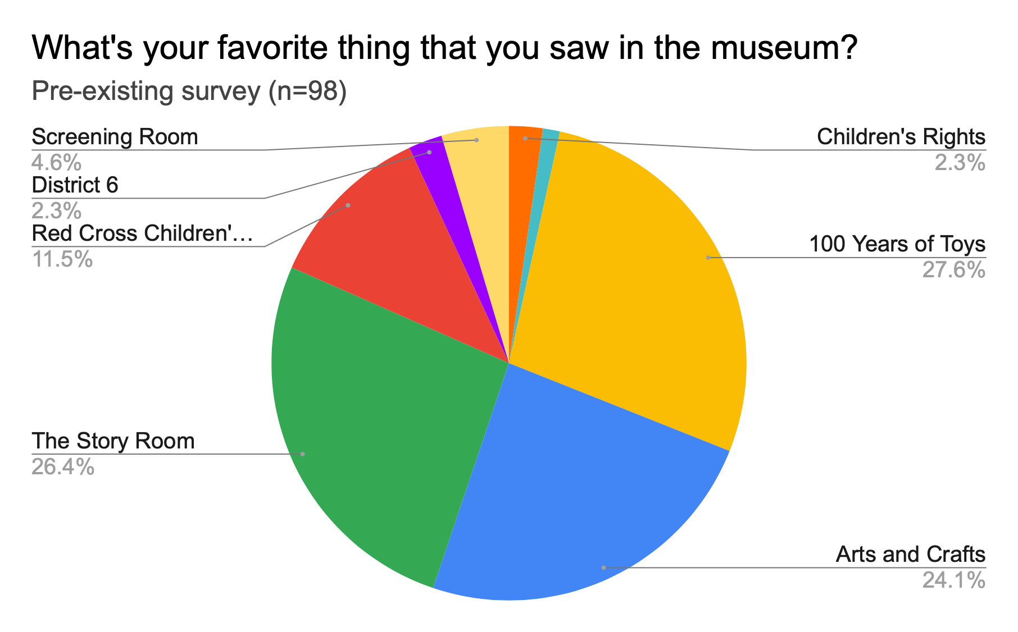
Survey Results
Pre-Existing Survey
Figure 1. Favorite Room; Pre-Existing Helpful Feedback Form; Oct 2021 - Oct 2022 (n=98)

Slide 11
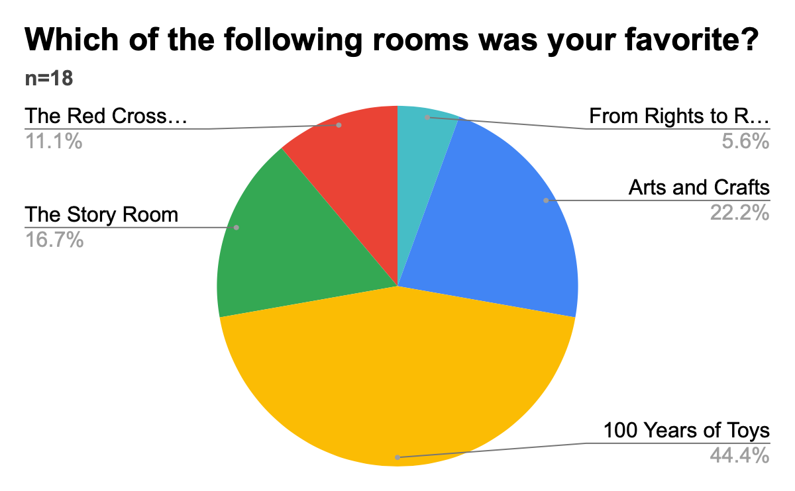
Survey Results
Helpful Feedback Survey - Favorite Exhibit
Figure 2. Favorite Room; New Helpful Feedback Form; Oct 2022 - Nov 2022 (n=18)

Slide 12
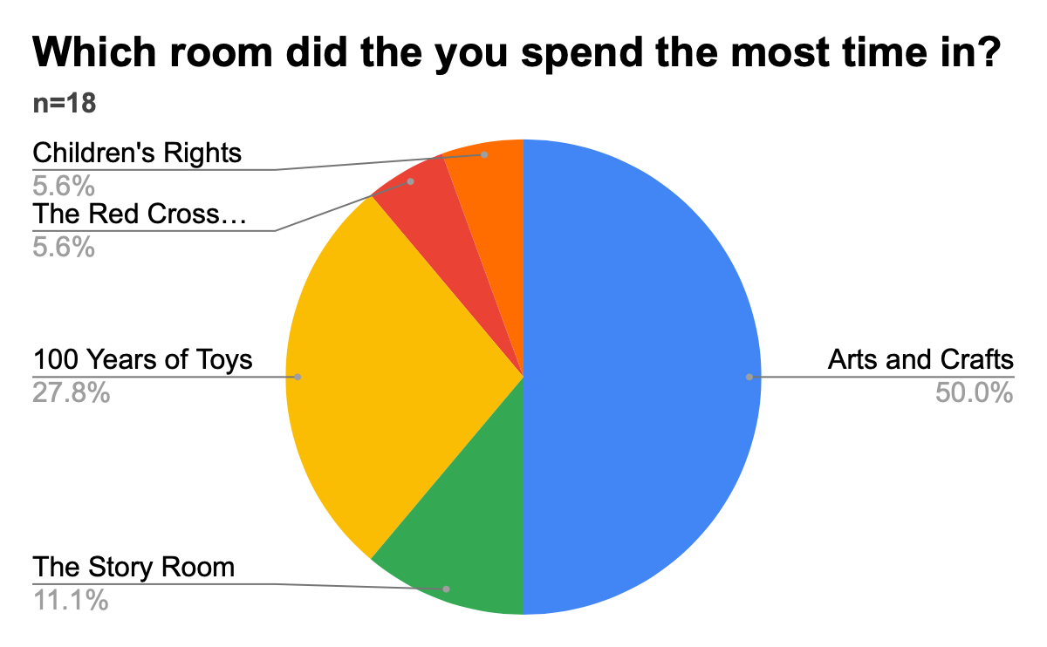
Survey Results
Helpful Feedback Survey - Most Utilized
Figure 3. Most Utilized Room; New Existing Helpful Feedback Form; Oct 2022 - Nov 2022 (n=18)

Slide 13
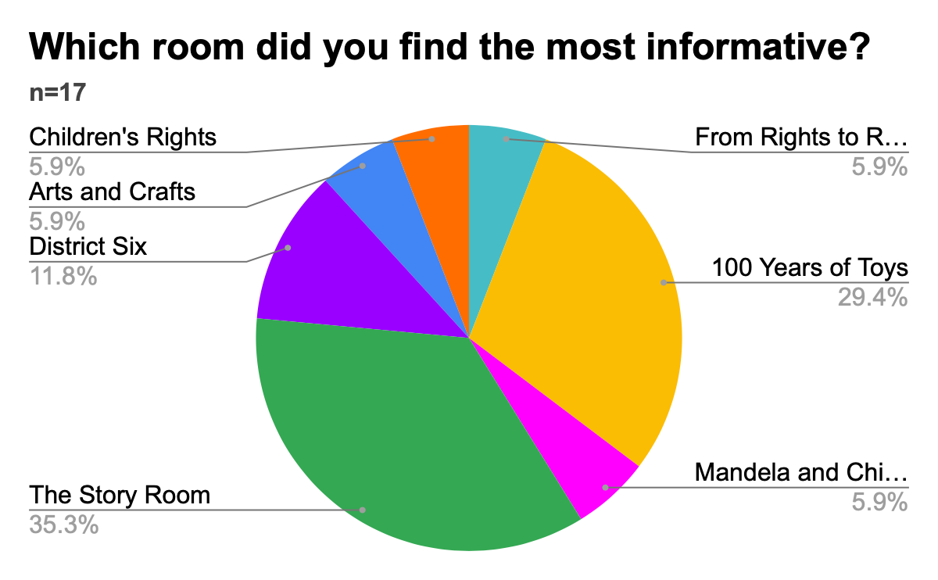
Survey Results
Helpful Feedback Survey - Most Informative
Figure 4. Most Informative Room; Pre-Existing Helpful Feedback Form; Oct 2022 - Nov 2022 (n=18)

Slide 14
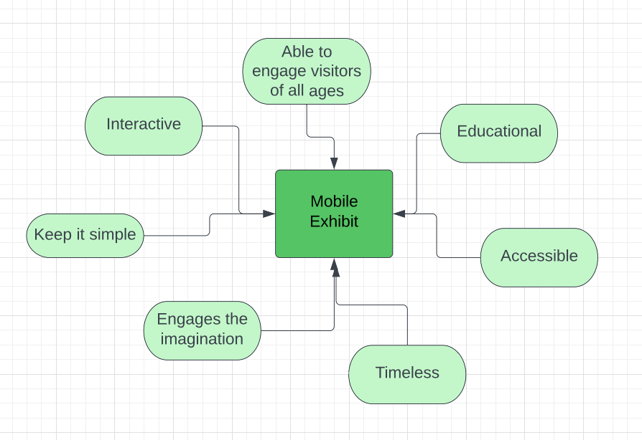
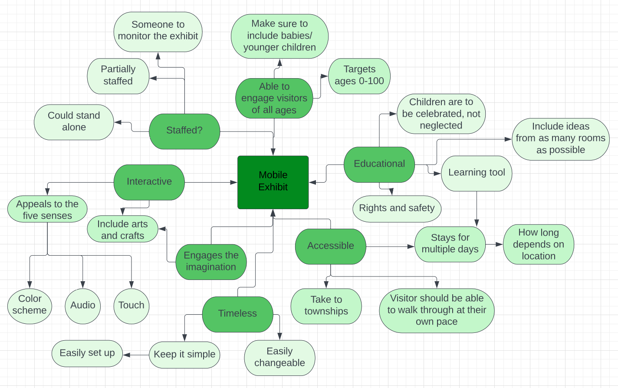
Staff Interviews
Mercury is the closest planet to the Sun and the smallest one in our Solar System—it’s only a bit larger than our Moon. The planet’s name has nothing to do with the liquid metal, since it was named after the Roman messenger god
Figure 5. Key Takeaways from Staff Interviews

Slide 15
Libraries
Pinelands Public Library
The Parent Centre
Schools
Christian David Moravian
Target Audience Interviews
Key Takeaway:
-Importance of fostering a connection between parent and child
Key Takeaways:
- Importance of interactivity
-Potential for guided accompanying program
Key Takeaways:
-Importance of interactivity
-Importance of addressing dysfunctional households

Slide 16
~THE MESSAGE~
CELEBRATING DIVERSE CHILDHOOD STORIES

Slide 17
THE DELIVERABLES
1. Mobile Exhibit
2. Virtual Tour

Slide 18
Immersive Storytelling Booths
Physical Design Parameters
Portable
Easy to assemble
Immersive
Striking
Structurally sound
Able to stand alone
Characteristics
1.2m x1m x2m interior space
Uninterrupted interior walls
Open bottom
Curtain Door
Five transportable sections
Interior Lighting
Surround speakers
CTMoC Color Scheme

Slide 19
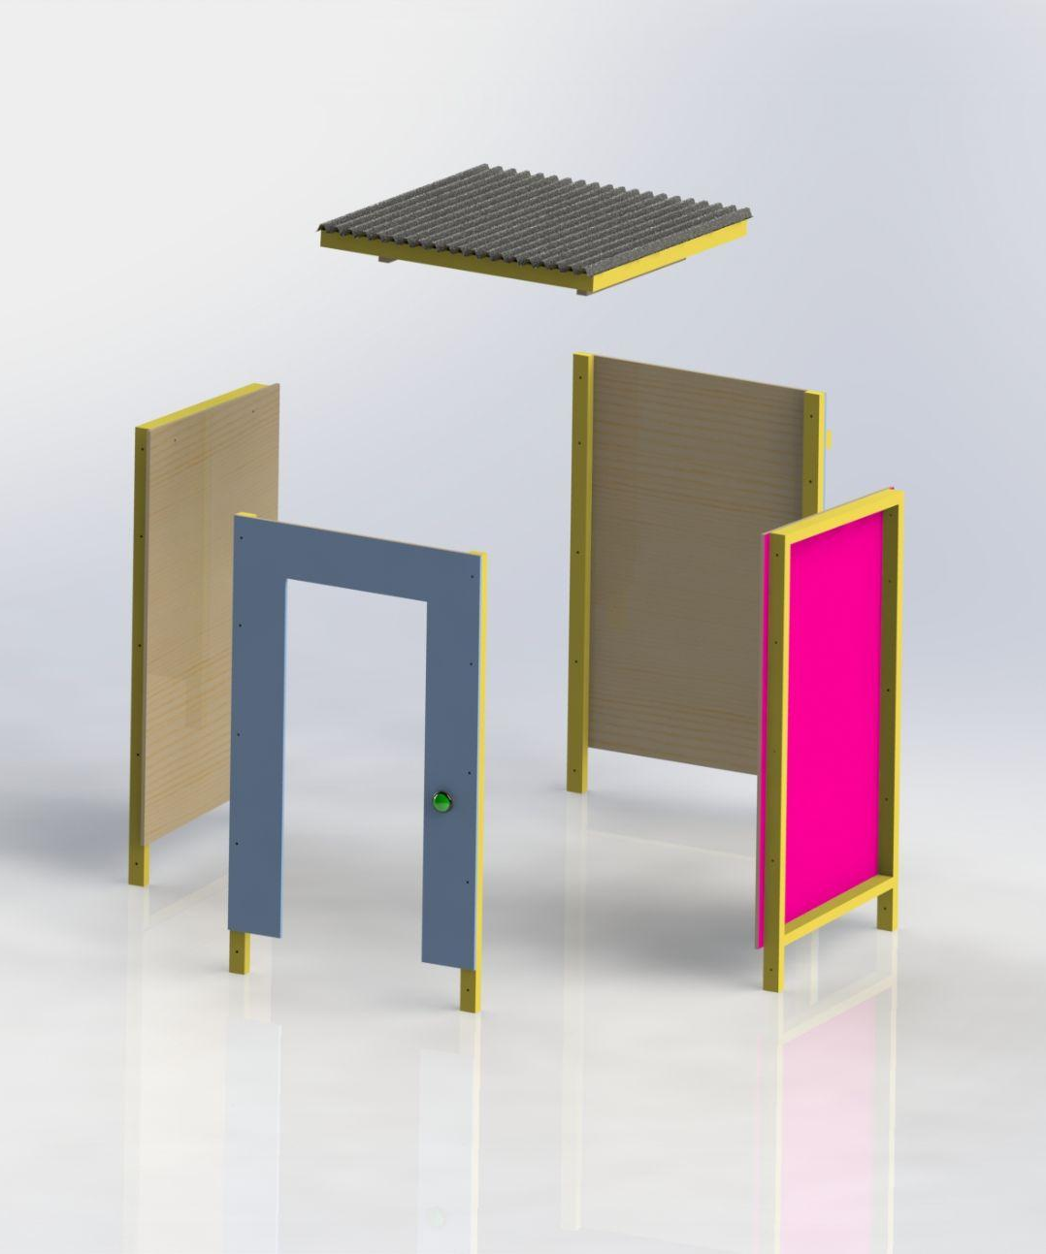
Immersive Story Booth Assembly

Slide 20
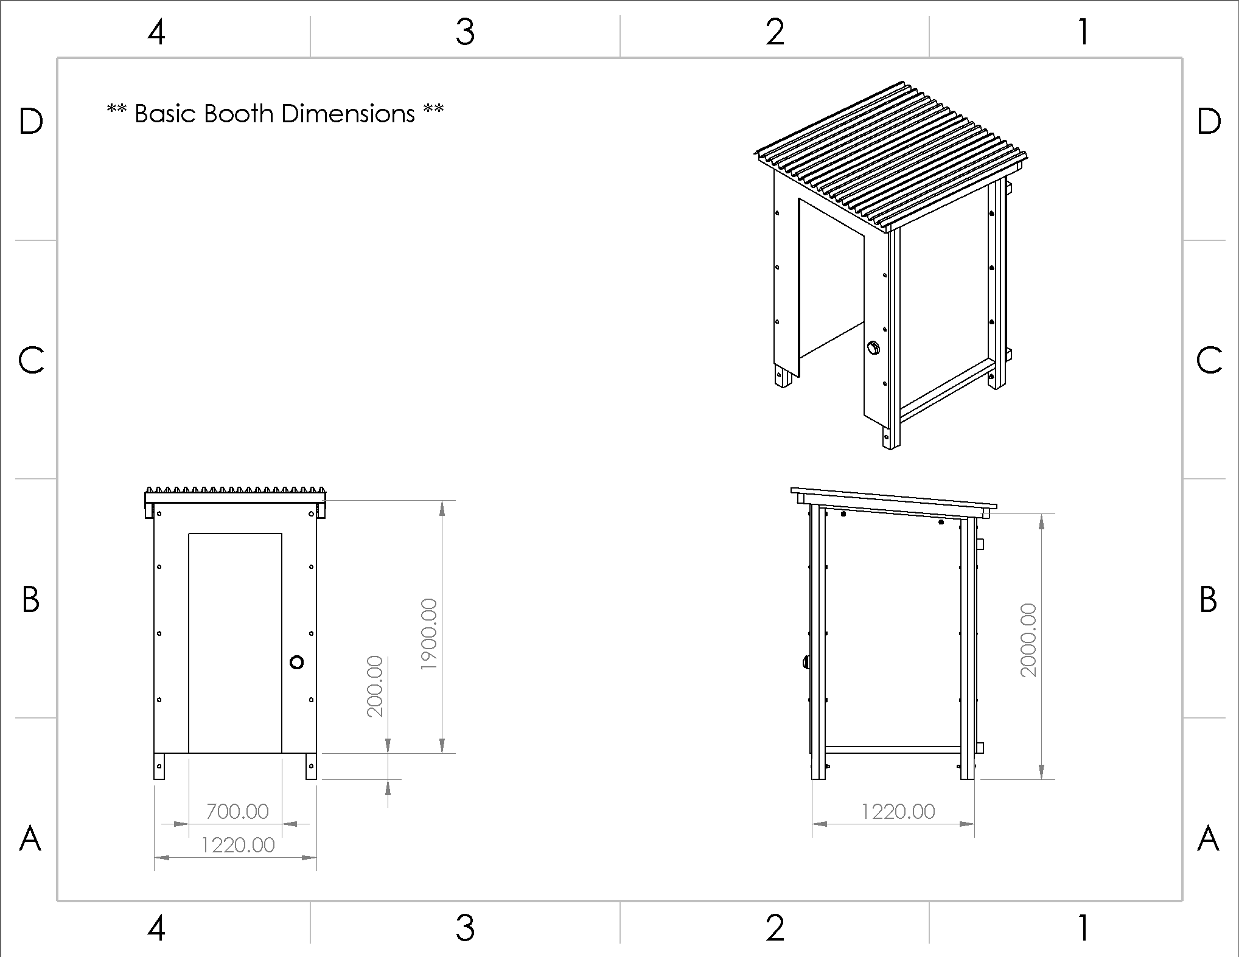
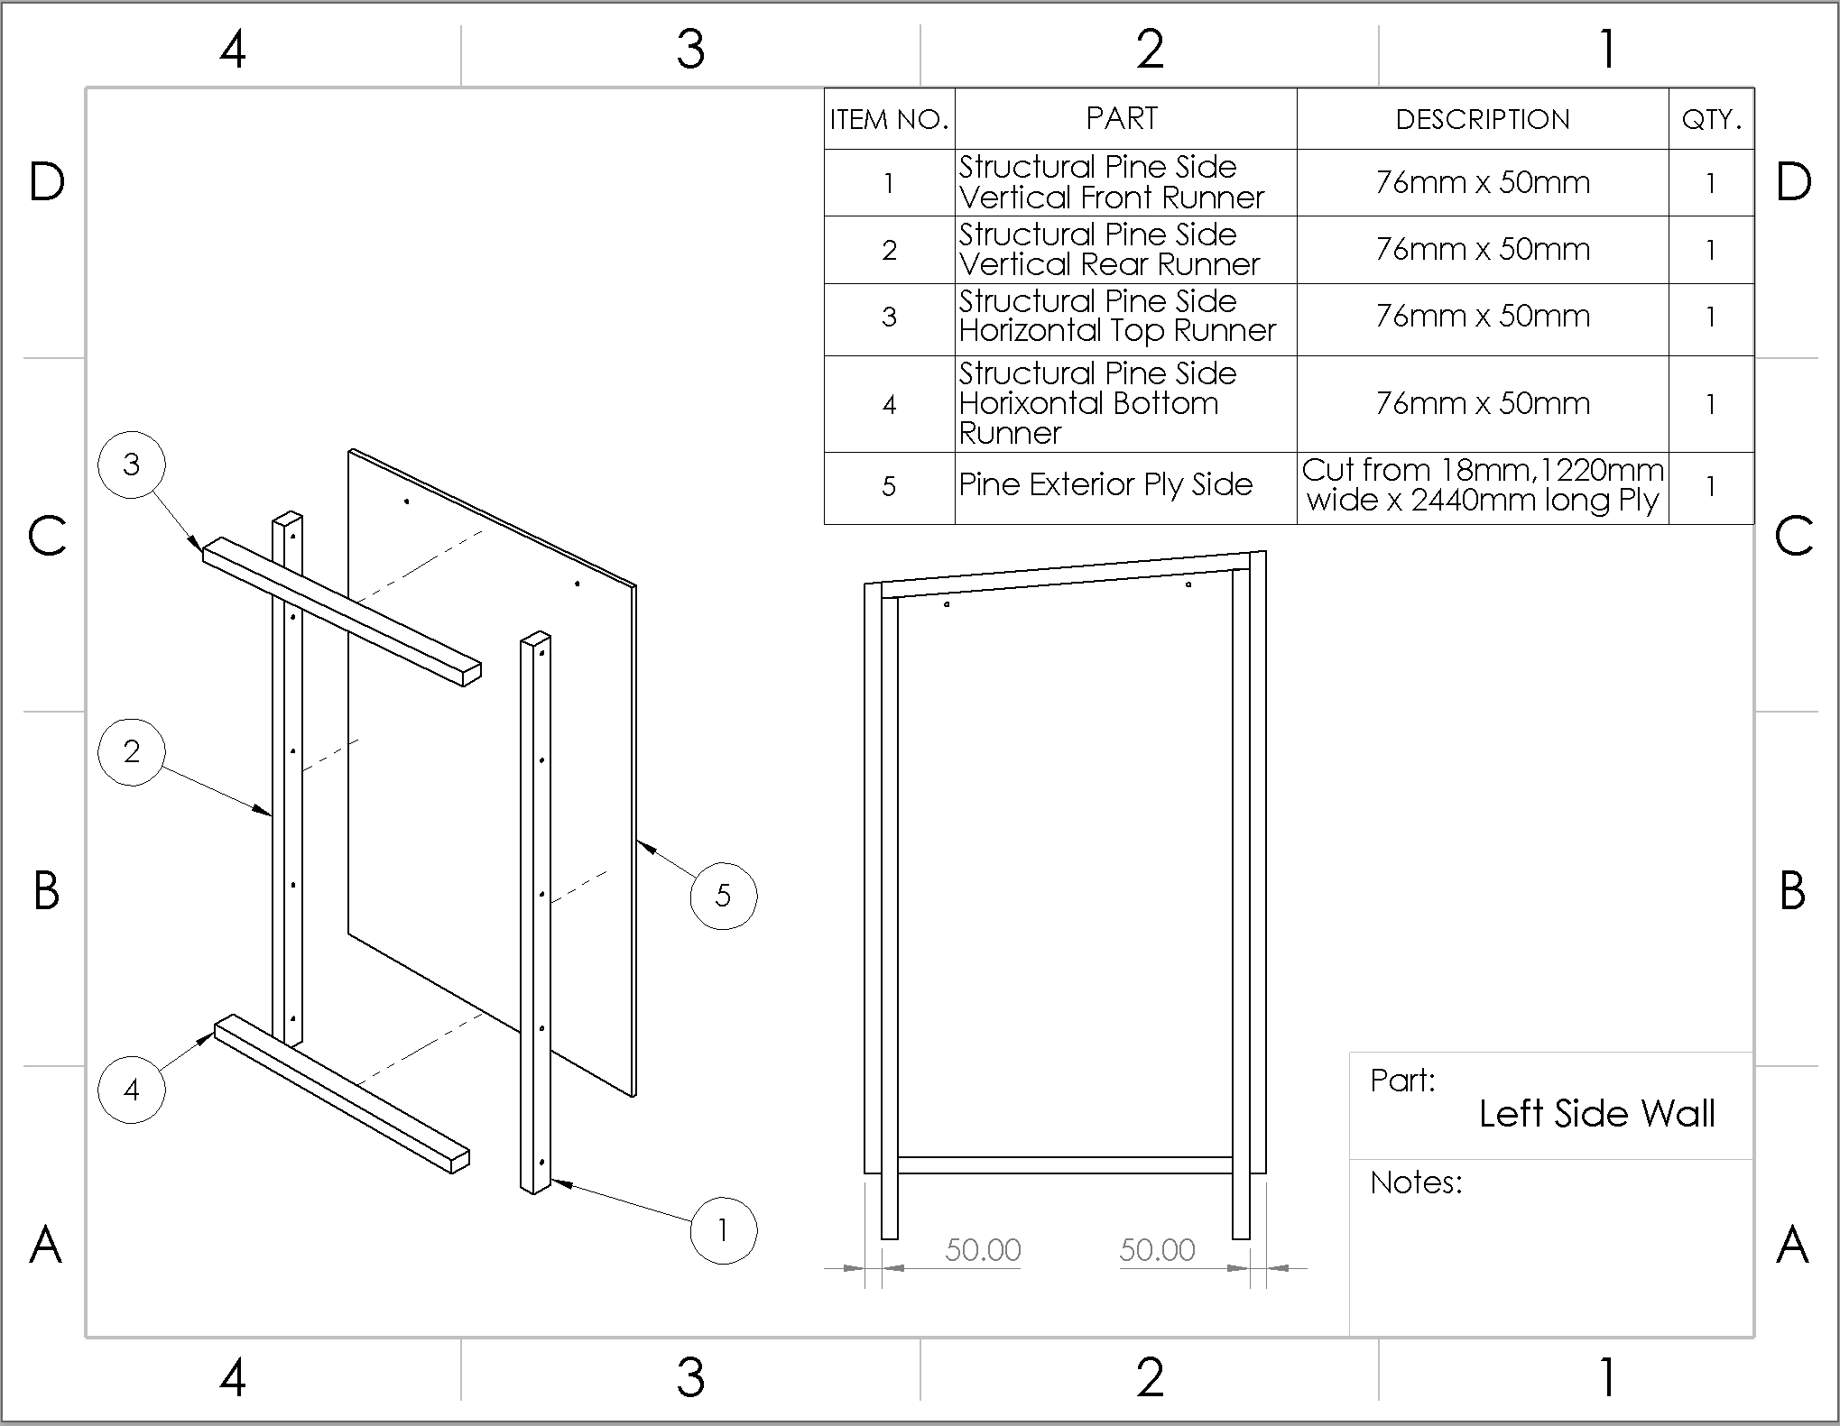
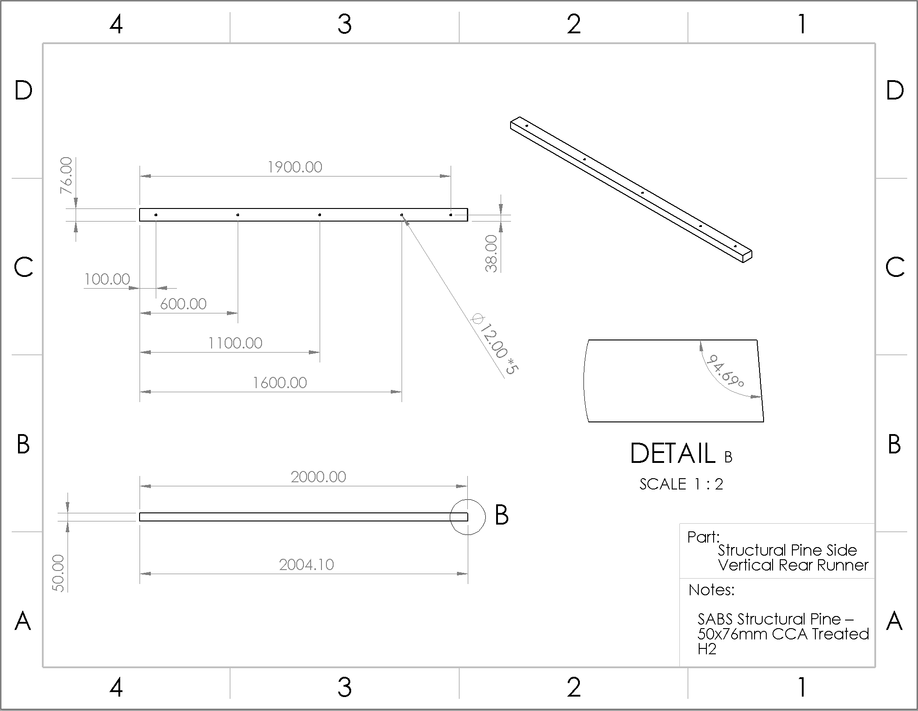
Immersive Story Booth Build
Building Material
Weather Resistance
Blue Prints
Material Cost

Slide 21
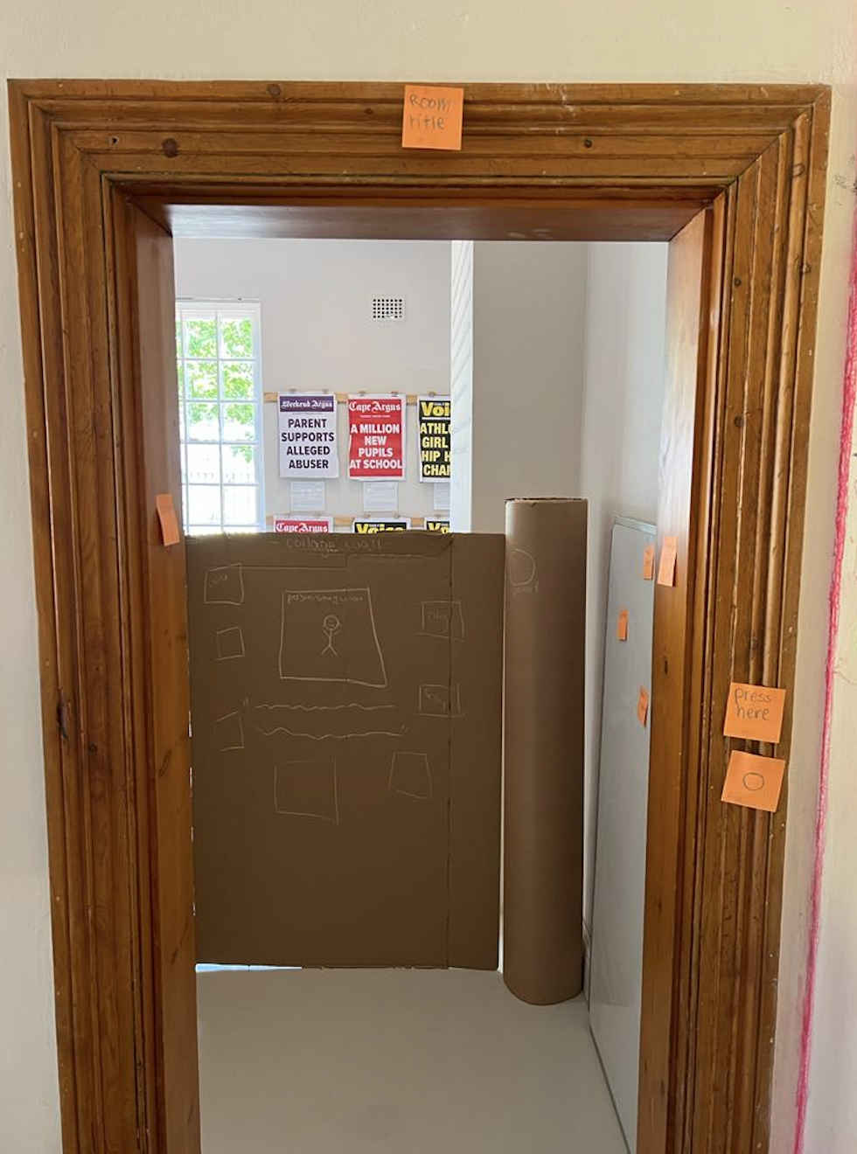
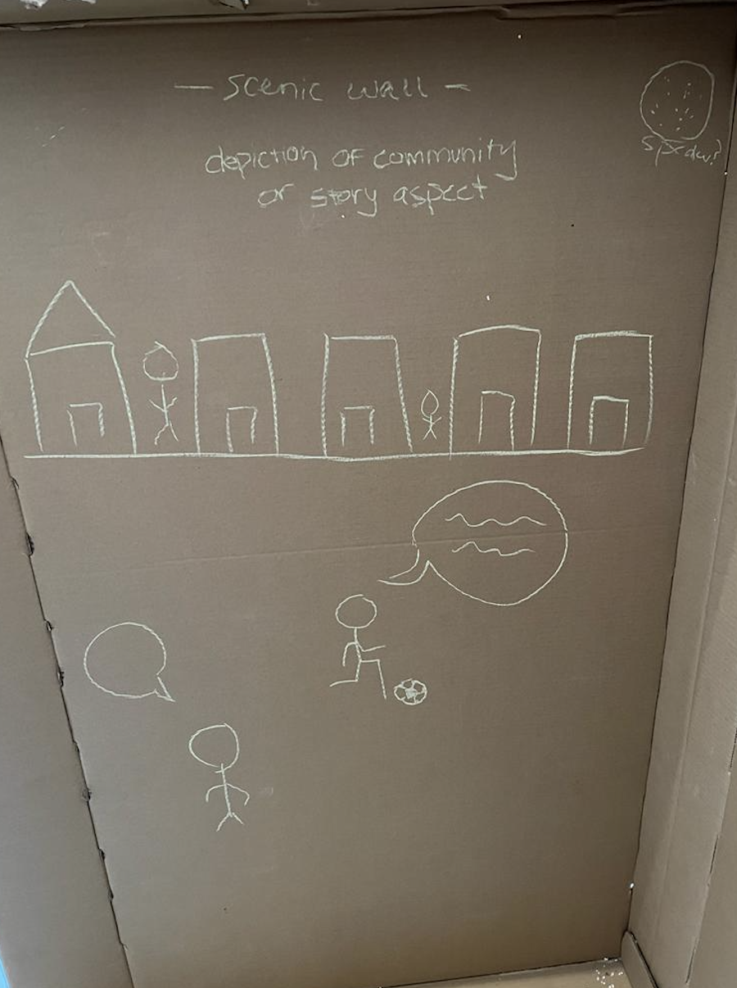
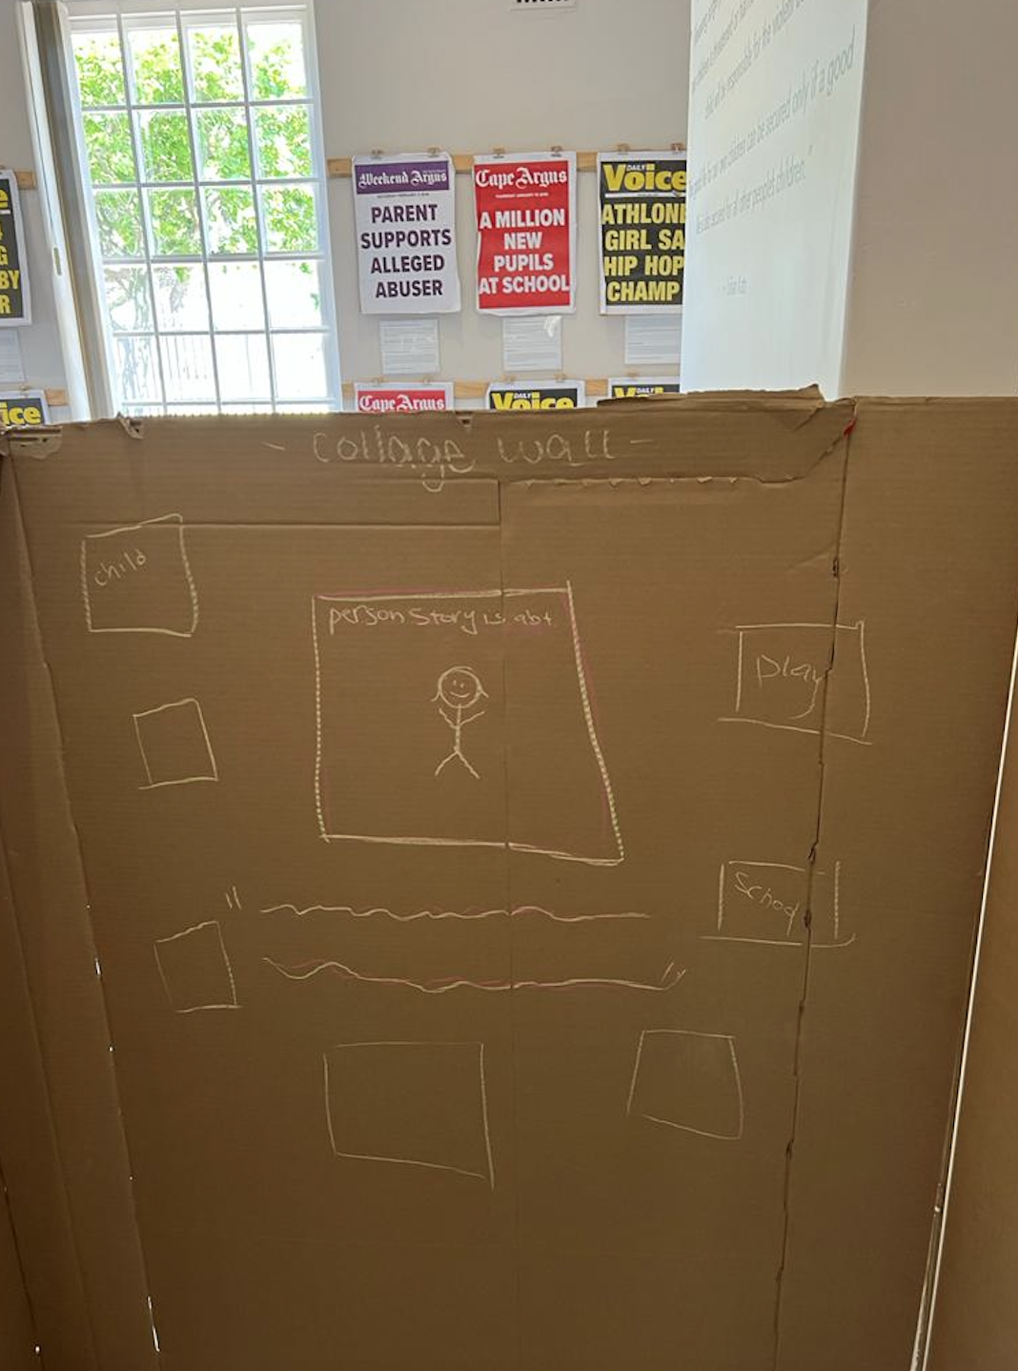
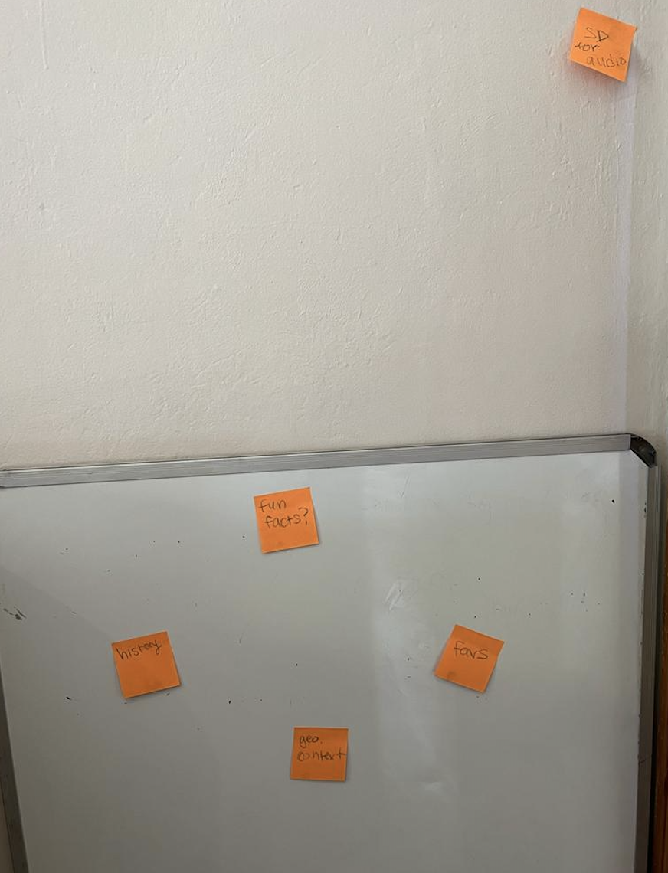
Immersive Storytelling Booths
3 story booths
incorporate visuals, audio, and text
each story should highlight a different childhood experience
immersive

Slide 22
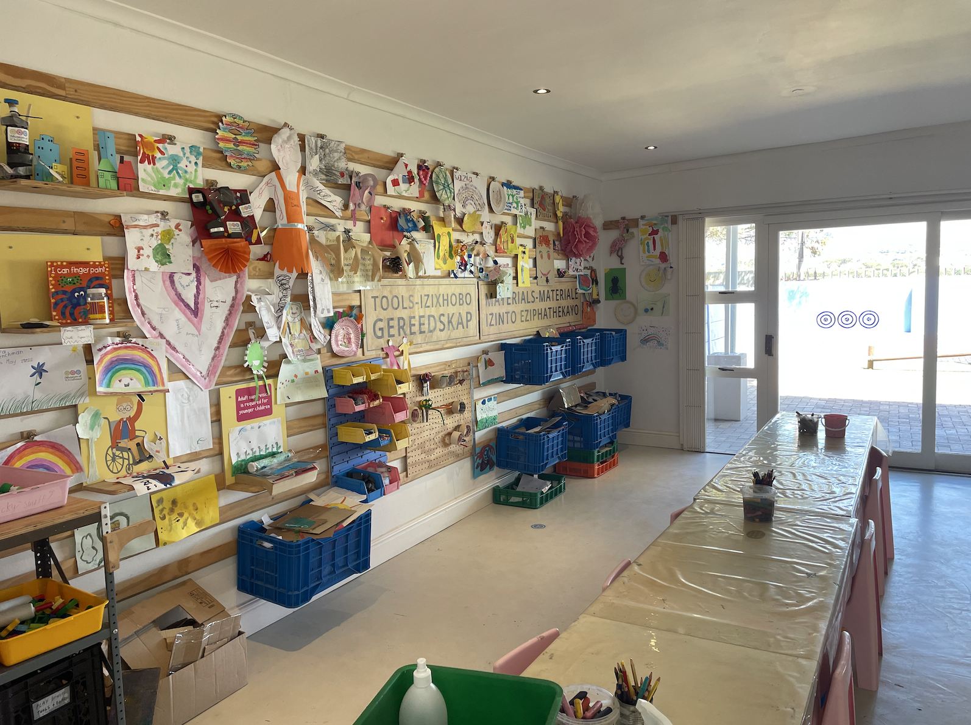
Interactive Storytelling Activity
One final booth contains an interactive activity for visitors
Opportunity for children to think about their own story in relation to the three booths
Community engagement

Slide 23
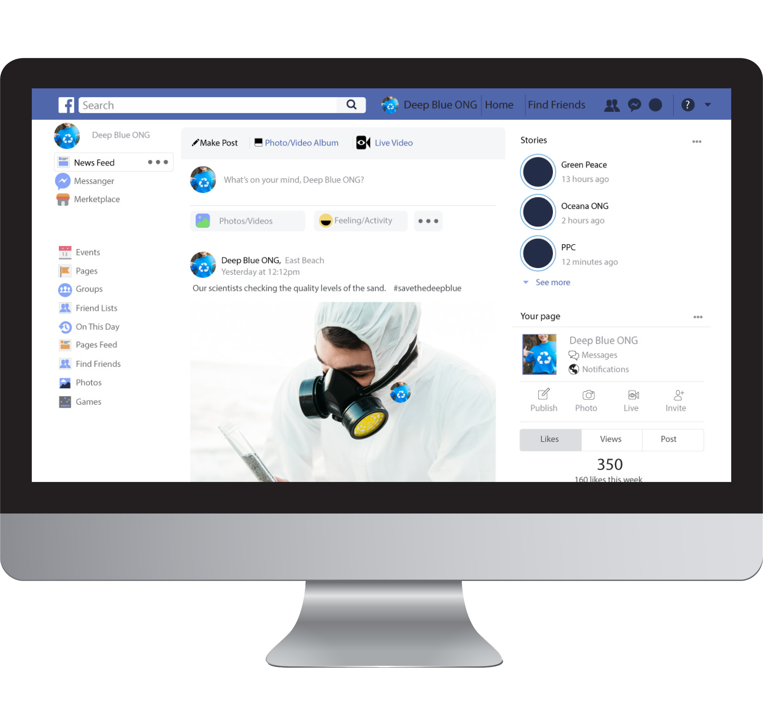
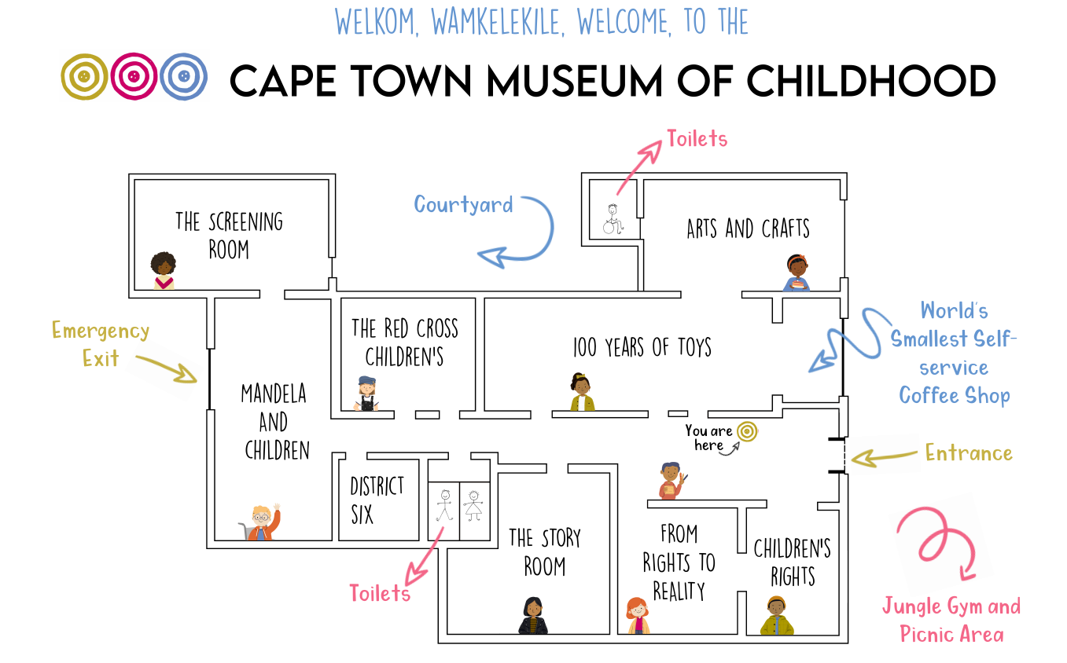
VIRTUAL TOUR
Scroll around each room inside a central 360 image
Showcases
Writing
Posters
Display cases
Audio
Video

Slide 24
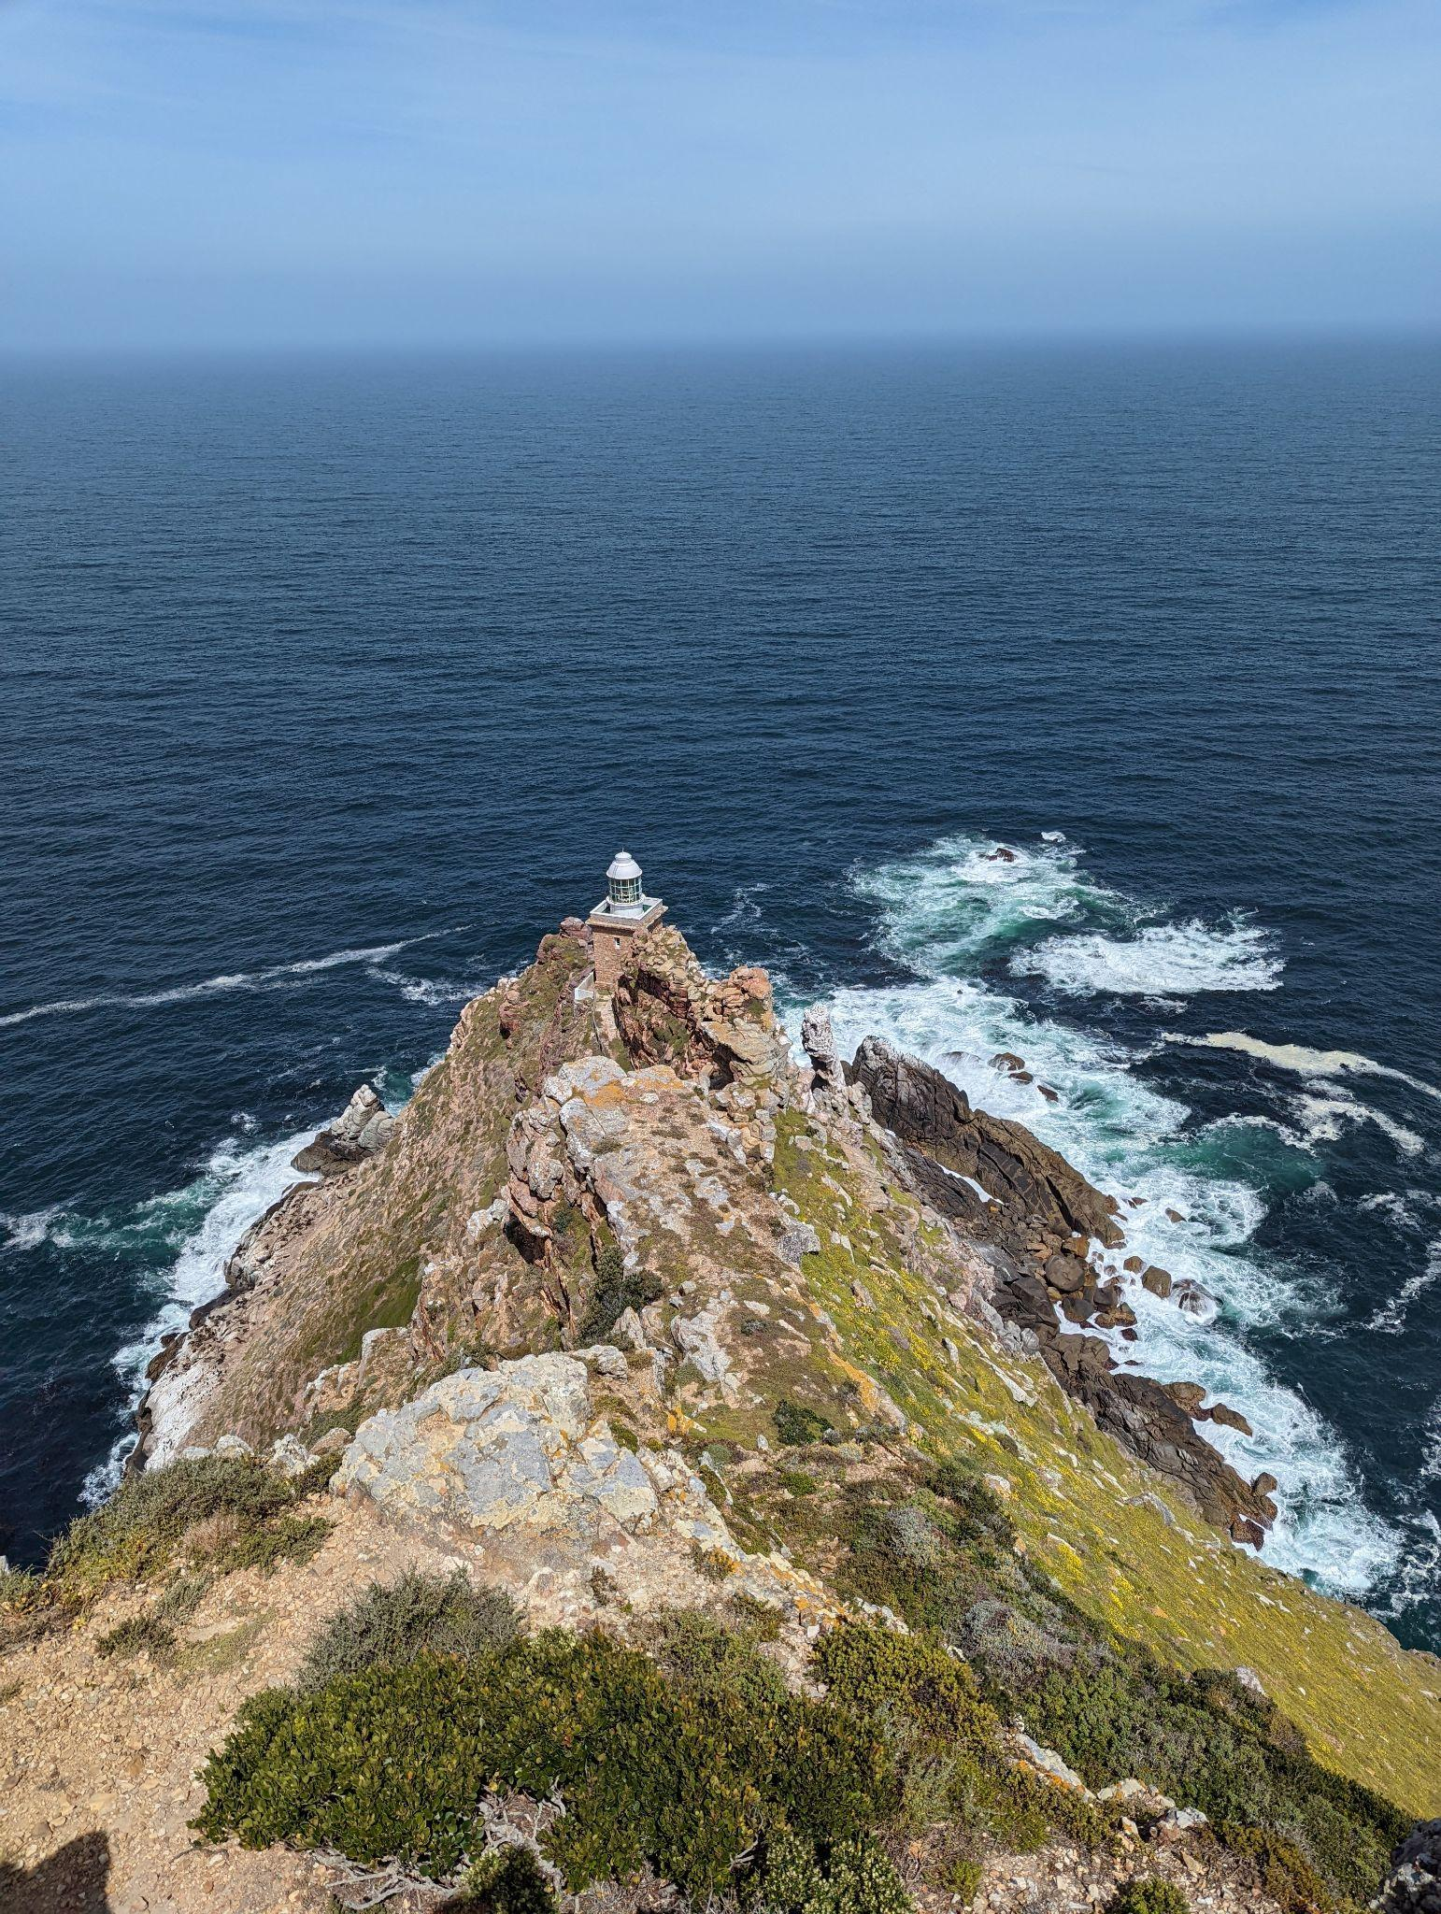
Recommendations
Mobile Exhibit
Determine the stories to be told
Collect multimedia elements to support the story (photographs, audio clips)
Contact contractors and graphic designers
Expand to contain more booths
Virtual Tour
Posted on website, on social media, QR codes

Slide 25
CONCLUSION

Slide 26
THANK YOU!
Sarah Atmore
Boniswa Gquma-Lisa
Claire Pearce
Eric Atmore
Michaela Ashley-Cooper
Alice, Babalwa, and Lucy from the Parent Centre
General Electric Foundation
Margaux Bergman
Benita Cornelius
Navarne Weeder
Bridget Kahts
Zara Nanji
Bomikazi
CECD

Slide 27
Immersive Storytelling Booths
Design Parameters
Portable
Easy to assemble
Durable
Striking
Structurally sound
Able to stand alone
Specifications
Uninterrupted interior walls
Open bottom
Made up of five sections
Interior Lighting
Surround speakers

