Slide 1
The Development and Study of Organic Composites
Timothy Cotter (ME)
Allyson Kearns (CHE, minor ME)
Allison Sichler (CHE, minor SE)
Aiden Wright (ME)

Slide 2
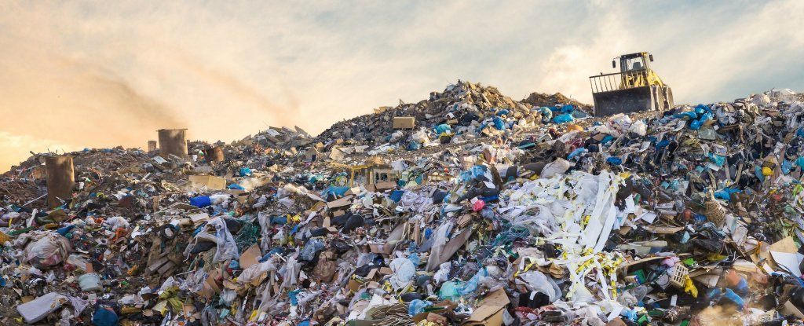
Introduction
In an effort to alleviate modern society’s reliance on petroleum-based plastics, our team explored compostable alternatives via organic fiber-reinforced composites.

Slide 3
Objectives
To develop a novel composite material made from bioplastic resins, reinforced with natural fibers
To explore the properties of the composite including: matrix-fiber adhesion, degradability, material composition, and mechanical strength

Slide 4
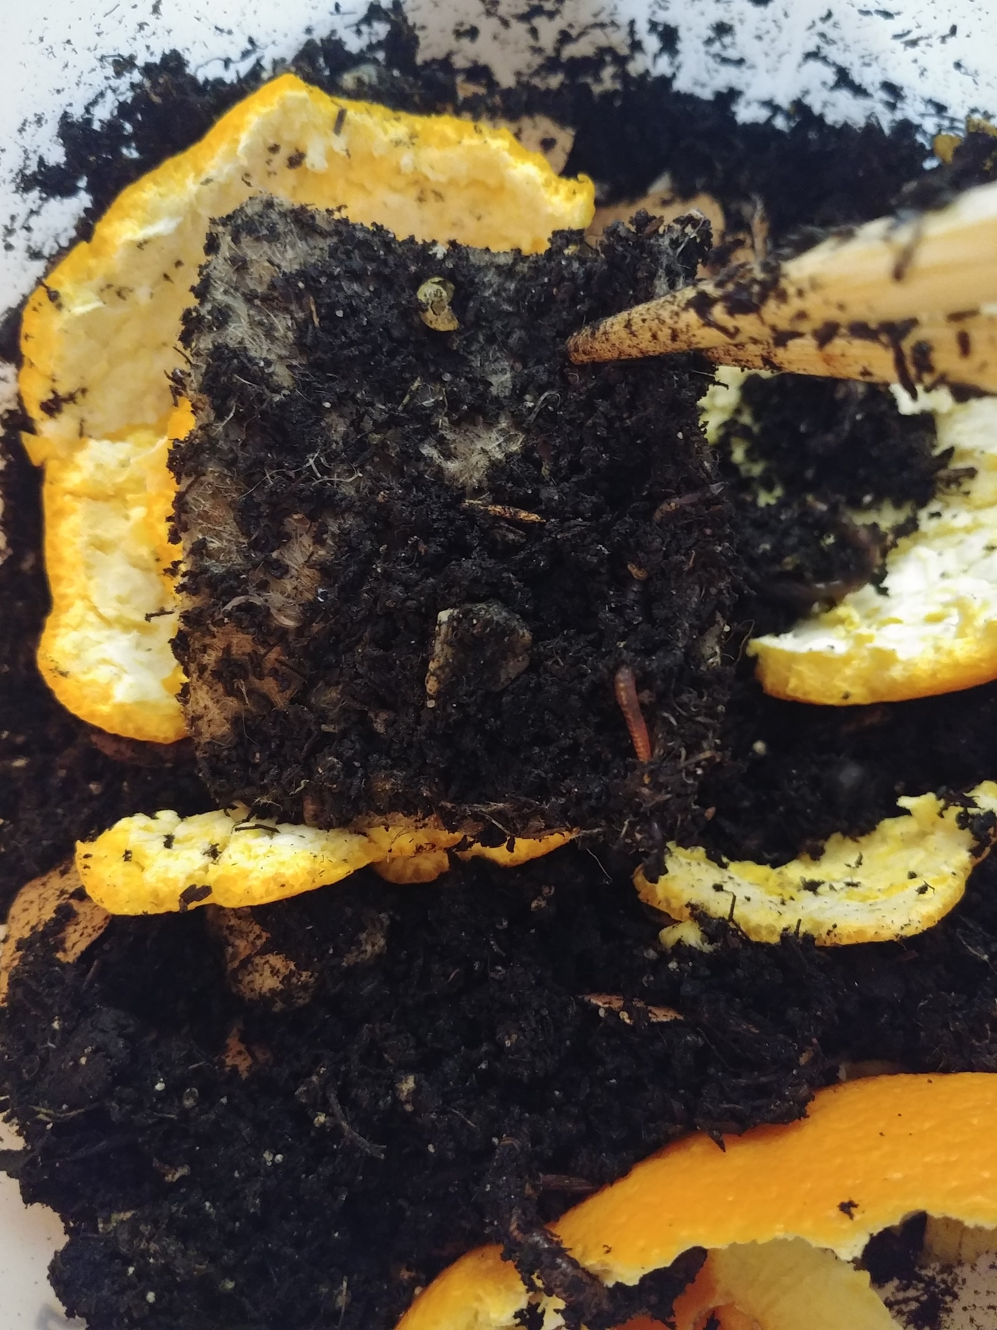
Characterization and Degradation
Material categorization
Biodegradable
Compostable
Organic
Biodegradation
Nutrient composition
pH
Gas exchange rates
Temperature

Slide 5
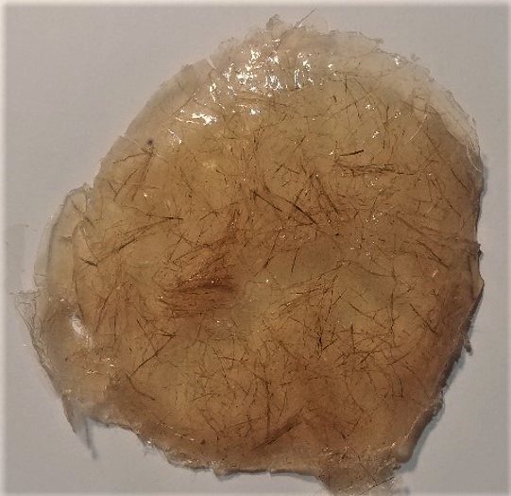
Fiber Reinforced Composites (FRC)
Random Orientation
Chopped Fibers

Slide 6
Methodology
Add 2.5 g potato starch, 3 mL of HCl, and 2 mL of glycerol to 25 mL of water
Place the mixture on a hot plate at 200°C for 15 minutes, mixing every couple of minutes
Add 3 mL of NaOH and pour the mixture and chopped fibers into a mold
Allow it to set over night either at room temp, in an oven at 105°C, or in the presence of a vacuum

Slide 7
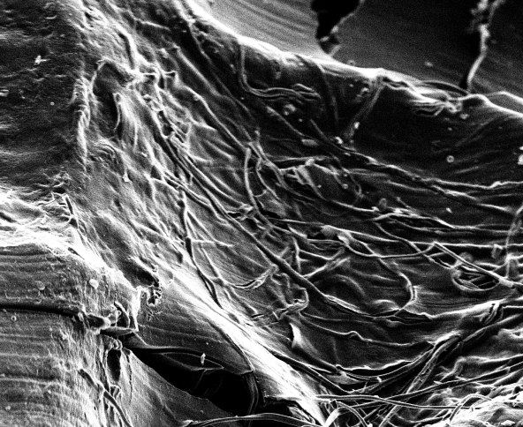
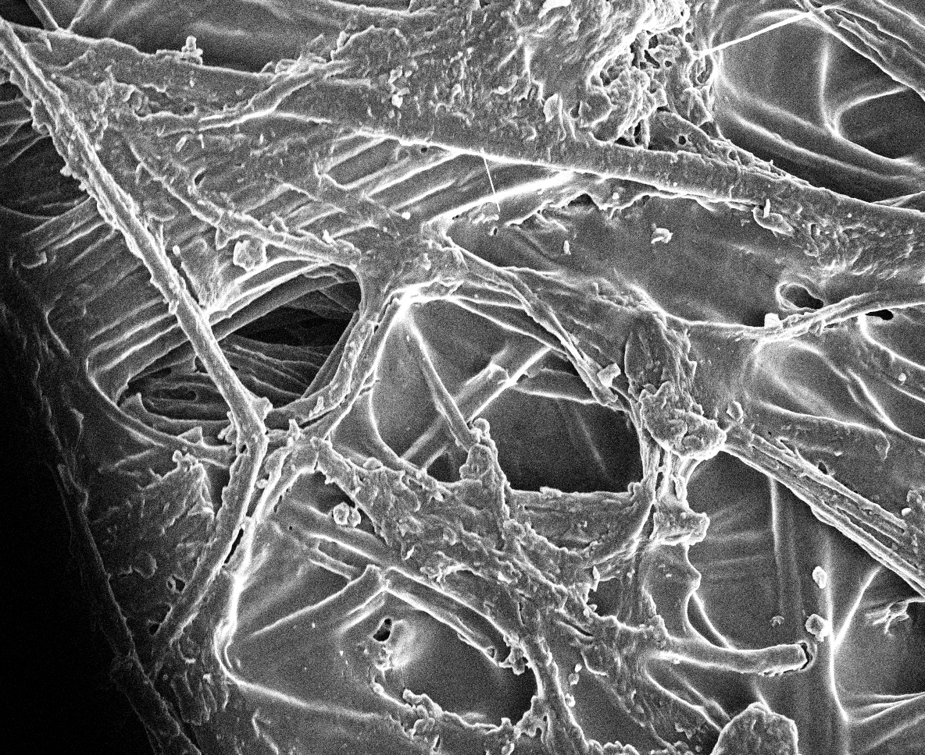
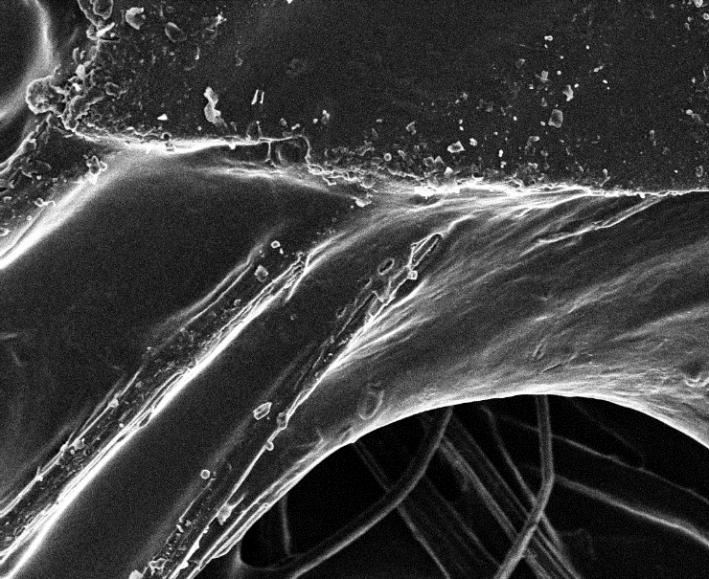
Material Analysis
Jute, 100x
Cotton, 100x Jute, 100x Flax, 125x

Slide 8
Material Analysis
Potato Starch Polymer
Flexible Composite
Total Vacuum Cure

Slide 9
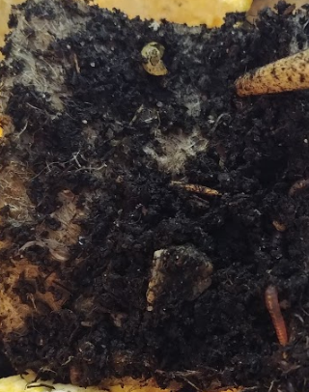
Material Analysis

Slide 10
Material Analysis
Notes:
Swollen, opaque. Indicative of compostability not just biodegradability.

Slide 11
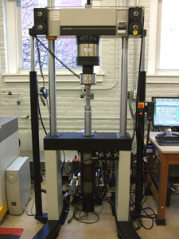
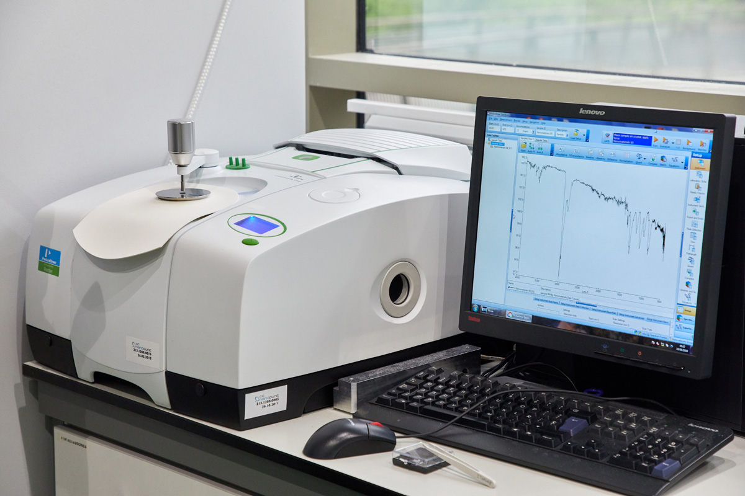
Recommendations
Fourier-Transform Infrared Microscopy → Chemical Composition
Instron → Tensile Testing

Slide 12
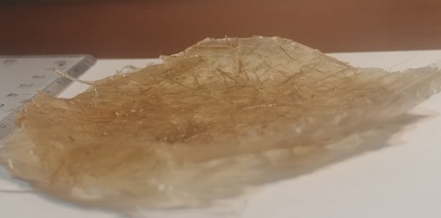
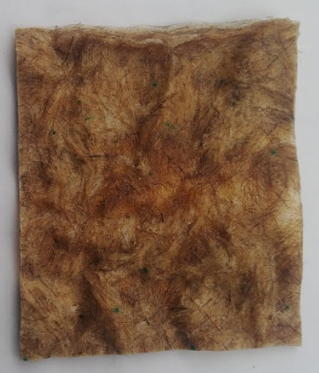
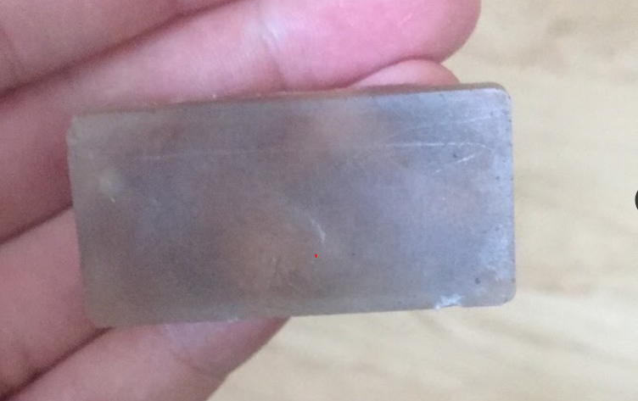
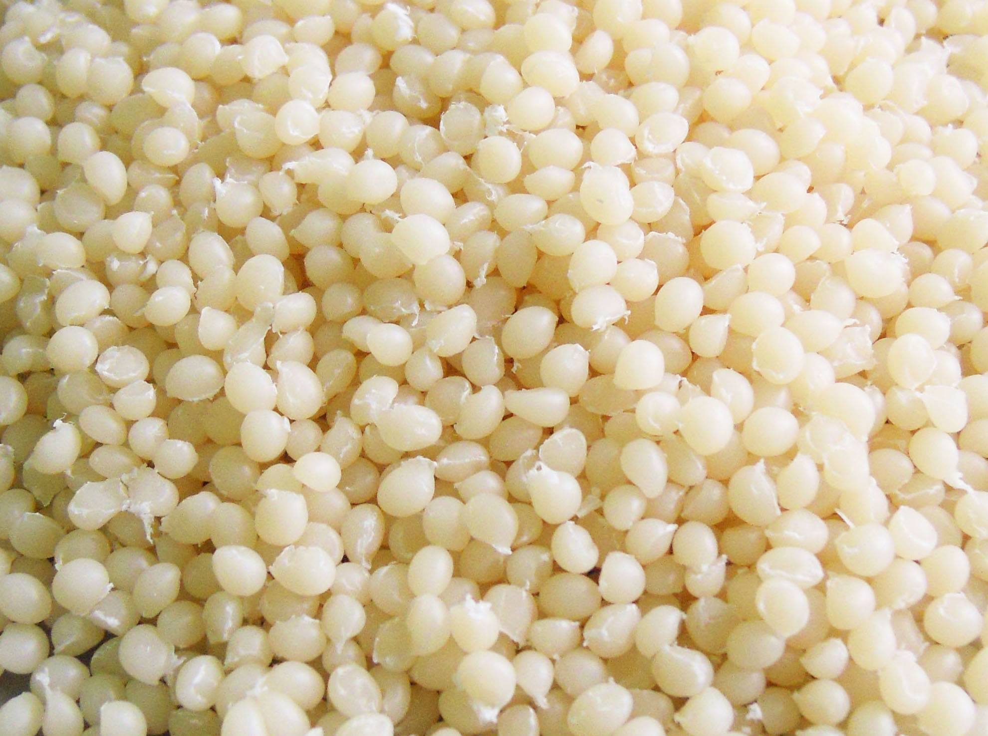
Recommendations
Thin-Flexible Plastic
Hard, High Strength Plastic
Create Samples in Vacuum
Corn-Starch Based Resins
Altered Fiber Orientation
Notes:
vacuum, toy, thin flexible plastic, FTIR, Instron
orientation, new resin materials

Slide 13
Questions?
Please feel free to contact us at
gr-mechem@wpi.edu
Or our advisors at
sjkmiotek@wpi.edu
guceri@wpi.edu

