Slide 1
Batch Reactor Pretreatment of Brewer's Spent Grain Enables Bioenergy Production From Continuous Anaerobic Digestion
Katherine Vaz Gomes
Advisor: Michael Timko
Brazil Project Center

Slide 2
Motivation
World is Currently Dependent on Petroleum Based Fuels (Figure 1)
Biogas Is an Attractive Option as an Alternative Fuel Source
Biogas Is Obtainable Through Anaerobic Digestion
Anaerobic Digestion Can Be Costly and Difficult Without a Pretreatment Method
This Study Examined the Pretreatment of Barley Bagasse by a Batch Reactor
Notes:
https://ourworldindata.org/energy

Slide 3
Background Research: Biogas and Characterization
Figure 2 displays the role of biogas as a renewable fuel source in the anaerobic digestion process
Biogas is an attractive renewable fuel source because it can be used for heat and electricity
Anaerobic Digestors are often characterized by numerous stability metrics to maintain high methane yield in the biogas
Alkalinity
Chemical Oxygen Demand
Ammoniacal Nitrogen
pH
Total & Volatile Solids
Biogas Composition
Source: https://www.eesi.org/papers/view/fact-sheet-biogasconverting-waste-to-energy
Notes:
https://www.eesi.org/papers/view/fact-sheet-biogasconverting-waste-to-energy

Slide 5
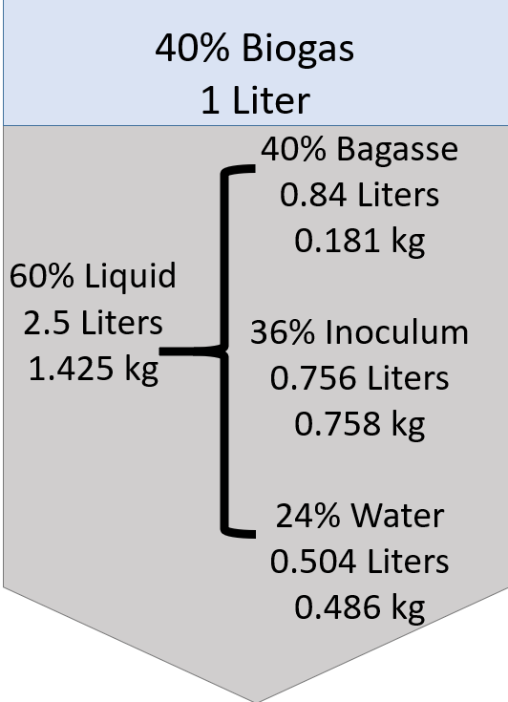
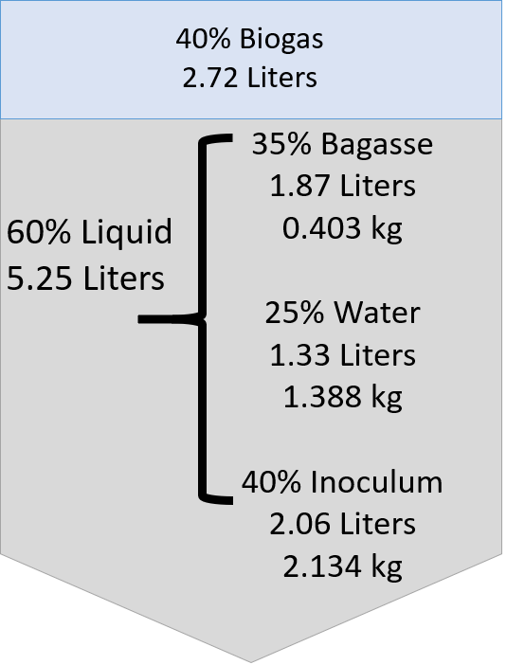
Experimental Procedure: Reactor Conditions
180 mL/day
Batch Reactor
Continuous Reactor

Slide 6
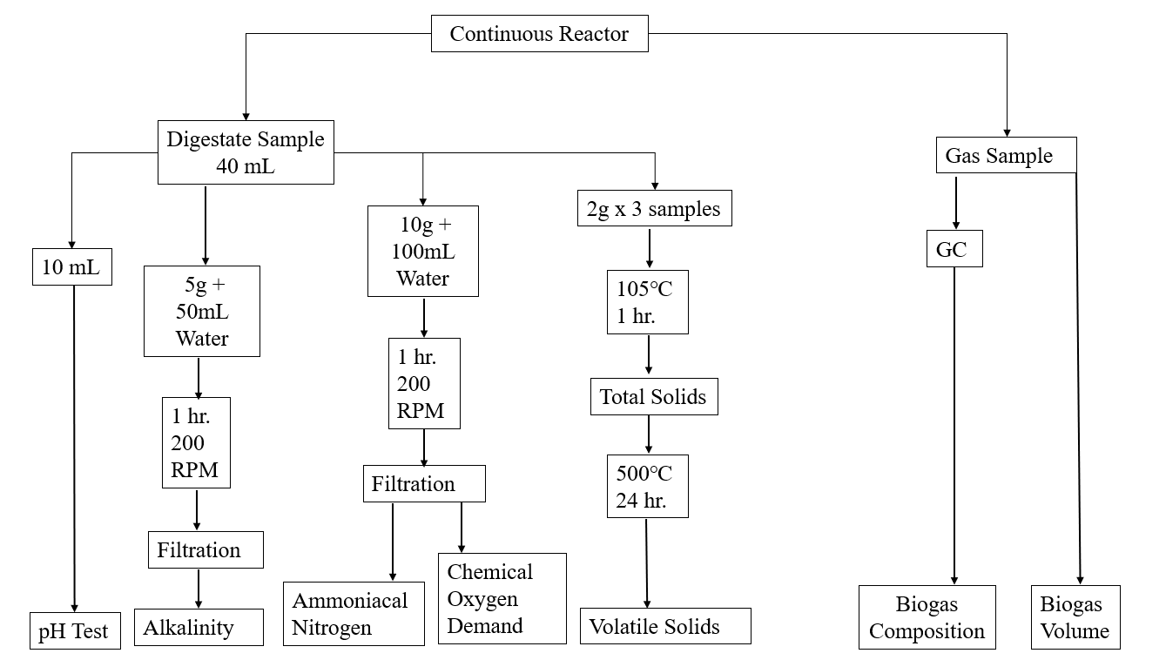
Experimental Procedure: Reactor Metrics

Slide 7
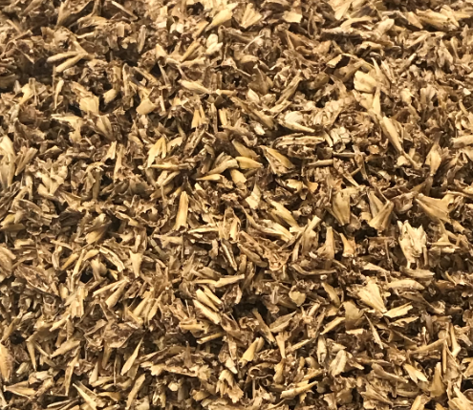
Experimental Procedure: Energetic Analysis
Analysis for the Energy Produced by the Reactor Made the Following Assumptions
Ideal Gas Behavior
100% of the Methane Is Combusted
Lower Heating Value for Methane

Slide 8
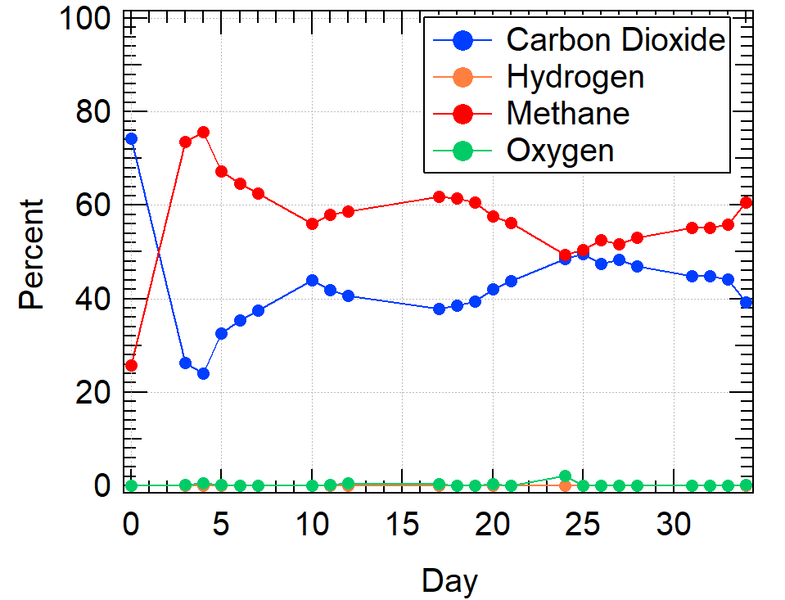
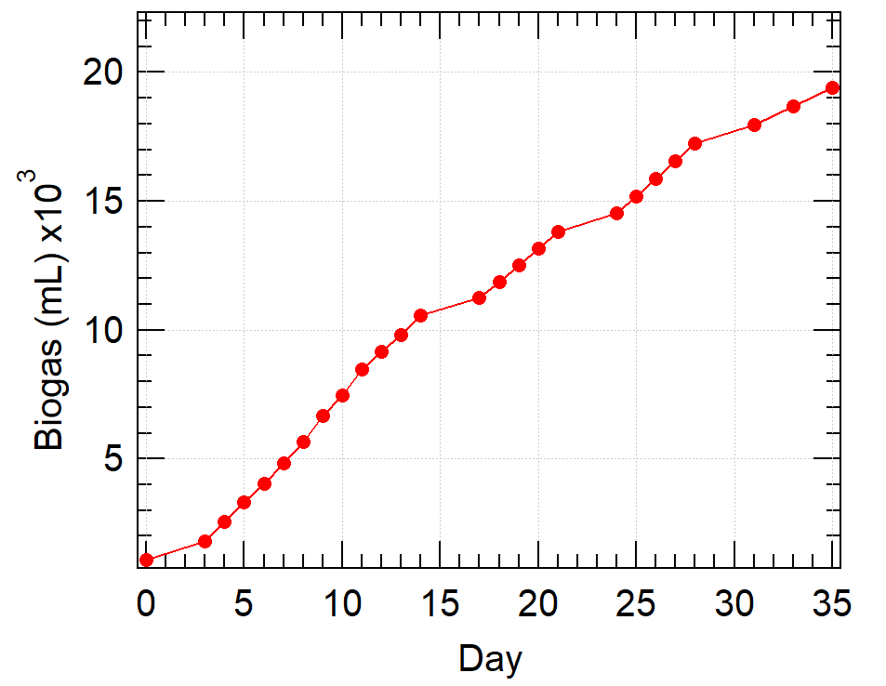
Results: Biogas Volume and Composition
Continuous Reactor produced an average of 58% methane in the biogas
Composition trends are consistent with highly biodegradable materials
Produced over 20L of Biogas with an average of 745 mL per day

Slide 9
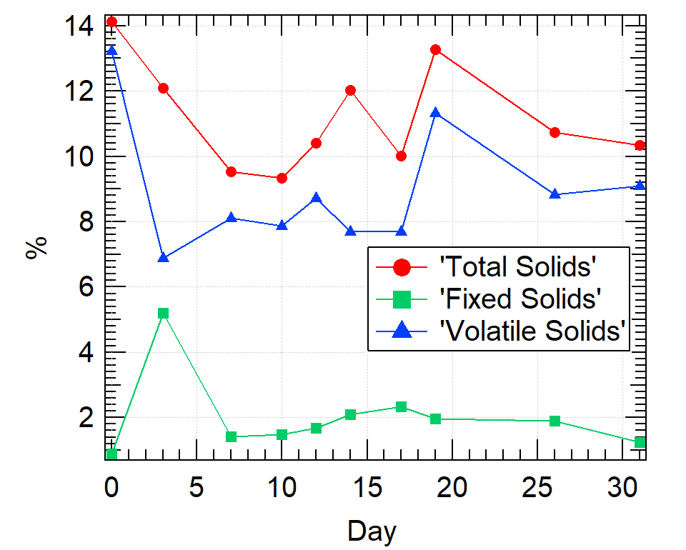
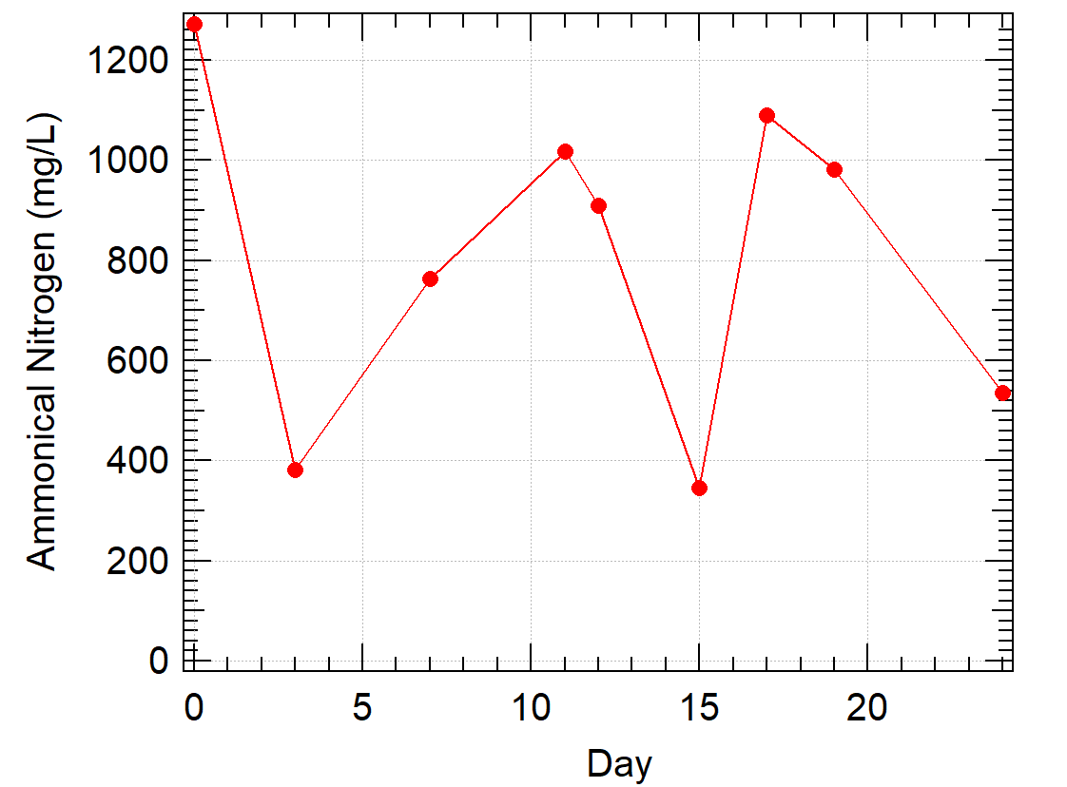
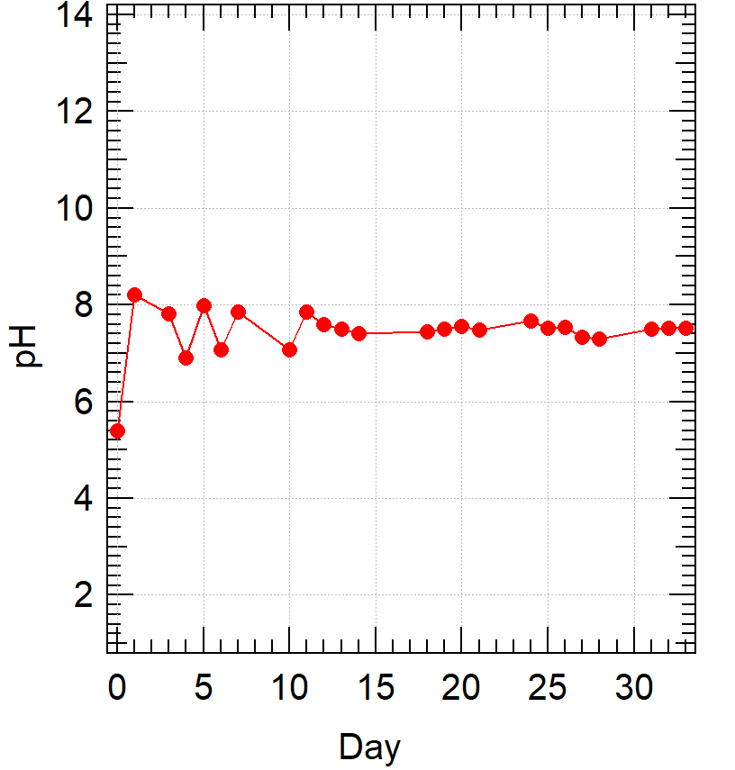
Results: Daily Metrics
Total & Volatile Solid Ratios
Ammoniacal Nitrogen Quantity
Daily pH Testing

Slide 10
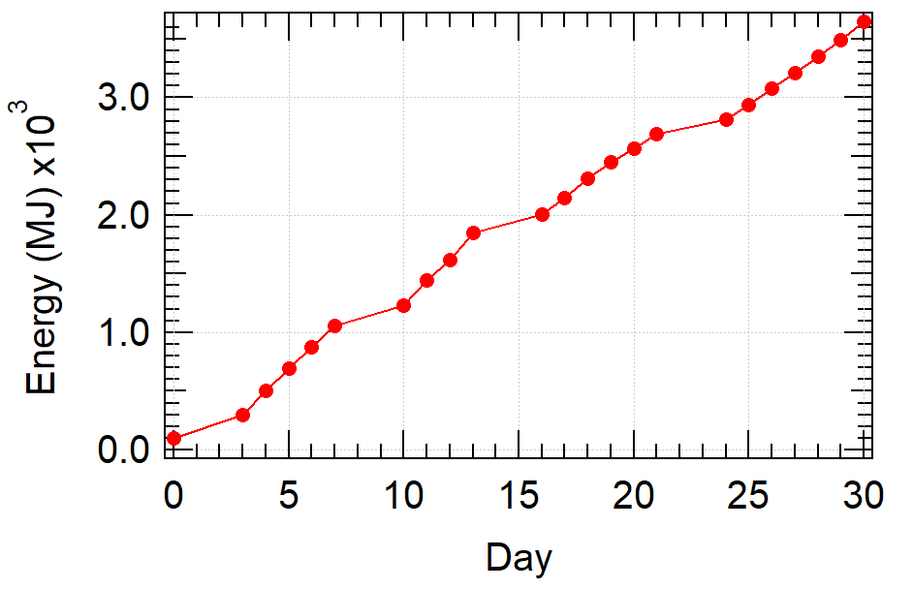
Results: Energy Production Analysis
0.00364 MJ of Energy Produced by the Continuous Reactor in a 30-Day Period
Continuous Reactor produced Energy to create 53% of one bottle of beer
Industry Standard Beer is 355 mL
The average brewery expends 200 MJ of energy to produce 1L of beer
Implications for the Sustainability of the Brewing Industry

Slide 11
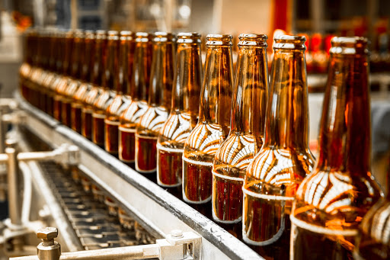
Conclusions
Energetic Analysis shows that this Batch Rector Pretreatment method is a promising option as a source of renewable energy for the brewing industry
Recommendation for future work to investigate the effects of changing the initial amount of barley bagasse, reactor conditions, and time spent in the Batch Reactor
Further work should pursue tuning this process to obtain optimal results
Recommendation for a technoeconomic analysis to examine the expenses associated with the industrialization of this process

Slide 12
Acknowledgements
Thank You To Everyone Who Made This Project Possible!
Prof. Michael Timko
Prof. Tania Forester-Carneiro
Researchers in the BIOTAR Lab
Laura Robinson &
Lori J. Ostapowicz-Critz

Slide 13
Please Contact Me With Any Questions or Feedback!
Reach Me At kvgomes@wpi.edu

