Slide 1
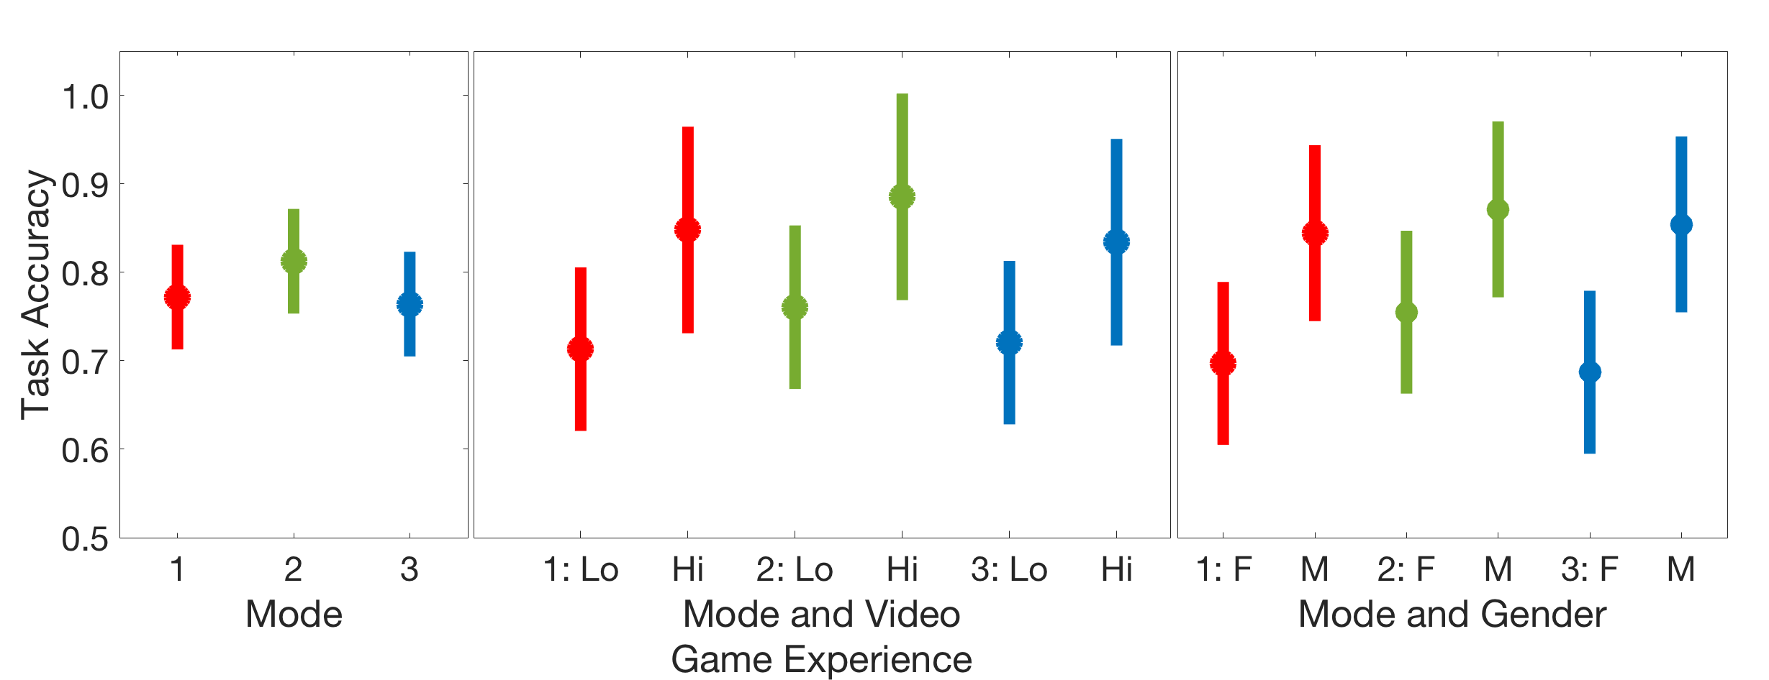
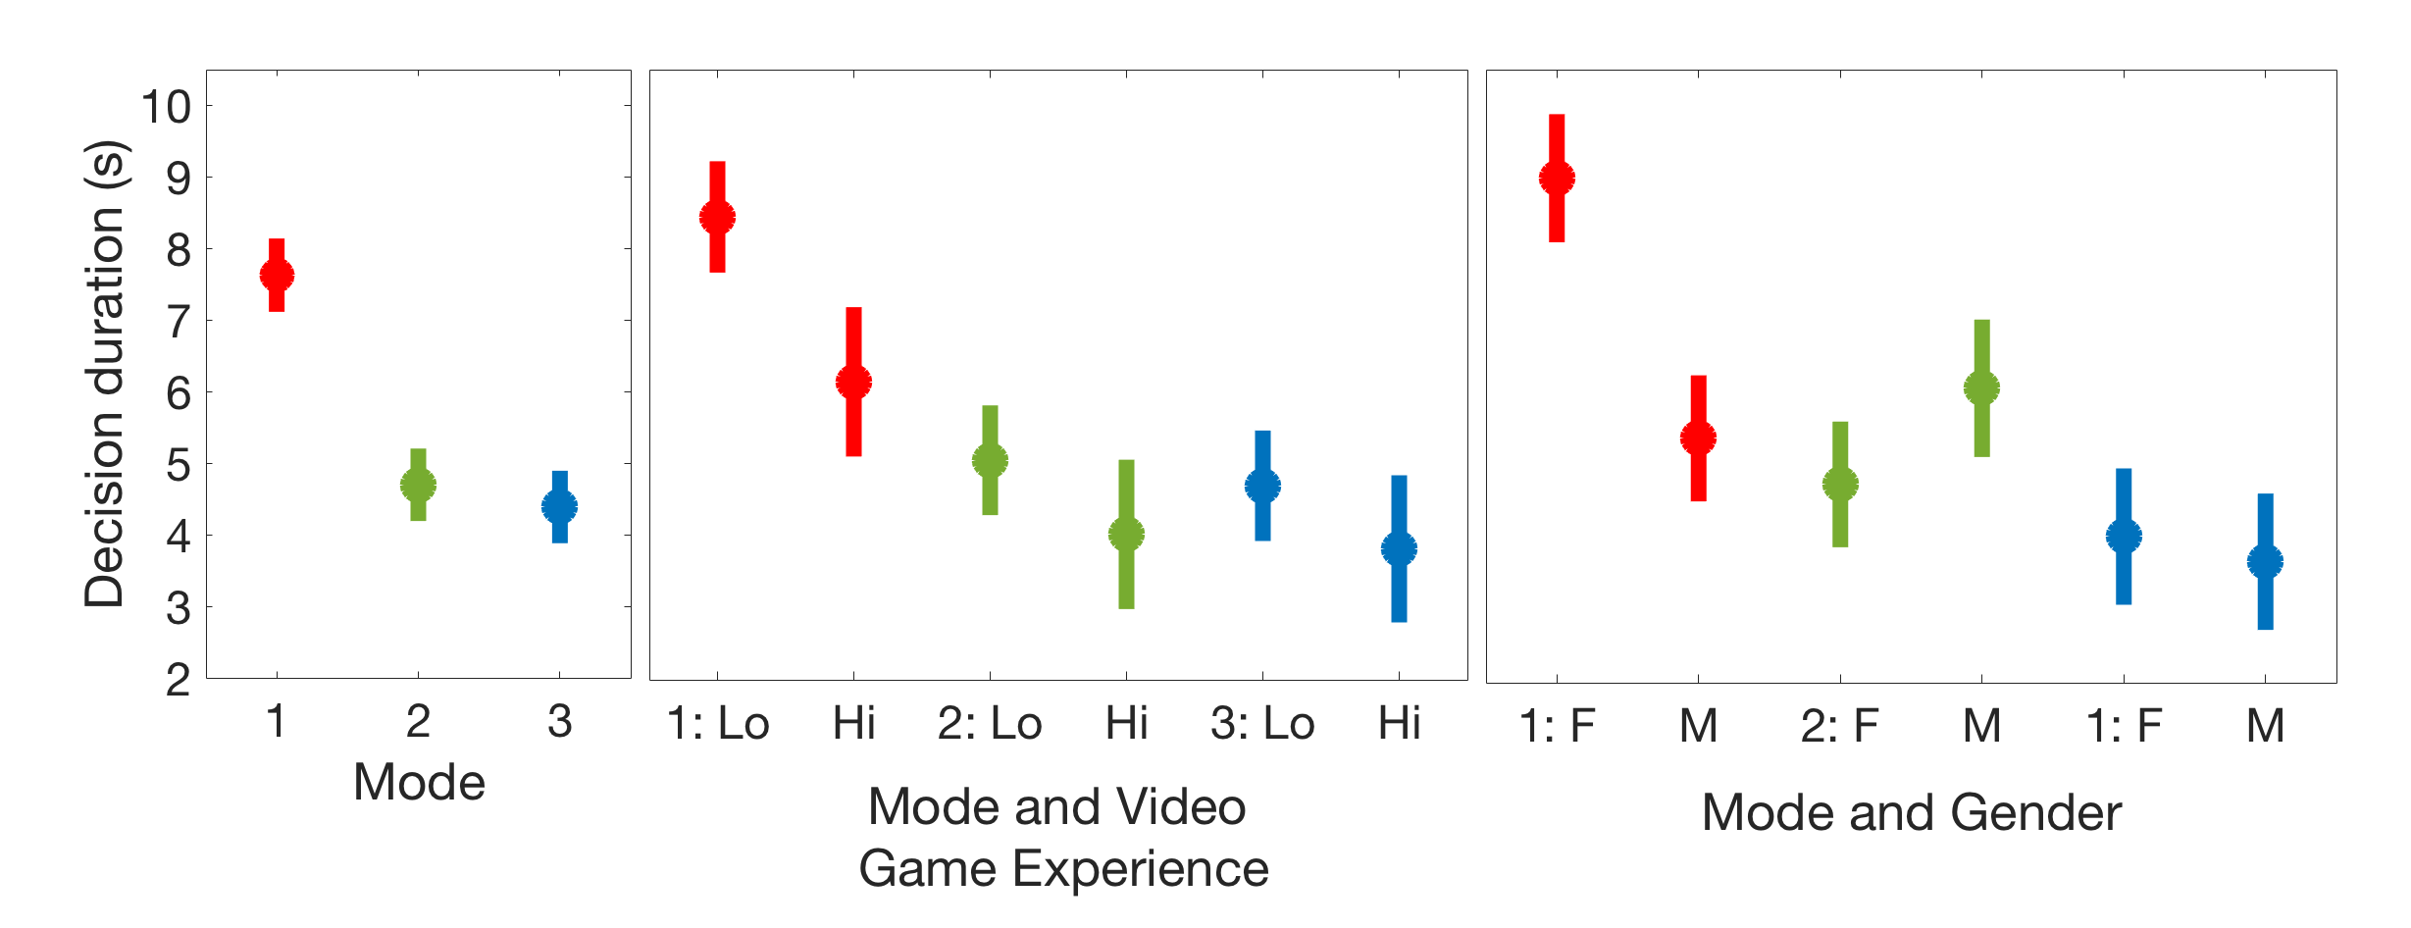
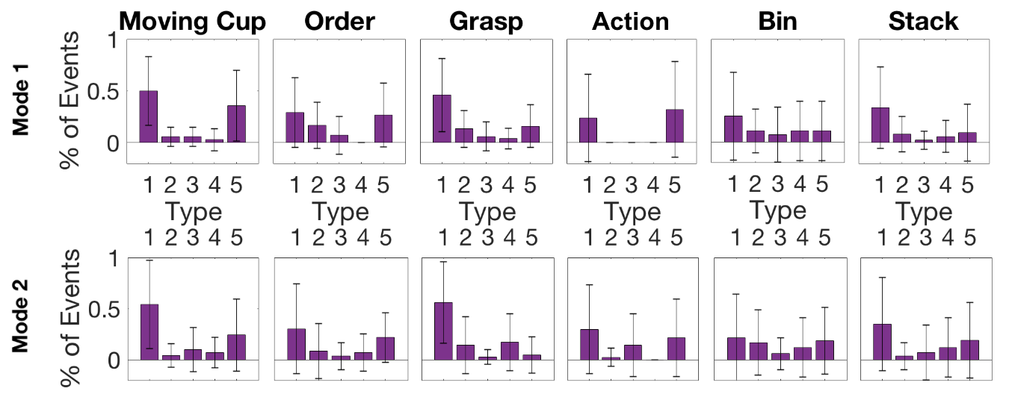
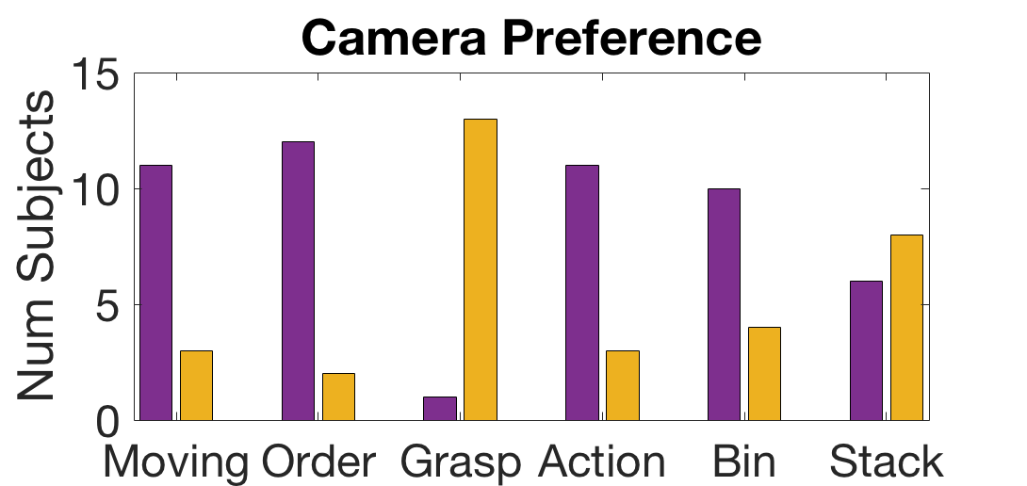
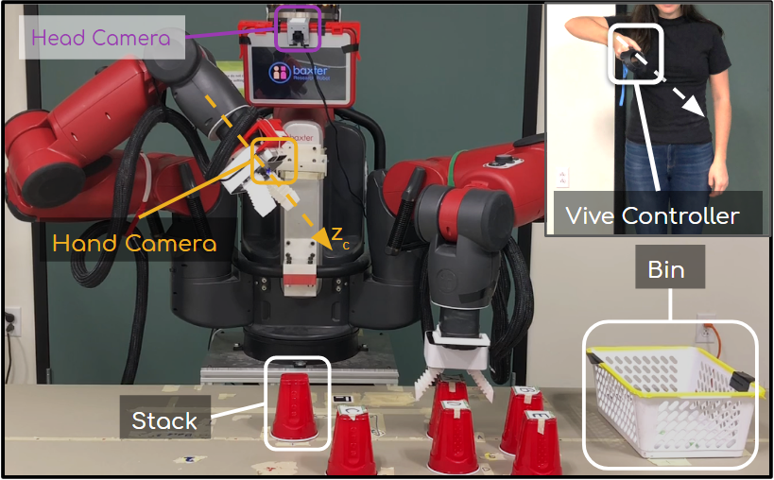
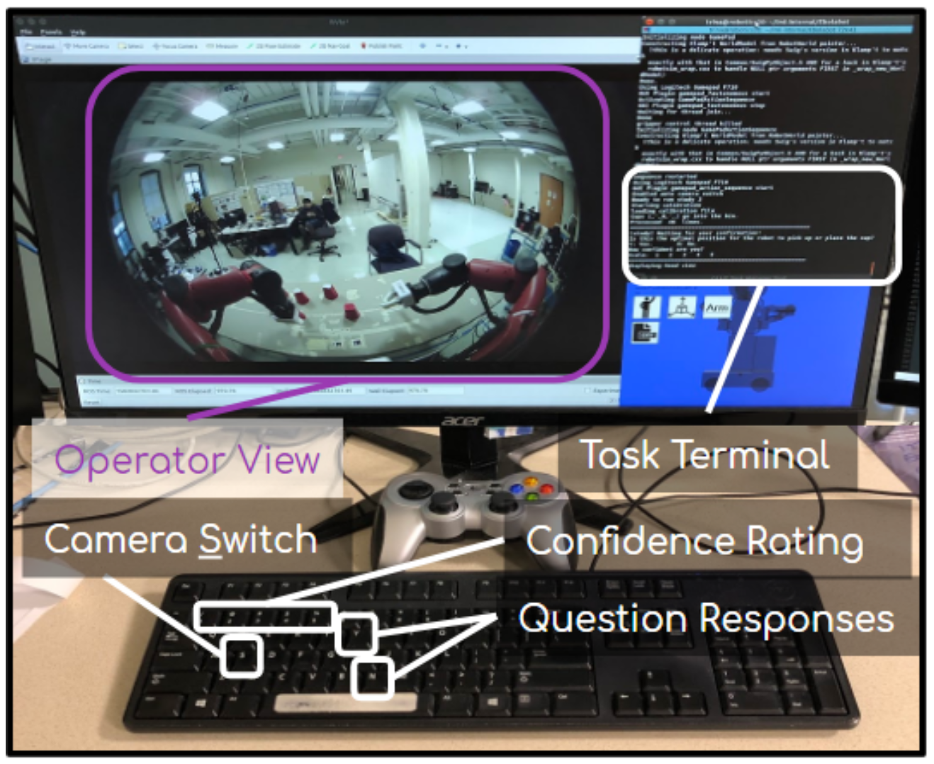
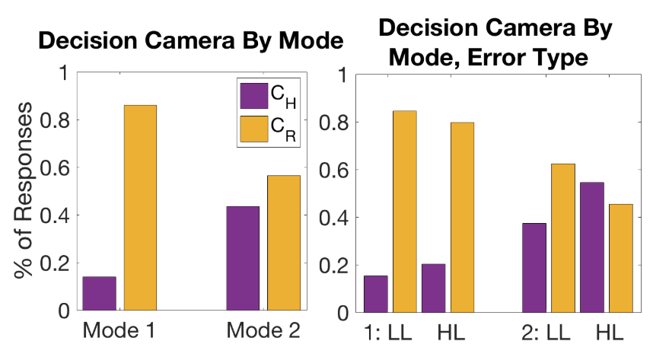
Active Telepresence Assistance for Supervisory Control:
A User Study with a Multi-Camera Tele-Nursing Robot
Undergraduate Researchers: Hannah Baez (RBE), Naomi Harrison(RBE/ME), Ajay Manohar(ECE), Brandon Navarro(CS), Justine Roy(RBE/ME), Thomas Schweich(CS)
Graduate Researcher: Alexandra Valiton (RBE)
Advisors: Professor Zhi Li (RBE/ME), Professor Carlo Pinciroli(RBE/CS), Professor Maqsood Ali Mughal (ECE)
Abstract
Supervisory control of a humanoid robot requires coordination of remote perception with robot action, which becomes more demanding with multiple moving cameras. This work explores autonomous camera control and selection to reduce operator workload and improve task performance by designing a novel method for autonomous camera selection and control and evaluating the approach in a user study.
We found autonomous camera control does improve task performance and operator experience, but autonomous camera selection requires further investigation.
Experiment
Results
Platform: TRINA is a multi-camera tele-nursing system, including a humanoid torso on an omni-directional base with soft grippers, webcams on each wrist, and a fish-eye camera located on the robot head.
Interface: HTC Vive controls the position and orientation of C_{R} when manual camera control is used. The trigger on the Vive controller or the ‘S’ key on the keyboard toggle the active camera view between C_{H} and C_{R}. Participants view the camera feeds on a computer monitor.
Task: Participants supervise TRINA in a manipulation task to pick up and sort cups into a cup stack or a collection bin. The workspace in front of TRINA contained five cups (lettered A-E), a plastic bin, and a stacking point with a base cup. TRINA should pick up the cups in alphabetical order and place some in the stack and some in the bin. The order of handling the cups does not change, but the cups destined for the bin or the stack are randomized at each trial and revealed to the participant at the beginning of the trial.
Task Sequence and Errors: The actions needed to accomplish this manipulation task form the task sequence, which is executed autonomously by the robot. The task sequence also included a random selection of high-level and low-level error positions.
Experimental Conditions: Each participant completed the task three times in three different remote perception modes. Each mode contains a different
Task Performance:
Autonomous camera control has a significant effect on decision duration, and mitigates the impacts of gender and video game experience (which are highly correlated) on both decision duration and task accuracy. Autonomous camera selection shows no significant impact on task performance.
Background
Camera Usage:
We labeled camera usage in two ways: the active camera at response time and camera selection behavior. Type 1 behavior means the participant uses C_{H} less than 20% of the decision time, while Type 5 usage means the participant uses C_{H} more than 80% of the decision time. Camera selection is inconsistent with declared preference, an inconsistent between Mode 1 and Mode 2 (manual vs. autonomous camera control)
Nursing is a critical role in society, but demand is expected to exceed the supply
Semi-autonomous nursing robots could supplement the nurse workforce for both quarantine and routine patient care.
Direct teleoperation is complex and challenging; supervisory control improves task performance, reduces workload, and lets a single human operator supervise multiple robots.
Robot autonomy may be unreliable due to perception limitations or task uncertainty, so appropriate active telepresence control is critical to maintaining operator situational awareness.
Remote perception is a challenge involving limited field of view, unfamiliar frame of reference, multiple camera perspectives, and lack of depth perception.
Results from Survey:
Mode 3 significantly reduces participants’ trust in autonomy
Mental demand, physical demand, and effort are significantly higher in Mode 1 than in Modes 2 and 3
Confidence in error detection accuracy was significantly lower in Mode 3 than in Modes 1, 2
Sustainability
combination of camera selection and camera control autonomy and were randomly ordered.
Our project addresses the need for the increased protection of our healthcare workers in potentially hazardous scenarios and the current societal demand for nursing staff while also aiding in our ability to meet the healthcare needs of future generations.
“Nursing: Supply and Demand through 2020.” CEW Georgetown, 21 May 2018, cew.georgetown.edu/cew-reports/nursingprojections/.
Proposed Design of Telepresence Assistance
Conclusion and Recommendations
Robot Autonomy for Camera selection:
Use the robot head camera (C_{H} ) to observe large robot motions and spatial relationships
Use the robot right hand camera (C_{R}) to observe precise motions and local task features
Robot Autonomy for Camera Control:
Adopts an autonomous dynamic camera control framework which selects the optimal robot arm configuration based on a weighted sum of objectives:
Look at Hand - Minimize the distance between the manipulator (left) hand and the camera z-axis.
Camera Roll - Keep the camera view gravity-referenced.
Camera Height - Match the height of C_{H}.
Viewing Distance - Keep the distance from the camera to the manipulation hand close to an empirically-determined ideal.
Side View - Select view that are perpendicular to head camera view.
TRINA platform, including C_{H} and C_{R}, with cups A-E, stack, and bin. Inset: HTC Vive control of right (camera) arm, available only in Mode 1. Participants respond to TRINA’s questions about grasp and placement positions in the Task Terminal.
Autonomous camera control significantly improved supervisory task performance and reduced workload
Autonomous camera selection policy decreased operator awareness of the task status and trust in the autonomy.
Manual camera control required significant physical and mental effort; offloading that burden to an effective autonomous camera controller significantly improved task performance and eliminated differences between participants with and without video game experience.
Based on this study, we present the following design guidelines for supervisory control system design:
2-3 cameras provide a sufficient view of the task space without overwhelming the operator.
Cameras that can be manipulated to change perspective should be automated to reduce the operator’s workload
If the active camera view is switched automatically, the operator should be able to override the action easily.
Examples of errors that may be introduced to the manipulation task sequence, executed by the autonomous camera controller. A: Placement Error (bin), B: Placement Error (stack), C: Grasp Error

