Slide 1
Valorization of poultry feathers via subcritical water hydrolysis
By: donna MURILLO

Slide 2
The poultry industry in brazil
The poultry industry makes up about 1.5 % of the nation’s Gross Domestic Product, and employs more than 3.6 million people
Brazil is the world’s 3rd largest poultry manufacturer accounting for about a 1/3 of the world’s poultry
Feather disposal has led to high farmer mortality rates of 0.25 % per day
Normal biomass removal methods had led to many environmental problems
Notes:
Define what biomass is here
Globally, the poultry industry produces about 1 million tons of poultry feathers (Cheng et al., 2007).

Slide 3
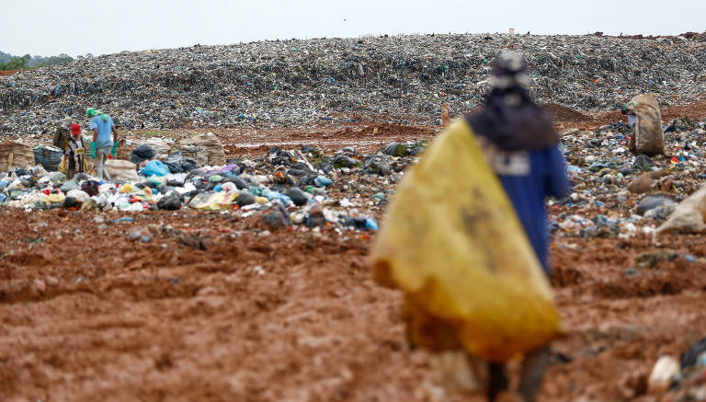
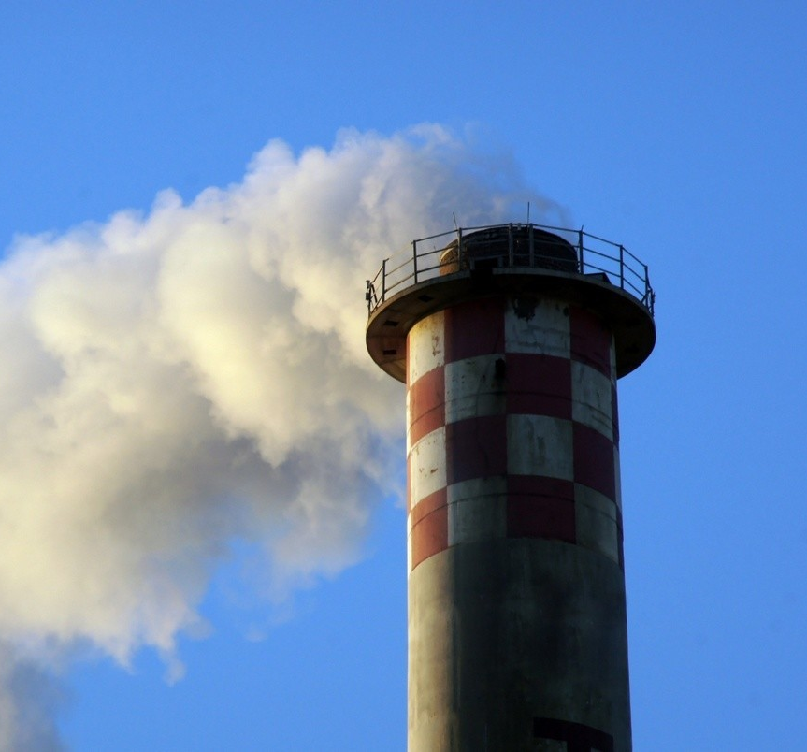
The biomass removal process
Biomass is usually disposed of by landfill removal or incineration
Incinerators are the leading source of dioxin into the global environment
78 % of people living closer to landfills indicated serious contamination of air quality
Subcritical water hydrolysis offers a safer method of waste disposal
Notes:
Incineration experts generally state that to have an economically viable operation, it is required to have an incinerator that burns at least 1000 tonnes of garbage each day. The cost to build such a facility is approximately $100 million. Operating costs to maintain the equipment, especially the pollution control equipment is also high
According to the United Nations Environment Program (UNEP), incinerators are the leading source of dioxin into the global environment. The EPA, in a recent study, identified dioxins as the cause of many cancers.
78% of participants living closer to the landfill site indicated serious contamination of air quality evident from bad odors linked to the landfill site (in south Africa)
Landfills are a major contributor to the world’s anthropogenic greenhouse gas (GHG) emissions because an enormous amount of CH4 and CO2 are generated from the degradation process of deposited waste in landfills

Slide 4
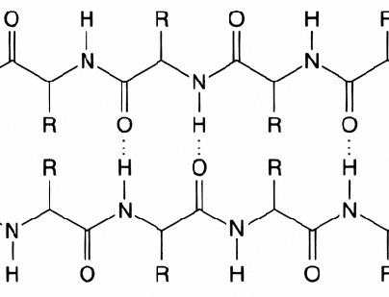
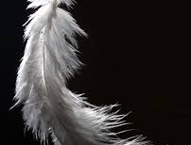
POULTRY FEATHER COMPOSITION
Chicken feathers are about 92% crude protein
Poultry feathers are made up of 35-40 protein residues
Feathers are made up of beta-keratins
Notes:
This is due to the extremely high protein content within the feather, which is about 82% crude protein (Tesfaye et al., 2017).

Slide 5
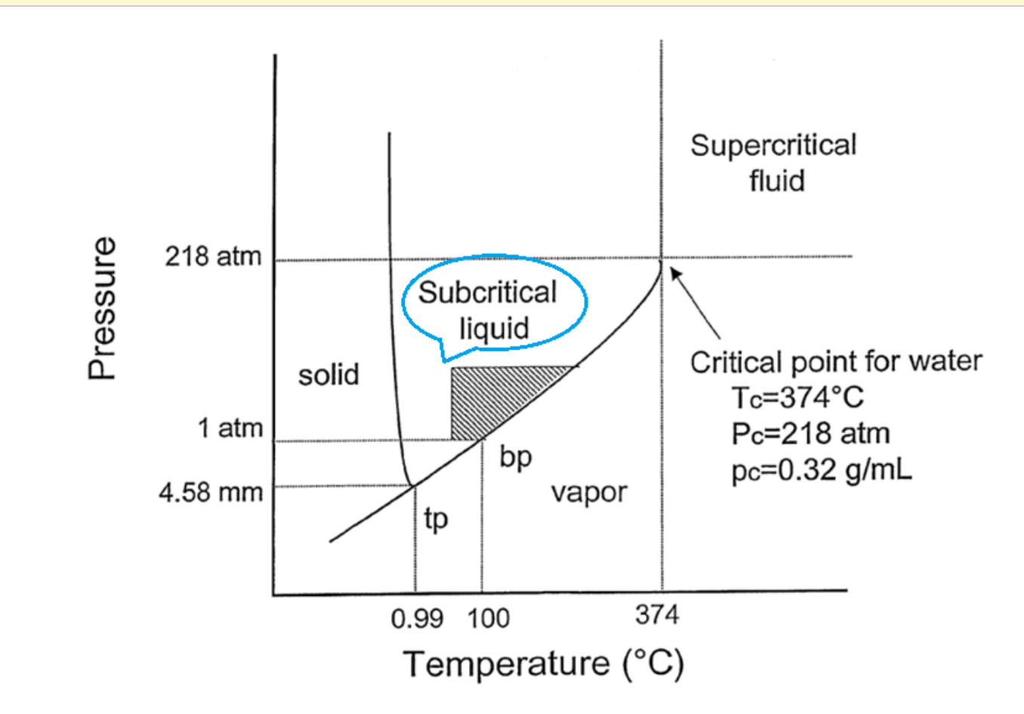
subcritical water TECHNOLOGY
Subcritical water hydrolysis is a great way to convert organic material into high-value amino acids
Subcritical liquid temperature and pressure range of 100 - 374 C and 1 - 218 atm
Water takes on unique properties within the subcritical range
SWH has many advantages compared to other chemical breakdown methods
Figure 1. Phases of water at different pressures and temperatures
Notes:
Hydrolysis chemical breakdown of a compound due to reaction with water. Subcritical refers to the pressure and temperature range of the water.
High density of liquid water held at high temperatures promotes the hydrolysis reactions required for conversion
Unique Properties of SWH
- water behaves like a nonpolar solvent and can be used as a clean medium for chemical reactions
- can also be applied in cases of energy and mass transfer due to the fluctuations in density and low dielectric properties
- the iconic content of subcritical water is approximately 1000x more than standard water, suggests that acidic and alkaline catalysts can be applied to the subcritical fluid.
Advantages
- requires minimal biomass pretreatment
- generates less waste
- requires shorter reaction times
- has fewer corrosion problems
- requires no toxic or expensive solvents
Clean technology;
+ Does not use dangerous solvents;
+ Ability to dissolve polar and non-polar molecules;
=
HIGH CATALYTIC CAPACITY WITHOUT GENERATING ENVIRONMENTAL LIABILITIES

Slide 6
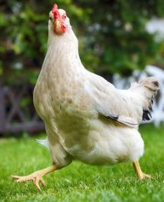
THE ECONOMIC CASE FOR AMINO ACIDS
1 million tons of poultry feathers produced per year
924,000 tons of protein
770,00 tons of available amino acids
17 trillion kgs of animal feed used per year
Amino acids can replaced 0.42% of total animal feed
The cost of animal feed is 48 billion per year
The substitution of amino acids can save up to 200 million per year
Notes:
Research has shown that chicken feathers are anywhere from 80-90% protein, which indicates a high amount of amino acids that can be extracted for commercial purposes. Some of these amino acids include glutamine, cysteine, and serine. Amino acids can be applied to the pharmaceutical industry, the farming industry as a nutritional additive for farm meal and many other applications.
Saravanan and Dhurai, 2012
(Ramakrishnan et al., 2011).
Poultry feathers are abundant in amino acids
Amino acids have a high value and variable applications
SWH is a clean way of achieving AAs

Slide 7
Project experimental FLOW
Hydrolysis
Hydrolysate Analysis
Characterization Studies
Amino Acid Analysis
Notes:
Characterization Studies
1. total solids
2. volatile solids
3. Total nitrogen
**have yet to do SN or COD on the raw feathers themselves
Hydrolysis
1. Objective is to test out different temperatures as well as different flowrates in order to determine the best conditions at which subcritical water hydrolysis works best at producing high amounts of protein residues.
Hydrolysate Analysis
1. Total nitrogen
2. SN
3. COD
The Amino Acid analysis portion will be conducted in a lab in Denmark by professor solange.

Slide 8
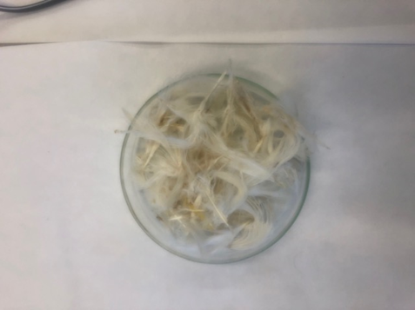
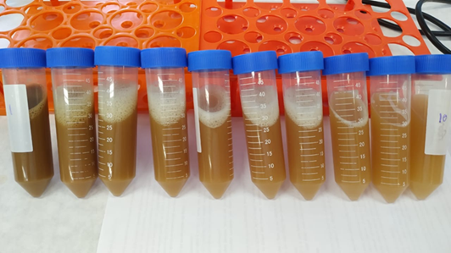
Our subcritical water hydrolysis system
Natural Feathers
Reactor Pressure Gauge
Temperature 1 Indicator
Temperature 2 Indicator
Reactor
Deionized Water
Heat Exchanger
Cooling Water
Hydrolysate
Hydrolysate
HPLC Pump
Notes:
Notes on how this works – Refer to Notebook

Slide 9
HYDROLYSIS experimental design
Notes:
In order to avoid the amino acid degradation from happening we operated at temperatures between 210-250 C at a moderate pressure and flowrate of 15 Mpa 10 mL/min, respectively.

Slide 10
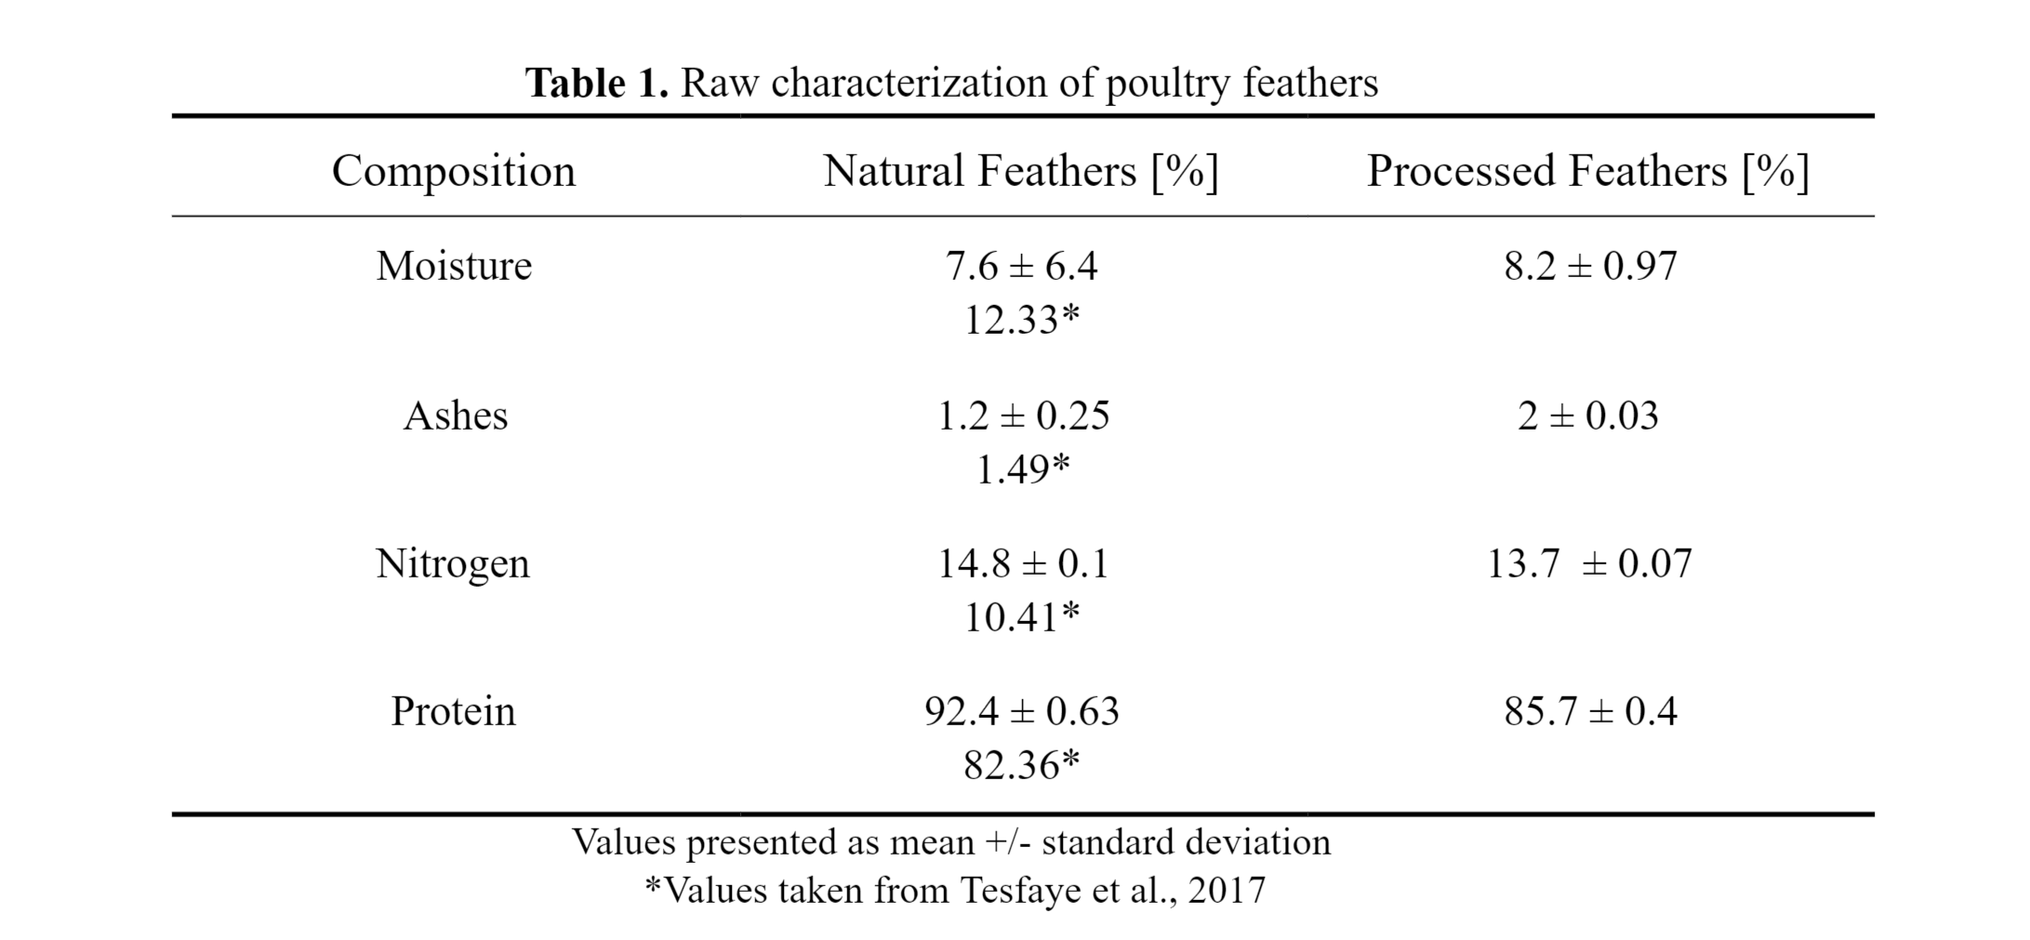
POULTRY FEATHER INITIAL TESTS
Notes:
Some characterization tests that were done on the natural and processed feathers include total solids and volatile testing, total nitrogen testing using the Khjedahl method, which is also how we found the protein content.

Slide 11
System heat transfer
Figure 2. Reactor heat transfer of first six runs (right) and last three runs (left).
Notes:
The graph on the right is the first initial 3 runs and the graph on the left are the most recent runs

Slide 12
Total nitrogen
Figure 3. Nitrogen recovery of the hydrolysates
Notes:
The percent of nitrogen recovered from the initial 10 g of feathers put in at each of the 8 collection points. Over the course of the approx. 32. minute run, 8 falcon tubes were filled with hydrolysate and tested on for total nitrogen. Not all of the nitrogen can be explained for with the presence of amino acids as we conducted a total nitrogen test, which also includes ammonical nitrogen. It can be seen that as time continutes the nitrogen from the raw feathers gets more and more depleted, suggesting that perhaps a shorter retention time might be more well-suited for the experiment.

Slide 13
Total nitrogen Accumulation
Figure 4. Total nitrogen accumulation during hydrolysis
Notes:
So in the end of the hydrolysis runs we were able to recover about 17% of nitrogen at 210 and 13% nitrogen at 230 C. This is a fairly good amount, especially considering the equipment that was used was not in brand new condition.
Though this is shown in percent nitrogen recovered, it is also important to note that the hydrolysis run at 210 C was able to recover about 81% of the protein in the raw feathers, while the run at 230 recovered a little over half at about 53%. This equates to a hydrolysate with about 8g of protein versus with about 5g of protein. Suggesting that 230 C may be too high to operate the hydrolysis technology.

Slide 14
CHEMICAL OXYGEN DEMAND (COD)
Figure 5. Chemical oxygen demand of initial three hydrolysis runs
Notes:
It can be seen that as the hydrolysis process continutes there is a drastic drop in the amount of organic content remaining. This drop happens around the collection 4 point, suggesting that after this point the hydrolysates may not be rich in organic matter such as amino acids. Furthermore, the 250 C run did have the highest overall organic matter content for the first 4 points, however after this point the three temperatures had very similar DQO values. The organic matter does not necessarily inidicate amino acid content. Having high DQO values does not mean that the hydrolsayte is abundant in amino acids, however having extremely low chemical oxygen demand does suggest the absence of amino acids.

Slide 15
Nelson-Somogyi
Figure 6. Total amount of sugar formed at the end of hydrolysis.
Notes:
Nelson-Somogyi testing was done just as a precautionary measure to ensure that the raw feathers used were in fact low in carbohydrate content. It can be seen that the final product of hydrolysates over the course of the run never reaches more than 2% sugar, which is what is expected from an organic substance that is around 90% protein.

Slide 16
Literature COMPARISON: The effect of temperature
Table 2. Effect of temperature on amino acid yield in biomass waste hydrolysate for 30 min (Cheng et al., 2008).

Slide 17
Literature comparison: The effect of reaction time
Figure 6. Amino acid yield at 5 MPa and 260 C for chicken waste (Cheng et al., 2008).

Slide 18
Conclusions
Temperatures at around 210 C point to optimal nitrogen recovery
Operating times around 10 minutes may prevent the degradation of amino acids
Subcritical water hydrolysis is a functional way of obtaining protein content from poultry feathers

Slide 19
Recommendations
Testing more temperatures lower than 210 C and higher than 250 C
Operating with a wider spectrum of flow rates to better determine the effects of retention time on hydrolysate composition
Additional hydrolysate analysis such as testing for carbon and hydrogen content. As well as using other techniques like Energy dispersive X-RAY and FESM Analysis
Notes:
Energy Dispersive X-ray analysis would aid in obtaining a more detailed elemental composition of the hydrolyzed poultry feathers. Likewise, a Field Emission Scanning Microscope (FESM) could be implemented to observe the hydrolyzed poultry feathers microstructures before and after hydrolysis.

Slide 20
References
ABPA Brazilian Chicken Background . http://www.brazilianchicken.com.br/en/poultry-industry/background.
Cheng, H.; Zhu, C.; Zhu, X.; Zhu, N.; Qian, J.; Zhao, L.; Chen, J. Hydrolysis technology of biomass waste to produce amino acids in subcritical water. Bioresource Technology 2008, 99, 3337-3341.
Environmental Protection Agency Landfill Methane Outreach Program (LMOP). https://www.epa.gov/lmop/basic-information-about-landfill-gas.
Lachos-Perez, D.; Martinez-Jimenez, F.; Rezende, C. A.; Tompsett, G.; Timko, M.; Forster-Carneiro, T. Subcritical water hydrolysis of sugarcane bagasse: An approach on solid residues characterization. The Journal of Supercritical Fluids 2016, 108, 69-78.
Negative Impacts of Incineration-based Waste-to-Energy Technology. https://www.alternative-energy-news.info/negative-impacts-waste-to-energy/.
Njoku, P. O.; Edokpayi, J. N.; Odiyo, J. O. Health and Environmental Risks of Residents Living Close to a Landfill: A Case Study of Thohoyandou Landfill, Limpopo Province, South Africa. International journal of environmental research and public health 2019, 16, 2125.
Ramakrishnan, J.; Balakrishnan, H.; Raja, S. T. K.; Sundararamakrishnan, N.; Renganathan, S.; Radha, V. N. Formulation of economical microbial feed using degraded chicken feathers by a novel Streptomyces sp: mitigation of environmental pollution. Brazilian journal of microbiology : [publication of the Brazilian Society for Microbiology] 2011, 42, 825-834.
Saravanan, K.; Dhurai, B. Exploration on the amino acid content and morphological structure in chicken feather fiber. Journal of Textile and Apparel, Technology and Management 2012, 7.
Tesfaye, T.; Sithole, B.; Ramjugernath, D.; Chunilall, V. Valorisation of chicken feathers: characterisation of chemical properties. Waste Manage. 2017b, 68, 626-635.
Tu, Y.; Huang, J.; Xu, P.; Wu, X.; Yang, L.; Peng, Z. Subcritical Water Hydrolysis Treatment. BioResources 2016.
World Health Organization Dioxins and their effects on human health. https://www.who.int/news-room/fact-sheets/detail/dioxins-and-their-effects-on-human-health.

Slide 21
A special thank you to…
Professor Timko
Professor Forster-Carneiro
Everyone in the UNICAMP BIOCHAR Lab!!
WPI IGSD & CHE Faculty

