Slide 1
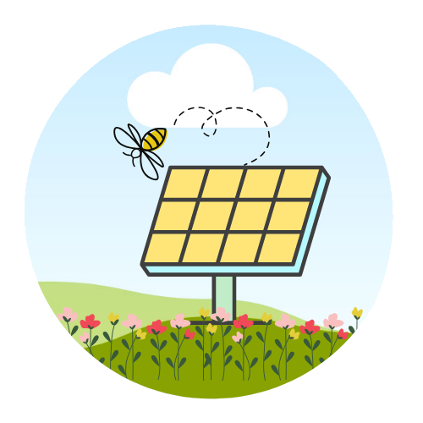
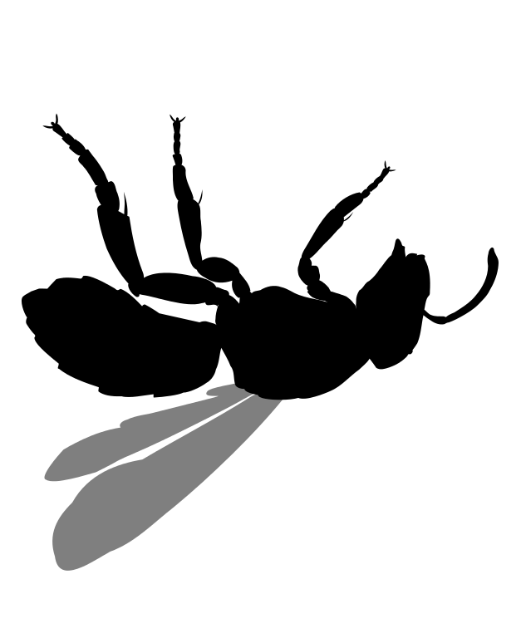
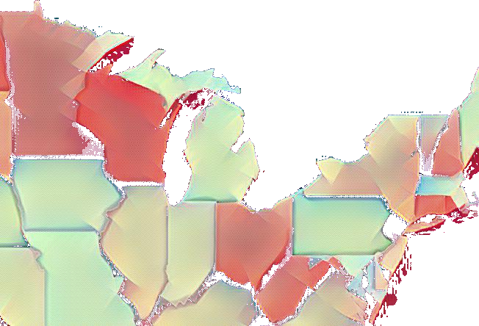
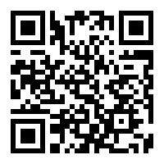
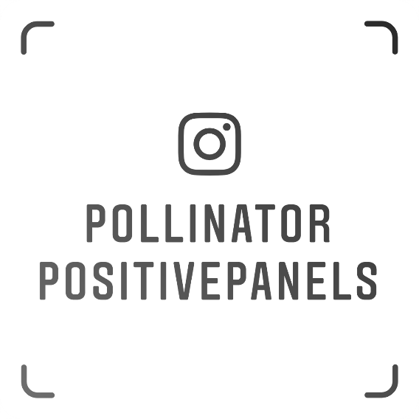
Pollinator Positive Panels
Emma Pruitt, Megan Hanlon, Daniel Zhao
Advisors: Dr. Geoff Pfeifer, Dr. Derren Rosbach
1
of the world’s food production is dependent upon pollinators
Problem:
3
Solution:
Benefits:
Implementation:
Rehabilitate the populations of threatened native pollinators affected by habitat loss in Massachusetts by integrating pollinator habitat on solar farms
more pollinators visit solar farms with native wildflower
landscaping
Locally establish guidelines
and expectations
similar to
those in
Minnesota
50%
return on investment in the first three years of replanting
Use social media to raise public awareness, interest, and participation
100%
$6.6 billion
have been invested in solar projects in Massachusetts
References
Bee insect drawing [Photograph]. Retrieved from www.needpix.com/photo/23395/bee-insect-drawing-flying-wings-isolated-
honeybee-beekeeping-pollinate
Broussard, M. (2016). Halictus rubicundus silhouette [Photograph]. Retrieved from
en.wikipedia.org/wiki/File:Halictus_rubicundus_silhouette.svg
Dandelion plant weed [Photograph]. Retrieved from www.needpix.com/photo/29951/dandelion-plant-weed-edible-flowers-leaves-
stems-yellow-flowers-flowering
Davis, R. (2016, March 17). Green landscapes on solar sites-an enormous business opportunity. Retrieved from
www.ecolandscaping.org/03/designing-ecological-landscapes/native-plants/green-landscapes-on-solar-sites-an-enormous-
business-opportunity
Montag, H., Parker, G., & Clarkson, T. (2016). The effects of solar farms on local biodiversity: a comparative study. Clarkson &
Woods and Wychwood Biodiversity. doi: 978-1-5262-0223-9
Semeraro, T., Pomes, A., Del Giudice, C., Negro, D., & Aretano, R. (2018). Planning ground based utility scale solar energy as green
infrastructure to enhance ecosystem services. Energy Policy, 117, 218–227. doi.org/10.1016/j.enpol.2018.01.050
Silver, C. (2019, June 30). Massachusetts solar. Retrieved from www.seia.org/state-solar-policy/massachusetts-solar
Solar Field Meadow Energy [Photograph]. Retrieved from pixabay.com/photos/solar-field-meadow-energy-current-3381073
USA map PNG [Photograph]. Retrieved from pngimg.com/download/46479
pollinatorpositivepanels.com
@pollinatorpositivepanels

