Slide 1
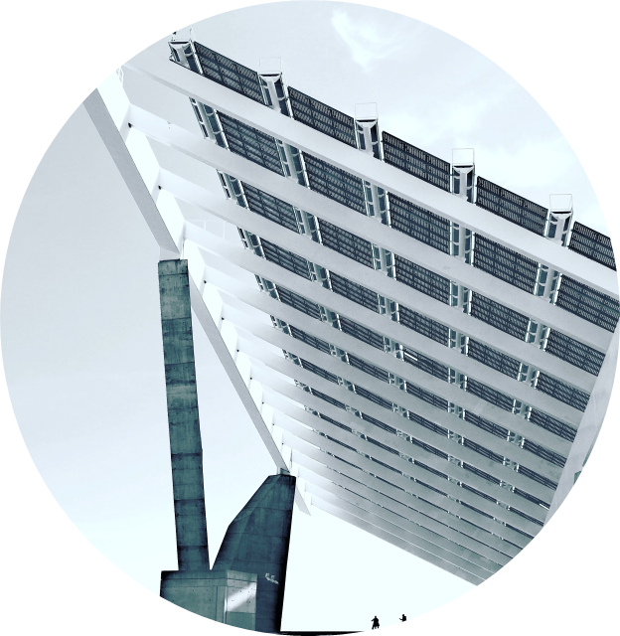
Silicon Epitaxy by Molten Salt Electrolysis
Sarat Buasai, Alexander McMahon, Yi Jie Wu
Advisors: Adam C. Powell, N. Aaron Deskins, Walter Towner

Slide 2
01
04
Background
Results and Discussion
02
05
Project Goal
Conclusion
03
06
Methods
Acknowledgement

Slide 3
Background

Slide 4
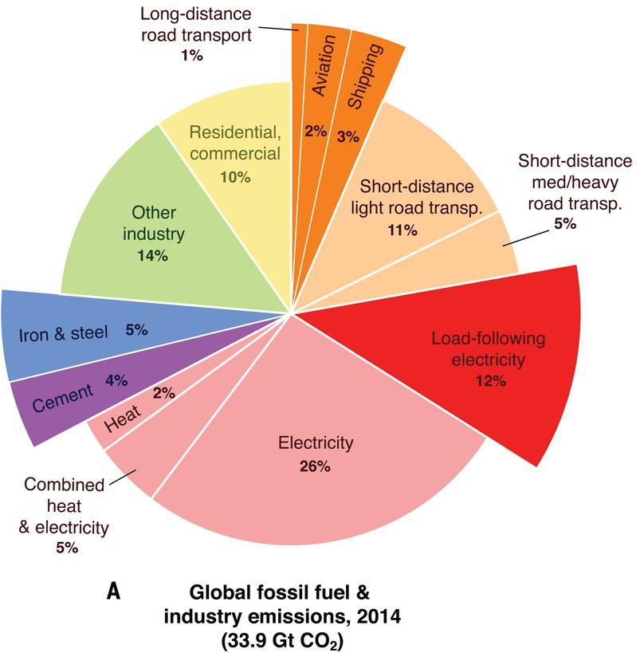
Background
Main Problem
Reduction of greenhouse gases emission
Reforming the Solar Silicon Production process
Davis et al., Science 360:1419 (2018)

Slide 5
State of Solar Silicon
Prices surged between 2005 and 2008
Predictions of increase in Solar Silicon Demand
Jacobson Scenario: 100% Sustainable energy by 2050, 58% solar
Bloomberg New Energy Finance: 48% Sustainable, 24% Solar
Del Norske Veritas and Germanischer Lloyd: 50% Sustainable Energy, 17% Solar
Current silicon production capacity can only support the latter two

Slide 6
Main Production Methods
Metallurgical Pathways
Siemens Process
Silane Pyrolysis
Main Method
Produces 90% of Solar Silicon
Purest Product
Alternative
Near Similar to Siemens
Direct refinement of MG-Si to Solar Silicon
Most Sustainable

Slide 7
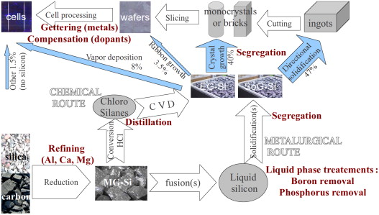
Silicon Production
Molten Salt Electrolysis - Inert Anode
Electrorefining
Image source: Y. Delannoy, J. Cryst. Growth 360:61-67 (2012)

Slide 8
Molten Salt Electrolysis (MSE)
The Process
Combination of salts heated in a furnace
Electric current passed through molten slurry from cathode to anode
Deposition of metal experienced at the cathode
Oxygen produced at anode
Benefits
No CO₂ emissions
Ultra-pure product

Slide 9
State of MSE Research
Chloride and/or fluoride baths
Various starting materials
Low and high purity
0.4V - 2V systems
Current densities of 0.15-0.20A/cm²
Multiple purity levels obtained
Thin film and crystalline silicon products

Slide 10
A Potential Solution
Bath Composition
MgF₂-CaF₂-CaO₂-YF₃-SiO₂
Starting Material
High Purity Quartzite (SiO₂)
Electrical Input
100kA Cell
4.5V
Product Purity
0.1ppm Al
0.02ppm B
Current Density
0.47A/cm² at the Anode
0.25A/cm² at the Cathode
Product Form
Crystalline Si
Cut from Cathode

Slide 11
Research Question
Analyze the process of solar grade silicon production from MgF₂-CaF₂-YF₃-CaO-SiO₂ bath molten salt electrolysis by completing the mass and energy balances of the process, determining the technological feasibility by constructing a prototype cell using various programs and performing Finite Element Analysis, and ascertaining the economic feasibility by performing a cost analysis.

Slide 12
Project Goals
Goal 1
Goal 2
Determine the technological feasibility of manufacturing solar grade Silicon through Molten Salt Electrolysis
Ascertain the economical practicality of scaling up the process

Slide 13
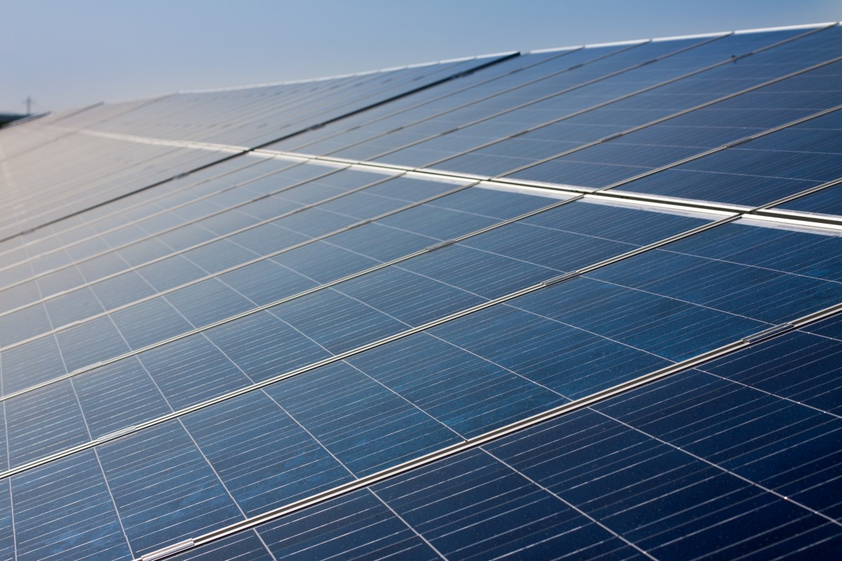
Methods

Slide 14
Methods
Mass and Energy Balance
Axiomatic Design
CAD Cell Design
Finite Element Analysis
Cost Modeling

Slide 15
Mass and Energy Balance
Mass Balance
Energy Balance
Development of PFD
Calculate the production rate
Rate of O₂ dispersion
Calculate heat loss, dissociation potential, overpotential

Slide 16
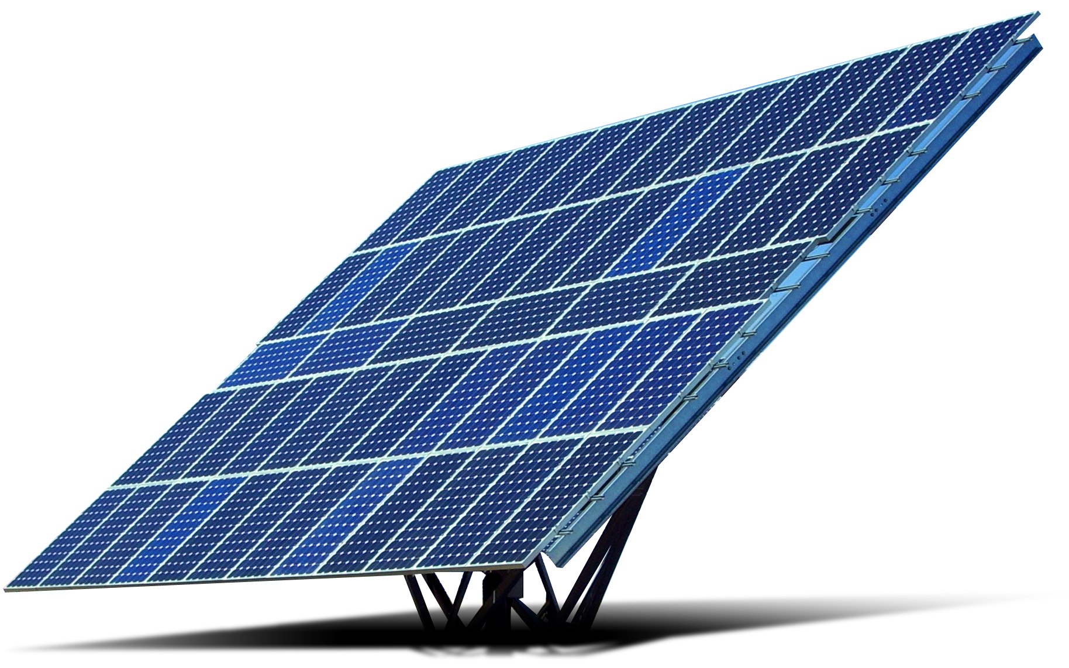
Cell Design and Modeling
Axiomatic Design
CAD Modeling
Finite Element Analysis
Decomposition of cell design for ease of understanding
Generation of potential electrolysis cell design, based on electronic needs of the system
Mesh development and analysis with software

Slide 17
Cost Modeling
Determine the financial viability of the plant
Consulted senior process potline engineer at Century Aluminum
Gained information on production, labour and construction

Slide 18
Results and Discussion

Slide 19
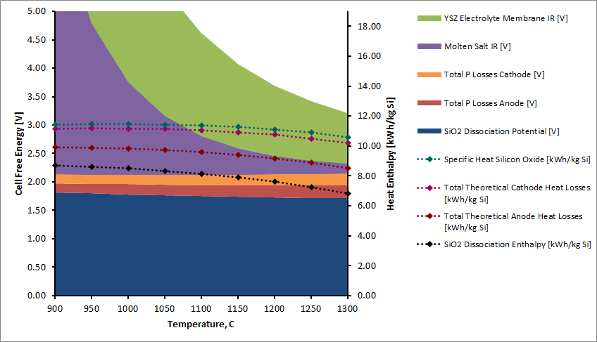
Energy Balance

Slide 20
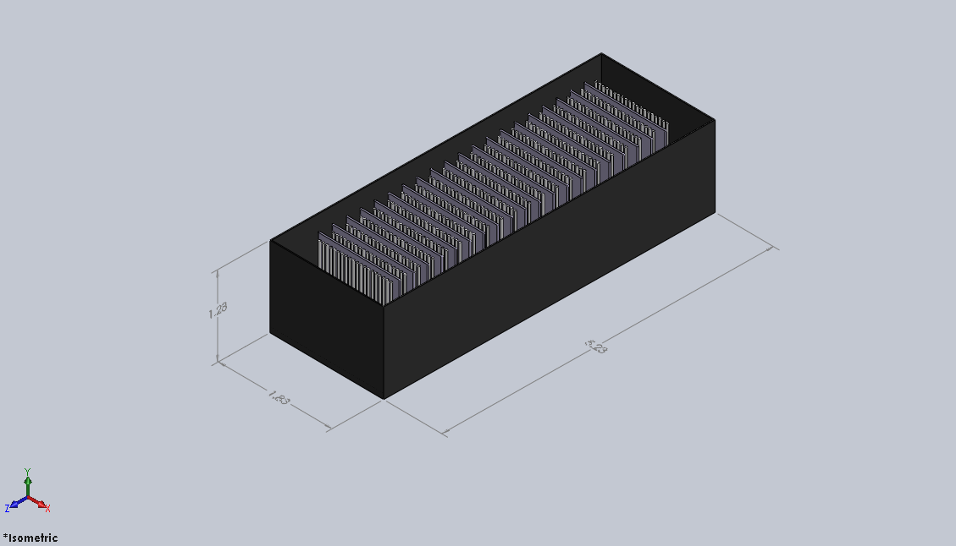
CAD Model - Preliminary 100kA Cell
100 kA Current Bus
20 slab cathodes
1.4m x 0.7m x 0.02m
420 Cylindrical Anodes
21x20 array
0.03m radius
52cm cylindrical height
Cell Footprint
10.3m²
Similar to existing Hall Heroult cells

Slide 21
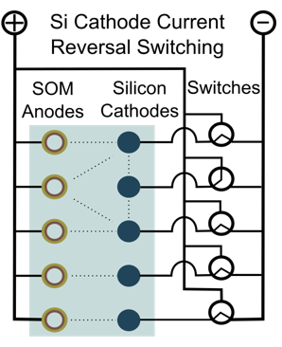
Preliminary Cell Modeling
Partial exploded view of electrodes
Switching setup
Slab cathode cell schematic
All cell renderings done in SolidWorks

Slide 22
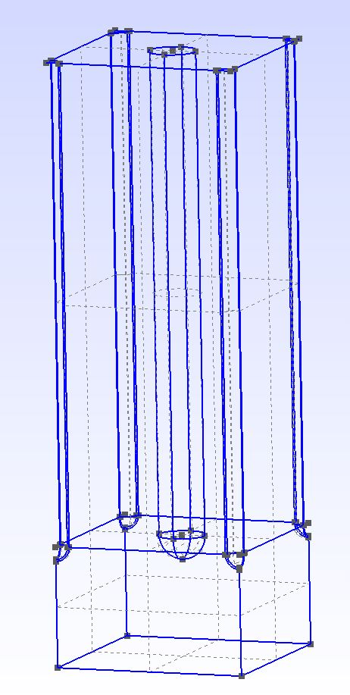
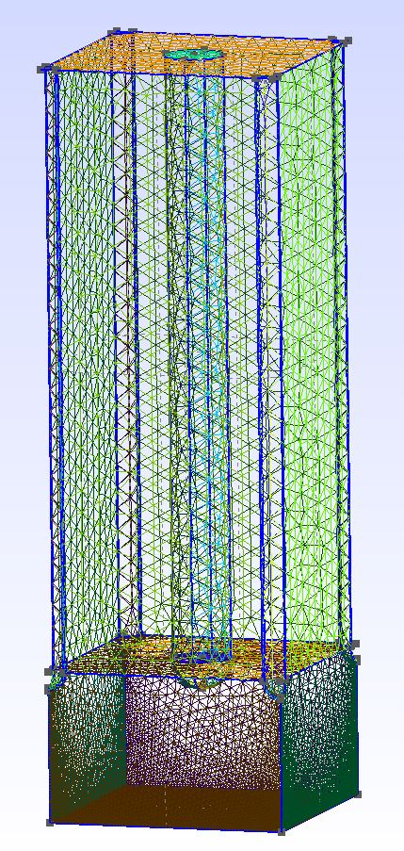
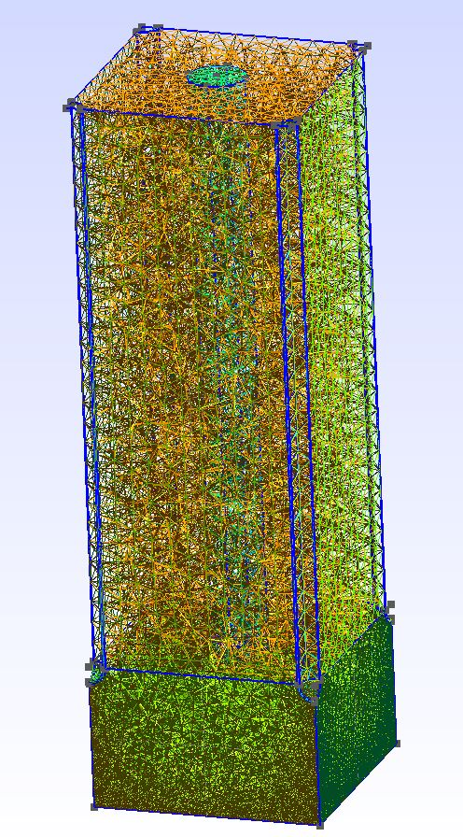
Theoretical Cell Modeling

Slide 23
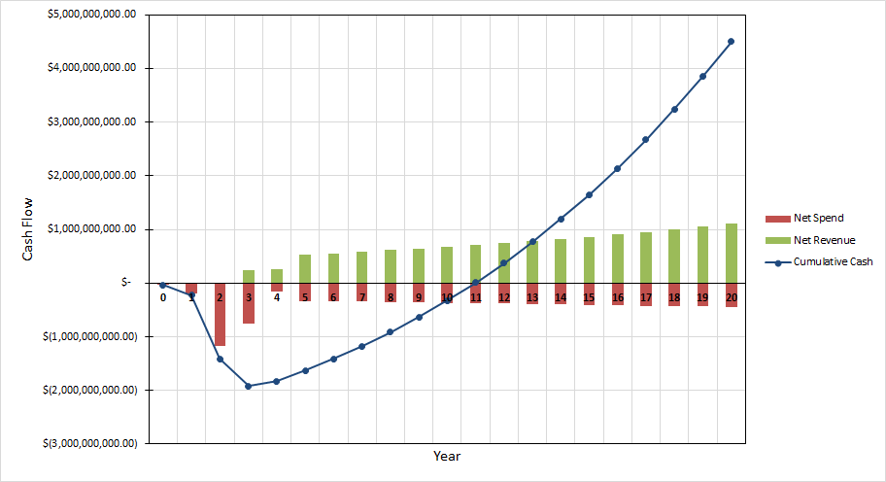
Cost Analysis: Cash Flow Diagram

Slide 24
Cost Analysis
Silicon Price: $3.0 per kg Si
Current Average Price: $14-15 per kg Si
Fixed Capital Investment: 2 Billion Dollars
Operating Cost: $1.6 per kg Si
Market Increase: 5% per year
Operating Cost Increase: 2% per year
Break Even Period: 11 Years

Slide 25
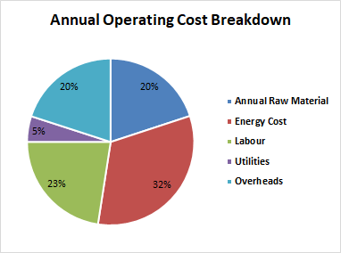
Cost Analysis
Scale Up Analysis compared to Century Aluminum Production Plant
Energy Intensive: Can be Operated Solely on Renewable Energy
No CO2 Emission
Reduced the Silicon price by 55%

Slide 26
Conclusion
Conclusion
Energy-intensive
Can be scaled up with a break even period of 11 years
Cost of Silicon Product can be cut by 55%
High annual operating cost, energy being the biggest factor
Future Work
Thorough Experimentation
More Variety in Molten Salt Cell Design
Additional Modeling with Magneto Hydro Dynamics

Slide 27
Acknowledgements
Adam C. Powell
Associate Professor, Mechanical Engineering, WPI
Walter Towner
Associate Teaching Professor, Industrial Engineering, WPI
N. Aaron Deskins
Associate Professor, Chemical Engineering, WPI
Uday Pal and his Research Group
Professor, Mechanical Engineering, Boston University
Christopher Ritter
Senior Process Potline Engineer, Century Aluminum
Aditya Moudgal
PHD Student, Mechanical Engineering, WPI
Mohammad Asadikiya
Post Doc Student, Mechanical Engineering, WPI

Slide 28
References
Teixeira, L. A. V., & Morita, K. (2009). Removal of Boron from Molten Silicon Using CaO–SiO2 Based Slags. ISIJ International, 49(6), 783–787. doi: 10.2355/isijinternational.49.783
Woditsch, P., & Koch, W. (2002). Solar grade silicon feedstock supply for PV industry. Solar Energy Materials and Solar Cells, 72(1-4), 11–26. doi: 10.1016/s0927-0248(01)00146-5
Bye, G., & Ceccaroli, B. (2014). Solar grade silicon: Technology status and industrial trends. Solar Energy Materials and Solar Cells, 130, 634–646. doi: 10.1016/j.solmat.2014.06.019
J. Guo, T. Villalon, U. Pal, S. Basu, “Effect of Optical Basicity on the Stability of Yttria‐stabilized Zirconia in Contact with Molten Oxy‐fluoride Flux”, J. Am. Ceram. Soc. 101:3605-3616, 2018, DOI: 10.1111/jace.15496
U.S. Department of Energy. (2010). 2008 Solar Technologies Market Report. Energy Efficiency & Renewable Energy.
Jacobson MZ et al (2017) Joule 1:108. https://doi.org/10.1016/j.joule.2017.07.005
Powell, A. C. (2019). Recycling in Supply Chains for Tomorrow’s Low-Carbon Industries. REWAS 2019 The Minerals, Metals & Materials Series, 9–18. doi: 10.1007/978-3-030-10386-6_2
Polysilicon Shortage: Production Solar panels in Danger https://www.betterworldsolutions.eu/rawmaterial-shortage-production-solar-panels-danger/ (accessed Apr 27, 2020)
Yang, X., Ji, L., Zou, X., Lim, T., Zhao, J., Yu, E. T., & Bard, A. J. (2017). Toward Cost-Effective Manufacturing of Silicon Solar Cells: Electrodeposition of High-Quality Si Films in a CaCl2-based Molten Salt. Angewandte Chemie, 129(47), 15274–15278. doi: 10.1002/ange.201707635
Filtvedt, W. O., Holt, A., Javidi, M., Melaaen, M. C., Marstein, E., Ramachandran, P. A., & Tathgar, H. (2010). Development of fluidized bed reactors for silicon production. Solar Energy Materials and Solar Cells, 94(12), 1980–1995. doi: https://doi.org/10.1016/j.solmat.2010.07.027
Ramos, A., Filtvedt, W., Lindholm, D., Ramachandran, P., Rodríguez, A., & Cañizo, C. D. (2015). Deposition reactors for solar grade silicon: A comparative thermal analysis of a Siemens reactor and a fluidized bed reactor. Journal of Crystal Growth, 431, 1–9. doi: 10.1016/j.jcrysgro.2015.08.023
Osborne, M. (2014, January 9). Explosion at Mitsubishi polysilicon plant in Japan causes deaths. PVTECH. Retrieved from https://www.pv-tech.org/news/explosion_at_mitsubishi_polysilicon_plant_in_japan_causes_deaths

Slide 29
References
Safarian, J., Tranell, G., & Tangstad, M. (2012). Processes for Upgrading Metallurgical Grade Silicon to Solar Grade Silicon. Energy Procedia, 20, 88–97. doi: 10.1016/j.egypro.2012.03.011
Morita, K., & Miki, T. (2003). Thermodynamics of solar-grade-silicon refining. Intermetallics, 11(11-12), 1111–1117. doi: 10.1016/s0966-9795(03)00148-1
Li, Y., Wu, J., Ma, W., & Yang, B. (2014). Boron Removal from Metallurgical Grade Silicon using a Refining Technique of Calcium Silicate Molten Slag Containing Potassium Carbonate. Silicon, 7(3), 247–252. doi: 10.1007/s12633-014-9222-2
de Wild-Scholten, M. J., Glockner, R., Odden, J. O., Halvorsen, G., & Tronstad, R. (2008). LCA Comparison of the Elkem Solar Metallurgical Route and Conventional Gas Routes to Solar Silicon.
Silicor Materials: Solar Silicon Manufacturer, San Jose, CA. (n.d.). Retrieved October 8, 2019, from https://www.silicormaterials.com/.
Nichol, S. (2010) United States Patent No. US 007727503B2
Haarberg, G. M. (2015). ELECTROCHEMICAL DEPOSITION OF HIGH PURITY SILICON FROM MOLTEN SALTS. Mediterranean Materials Congress on Energy and Infracstructure.
Dong, Y., Slade, T., Stolt, M. J., Li, L., Girard, S. N., Mai, L., & Jin, S. (2017). Low-Temperature Molten-Salt Production of Silicon Nanowires by the Electrochemical Reduction of CaSiO3. Angewandte Chemie, 129(46), 14645–14649. doi: 10.1002/ange.201707064
Haarberg, G. M., Kato, T., Norikawa, Y., & Nohira, T. (2019). Electrodeposition of Silicon with a Liquid Gallium Cathode in Molten Salts. ECS Transactions, 89(7), 29–35. doi: 10.1149/08907.0029ecst
Ramírez-Márquez, C., Otero, M. V., Vázquez-Castillo, J. A., Martín, M., & Segovia-Hernández, J. G. (2018). Process design and intensification for the production of solar grade silicon. Journal of Cleaner Production, 170, 1579–1593. doi: 10.1016/j.jclepro.2017.09.126
Glockner, R., & de Wild-Scholten, M. (2012). ENERGY PAYBACK TIME AND CARBON FOOTPRINT OF ELKEM SOLAR SILICON.
U.S. Department of Energy. (2010). 2008 Solar Technologies Market Report. Energy Efficiency & Renewable Energy.
Norgate, T., Jahanshahi, S., & Rankin, W. (2007). Assessing the environmental impact of metal production processes. Journal of Cleaner Production, 15(8-9), 838–848. doi: 10.1016/j.jclepro.2006.06.018
Yadav, S.; Chattopadhyay, K.; Singh, C. V. Solar Grade Silicon Production: A Review of Kinetic, Thermodynamic and Fluid Dynamics Based Continuum Scale Modeling. Renewable and Sustainable Energy Reviews 2017, 78, 1288–1314. https://doi.org/10.1016/j.rser.2017.05.019.

