Slide 1
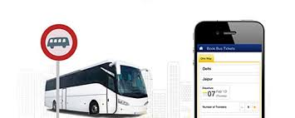
PROJECT: TIKETI RAFIKI
COUNTRY: United Republic of Tanzania
East Africa

Slide 2
FOUNDER: Raymond Magambo
MSc. Information Technology (Student)
Foisie Business School
Worcester Polytechnic Institute (WPI)

Slide 3
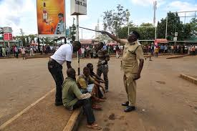
Problem
Currently, 60,000 people take buses daily in Tanzania.
On average they travel 20 km
to buy tickets from booking offices
5% chance of getting robbed.
There are unscrupulous agents who mislead and take advantage of people especially women and children.

Slide 4
Problem
Most of the bus agents are untrustworthy and they’re the ones who receive cash directly from passengers
Laws have failed to stop harassment to passengers in bus stations
Fares are high due to agents’ commission
Overcrowded bus stations are mainly caused by manual booking

Slide 5
QUEUE FOR TICKETS AT BUS BOOKING OFFICES IN TANZANIA

Slide 6
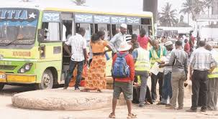
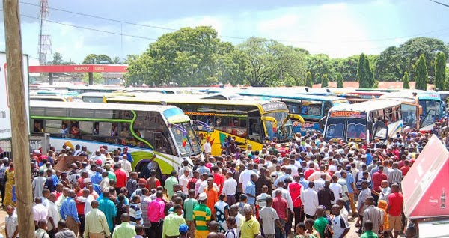
BUYING TICKETS FROM AGENTS AND POPULATION AT BUS STATIONS IN TANZANIA

Slide 7
Solution: Tiketi Rafiki booking platform
No. of mobile phone users is 44 million people in Tanzania

Slide 8
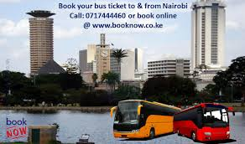
Online ticket booking in Africa
In countries like Kenya and South Africa it’s common for people to book their tickets online using their mobile phones.
In Tanzania, few buses have their own electronic ticketing platforms.

Slide 9
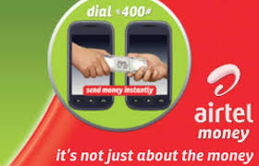
Mode of payment
Mobile-phone money transfer service is the most popular and is open for anyone with a SIM card

Slide 10
Other payment options
Debit cards
Cash
Tiketi Rafiki cards

Slide 11
Competition
There are two main categories of competition
Booking platforms of four individual buses which go to specific regions
Start my safari company

Slide 12
Marketing and Sales

Slide 13
Partners
Bus operators:
Still looking for efficient systems
Telecommunication companies:
Encourage partnerships with small and large businesses in order to increase their sales.
Banks to support and facilitate collections and payments
Insurance companies: to cover passengers who will use our service

Slide 14
Project Timeline for 2020
Jan -Mar March-June June - December
Initial plan
Stakeholders’ meetings
Software requirements
Specification
Design description
Partnerships
Developing a prototype
Testing
Improving
Launching
Marketing
Feedback
Continuous improvement
Partnerships

Slide 15
Future expansion
Expanding to other African countries
Venture into ticketing service for:
Events
Flight tickets
Supporting technologies related to the business such as car seat massagers etc.

