Slide 1


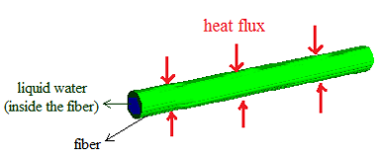
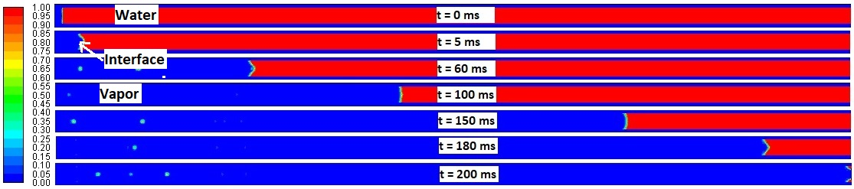
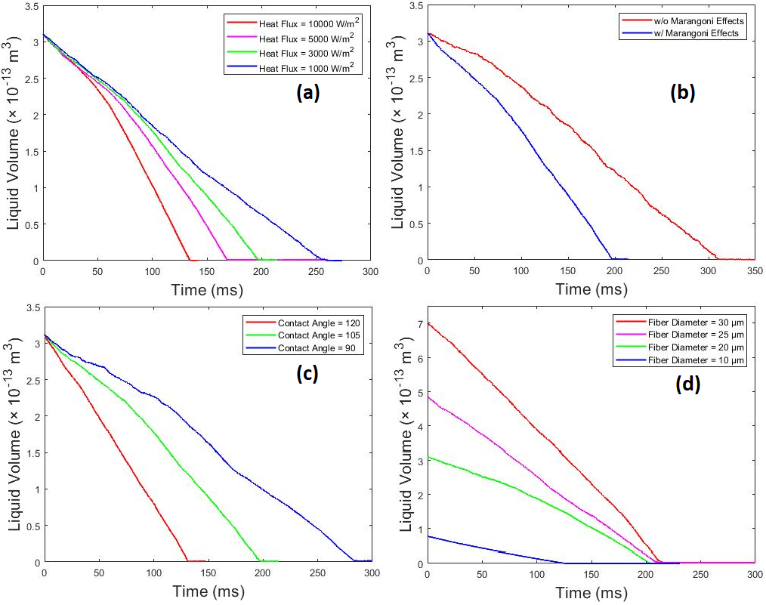
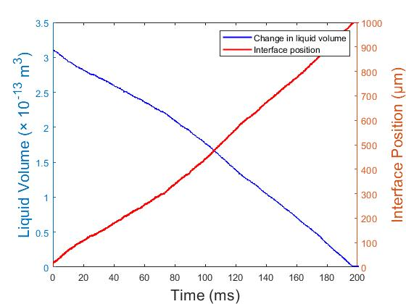
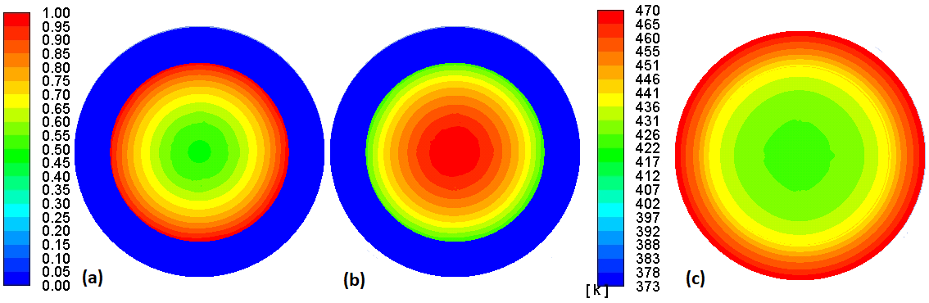


Removal of Water Trapped Inside a Single Cellulose Fiber
Zahra Noori¹, Prof. Jamal Yagoobi¹, Prof. Burt Tilley²
¹ Mechanical Engineering Department, WPI
² Mathematical Sciences Department, WPI
Introduction
Computational Model
The structure of a paper has different scales (macroscale and microscale) and therefore there are two types of water to be removed (free water and bound water).
Assumptions:
Continuum theory
Liquid is a Newtonian viscous fluid
Vapor is a singe component incompressible fluid
Fibers are impermeable
Surface tension and contact angle have constant values
By definition, bound water is the water in microscale, inside the pores between the fibers and within the fibers.
Industrial drying consumes 16% of all process energy used in American manufacturing annually.
DOE estimates that 40% of the energy used in industrial drying can be saved with new technologies annually. This would save industry $8B/year.
The impact of CARD is saving 36 millions of barrels of oil and also 4,000 Olympic-sized swimming pools of water annually in USA.
Results
Contours of volume fraction of liquid during evaporation for applied heat flux = 3000 W/m².
Change in liquid volume (left axis) along with the interface position (right axis) vs time.
Interface position vs time.
Governing Equations
Contours of (a) volume fraction of water, (b) volume fraction of vapor, and (c) temperature at time = 180 ms and applied heat flux = 3000 W/m².
The effect of different effective parameters on the drying rate.
Transient Navier-Stokes and energy equations applied to the liquid and vapor layers.
Energy equation applied for fibers.
Boundary conditions at the interface are based on energy balance, mass balance, normal stress balance, and shear stress balance.
Summary and Conclusions
Future Plans
A valuable model is proposed for studying the removal of water-liquid trapped inside a single cellulose fiber.
Expanding the model for studying bound water removal from nano-pores inside the fiber walls.
At a constant value for the applied heat flux at the outer surface of the fiber, the evaporation starts from the center –line of the fiber and it grows radially.
Doing experiments
This research provides the Pulp and Paper industry with basic understanding of bound water removal under various operating conditions.
Developing IR drying.
Developing Ultrasonic drying.
Developing EHD technology.
dryingresearch.org
Contact cardinfo@dryingresearch.org for more information
Center Proprietary

